Slide 1

Bank Asset Liability
Management
Võ Tấn Phát Nguyễn Tiến Hưng
Trần Huy Hoàng
Hoàng Thái Dương

Slide 2
1
Introduction
2
Methodologies
3
Result
4
Model

Slide 3

1
Introduction
Review Topic
1
2
3
4
1 to 14 days
15 to 30 days
1 to 3 months
3 to 6 months
5
6
7
8
6 months to 1 year
1 to 3 years
3 to 5 years
More than 5 years

Slide 4
1
Introduction
Review Topic
Cost | CLDD Demand | CLSD Saving | CLTD Term | CLB Borrowings
Bucket 1 | 0% | 3.5% | 3.5% | 3.5%
Bucket 2 | 0% | 3.5% | 4.25% | 3.5%
Bucket 3 | 0% | 3.5% | 5.75% | 5.5%
Bucket 4 | 0% | 3.5% | 6.25% | 5.5%
Bucket 5 | 0% | 3.5% | 8.5% | 5.5%
Bucket 6 | 0% | 3.5% | 8.75% | 8.5%
Bucket 7 | 0% | 3.5% | 9% | 9%
Bucket 8 | 0% | 3.5% | 10% | 9.5%

Slide 5
1
Introduction
Review Topic
Return | RABCB Central bank | RABOB Other banks | RAGs Government Securities | RADB Debentures & Bonds | RAA Advances
Bucket 1 | 3.5% | 3.5% | 3.5% | 3.5% | 5%
Bucket 2 | 3.5% | 4.25% | 3.5% | 3.5% | 5%
Bucket 3 | 5.5% | 5.75% | 5.5% | 5.5% | 6.5%
Bucket 4 | 5.5% | 6.25% | 5.5% | 5.5% | 6.5%
Bucket 5 | 5.5% | 8.5% | 5.5% | 5.5% | 8%
Bucket 6 | 6% | 8.75% | 8.5% | 8.5% | 9%
Bucket 7 | 6.5% | 9.5% | 9% | 9% | 9.5%
Bucket 8 | 7% | 10% | 9.5% | 9.5% | 10%

Slide 6
1
Introduction
Intro to GAs
Natural selection
Genetic
Algorithm
are search algorithms
Based on
Natural Genetics

Slide 7
1
Introduction
Intro to GAs
Mutation
Genetic
Algorithm
used to generate high-quality solutions to optimization and search problems
relying on bio-inspired operators
Crossover
Selection

Slide 8
2
Methodology
Terms
Individual/ Chromosome
Candidate solution to the problem you want to solve
Genes
Represent variables
Fitness score
determines the fitness or acceptability of a solution set/ chromosome.
Converge
does not produce offspring which are significantly different from the previous generation.

Slide 9
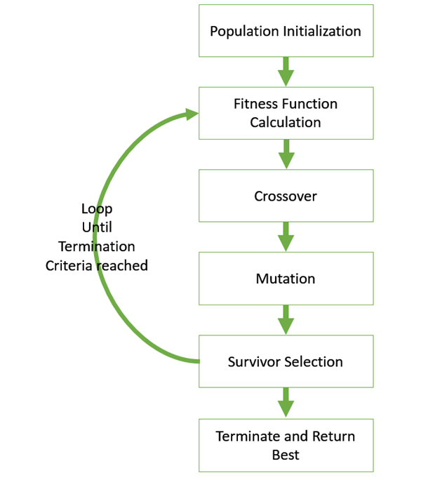
2
Methodology
Phases
https://www.tutorialspoint.com/genetic_algorithms/genetic_algorithms_fundamentals.htm

Slide 10
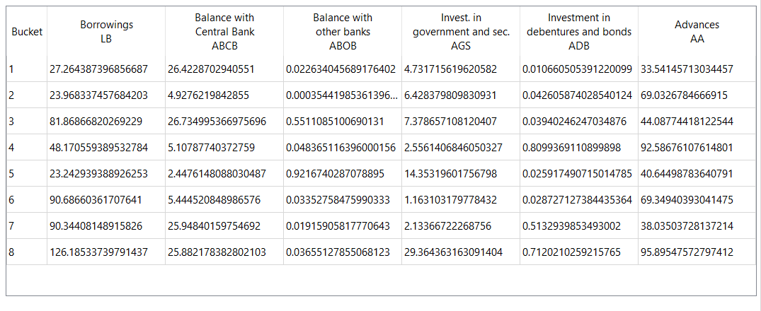
2
Methodology
Representation of Solution

Slide 11
2
Methodology
Fitness Function
Fitness = Revenue - Cost

Slide 12
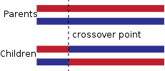
2
Methodology
Genetic Operators
One Point
Crossover

Slide 13
2
Methodology
Genetic Operators
Uniform Mutation
Replaces the value of the chosen gene with a uniform random value selected between predefined upper and lower bounds for that gene.

Slide 14
4
Model
Demo

Slide 15
3
Result
The implemented genetic algorithm does not solve the ALM problem
The objective value is not optimal and not all the constraints are satisfied
The running time is longer than the simplex method implemented in the Excel Solver
=> For the discussed ALM problem, simplex method is encouraged

Slide 16
Thank you for your listening

