Slide 1

Jingga
Product information presentation

Slide 2
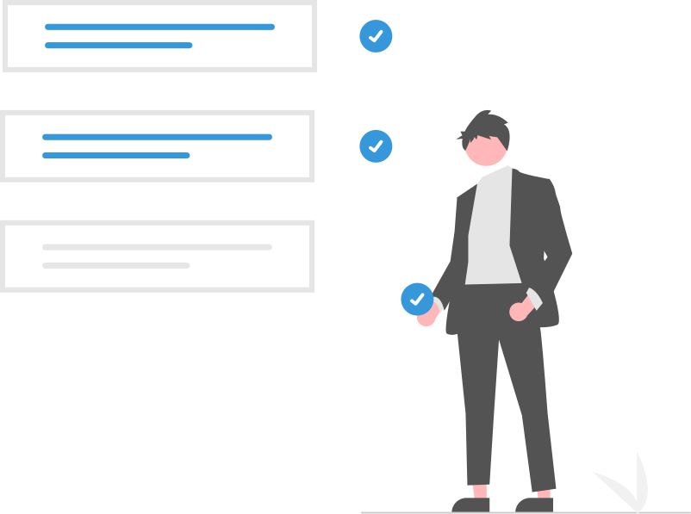
Table of Contents
Introduction
Key value proposition
Key business products
Key services
Live demo
Pricing
Next steps
Q&A

Slide 3

What is Jingga?
Jingga is a collection of tools & workflows to map your business processes and support you in your everyday business operations.

Slide 4
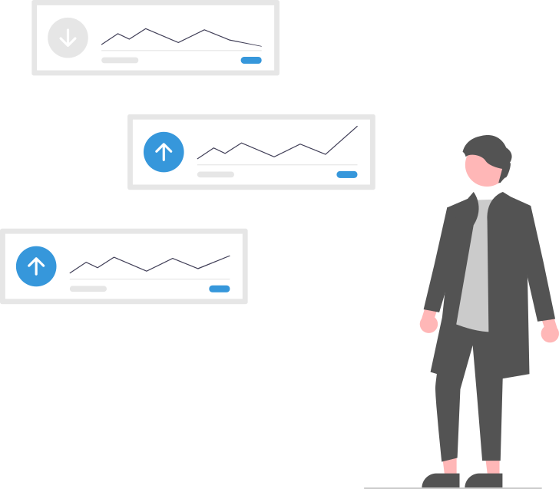
Key value proposition
Multiple platforms and OS
PC / Mac / Linux
Desktop / Laptop / Tablet / Smartphone
Hosted in the cloud or your local servers
End-user benefits
Simple & intuitive
Saves time
Automates and streamlines processes
Company benefits
Improves quality and reduces risks
Improves productivity
Modular
Fair pricing (with price guarantee)
Security
Audit logs
Data encryption
Blockchain data integrity
Application integrity validation

Slide 5

Key business products
Project Management
CMS
Office Tools
Finance
CRM
Shop
Production
ERP
Analysis
QM

Slide 6
Key services
Module Consulting
We create you an offer based on your requirement specification.
Setup
Installation of the application and the purchased modules. Price for setup
Data Migration
Data migration. Timeline and costs depend on the data source.
Support, Maintenance & Updates
Periodical maintenance and support & updates.
Customization
Custom layout & functionality. Timeline and costs depend on the requirements.
Hosting
We can host the app on our servers if you prefer this option over using your own servers.

Slide 7
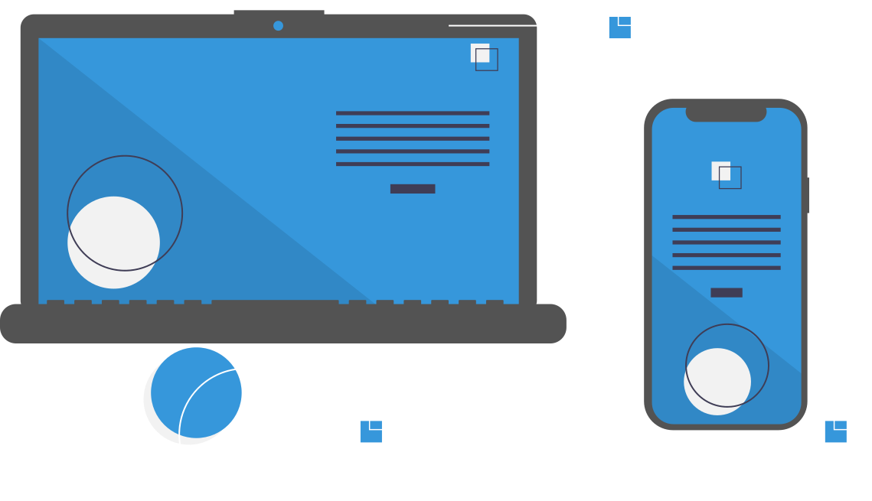
Live demo

Slide 8
Option 1
Option 2
Pick a predefined module collection
Choose the modules based on your own needs

Slide 9
Pricing based on licenses
Tier 1 - No Discount
0.0 %
Per month, per user
[1 - 10 users]
Price guarantee for 12 months.
Tier 2 - Discount
-2.5 %
Per month, per user
[11 - 50 users]
Price guarantee for 18 months.
Tier 3 - Discount
-5.0 %
Per month, per user
[51 - 250 users]
Price guarantee for 24 months.
Tier 4 - Discount
-7.5 %
Per month, per user
[251 - 500 users]
Price guarantee for 36 months.
Tier 5 - Discount
-10.0 %
Per month, per user
[501 - 1000 users]
Price guarantee for 48 months.
Tier 6 - Discount
TBD
Per month, per user
[1001 - ??? users]
Price guarantee TBD.
* discounts and guarantees depend on maintaining the respective license quantities. For details regarding the discounts check the general terms and conditions
Notes:
Depending on the amount of modules and licenses it sometimes can make sense to order one or two additional licenses without needing them in order to get into the next tier level.

Slide 10
Predefined packages
Basic
€ 9.99
Medium
€ 14.99
Advanced
€ 19.99
Custom
TBD
Per month, per user
Per month, per user
Per month, per user
Per month, per user
The base price depends on the module selection. Price guarantee for 12 months.
The base price depends on the module selection. Price guarantee for 18 months.
The base price depends on the module selection. Price guarantee for 24 months.
Conditions and features to be discussed individually.
Key components:
Customer Management
Supplier Management
Item Management
Billing
Accounting
Additional key components:
Asset Management
Warehouse Management
Contract Management
Jobs
Workflows
Additional key components:
Cash
Financial reporting
Tax reporting
Helper
Checklist
Additional key components:
To be discussed
* all prices without hosting, support, maintenance, etc. excl. VAT
* the customers can add additional modules to these predefined packages based on their need
* prices for individual / additional modules depend on the module (please check out the shop)

Slide 11
Next steps
Presentation & Demo
Client considers next steps
Create module selection
Create offer
Setup
Follow up
Test the public demo and / or receive presentation from Orange Management.
Is Orange Management a fitting partner? Continue software testing, ...
Client either creates own module selection or together in a workshop with Orange Management.
Orange Management creates an offer.
Setup application (either alone or together with Orange Management).
Optional: Software training, data migration, customization, ...

Slide 12
Thank you very much!
Q&A
orange-management.org
d.eichhorn@orange-management.email
+49 123 / 4567890

