Slide 1

Orange-Management
Episode 1

Slide 2
Application
CRM
Intranet
CMS
Shop
ERP
Finance
Office
SRM
HR
Media
BI
Production
Analytics
….

Slide 3
What Are The Key Goals?
Focus on
the solution
of the problem
Financially attractive
for many end-users
Solve a wide range
of problems
Integrate solutions
for seamless
workflows
Accessible for
everyone
Fast user interface
feedback and
good performance

Slide 4
Use it during
development incl.
user feedback
One philosophy
and one system
for every module
Solution
Integration
Modular system
and fair pricing
Put experience
above ease of
implementation
How To Achieve
These Goals?
Costs
Accessibility
Functionality
Performance
Custom targeted
implementations
vs. generalizations
Speak to users
and implement
common workflows

Slide 5
Current Draft/Concept Status
Draft frontend framework
Draft backend framework
Draft core application
Draft build process & test suit
Drafted some modules
Draft style/layout
UI functionality/features
Frontend content loading
Project website
Caching
Many more frontend & backend aspects

Slide 6
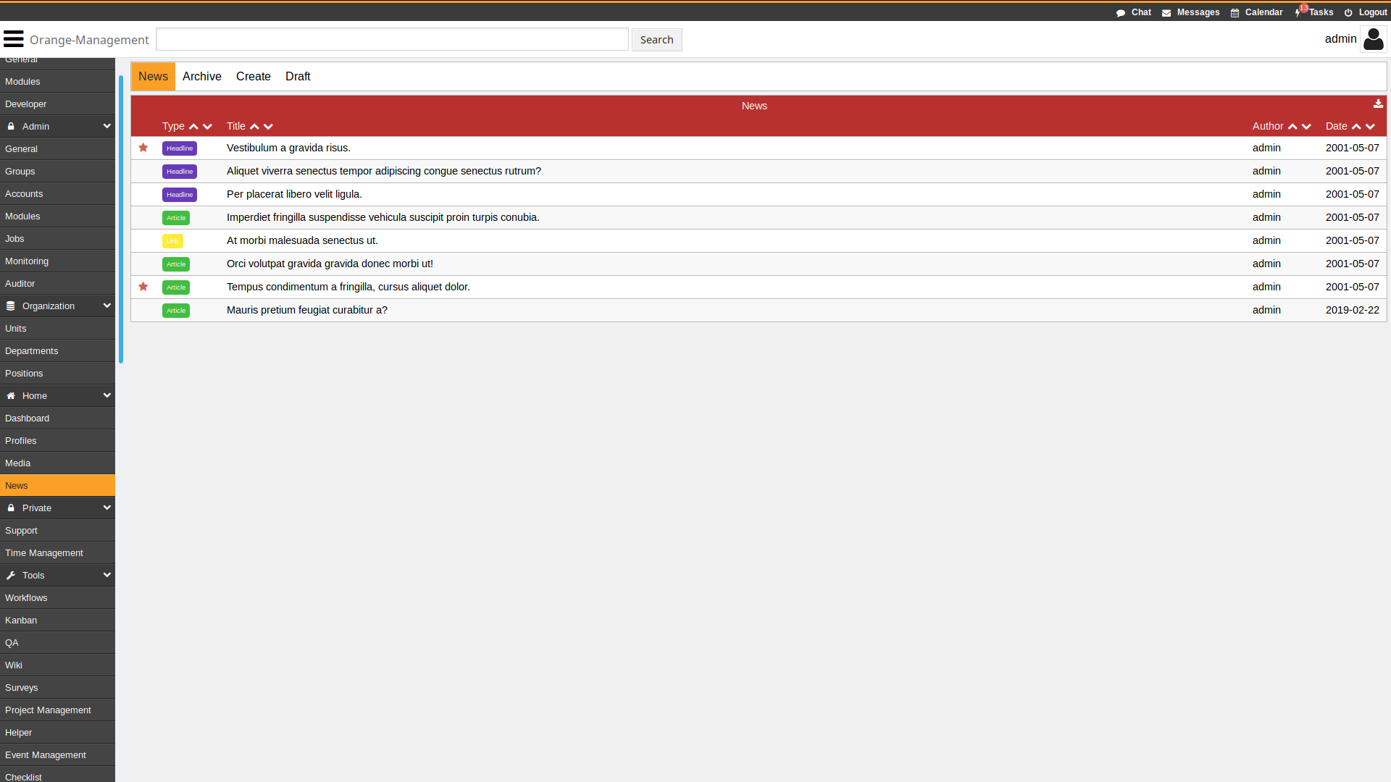
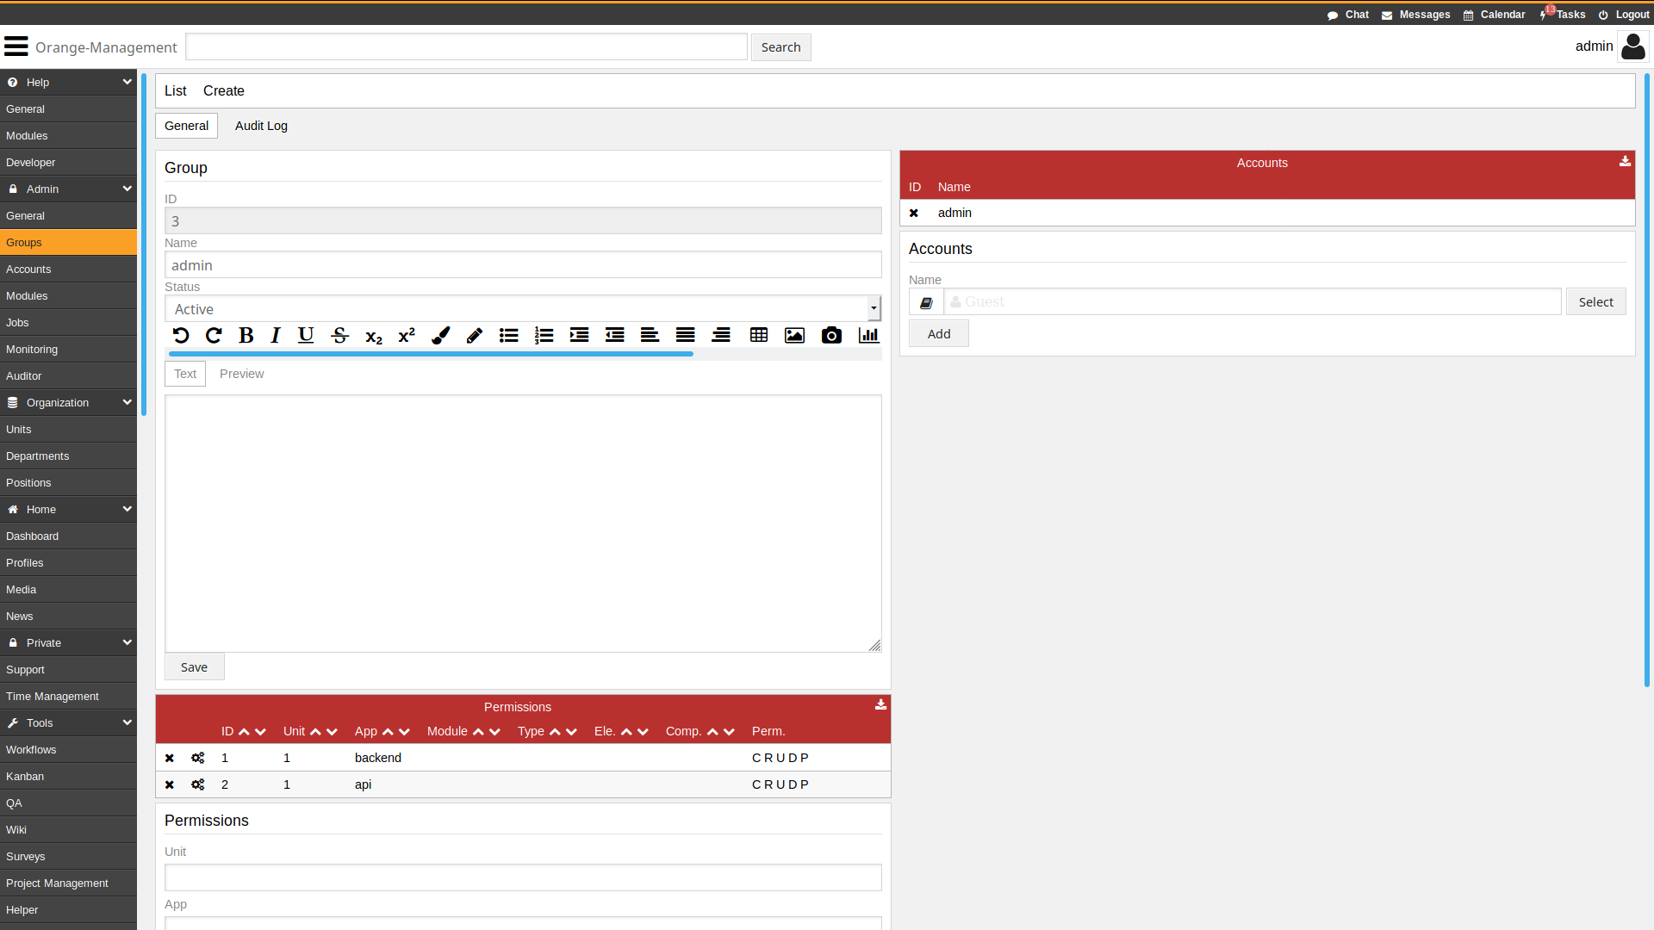
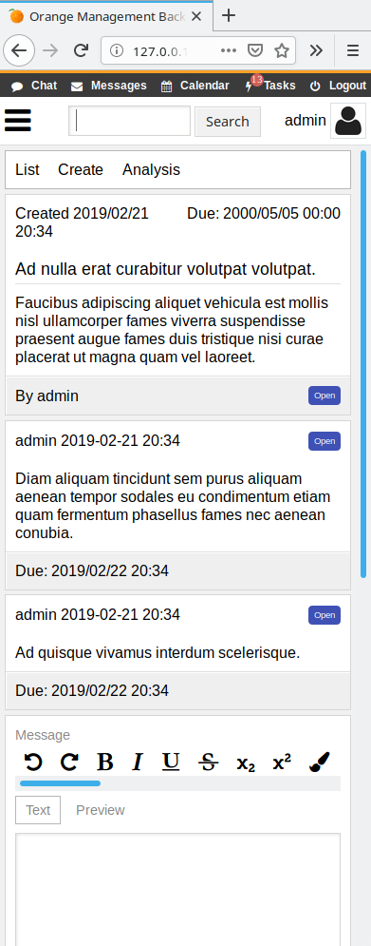
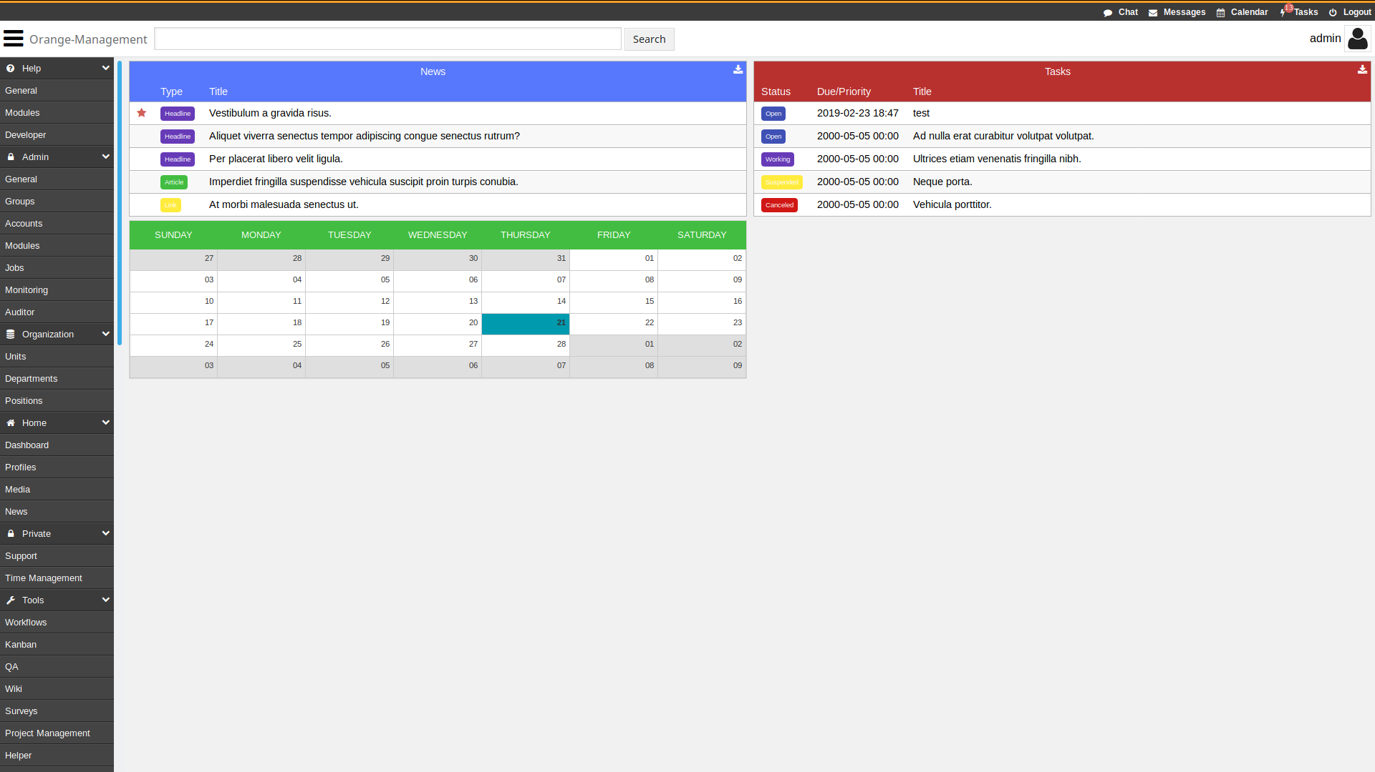
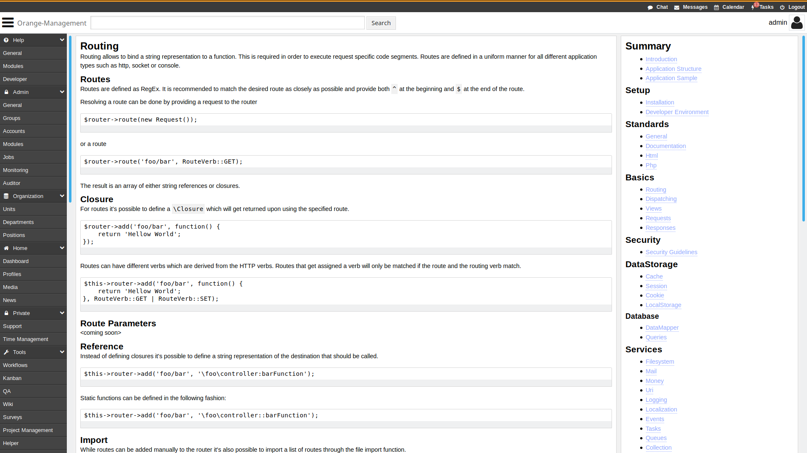
Sample screenshots

Slide 7
Episode 1
What is Orange-Management about?
Episode 3
The backend application & API
Episode 5
The application build and test suit setup
Episode 2
The backend framework phpOMS
Episode 4
How to develop and integrate modules?
Episode 6
The current status and the upcoming steps
website: orange-management.org
twitter: @orange_mgmt
youtube: Orange-Management
patreon: orange_management

