Slide 1

Orange Management

Slide 2
Current Situation
Many different software solutions
  ERP, CRM, Fibu, Ticket, Shop, Website, Dataframe, Sfirm, Lodas, Creditreform, Outlook, Lucanet, Custom Excel Solutions, Anbu, AutoUpdater, Phone Time Tracking, Kanban, Owncloud, UPS, DPD
Many software solutions are only partially integrated
  ERP and CRM, Shop and CRM, Fibu and Lucanet
Many software solutions are not integrated
  CRM and Tickets, Shop and ERP, ERP and UPS
Software crashes
  Certain ERP buttons when clicked, Lucanet loses connection
Slow
Bad user experience
  ERP/Fibu vertical scrolling, ERP/Fib window resizing, ERP/Fibu no multiple windows, ERP/Fibu/Lucanet no visualizations, Export to excel, user interface
Missing features
  Automatic reports, Reports and analysis which requires data/information from multiple systems like ERP and CRM
  Modern time tracking/vacation tracking
  HR Management
  Automation of tasks: credit management, article price changes, document generation, approval processes
Orange Management

Slide 3
What Software SHOULD be/do!
Should work
Should solve problems
Should save time
Should be fast
Should be simple
Should reduce complexity
Should reduce risks
Should save costs
Should improve quality
Should be fun
Orange Management

Slide 4
Solution
Build our “own” Software
Orange Management

Slide 5
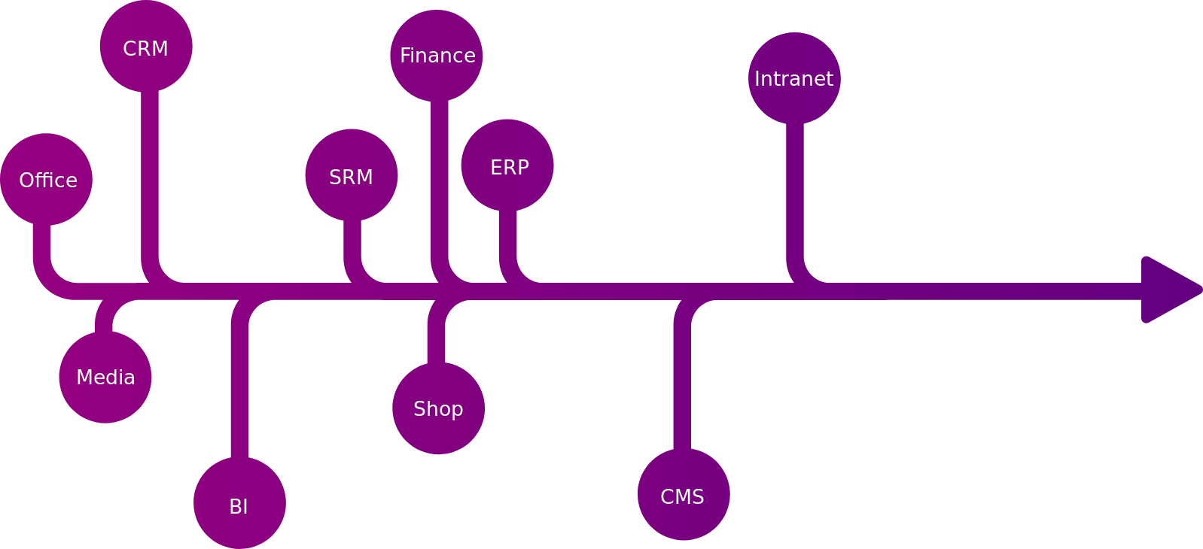
Software Components
Orange Management

Slide 6
Time-Frame
2020 June Time Tracking & HR Management incl. employee cards, terminals, vacation tracking/approval, sick days
2020 December Ticket System
2021 March Replace Dataframe create all reports and data analyzer
2022 March Replace CRM incl. workflows, sales rep views, contracts, customer data
2022 June Replace Anbu
2023 June Replace ERP incl. import of historic data
2024 June Replace Fibu incl. import of historic data
2024 December Replace UPS and DPD software
2025 December Replace website & shop system
Orange Management

Slide 7
Additional possible projects
Website builder for customers
Video archive of training and seminars
Data sharing platform for customers
Business management software for customers
Knowledge sharing platform between specialists
Patient management software
Orange Management

Slide 8
Website: orange-management.org [under construction]
Github: orange-management [source code]

