Slide 1
P1Group_3
2024
Data Science Project

Slide 2
Salaries and Job Types
2024
P1Group_ will focus on salaries and job types in the Data Science Filed. We will explore the relationships between salary, job title, experience, remote work and other variables. Our goal is to uncover the best data science jobs based on available criteria such as: job category, location, growth, etc. to obtain the maximum salary. We will apply the strategies learned in class to evaluate our questions and support our findings. Data source Kaggle.com.
Data Science Field

Slide 3
Trends_in_DataSci_2024
2024
Questions

Slide 4
What Data Science jobs show the most growth?
20XX
Data Visualization Includes
2020-2024
What Data Science jobs show the most growth?
We will create a chart showing count of job of job title by year to determine what jobs are growing over the time period.
We will create pie charts for 2024 showing job title frequency.
We will take the top 5Job titles and calculate trend lines to show the growth of those jobs-2020 to 2024.
How does experience influence salary?
We will create line graphs and bar graphs with experience vs. salary (including top 5 job titles).
What countries pay better salaries?
We will show countries included in the datasets.
We will show different points on map for stats.
Most popular Data Science roles.

Slide 5
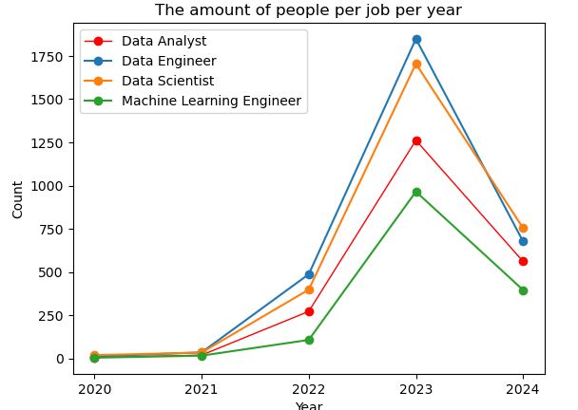
Data Science Jobs
2024
Job Title
The amount of people per job per year
Data Scientist-Orange
Data analyst-Red
Data Engineer-Blue
Machine Learning Engineer-Green

Slide 6




Top 4 Data Science Jobs
2024
Data Scientist
Data engineer
Data Analyst
A person employed to analyze and interpret complex digital data, such as the usage statistics of a website, especially in order to assist a business decision.
Builds systems that collect, manage, and convert raw data into usable information for data scientist and business analysis.
Will review data and determine how to solve problems using data, learn critical insights about a business’s costumers and boost profits.
Machine Learning Engineer
Trends_In
DataSci_2024
A programmer who designs and builds software that can automate AI and machine learning models.
Job market
Average salaries per experience levels

Slide 7
THANK YOU!
2024
P1Group_3

