Slide 1
TODO
Change Timer example to use new Executors.ScheduledThreadPool
Change vars to be of type List instead of ArrayList
Drop this lecture from class??

Slide 2
Course Material Usage Rules
PowerPoint slides for use only in full-semester, for-credit courses at degree-granting institutions
Slides not permitted for use in commercial training courses except when taught by coreservlets.com (see http://courses.coreservlets.com).
Slides can be modified by instructor
Please retain this notice and attribution to coreservlets.com
Instructor can give PDF or hardcopy to students, but should protect PowerPoint files
This slide is suppressed in Slide Show mode

Slide 3
Multithreaded Graphics
Originals of Slides and Source Code for Examples:
http://courses.coreservlets.com/Course-Materials/java.html

Slide 4

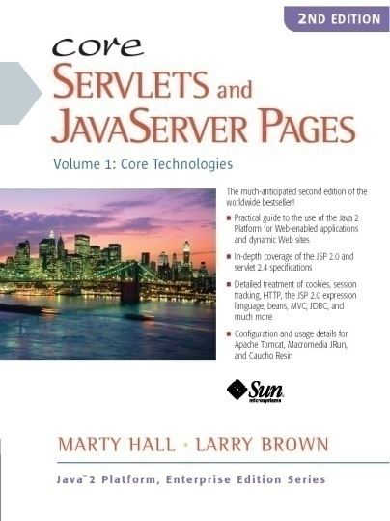

For live Java EE training, please see training courses at http://courses.coreservlets.com/. JSF 2.0, PrimeFaces, Servlets, JSP, Ajax (with jQuery), GWT, Android development, Java 6 and 7 programming, SOAP-based and RESTful Web Services, Spring, Hibernate/JPA, XML, Hadoop, and customized combinations of topics.
Taught by the author of Core Servlets and JSP, More Servlets and JSP, and this tutorial. Available at public venues, or customized versions can be held on-site at your organization. Contact hall@coreservlets.com for details.

Slide 5
Agenda
Approaches for animation
Redraw everything in paint
Have routines other than paint draw directly on window
Override update and have paint do incremental updating
Double buffering
Reducing flicker in animations
Implementing double buffering
Animating images

Slide 6
Multithreaded Graphics: Alternative Approaches
Redraw everything in paint
Simple and easy, but if things change quickly it is slow and can result in a flickering display
Have routines other than paint directly do drawing operations
Easy, efficient, and flicker-free, but results in “transient” drawing that is lost next time the screen is redrawn
Override update and have paint do incremental updating
Eliminates the flicker and improves efficiency somewhat, but requires the graphics to be non-overlapping
Double buffering
Most efficient option and has no problem with overlapping graphics.
More complex and requires additional memory resources

Slide 7
Redraw Everything in paint
Idea
Have user actions change non-graphical data structures, then call repaint.
The repaint method sets a flag that tells the event-handling process to call update.
The standard update method clears the screen and then calls paint.
The paint method completely redraws everything.
Advantage
Easy
Disadvantages
Flickers, slow.

Slide 8
Redrawing Everything in paint: Example
import java.applet.Applet;
import java.awt.*;
import java.awt.event.*;
import java.util.*;
/** An applet that draws a small circle where you click.
*/
public class DrawCircles extends Applet {
private ArrayList<SimpleCircle> circles;
public void init() {
circles = new ArrayList<SimpleCircle>();
addMouseListener(new CircleDrawer());
setBackground(Color.WHITE);
}
...

Slide 9
Redrawing Everything in paint: Example (Continued)
/** When you click the mouse, create a SimpleCircle,
* put it in the list of circles, and tell the system
* to repaint (which calls update, which clears
* the screen and calls paint).
*/
private class CircleDrawer extends MouseAdapter {
public void mousePressed(MouseEvent event) {
circles.add(new SimpleCircle(event.getX(),
event.getY(), 25));
repaint();
}
}

Slide 10
Redrawing Everything in paint: Example (Continued)
/** This loops down the available SimpleCircle objects,
* drawing each one.
*/
public void paint(Graphics g) {
for(SimpleCircle circle: circles) {
circle.draw(g);
}
}
}

Slide 11
Redrawing Everything in paint: Example (Continued)
public class SimpleCircle {
private int x, y, radius;
public SimpleCircle(int x, int y, int radius) {
setX(x);
setY(y);
setRadius(radius);
}
/** Given a Graphics, draw the SimpleCircle
* centered around its current position.
*/
public void draw(Graphics g) {
g.fillOval(x - radius, y - radius,
radius * 2, radius * 2);
}
...
}

Slide 12
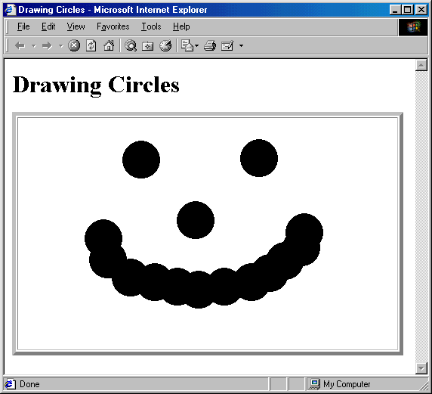
Redrawing everything in paint: Result
By storing results in a permanent data structure and redrawing the whole structure every time paint is invoked, you cause the drawing to persist even after the window is covered up and reexposed

Slide 13
Have Other Routines Draw Directly on Window
Idea
Arbitrary methods (i.e., other than paint) can call getGraphics to obtain the window’s Graphics object
Use that Graphics object to draw
Drawing lost if
Window covered up and reexposed
The update method called (e.g., via repaint)
Advantage
Fast
Disadvantage
Temporary

Slide 14
Drawing Directly on Window: Example
public class Rubberband extends Applet {
private int startX, startY, lastX, lastY;
...
private void drawRectangle(Graphics g, int startX,
int startY, int stopX, int stopY ) {
int x, y, w, h;
x = Math.min(startX, stopX);
y = Math.min(startY, stopY);
w = Math.abs(startX - stopX);
h = Math.abs(startY - stopY);
g.drawRect(x, y, w, h);
}
... private class RectRecorder extends MouseAdapter {
public void mousePressed(MouseEvent event) {
startX = event.getX();
startY = event.getY();
lastX = startX;
lastY = startY;
}

Slide 15
Drawing Directly on Window: Example (Continued)
public void mouseReleased(MouseEvent event) {
Graphics g = getGraphics();
g.setColor(Color.BLUE);
drawRectangle(g, startX, startY, lastX, lastY);
}
}
private class RectDrawer extends MouseMotionAdapter {
public void mouseDragged(MouseEvent event) {
int x = event.getX();
int y = event.getY();
Graphics g = getGraphics();
g.setXORMode(Color.LIGHT_GRAY);
drawRectangle(g, startX, startY, lastX, lastY);
drawRectangle(g, startX, startY, x, y);
lastX = x;
lastY = y;
}
}
}

Slide 16
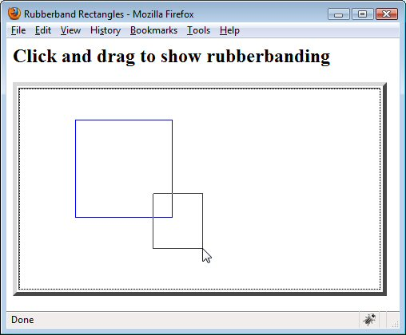
Drawing Directly on Window: Result
By retrieving the Graphics object, methods other than paint
can draw directly on the window

Slide 17
Override update and Have paint do Incremental Updating
Idea
Have repaint (which triggers update) avoid clearing the screen each time by overriding update as follows: public void update(Graphics g) { paint(g); }
Then, assuming objects don’t overlap, erase each object at its old location by drawing over it in the background color then drawing it at the new location
Advantages
No flicker, faster
Disadvantage
Fails for overlapping images

Slide 18
Incremental Updating: Bounce Applet
public class Bounce extends Applet implements Runnable,
ActionListener{
private ExecutorService taskList;
private volatile boolean running = false;
private ArrayList<MovingCircle> circles;
private int width, height;
private Button startButton, stopButton;
public void init() {
taskList = Executors.newFixedThreadPool(5);
setBackground(Color.WHITE);
width = getSize().width;
height = getSize().height;
circles = new ArrayList<MovingCircle>();
startButton = new Button("Start a circle");
startButton.addActionListener(this);
add(startButton);
stopButton = new Button("Stop all circles");
stopButton.addActionListener(this);
add(stopButton);
}

Slide 19
Bounce Applet (Continued)
public void actionPerformed(ActionEvent event) {
if (event.getSource() == startButton) {
if (!running) {
// Erase any circles from previous run.
getGraphics().clearRect(0, 0, getSize().width,
getSize().height);
running = true;
taskList.execute(this);
}
int radius = 25;
int x = radius + randomInt(width - 2 * radius);
int y = radius + randomInt(height - 2 * radius);
int deltaX = 1 + randomInt(10);
int deltaY = 1 + randomInt(10);
circles.add(new MovingCircle(x, y, radius, deltaX, deltaY));
} else if (event.getSource() == stopButton) {
running = false;
circles.clear();
}
repaint();
}

Slide 20
Bounce Applet (Continued)
/** Each time around the loop, call paint and then take a
* short pause. The paint method will move the circles and
* draw them.
*/
public void run() {
while(running) {
repaint();
pause(100);
}
}

Slide 21
Bounce Applet (Continued)
/** Skip the usual screen-clearing step of update so that
* there is no flicker between each drawing step.
*/
public void update(Graphics g) {
paint(g);
}
/** Erase each circle's old position, move it, then draw it
* in new location.
*/
public void paint(Graphics g) {
for(MovingCircle circle: circles) {
g.setColor(getBackground());
circle.draw(g); // Old position.
circle.move(width, height);
g.setColor(getForeground());
circle.draw(g); // New position.
}
}

Slide 22
Incremental Updating: MovingCircle Class
public class MovingCircle extends SimpleCircle {
private int deltaX, deltaY;
...
public void move(int windowWidth, int windowHeight) {
setX(getX() + getDeltaX());
setY(getY() + getDeltaY());
bounce(windowWidth, windowHeight);
}
private void bounce(int windowWidth, int windowHeight) {
int x = getX(), y = getY(), radius = getRadius(),
deltaX = getDeltaX(), deltaY = getDeltaY();
if ((x - radius < 0) && (deltaX < 0))
setDeltaX(-deltaX);
else if ((x + radius > windowWidth) && (deltaX > 0))
setDeltaX(-deltaX);
if ((y -radius < 0) && (deltaY < 0))
setDeltaY(-deltaY);
else if((y + radius > windowHeight) && (deltaY > 0))
setDeltaY(-deltaY);
}
...
}

Slide 23
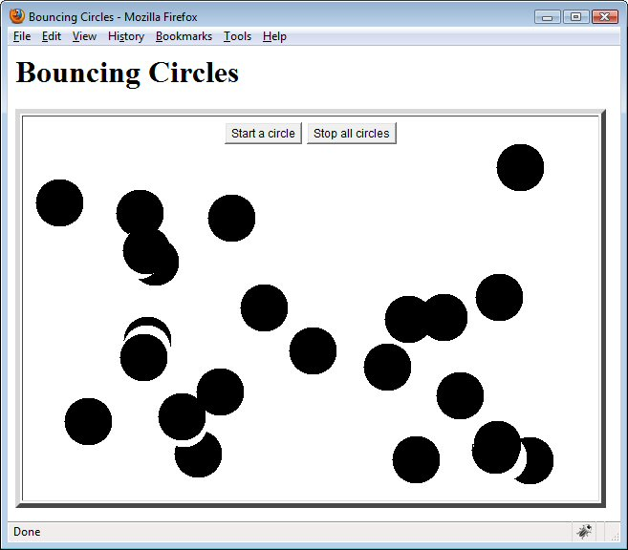
Incremental Updating, Result
Incremental updating from paint can be flicker free and
relatively fast, but it does not easily handle overlapping items

Slide 24
Option 4: Double Buffering
Idea
Draw into an off-screen pixmap, then draw that pixmap on window
Outline
Override update to simply call paint
This prevents the flicker that would normally occur each time update clears the screen before calling paint
Allocate an Image using createImage
Note that since this image uses native window-system support, it cannot be done until a window actually appears
Look up its Graphics object using getGraphics
Unlike with windows, where you need to look up the Graphics context each time you draw, with images it is reliable to look it up once, store it, and reuse the same reference thereafter
For each step, clear the image and redraw all objects onto it
Dramatically faster than drawing onto a visible window
Draw the offscreen image onto the window
Use drawImage

Slide 25
Double Buffering: Pros & Cons
Advantages
Much faster
Can easily handle overlapping objects
Disadvantages
More complex
Memory requirements for offscreen pixmap
Sometimes less incremental update of display

Slide 26
Double Buffering: Example
public class DoubleBufferBounce extends Applet
implements Runnable, ActionListener {
private ExecutorService taskList;
private volatile boolean running = false;
private ArrayList<MovingCircle> circles;
private int width, height;
private Image offScreenImage;
private Graphics offScreenGraphics;
private Button startButton, stopButton;
public void init() {
taskList = Executors.newFixedThreadPool(5);
setBackground(Color.WHITE);
width = getSize().width;
height = getSize().height;
offScreenImage = createImage(width, height);
offScreenGraphics = offScreenImage.getGraphics();
offScreenGraphics.setColor(Color.BLACK);
circles = new ArrayList<MovingCircle>();
...
}

Slide 27
Double Buffering: Example
public void run() {
while(running) {
for(MovingCircle circle: circles) {
circle.move(width, height);
}
repaint();
pause(100);
}
}
public void update(Graphics g) {
paint(g);
}
public void paint(Graphics g) {
offScreenGraphics.clearRect(0, 0, width, height);
for(MovingCircle circle: circles) {
circle.draw(offScreenGraphics);
}
g.drawImage(offScreenImage, 0, 0, this);
}

Slide 28
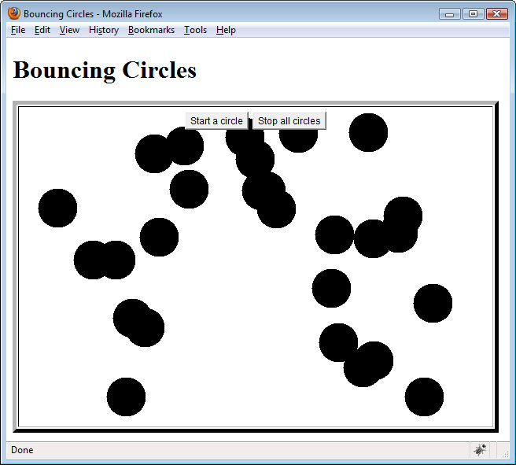
Double Buffering: Result
At the expense of memory and some complexity, double buffering allows fast,
flicker-free updating of possibly overlapping images

Slide 29
Array-Based Animation
Idea
Load a sequence of images into an array
Start a thread to cycle through the images and draw to the graphics object
Each time the thread loops through the while loop, the array index is incremented and repaint (which triggers update) is called to update the images on the screen
Stop the animation by setting a flag
In an applet, end the animation from the applet’s stop method

Slide 30
Array-Based Animation: Example
public class ImageAnimation extends Applet {
private static final int NUMDUKES = 2;
private Duke[] dukes; // Duke has array of images
private int i;
public void init() {
dukes = new Duke[NUMDUKES];
setBackground(Color.white);
}
public void start() {
int tumbleDirection;
for (int i=0; i<NUMDUKES ; i++) {
tumbleDirection = (i%2 == 0) ? 1 :-1;
dukes[i] = new Duke(tumbleDirection, this);
dukes[i].start();
}
}
...

Slide 31
Animation Example (Continued)
public void update(Graphics g) {
paint(g);
}
public void paint(Graphics g) {
for (i=0 ; i<NUMDUKES ; i++) {
if (dukes[i] != null) {
g.drawImage(Duke.images[dukes[i].getIndex()],
200*i, 0, this);
}
}
}
public void stop() {
for (int i=0; i<NUMDUKES ; i++) {
if (dukes[i] != null) {
dukes[i].setState(Duke.STOP);
}
}
}
}

Slide 32
Animation Example (Continued)
public class Duke extends Thread {
...
public static Image[] images;
private static final int NUMIMAGES = 15;
private static Object lock = new Object();
private int state = RUN;
public Duke(int tumbleDirection, Applet parent) {
this.tumbleDirection = tumbleDirection;
this.parent = parent;
synchronized(lock) {
if (images == null) { // If not previously loaded.
images = new Image[ NUMIMAGES ];
for (int i=0; i<NUMIMAGES; i++) {
images[i] = parent.getImage( parent.getCodeBase(),
"images/T" + i + ".gif");
}
}
}
}
...

Slide 33
Animation Example (Continued)
public void run() {
while (checkState()!=STOP) {
index += tumbleDirection;
if (index < 0) {
index = NUMIMAGES - 1;
} else if (index >= NUMIMAGES) {
index = 0;
}
parent.repaint();
try {
Thread.sleep(100);
} catch (InterruptedException e) {
break; // Break while loop.
}
}
}
}

Slide 34
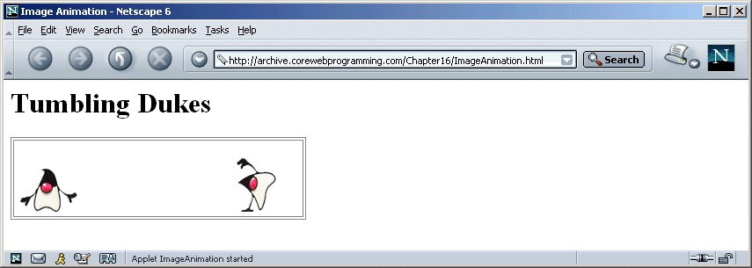
Animation: Result
Duke is a registered trademark of Sun Microsystems, Inc.
All restrictions apply (http://www.sun.com/policies/trademarks/).
Used with permission.

Slide 35
Timers
Swing defines a Timer class
A Timer can ring for a single cycle or fire periodically
At each ring an ActionEvent is fired
Useful for animations, simulations, and timing out secure network connections
Approach
Timer timer = new Timer(milliseconds, listener);
timer.start();
...
...
timer.stop();

Slide 36
Useful Timer Methods
start/stop
Starts or stops the timing sequence
restart
Cancels any undelivered time events and starts the timer again
setCoalesce
Turns coalescing off or on
By default, if a timer event is in the event queue (coalesce true), a new ActionEvent is not created at the next firing interval
setRepeats
Sets the timer to ring once (false) or to ring periodically (true)
Default behavior is to ring periodically

Slide 37
Timer: Example
import java.awt.*;
import javax.swing.*;
public class TimedAnimation extends JApplet {
private static final int NUMDUKES = 2;
private TimedDuke[] dukes;
private int i, index;
public void init() {
dukes = new TimedDuke[NUMDUKES];
setBackground(Color.white);
dukes[0] = new TimedDuke( 1, 100, this);
dukes[1] = new TimedDuke(-1, 500, this);
}
// Start each Duke timer.
public void start() {
for (int i=0; i<NUMDUKES ; i++) {
dukes[i].start();
}
} ...

Slide 38
Timer Example (Continued)
...
public void paint(Graphics g) {
for (i=0 ; i<NUMDUKES ; i++) {
if (dukes[i] != null) {
index = dukes[i].getIndex();
g.drawImage(TimedDuke.images[index], 200*i, 0, this);
}
}
}
// Stop each Duke timer.
public void stop() {
for (int i=0; i<NUMDUKES ; i++) {
dukes[i].stop();
}
}
}

Slide 39
Timer Example (Continued)
import java.applet.Applet;
import java.awt.*;
import java.awt.event.*;
import javax.swing.*;
public class TimedDuke extends Timer
implements ActionListener {
private static final int NUMIMAGES = 15;
private static boolean loaded = false;
private static Object lock = new Object();
private int tumbleDirection;
private int index = 0;
private Applet parent;
public static Image[] images = new Image[NUMIMAGES];
public TimedDuke(int tumbleDirection, int msec,
Applet parent) {
super(msec, null);
addActionListener(this);
this.tumbleDirection = tumbleDirection;
this.parent = parent; ...

Slide 40
Timer Example (Continued)
synchronized (lock) {
if (!loaded) { // Load images using MediaTracker
...
}
}
}
// Return current index into image array.
public int getIndex() { return index; }
// Receives timer firing event. Increments the index into
// image array and forces repainting of the new image.
public void actionPerformed(ActionEvent event) {
index += tumbleDirection;
if (index < 0){
index = NUMIMAGES - 1;
}
if (index >= NUMIMAGES) {
index = 0;
}
parent.repaint();
}
}

Slide 41
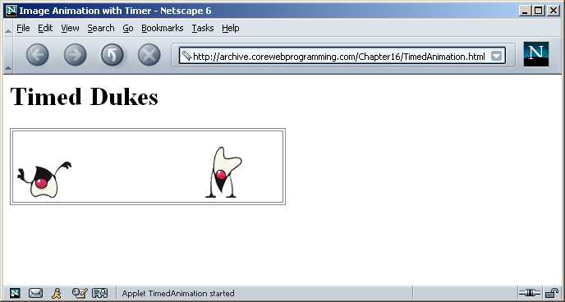
Timer Example: Result
Each Duke moves at a different speed
Duke is a registered trademark of Sun Microsystems, Inc.
All restrictions apply (http://www.sun.com/policies/trademarks/).
Used with permission.

Slide 42
Summary
Options for fast-changing graphics
Redraw everything in paint
Have routines other than paint directly do drawing operations
Override update and have paint do incremental updating
Double buffering
Animation can be achieved by cycling through a sequence of images
Usually in conjunction with double buffering

Slide 43
Questions?

