Slide 1
LITERATURE SURVEY
TEAM NO :07
ConserVision
Christen – 20BCS022
Devasenan – 20BCS025
Jerin Thomas – 20BCS043
Karan – 20BCS048
Kishore – 20BCS057
Faculty Name
V.SENTHIL KUMAR AP II/CSE
Kumaraguru College of Technology/
Coimbatore
Engineering Clinic V
Sem V |CSE | Kumaraguru College of Technology

Slide 2
Presentation Outline
TEAM NO :04
Literature Survey
Inference
Problem Statement
Dataset Used
Block diagram for Proposed System
Front End & Back End
Timeline using Gantt chart
References
Kumaraguru College of Technology/
Coimbatore
Engineering Clinic V
Sem V |CSE | Kumaraguru College of Technology

Slide 3
PROBLEM STATMENT
Our goal is to classify the species that appear in camera trap images collected by our research partners at the Wild Chimpanzee Foundation and the Max Planck Institute for Evolutionary Anthropology.
As mentioned in the about page, camera traps are one of the best tools available to study and monitor wildlife populations, and the enormous amounts of data they provide can be used to track different species for conservation efforts—once they are processed.
There are seven types of critters captured in this set of images: birds, civets, duikers, hogs, leopards, other monkeys, and rodents. There are also images that contain no animals. Your job is to build a model that can help researchers predict whether an image contains one of these seven types of species.

Slide 4
Literature Survey TITLE AND AUTHOR | Problem Statement: | Motion-sensor cameras in natural habitats offer the opportunity to inexpensively and unobtrusively gather vast amounts of data on animals in the wild. A key obstacle to harnessing their potential is the great cost of having humans analyze each image.
Automatically identifying, counting, and describing wild animals in camera-trap images with deep learning Mohammad Sadegh Norouzzadeh, Anh Nguyen, Margaret Kosmala, Alexandra Swanson, Meredith S. Palmer, Craig Packer, and Jeff Clune Published: June 5, 2018 | Proposed Solution: | They harness deep learning, a state-of-the-art machine-learning technology when classifying images, the machine is trained with many pairs of images and their corresponding labels, where the image is the input and its correct label (e.g., “buffalo”) is the output.
 | Output: | when classifying images, the machine is trained with many pairs of images and their corresponding labels, where the image is the input and its correct label (e.g., “buffalo”) is the output
 | Merits: | A general algorithm that learns features automatically can improve performance on very different types of data , increasing the impact of the approach
 | Demerits: | Need to use a lot of data to teach the model to accurately identify the animals. Some species cannot be identified accurately.
 | Future Scope: | In 97.5% of images, it correctly listed one of the species present, providing useful information, but the impact of missing the other species should be kept in mind and will depend on the use case. However, one could train networks to list multiple species via a variety of more sophisticated deep-learning techniques, a profitable area for future research.

Slide 5
Literature Survey TITLE AND AUTHOR | Problem Statement: | Animal recognition and classification is an important area which has not been discussed rapidly. Also, as all objects, they may appear under different illumination conditions, viewpoints and scales. There are attempts to apply recognition methods on images of animals, but the specific problem of animal categorization has recently attracted limited interest.
Animal classification using facial images with score-level fusion Authors: Shahram Taheri,Önsen Toygar Published: 21 March 2018 | Proposed Solution: | This approach combines the extracted features from different methods and concatenates them to build a more powerful feature vector. Instead of using complex representation, the information is consolidated from different classifiers and a decision is made according to it. This method is known as score-level fusion.
 | Output: | The match scores contain the richest information about the input pattern. Additionally, it is relatively easy to access and combine the scores generated by different biometric matchers. Score-level fusion has been used in many research studies.
 | Merits: | Score-level fusion shows very good performance in multimodal biometric systems. In a biometric recognition system, the match score is a measure of similarity between the input and template biometric feature vectors.
 | Demerits: | The first approach constructs complex features which represents and discriminates sample images better but creating such a feature is complicated and it is problem dependent.
 | Future Scope: | score-level fusion can be applied to other classification and recognition problems.

Slide 6
Literature Survey TITLE AND AUTHOR | Problem Statement: | When it comes to animal classification, the difficulties as well as challenging problems are not less than any other field of the recognition, while its application is limited. Although there are still places for application of this problems but not many people or publications dedicate to solve this
ANIMAL CLASSIFICATION IN WILDLIFE THROUGH IMAGES USING STATISTICAL METHODS AND DECISION TREE Authors: Muhammad Ahsan Nawaz , Vu thanh ngo , Aldemuro Mandalamuri Abdul Haris Published: July 2015 | Proposed Solution: | One method is working with the images and applies the naïve Bayesian classifier to distinguish the different and classify that image into one animal category. Several image processing techniques as well as machine learning and probability methods are researched and applied for this approach. The other is based on question and answer which can be described by “logic-based” model.
 | Output: | The pixel is counted and store in a matrix for further calculation. That number is put in the different Gaussian distributions with the mean and the standard deviation calculated before. Which one has the highest probability is concluded to be the class that image falls into.
 | Merits: | This project venture two approaches and therefore provide two prototypes as two models for classification of animal (probabilistic model and logic-based model) through different source.
 | Demerits: | The scope of this project is limited. There are more advanced methods for classification but only two methods are explored and implemented. For the naïve Bayesian classifier method, the accuracy is not high for just 3 classes of animal due to the features which are chosen. Only two features are taken into account and the image processing doesn’t help much for raising the accuracy.
 | Future Scope: | This Project is all about exploring method for animal classification and using them for experiments which help to discover the advantages and disadvantages of each method. In the future, more features can be applied for Bayesian classifier and more question to complete

Slide 7
Literature Survey TITLE AND AUTHOR | Problem Statement: | Missing, disappearing, swapping are fundamental problems encountered especially in pet animals that are very similar. Unfortunately, there are few methods that can overcome such problems. Traditionally, animals are known through their external appearances and patterns. Biometric based systems developed for the identification of animals are scarce and many of these systems are inadequate.
PCA-Based Animal Classification System Authors: Emre Dandil Rukiye Polatimmur Published: July 2018 | Proposed Solution: | In this study, a Principal Component Analysis (PCA) based system was developed for the recognition and classification of different species of animals. Thanks to the application software in the structure of the developed system, it is possible to identify the animals most resembling an animal in the image dataset.
 | Output: | After determining the matching first and second images on the PCA based software, it is decided what the type of animal is. Even though the image of animal was taken from different angles, the software has identified both matching images as successful in the same class as the loaded image
 | Merits: | The fact that there are more images than the same animal is an advantage in the system of matching the images of the same animal.
 | Demerits: | Limited Scope More time for image processing
 | Future Scope: | This Project is all about exploring use of PCA for method for animal classification and using them for experiments . However, only a small prototype of an application of each method is implemented. In the future, more features can be applied for classifier and more question to complete

Slide 8
Literature Survey TITLE AND AUTHOR | Problem Statement: | Detection of animals has got several applications such as animal-vehicle accident prevention, and animal trace facility, identification, antitheft, security of animals in zoo. Presently researchers identifying animals manually this is tedious and time consuming. Since the dataset is very large, manual identification is a daunting task
Title: Animal Classification System: A Block Based Approach Author: Y.H.Sharath Kumar N.Manohar H.K.Chethan Published: December 2015 | Proposed Solution: | segmentation is carried out to get the animal region which is only the region of our interest in it. Pixel based segmentation, which uses only pixel appearance to assign a label to a pixel Region based segmentation, the algorithm detects for valid segments at each scale further segments extracted at various scale are integrated to get the final result
 | Output: | We report maximum, minimum and average of the accuracy obtained in all cases. For all blocks the experimentation has been conducted on database of 25 classes under varying training samples from 30 to 70 percent of database
 | Merits: | Colour Space Selection Local Fourier Transform Colour feature Extraction
 | Demerits: | Time Consuming Human error
 | Future Scope: | Investigate a comprehensive solution especially classifications based on Segmentation

Slide 9
Inference From literature Survey
Many methods like PCA, segmentation and Block based approach were used to derive solution
Combining existing solution and covering the issue in one of them and improving
To eliminate the irrelevant and noisy features for efficient working of ML algorithms
Observation List
Score-level predictions shows very good performance, instead of binary predictions

Slide 10
Datasets
Each record in the dataset corresponds to a single image captured by a camera trap.
Each record has one .jpg file associated with it in either the train_features or test_features directory, depending on which dataset it is a part of.
Each image is accompanied by additional information in train_features.csv and test_features.csv, which contain the following fields:
id (string, unique identifier) - a unique identifier for each image
filepath (string, feature) - image path including its split directory (train or test)
site (string, feature) - the site in which the image was taken

Slide 11
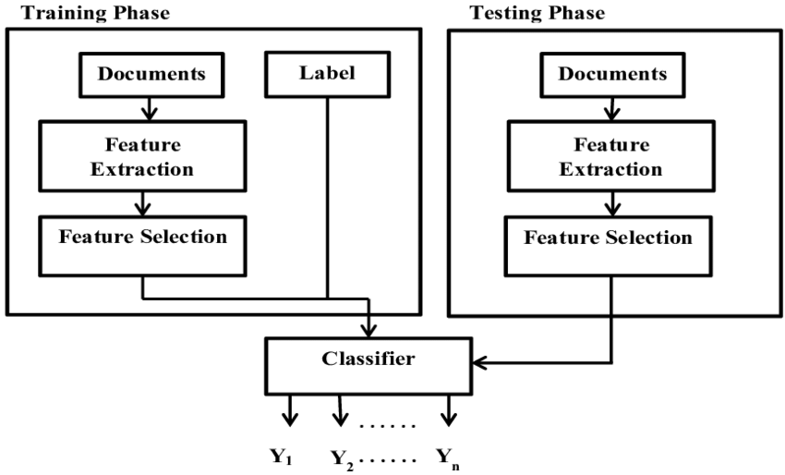
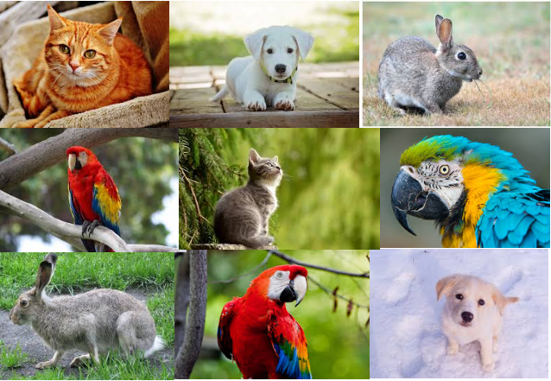
Block diagram of Proposed System
Multi-Class Single Label
Image Classification

Slide 12



System Requirements
Front End: We are building our website’s UI with CSS and HTML.
Back End: Our website runs on the Django framework along with keras, scikit learn libraries – to build our machine learning model.

Slide 13
References
1.https://www.pnas.org/doi/10.1073/pnas.1719367115
2.https://ietresearch.onlinelibrary.wiley.com/doi/full/10.1049/iet-cvi.2017.0079
3.https://www.researchgate.net/publication/315146311_ANIMAL_CLASSIFICATION_IN_WILDLIFE_THROUGH_IMAGES_USING_STATISTICAL_METHODS_AND_DECISION_TREE
4.https://www.researchgate.net/publication/329561682_PCA-Based_Animal_Classification_System
5.https://www.nature.com/articles/s41598-019-44565-w
6.https://www.researchgate.net/publication/274096404_Animal_Classification_System_A_Block_Based_Approach

Slide 14


