Slide 1

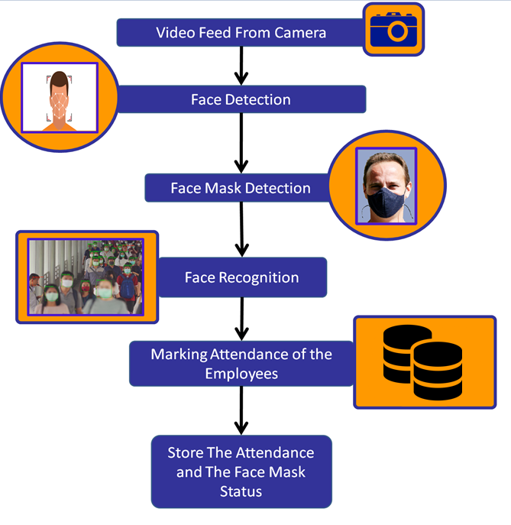

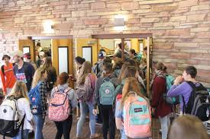
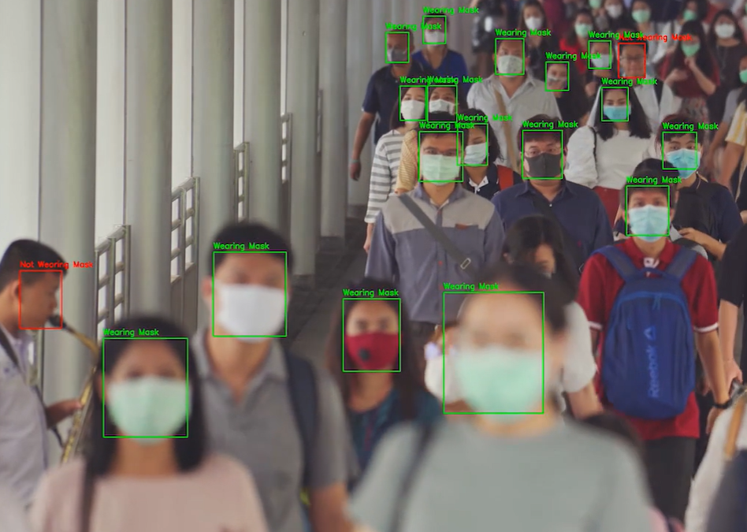
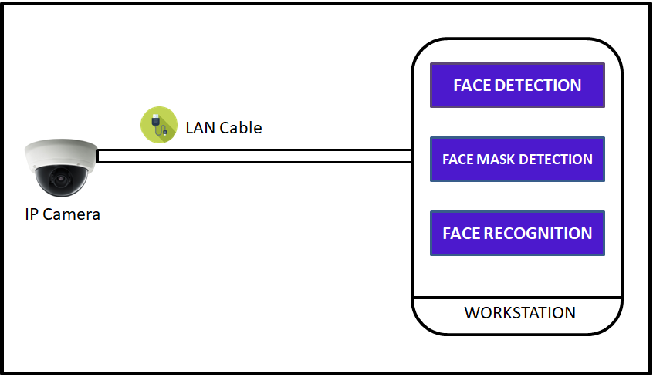

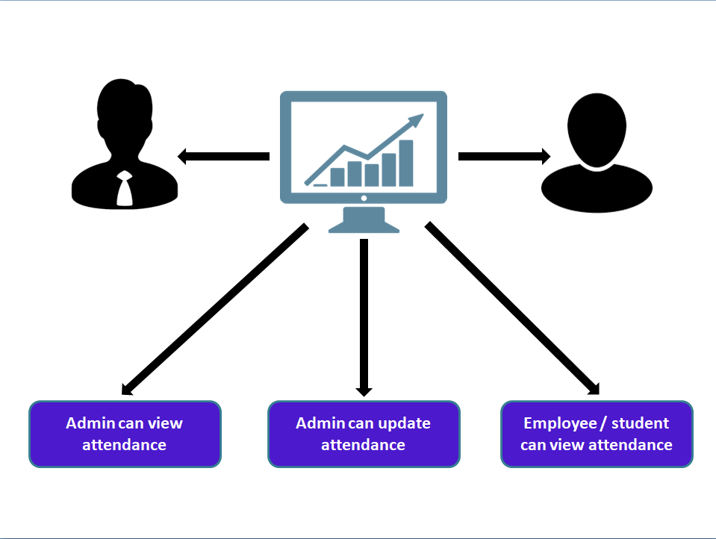


Masked Face Attendance
[Rohini Sharma|Kriti Singh|Aparnam Saini|Karan Dogra|Issha Sethi]
[rohini.123-cse-17@mietjammu.in|kriti.84-cse-17@mietjammu.in|aparnam.28-cse-17@mietjammu.in|karan.03-cse-17@mietjammu.in|issha.35-cse-17@mietjammu.in]
Abstract
Entity Relationship Diagram / Data Processing workflow
In this pandemic, facemasks have proven to be a very effective measure to slow down the spread of the disease and it is recommended by all organizations like WHO, CDC, etc to wear them when in public places. As it helps in controlling the spread of Covid 19.So our project i.e. Masked Face Attendance to complement people’s efforts and to help in making their workplace safe. Many existing automatic face recognition systems have failed since they are unable to recognize people while they are wearing face masks.
Our project aims to solve this problem by using the uncovered portion of their faces as the dataset for training the model which helps in overcoming this existing problem. At the same time our objective is to mark the attendance even if an individual is wearing a face mask or not with no human interference. Also this application checks whether an employee is wearing a face mask or not.
Innovation & Impact
INNOVATION:
Most of the face recognition systems uses facial features for the recognition process but during this pandemic face masks have become mandatory by the government, because of this many facial recognition systems are struggling with this change. Our project aims to overcome this hurdle with use of LBPH face recognition algorithm and with the use of advanced face mask detection model.
IMPACT:
Manages Attendance in any organization.
Tighter Security and eliminates proxy attendance
Encourages the use of face mask in the general public
Aims to help in controlling the spread of COVID-19.
Use Cases | Functional Workflow
Architecture Diagram
Use Case 1
1. Employees entering the institute.
2. Camera taking video stream.
3. Model recognizing faces with mask as well as without mask.
4. Identifies whether the employee is wearing a mask or not.
5. Storing the employee information.
Use Case 2
1. Admin login into the website.
2. Admin can view the attendance of all employees.
3. Check whether the employee is with or without mask.
4. Admin can view trends, graphs of the attendance.
5. Admin can add new users
Employee or Student entering to mark their attendance
Face Recognition and Face mask Detection
Admin / Employee can view their attendance
Screen Flow | Interaction Model
Dashboard
Admin and Employee
Language(s) | API(s) | Technology Stack
Languages:
Python
Technology Stack
Software Requirements : Operating System - Windows / linux
Hardware Requirements : Stable Internet Connection, Intel i3 or higher, RAM- 4GB, Secondary storage - 200 GB, One Camera
System Dependencies: OpenCV-contrib-python , Numpy , uitils, request, openpyxl, paddle hub.
Project Code: - CSEA1_P9

