Slide 1

Digital KYC Conversion Optimisation – HDFC Bank
Innovation Sprint 2025

Slide 2
Problem Overview: Digital KYC Onboarding Challenges
Our initiative focuses on enhancing the digital Know Your Customer (KYC) onboarding journey for HDFC Bank as part of the Innovation Sprint 2025. The core objective is to identify and address user drop-offs, ultimately streamlining the onboarding process.
Identify Drop-offs
Redesign Funnel
Pinpointing exact stages where users abandon the digital KYC process.
Creating a more intuitive and efficient KYC journey to boost completion rates.
Reduce Errors
Speed Up Onboarding
Minimising errors during document submission and verification to ensure accuracy.
Accelerating the overall KYC process to improve user experience and operational efficiency.

Slide 3




Current KYC Journey & Drop-off Summary
The existing digital KYC process faces significant challenges, with a high overall drop-off rate. Key problem areas have been identified across crucial steps, leading to user frustration and incomplete applications.
Document Scanning
Users encounter difficulties in accurately scanning required documents.
Document Upload
Issues arise during the upload phase, often due to file size or network constraints.
KYC Verification
A notable number of users fail to complete the verification stage.
Selfie Capture
Challenges in capturing a clear and valid selfie contribute to drop-offs.
Further issues include slow processing times, OCR failures, and confusing user interfaces, all contributing to a suboptimal onboarding experience. The overall funnel completion currently stands at approximately 32%.

Slide 4
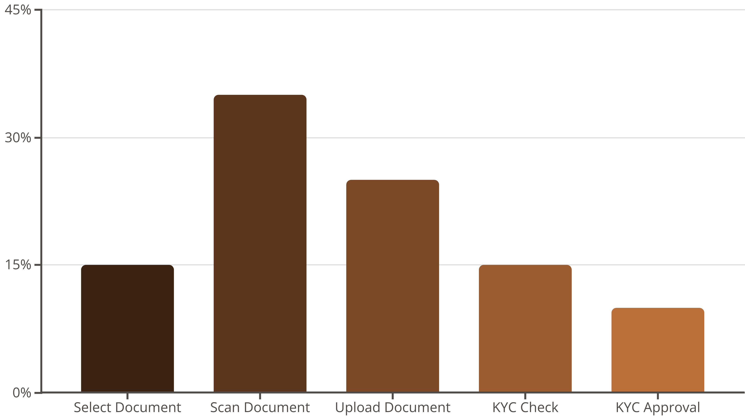
Funnel Performance: Stage-wise Drop-off Rates
Analysis of the current KYC journey reveals critical drop-off points, with document scanning being the most significant hurdle for users.
The data clearly highlights the need for targeted improvements at each stage, especially focusing on the scanning and uploading processes, to significantly improve the overall completion rate.

Slide 5
Dataset Insights: Understanding User Failure Points
A detailed analysis of the 400-row session dataset provides crucial insights into the specific errors and behaviours contributing to drop-offs during the digital KYC process.
1
2
Common Error Messages
Attempt Count for Failures
"Please scan the correct document," "KYC data not found," "Please select correct document type," and "Maximum tries exceeded" are frequently observed.
Most users encounter failures at their second or third attempt, with many reaching hard lockouts after four attempts.
3
4
Time Taken Per Step
OCR & Selfie Mismatch
Sessions often show excessive time spent per step, ranging from 25 to 45 seconds, indicating friction in the user flow.
A high rate of Optical Character Recognition (OCR) failures and selfie mismatches further complicates the verification process.
These insights underscore the need for more robust error handling, clearer guidance, and a more forgiving retry mechanism to prevent user abandonment.

Slide 6

Root Cause Analysis: Unpacking the Obstacles
A comprehensive root cause analysis reveals four primary categories contributing to the high digital KYC drop-off rates, encompassing UX, technical, device/network, and process/policy issues.
UX Problems
Device & Network
Lack of guidance for document handling (glare, angle, brightness)
Low-end smartphones face challenges with image processing
Confusing dropdown menu for document selection
Slow or unstable network connections (2G/weak mobile data) lead to upload failures
Absence of multilingual assistance
Technical Issues
Process & Policy
Slow sequential processing increases Turnaround Time (TAT)
Strict hard lockouts after a limited number of attempts
Duplicate KYC checks are performed too late in the process
Large image file uploads hinder performance
OCR engine struggles with low-quality images
Unclear and unhelpful error messaging
No autosave functionality, forcing full journey restarts

Slide 7

Proposed UX Redesign: A Seamless User Experience
Our redesigned KYC journey focuses on creating an intuitive, user-friendly interface that addresses the identified UX challenges and simplifies the onboarding process.
Card-based Document Selection UI
Simplifies the choice of document types, reducing user confusion.
Smart Camera Integration
Features auto-edge detection, auto-capture, and on-device compression for optimal image quality.
Multilingual Support
Offering guidance in English, Hindi, Assamese, Bengali, and Marathi for broader accessibility.
Clear, Situation-Specific Error Messages
Provides actionable feedback to users, guiding them through corrections.
Auto-fill Using OCR
Automatically populates fields from scanned documents, saving time and reducing manual entry errors.

Slide 8

Technical Architecture Improvements: Enhancing Backend Efficiency
The proposed technical architecture overhaul targets critical performance bottlenecks and introduces robust features for a faster, more reliable digital KYC system.
Device fingerprinting
Parallel processing
Contextual device signals
Concurrent task execution
Secure data transfer
Resumable uploads
New Digital KYC Backend
Continue interrupted transfers
Encrypted in transit
Vendor-agnostic OCR
Autosave state
Pluggable recognition engine
Resumable Uploads & Autosave
Parallel Processing
Ensures user progress is saved, preventing restarts and improving completion rates.
Enables simultaneous operations for significantly faster response times and reduced TAT.
Persist progress frequently
Vendor-Agnostic OCR
Device Fingerprinting
Flexibility to integrate with multiple OCR providers, enhancing accuracy and reducing dependency.
Adds an additional layer of security and helps in identifying unique user sessions.

Slide 9




Security & Fraud Controls: Protecting User Data
Robust security measures are paramount to ensure the integrity of the digital KYC process and protect sensitive customer information.
Enhanced Encryption
Implementation of TLS 1.3 and AES-256 for secure data transmission and storage.
PII Minimisation
Strict protocols to minimise the collection and retention of Personally Identifiable Information.
Liveness & Anti-Spoofing
Advanced techniques to verify user presence and prevent fraudulent identity attempts.
Face-Match Threshold
Configurable thresholds for facial recognition to enhance accuracy and security during selfie capture.
These controls are designed to build user trust and ensure compliance with stringent regulatory requirements.

Slide 10




KPI Targets & Expected Impact: Driving Business Outcomes
The proposed redesign is projected to deliver significant improvements across key performance indicators, translating into substantial business benefits for HDFC Bank.
Metric
Current Target
Projected Target
Scan Success
65%
85%
Upload Success
75%
90%
Verification Success
85%
90%
Overall Completion Rate
32%
55-60%
Expected Business Outcomes:
2x More Successful Onboardings
40% Lower Onboarding Cost
30% Fewer Manual Rechecks
Higher Customer Satisfaction

