Slide 1

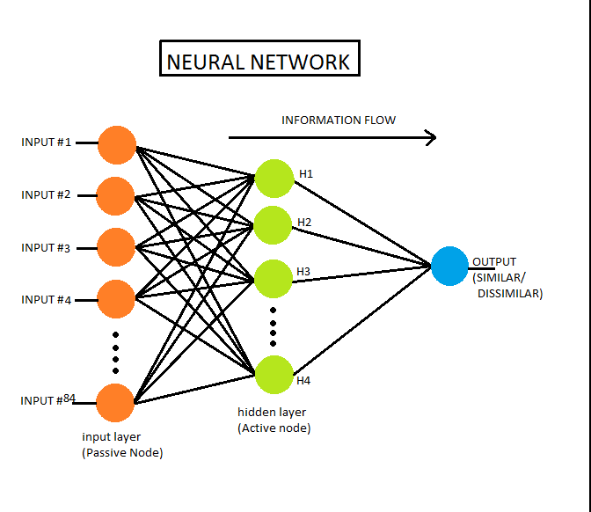
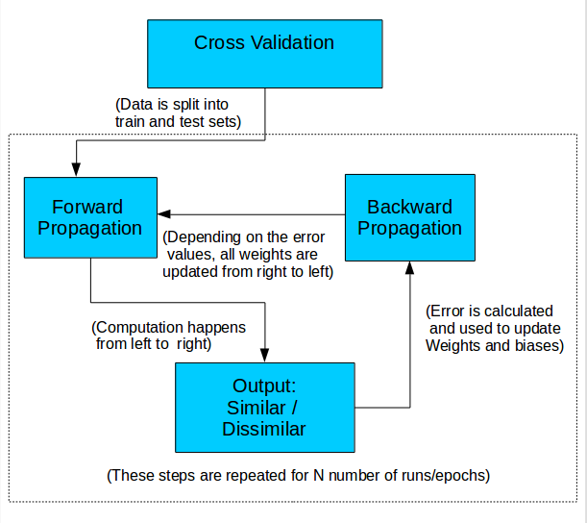
A MACHINE LEARNING APPROACH TO
PROTEIN FOLD RECOGNITION
DON BOSCO INSTITUTE OF TECHNOLOGY , KURLA WEST 400 070
ABSTRACT:
Protein folding is the physical process by which a protein chain acquires its native 3-dimensional structure, a conformation that is usually biologically functional, in an expeditious and reproducible manner.
An important task in protein structure prediction is to identify proteins that have similar tertiary structures (from among those that have already been determined experimentally).
By identifying such proteins, their structures can be used as a template to model the unknown structure of another protein.
For accurate recognition of protein folds, a neural network is developed to predict whether a given protein pair belongs to the same structural fold.
MECHANISM :
POSSIBLE FUTURE DIRECTIONS :
Creating a dynamic system which takes input in the FASTA format and generates similarity scores by accessing tools(data pre-processing).
CONCLUSION :
Neural networks give better accuracy as compared to other machine learning methods like SVM, regression etc.
KEY POINTS :
For each pair of proteins in the dataset, 84 pairwise similarity features are used to characterize the protein pair.
These similarity features used were obtained through five types of sequence alignment and/or protein structure prediction tools (i.e., sequence-sequence alignment, sequence-family information, sequence-profile alignment, profile-profile alignment and structural information) and selected based on their use in prior works.
The dataset consists of proteins from the SCOP dataset (version 1.37) such that the sequence identity between any pair of proteins was <40%.
Two proteins pertaining to the same structural fold is a problem that can be readily addressed as a binary classification problem. In this context, a protein pair which shares the same structural fold is labelled as 1 and pairs from dissimilar folds are labelled as 0.
REFERENCE :
http://www.nature.com/articles/srep17573#abstract
http://iris.rnet.missouri.edu/dnfold/
PROJECT GUIDE :
UDAY NAYAK
PROJECT TEAM :
KARAN MANGHI
KAVYA KOTIAN
CHIRAAG LIMAYE
ASHWIN FERNANDES

