Slide 1
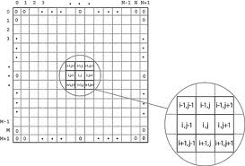


CHARACTER ARRAYS STRINGS

Slide 2
Strings
Definition
A string is an array of characters.
Any group of characters (except double quote sign) defined between double quotation marks is a constant string.
Character strings are often used to build meaningful and readable programs.
The common operations performed on strings are
Reading and writing strings
Combining strings together
Copying one string to another
Comparing strings to another
Extracting a portion of a string ..etc.
Notes:
A new data type , the character string, which is used to represent a sequence of characters regarded as a single data item. In C++ strings of characters are held as an array of characters, one character held in each array element.

Slide 3
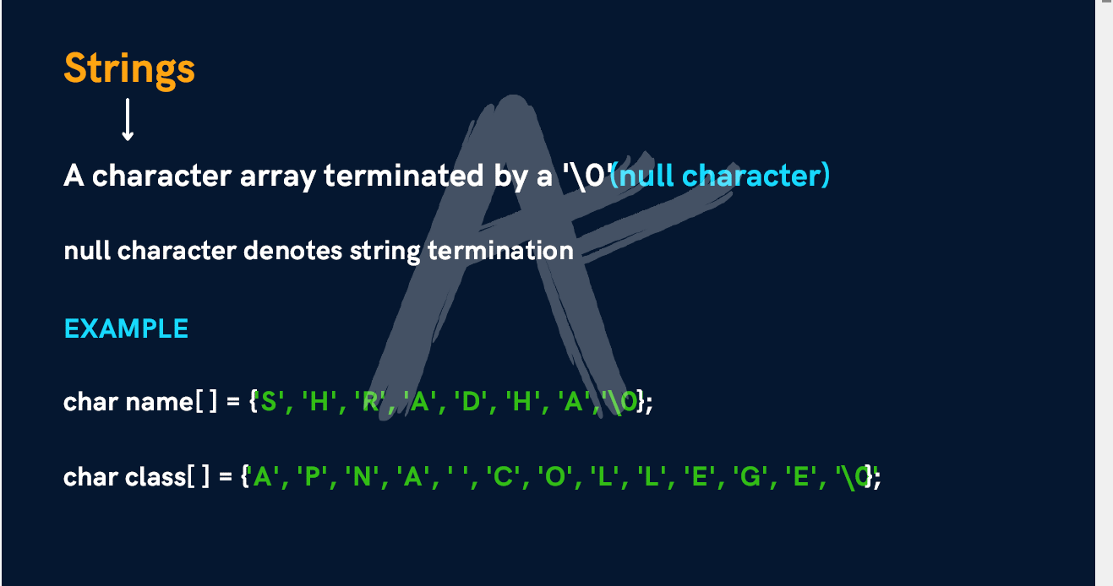

Slide 4
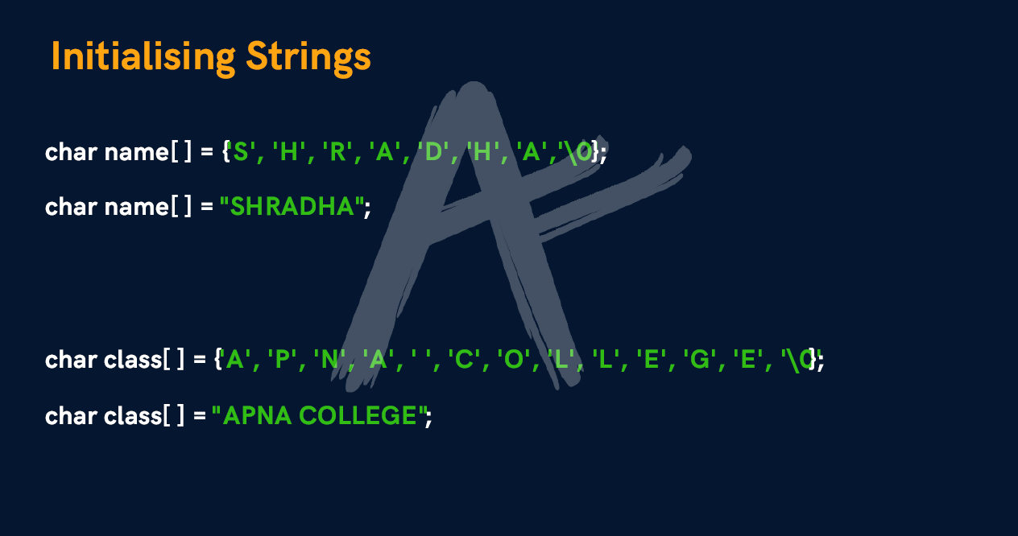

Slide 5
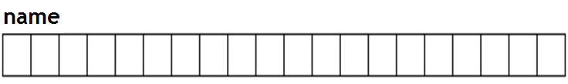
Strings
Declaration and initialization
char string_name[size];
The size determines the number of characters in the string_name.
For example, consider the following array:
char name [20];
is an array that can store up to 20 elements of type char.
It can be represented as:
Notes:
Syntax for declaration
char <array/string name> [max. number of characters to be stored +1];
The number of elements that can be stored in a string is always n-1, if the size of the array specified is n. This is because 1 byte is reserved for the NULL character '\0' i.e. backslash zero. A string is always terminated with the NULL character.
Example: char str[80]; In the above example, str can be used to store a string with 79 characters.

Slide 6
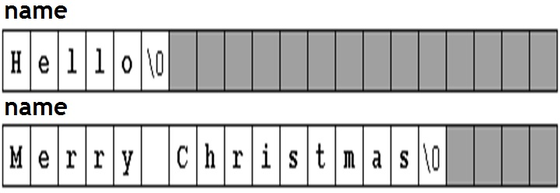
Strings
The character sequences "Hello" and "Merry Christmas" represented in an array name respectively are shown as follows :

Slide 7
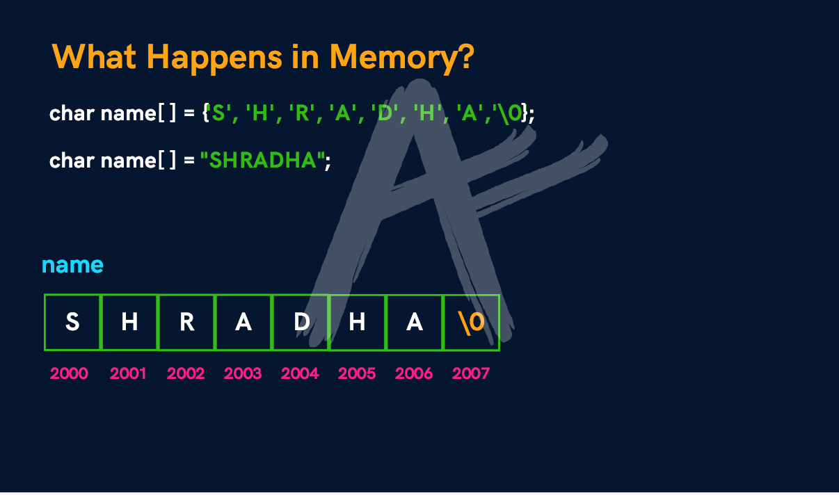

Slide 8
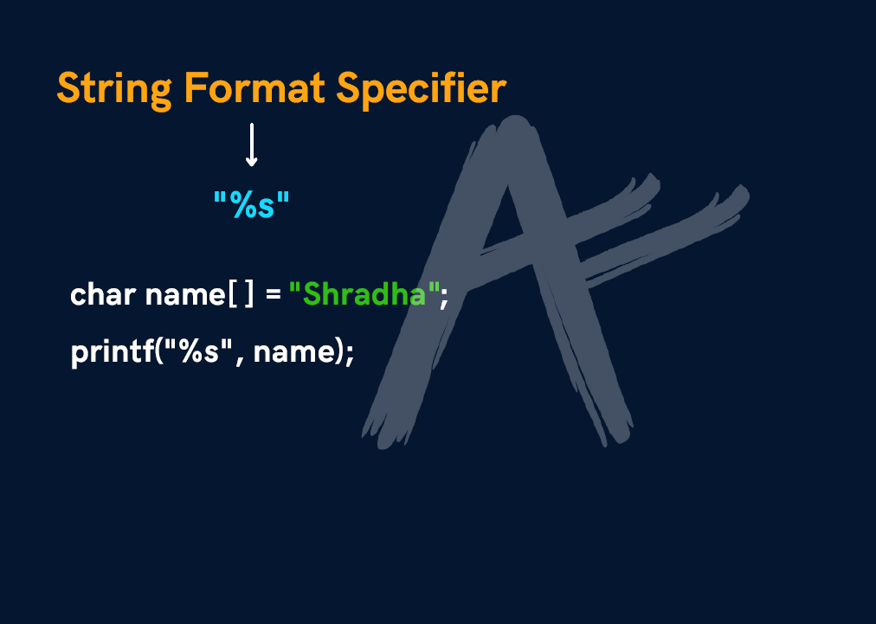

Slide 9
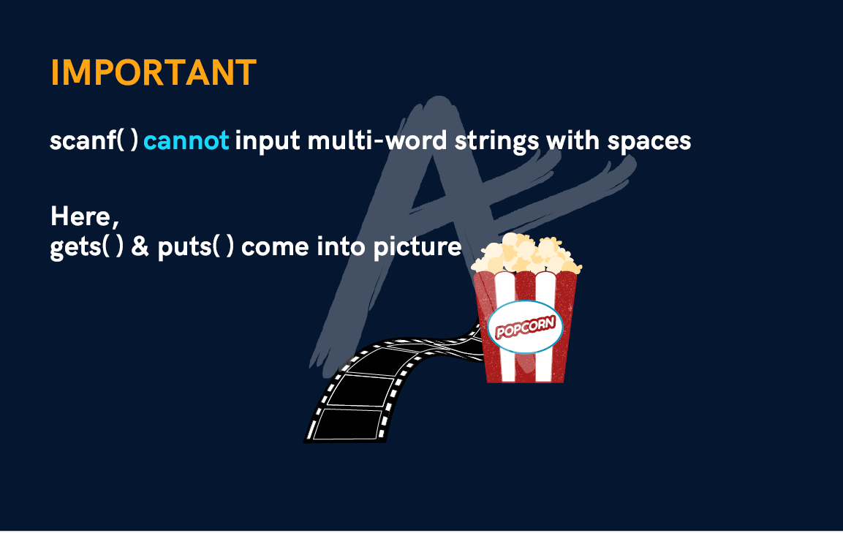

Slide 10

Initialization of null-terminated character sequences
arrays of characters or strings are ordinary arrays that follow the same rules of arrays.
For example
To initialize an array of characters with some predetermined sequence of characters one can initialize like any other array:
char myWord[ ] = { 'H', 'e', 'l', 'l', 'o', '\0' };
Notes:
Because a character is initialized by including it in single-quotes, when creating an array of characters, to initialize it, you must also include each letter accordingly. A name such as James can be initialized as follows:
char Name[6] = { 'J', 'a', 'm', 'e', 's' };

Slide 11
Initialization of null-terminated character sequences
Arrays of char elements have an additional methods to initialize their values: using string literals
“Manipal ” is a constant string literal.
For example,
char result[14] =“Manipal”;
Double quoted (") strings are literal constants whose type is in fact a null-terminated array of characters.
So string literals enclosed between double quotes always have a null
character ('\0') automatically appended at the end.

Slide 12
Initialization
Initialization:
char myWord [ ] = { 'H', 'e', 'l', 'l', 'o', '\0' };
char myWord [ ] = "Hello";
In both cases the array of characters myword is declared with a size of 6 elements of type char:
The 5 characters that compose the word "Hello" plus a final null character ('\0') which specifies the end of the
sequence and that,
In the second case, when using double quotes (") null character ('\0') is appended automatically.
Notes:
Initializing a string
A string can be initialized to a constant value when it is declared.
char str[ ] = "Good"; Or char str[]={'G','o','o','d','\0'};
Here. 'G' will be stored in str[0], 'o' in str[1] and so on.
Note: When the value is assigned to the complete string at once, the computer automatically inserts the NULL character at the end of the string. But, if it is done character by character, then we have to insert it at the end of the string.

Slide 13
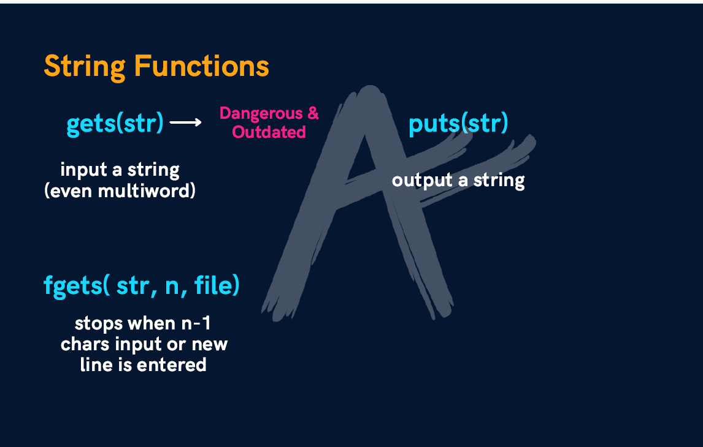

Slide 14
Example
#include <stdio.h>
int main() {
char question[ ] = "Please, enter your first name: ";
char greeting[ ] = "Hello, ";
char yourname [ 80];
printf(“%s”,question);
scanf(“%s”, yourname);
printf(“%s…. %s\n”,greeting, yourname );
return 0;
}
Please, enter your first name: Jey
Hello, ... Jey
Notes:
gets()
It can be used to take input of a value of any data type.
It can be used to take input of a string.
It takes the white space i.e. a blank, a tab, or a new line character as a string terminator.
It does not take the white space i.e. a blank, a tab, or a new line character, as a string terminator.
It requires header file iostream.h
It requires the header file stdio.h
Example: char S[80]; cout<<"Enter a string:”; cin>>S;
Example: char S[80]; cout<<"Enter a string:"; gets(S);

Slide 15
Example
#include <stdio.h>
int main()
{
const int MAX = 80; //max characters in string
char str[MAX]; //string variable str
printf("Enter a string: \n");
scanf("%s",&str); //put string in str
printf("%s",str); //display string from str
return 0;
}
Enter a string:
gautam kumar
gautam
Notes:
cout
puts()
It can be used to display the value of any data type.
It can be used to display the value of a string.
It does not take a line feed after displaying the string.
It takes a line feed after displaying the string.
It requires the header file iostream.h
It requires the header file stdio.h
Example: char S[80]="Computers"; cout<<S<<S; Output: ComputersComputers
Example: char S[80]="Computers"; puts(S); puts(S); Output: Computers Computers

Slide 16
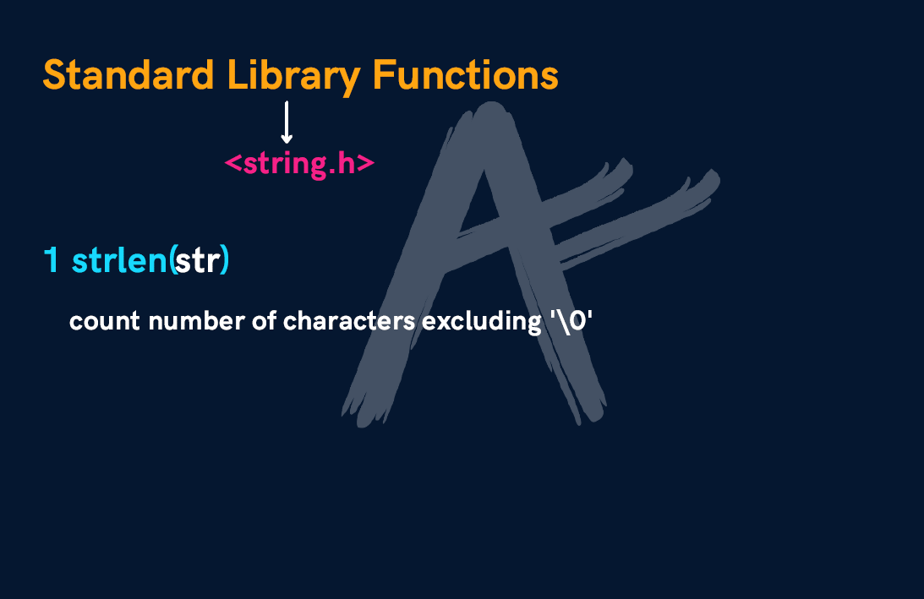

Slide 17
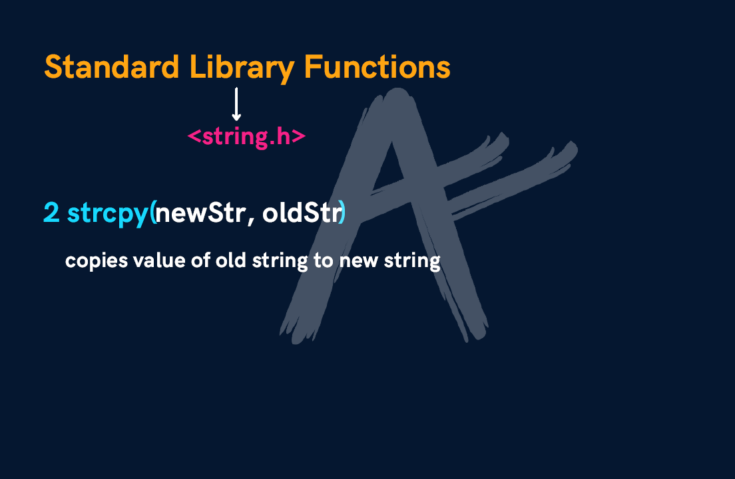

Slide 18
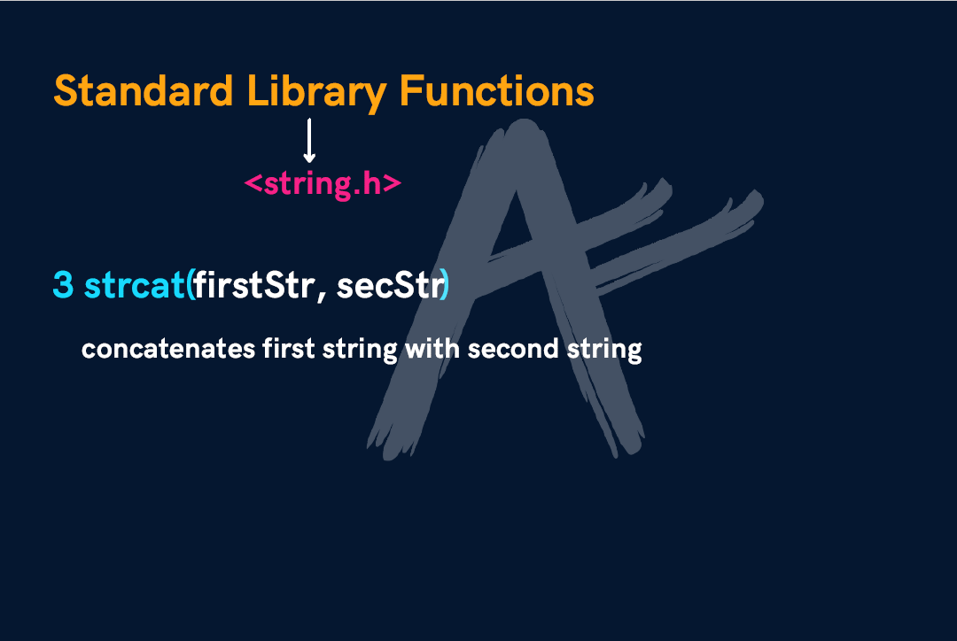

Slide 19
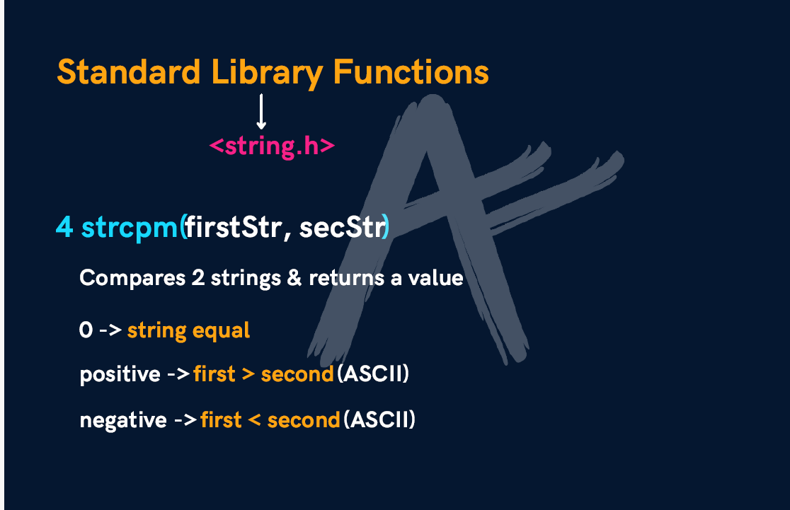

Slide 20
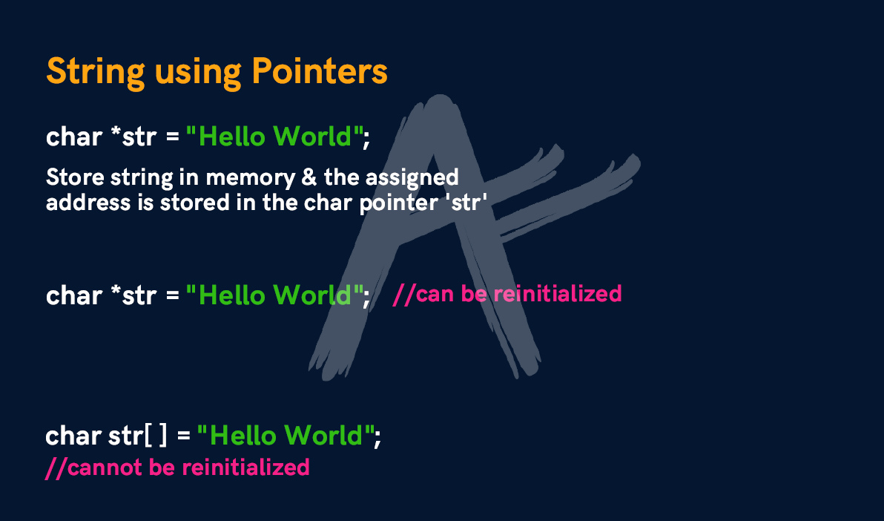

Slide 21
Reading Embedded Blanks
To read everything that you enter from the keyboard until the ENTER key is pressed (including space).
Syntax:
gets(string) ;
Notes:
Reading strings with/without embedded blanks
To read a string without blanks cin can be used cin>>str; To read a string with blanks cin.getline() or gets() can be used. cin.getline(str,80); -Or- gets(str);

Slide 22
Example
#include <stdio.h>
#include<string.h>
int main()
{
char str[80]; //string variable str
printf(“\nEnter a string: ”);
gets(str); //put string in str or use gets(str)
printf(“ the string is \n“);
puts(str);
return 0;
}
Enter a string: Manipal University Jaipur, India
The Entered String is
Manipal University Jaipur, India

Slide 23
Count the number of characters in a string
#include <stdio.h>
int main()
{
char sent[100];
int i=0, count=0;
printf("enter sentence \n“);
gets(sent);
puts(sent);
while(sent[i]!='\0')
{
count++;
i++;
}
printf(“\n The No of characters=%d “, count);
return 0;
}

Slide 24
Count the number of words in a sentence
#include <stdio.h>
int main()
{
const int MAX = 100;
char sent[MAX];
int i=0,count=1;
printf("enter sentence \n“);
gets(sent);
printf("\n“);
while(sent[i]!='\0')
{
if (sent[i]==' '&& sent[i+1]!=' ')
count++;
i++;
}
printf(“n %d n no. of words = " ,count);
return 0;
}

Slide 25
Reading multiple lines: Example
#include <stdio.h>
int main()
{
const int MAX = 2000; //max characters in string
char str[MAX]; //string variable str
printf("\nEnter a string:\n“);
gets(str);
printf("You entered:\n“);
printf(“%s”,str);
return 0;
}
The function will continue to accept characters until enter key is pressed.

