Slide 1
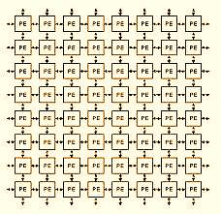
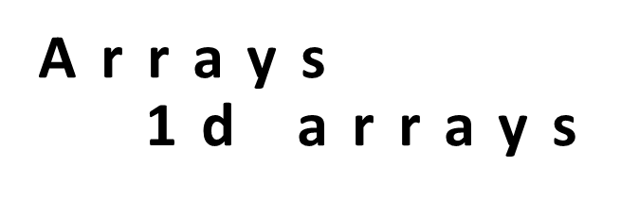

Slide 2
Linear Search
#include<stdio.h>
int main()
{
int a[20],i,x,n;
printf("How many elements?");
scanf("%d",&n);
printf("Enter array elements:");
for(i=0;i<n;++i)
scanf("%d",&a[i]);
printf("\n Enter element to search:");
scanf("%d",&x);

Slide 3
for(i=0;i<n;++i)
if(a[i]==x)
break;
if(i<n)
printf("Element found at index %d",i);
else
printf("Element not found");
return 0;
}

Slide 4
WAP to insert an element to an array at a given position
int a[100], n,i, pos,ele;
scanf(“%d”,&n); // number of elements
printf("\nEnter the elements of array:“);
for(i=0;i<n;i++)
scanf(“%d”,&a[i]);
printf("\nEnter the element and position of insertion:“);
scanf(“%d %d”,&ele,&pos);
for(i=n; i>=pos; i--) //shift the elements to right
a[i]=a[i-1];
a[pos-1] = ele;//ele is inserted at the specified pos.
n = n + 1; // increment the count of no of elements
printf("\nThe array after insertion is:“);
for(i=0;i<n; i++) printf(“%d\n”,a[i]);
Example : insert 9 at 2nd position
a[ ]={1, 2, 3, 4, 5}
New array after inserting 9 :
a[ ]={1, 9, 2, 3, 4, 5}

Slide 5
WAP to delete an element from an array
printf("enter no of numbers“);
scanf(“%d”,&n);
printf("enter n numbers \n“);
for(i=0;i<n;i++)
scanf(“%d”,&a[i]);
printf("enter the position at which the element to be deleted“);
scanf(“%d”,&pos);
for(i=pos-1; i<n-1; i++)
a[i] =a[i+1]; //shift the elements to left
n = n-1; //decrement the count of no of elements
for(i=0;i<n;i++)
printf(“%d”,a[i]);
Example : delete ele at 2nd position
a[ ]={1, 2, 3, 4, 5}
New array after deleting 2:
a[ ]={1, 3, 4, 5}

Slide 6
Insert an element into a sorted array
Read array elements (in sorted order) & element ‘ele’ to be inserted
Example: insert 3 into the array
a[ ] = {1, 2, 4, 5,6}
//finding position
for(i=0;i<n;i++)
if (ele<a[i]) break;
pos = i+1; //position of insertion
for(i=n; i>=pos; i--) //shift the elements to right
a[i]=a[i-1];
a[pos-1] = ele;//ele is inserted at the specified pos.
n = n + 1; // increment the count of no of elements
New array after inserting 3 :
a[ ] = {1, 2, 3, 4, 5,6}

Slide 7
Summary
Arrays
1 Dimensional arrays (lists)
Problems on 1D arrays

Slide 8
Syntax
1D Array:
Syntax: type array_name[size];
Memory Requirement:
Total size =size *(sizeof(data_type));
Initialization:
type array-name [size]={list of values}
Write and Read:
for(i=0;i<n;i++) for(i=0;i<n;i++)
scanf(“%d”,&a[i]); prinft(“%d\n”,a[i]);

Slide 9
Tutorials on Array
Write a program to find average of an 1-D array.
Write a program to find second largest element in an array.
Write a program to find union and intersection of two arrays.

Slide 10
Syntax
1D Array:
Syntax: type array_name[size];
Memory Requirement:
Total size =size *(sizeof(data_type));
Initialization:
type array-name [size]={list of values}
Write and Read:
for(i=0;i<n;i++) for(i=0;i<n;i++)
scanf(“%d”,&a[i]); prinft(“%d\n”,a[i]);

Slide 11
Tutorials on Array
Write a program to find average of an 1-D array.
Write a program to find second largest element in an array.
Write a program to find union and intersection of two arrays.

