Slide 1
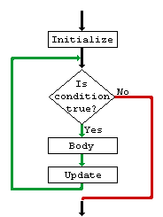
Loop Control Structures

Slide 2
Controlling the program flow
Forms of controlling the program flow:
Executing a sequence of statements
Using a test to decide between alternative sequences (branching)
Repeating a sequence of statements (until some condition is met) (looping)
Statement1
Statement2
Statement3
Statement4
Statement5
Statement6
Statement7
Statement8

Slide 3
Program Looping
A set of statements that executes repetitively for a number of times.
Simple example: displaying a message 100 times:
printf(hello !\n”);
printf(hello !\n”)
printf(hello !\n”)
…
printf(hello !\n”)
printf(hello !\n”)
Repeat 100 times
printf(hello !\n”)
Program looping: enables you to develop concise programs containing
repetitive processes that could otherwise require many lines of code !

Slide 4
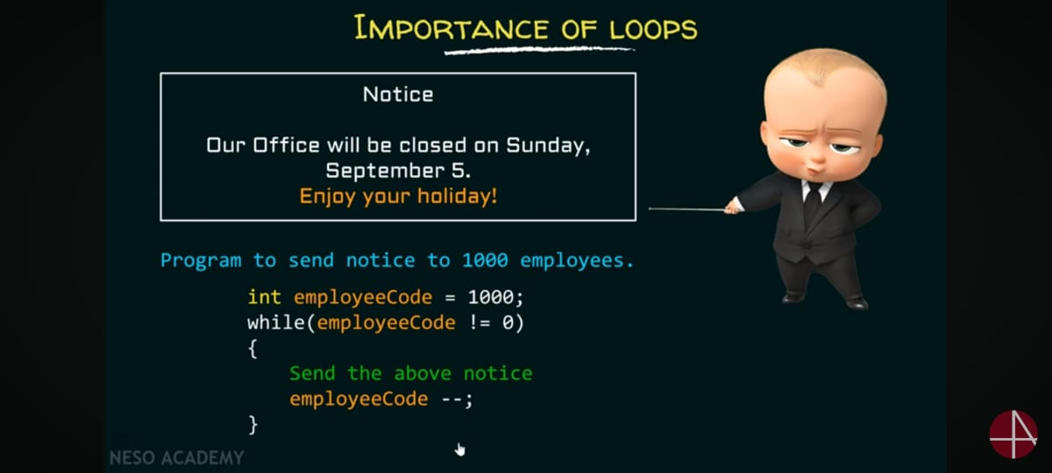

Slide 5
The need for program looping
Example problem: computing triangular numbers.
(The n-th triangular number is the sum of the integers from 1 through n)
#include <stdio.h>
int main (void)
{
int triangularNumber;
triangularNumber = 1 + 2 + 3 + 4 + 5 + 6 + 7 + 8;
printf(“The eighth triangular number is %d“,triangularNumber);
return 0;
}
What if we have to compute the 200-th (1000-th, etc) triangular number ?
We have 3 different statements for looping.

Slide 6
Iterative (loop) control structures
Three kinds of loop control structures:
while
do while
for
Notes:
Iterative (repetitive) control structures are used to repeat certain statements for a specified number of times.
The statements are executed as long as the condition is true
These kind of control structures are also called as loop control structures

Slide 7
Iterative (loop) control structures
Each loop control structure will have
Program loop: body of loop.
control statement → tests certain conditions & then directs repeated execution of statements within the body of loop.
Two types: Based on position of control statement.
1) Entry controlled loop: control is tested before the start of the loop. If false, body will not be executed.
2) Exit controlled loop: test is performed at the end of the body. i.e. body of loop executed at least once.

Slide 8
Entry Controlled & Exit controlled loops
Entry
Entry
Test
Condition
False
Body of
The loop
True
Body of
The loop
Test
Condition
True
False

Slide 9
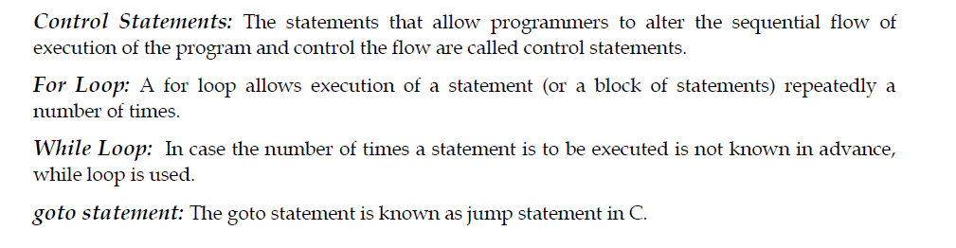
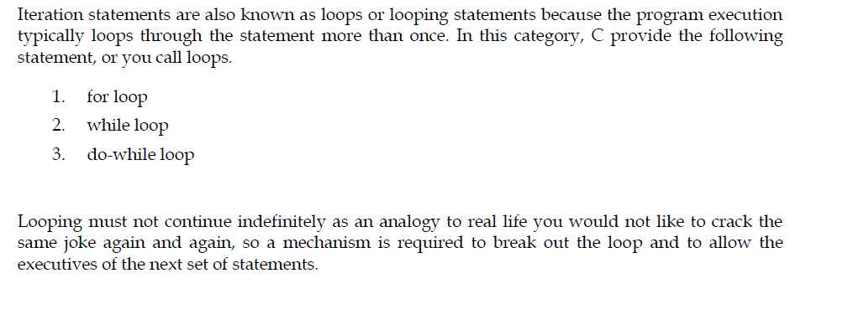

Slide 10
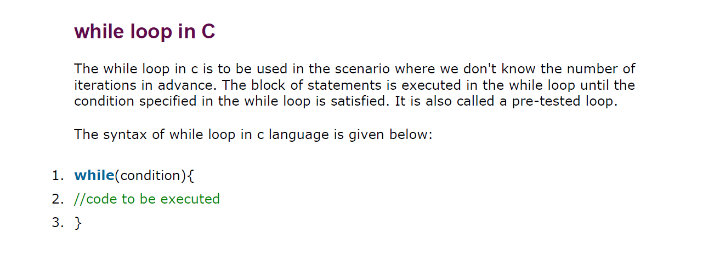

Slide 11
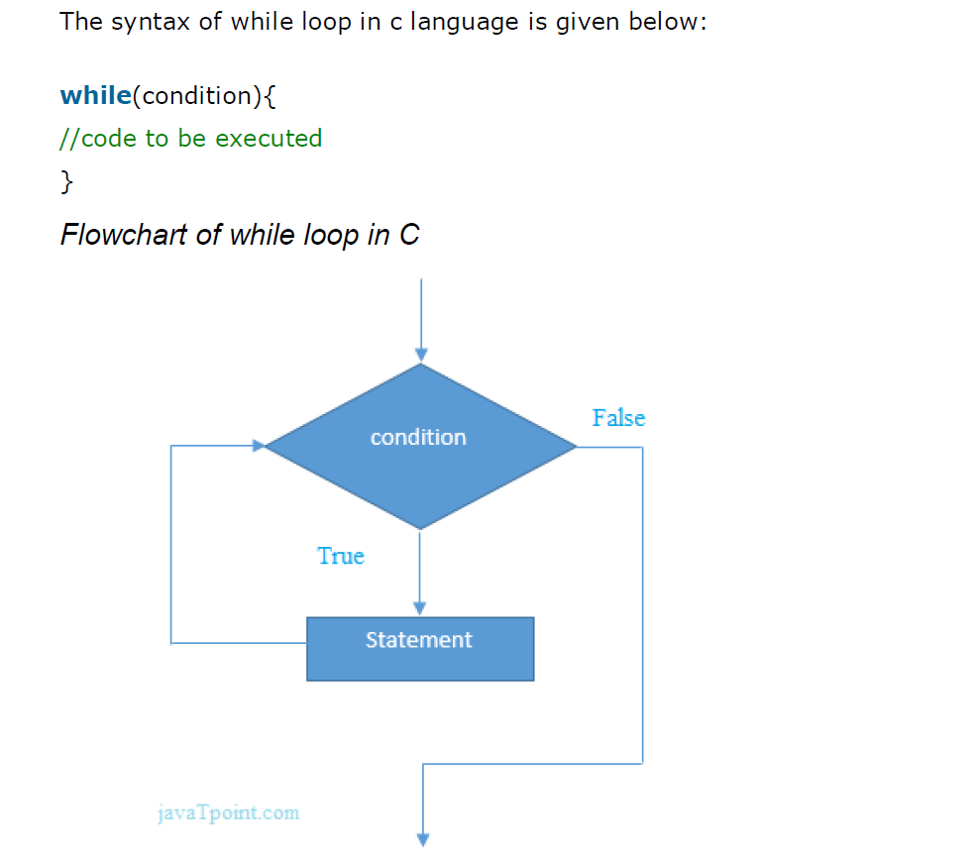
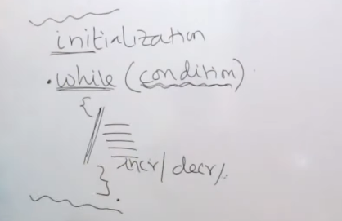

Slide 12
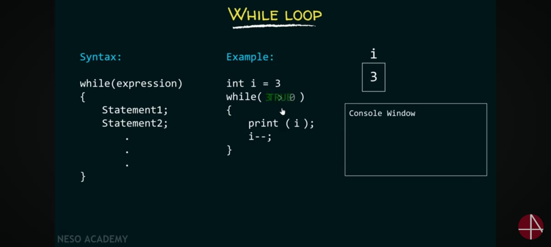

Slide 13
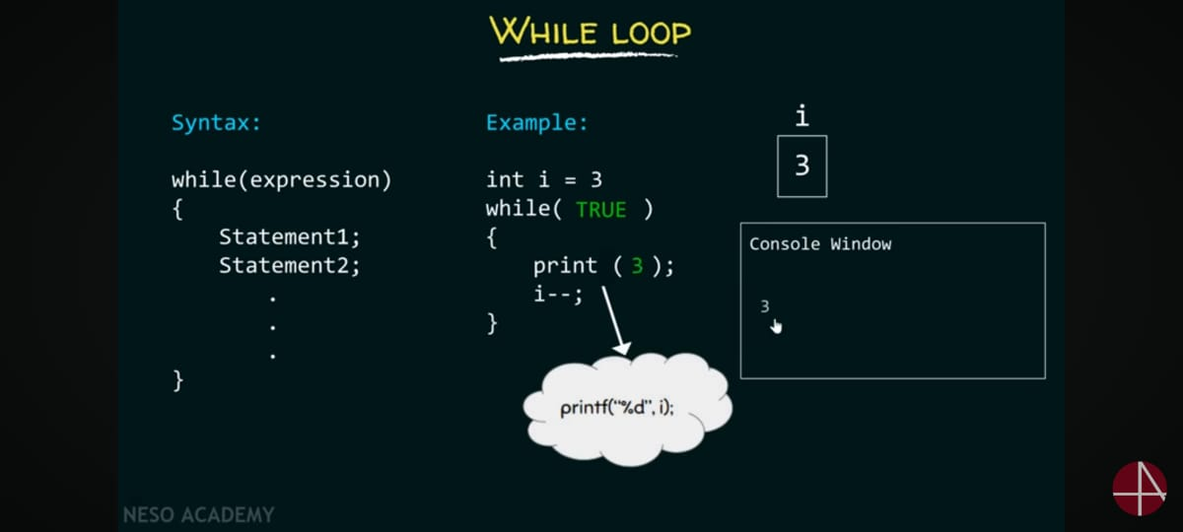

Slide 14
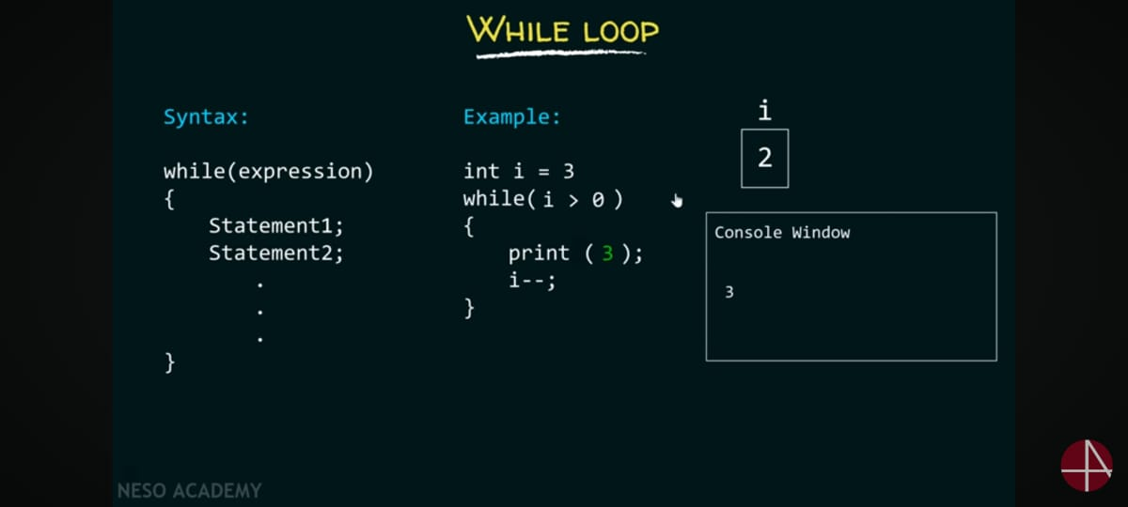

Slide 15


Slide 16
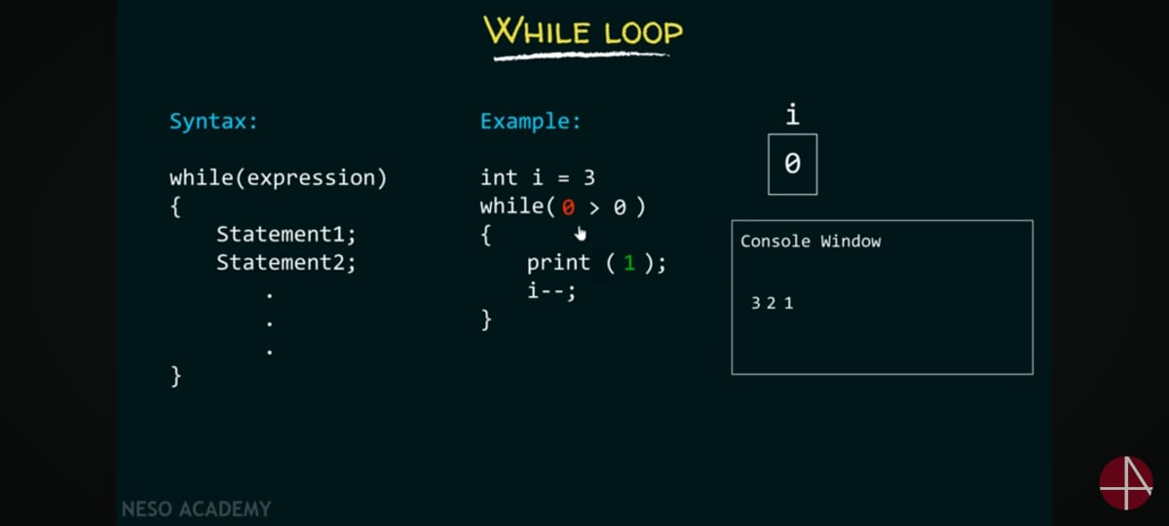

Slide 17


Slide 18
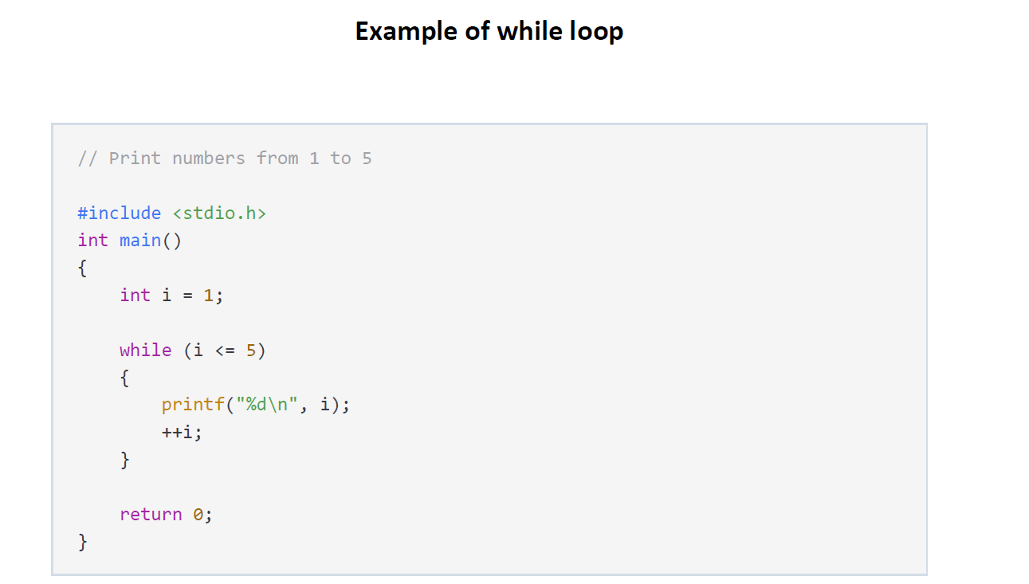
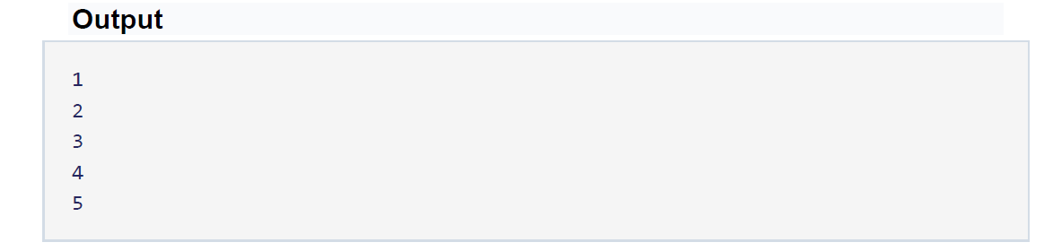

Slide 19
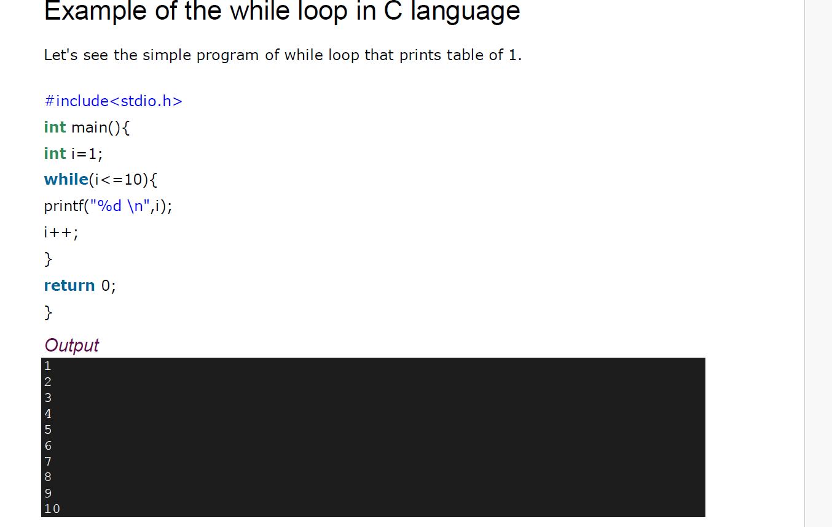

Slide 20
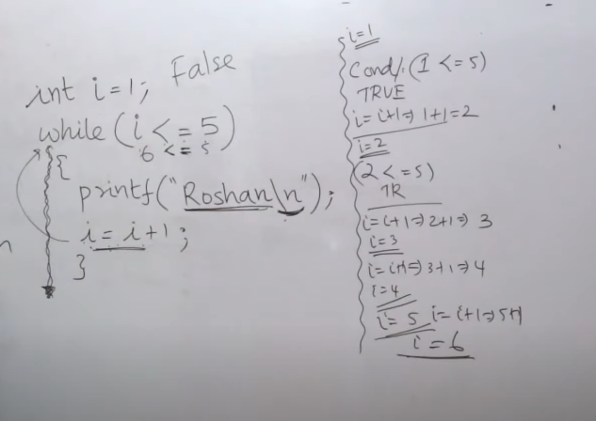

Slide 21
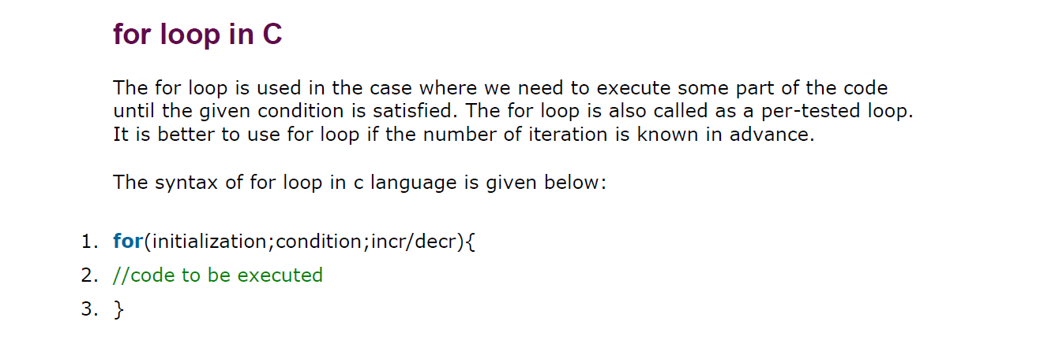

Slide 22
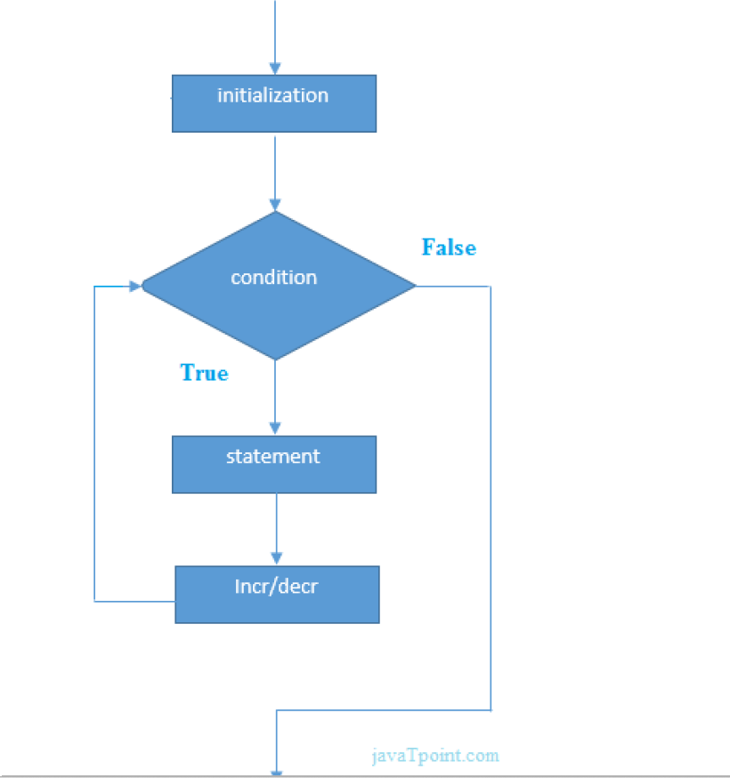

Slide 23
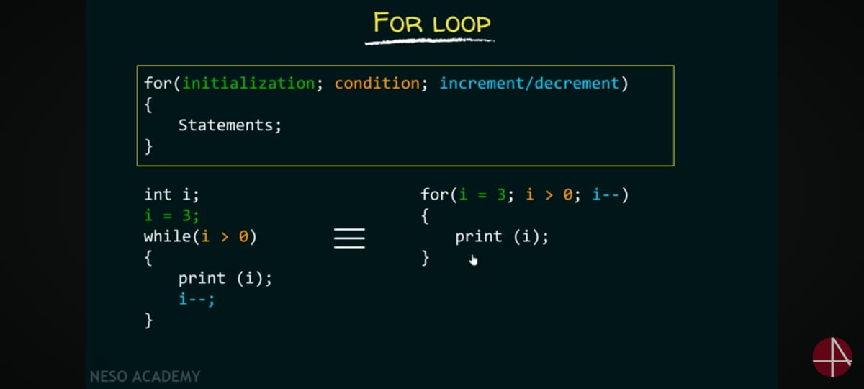

Slide 24
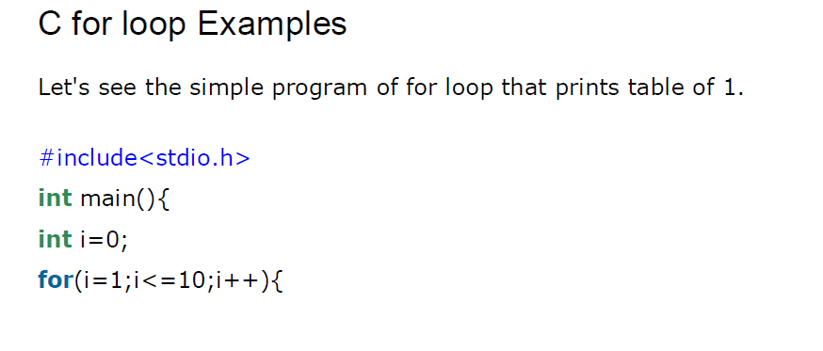
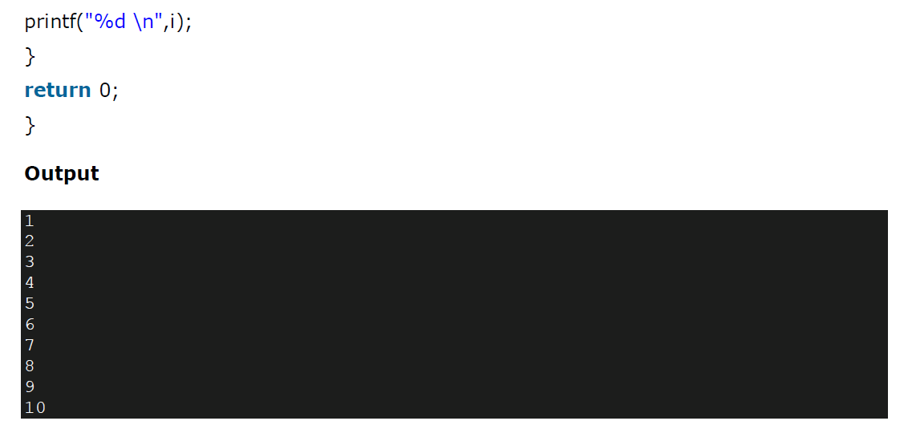

Slide 25
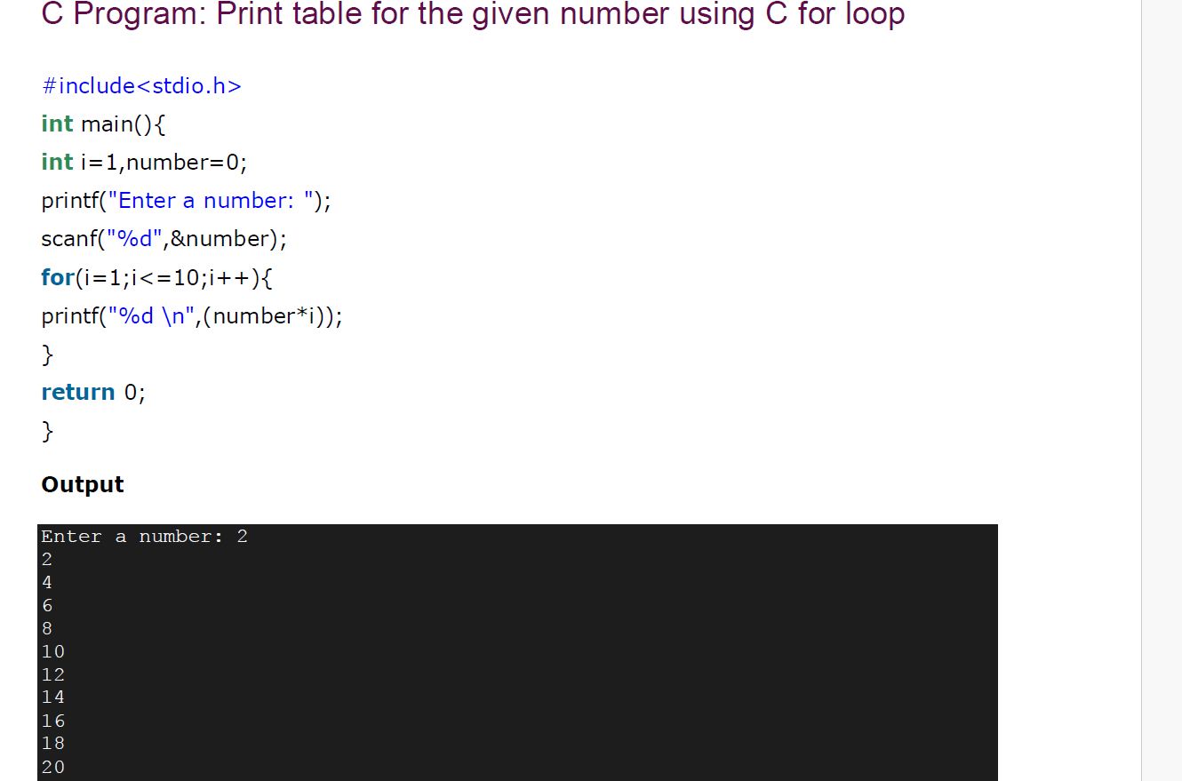

Slide 26
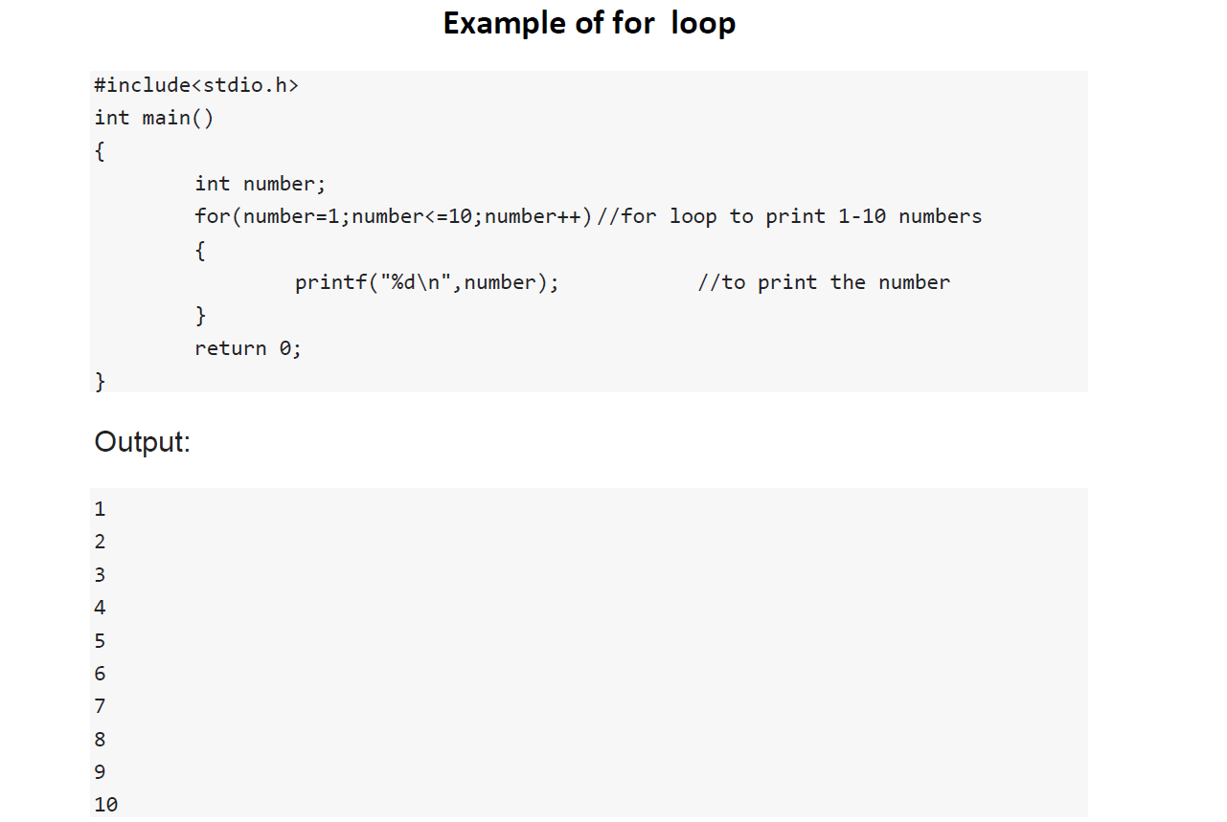

Slide 27
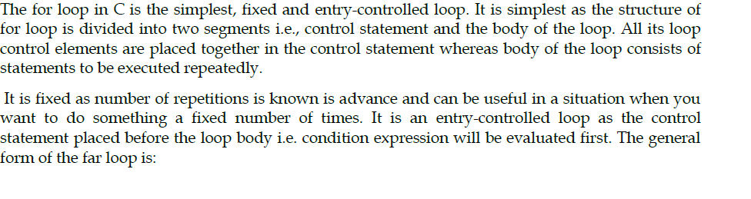

For Loop

Slide 28
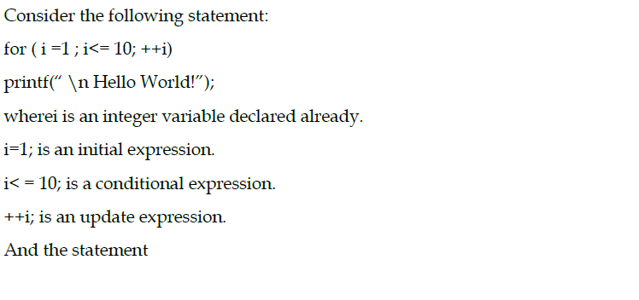

Slide 29
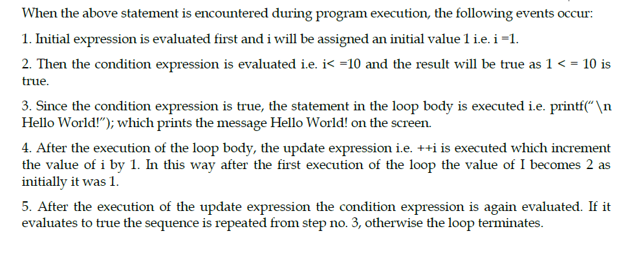

Slide 30
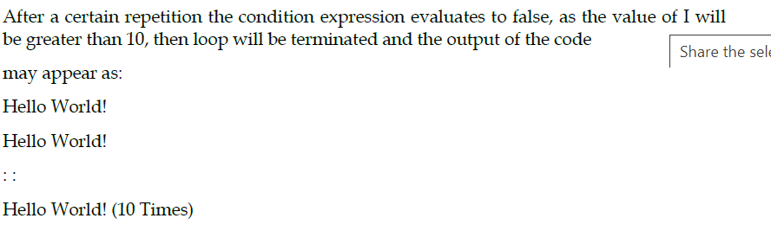

Slide 31
Example – 200th triangular number
Statement before loop
triangularNumber = 0
init_expression
n=1
n<=200
no
loop_condition
yes
Statement(s)
triangularNumber =
triangularNumber + n
loop_expression
n=n+1
Statement after loop
Print triangularNumber

Slide 32
The ‘for’ loop
for ( init_expression; loop_condition; loop_expression )
{ program statement(s)
}
1
init_expression
loop_condition
no
5
2
yes
3
Program statement
4
Loop expression
Next Statement

Slide 33
How for works
The execution of a for statement proceeds as follows:
1. The initial expression is evaluated first. This expression usually sets a variable that will be used inside the loop, generally referred to as an index variable, to some initial value.
2. The looping condition is evaluated. If the condition is not satisfied (the expression is false – has value 0), the loop is immediately terminated. Execution continues with the program statement that immediately follows the loop.
3. The program statement that constitutes the body of the loop is executed.
4. The looping expression is evaluated. This expression is generally used to change the value of the index variable
5. Return to step 2.

Slide 34
The for statement
sum = 0;
no
for ( n = 1; n <= 200; n = n + 1 )
{ sum = sum + n; }
1
2
5
4
yes
3
Next Statement
for ( init_expression; loop_condition; loop_expression )
{ program statement(s)
}

Slide 35
Finding sum of natural numbers up to 100
#include <stdio.h>
int main()
{
int n;
int sum;
sum=0; //initialize sum
for(n = 1; n <=100; n=n + 1)
{
sum=sum + n;
}
printf(“%d”,sum);
return 0;
}

Slide 36
Infinite loops
It’s the task of the programmer to design correctly the algorithms so that loops end at some moment !
// Program to count 1+2+3+4+5
#include <stdio.h>
int main()
{
int i, n = 5, sum =0;
for ( i = 1; i <= n; n = n + 1 )
{
sum = sum + i;
printf(“%d”,sum);
}
return 0;
}
What is wrong here ?
Does the loop end?

Slide 37
Example – for with a body of 2 statements
// Program to generate a table of triangular numbers
#include <stdio.h>
int main()
{
int n, triangularNumber=0;
printf(“TABLE OF TRIANGULAR NUMBERS\n\n“);
printf(“Sum from 1 to n\n“);
for ( n = 1; n <= 10; n++ )
{
triangularNumber += n;
printf(“The %d th triangular number is %d\n”,n,triangularNumber);
}
return 0;
}

Slide 38
for loop variants
Multiple expressions (comma between…) for(i=0 , j=10 ; i<j ; i++ , j--)
Omitting fields (semicolon have to be still…) i=0; for( ; i<10 ; i++ )
Declaring variables for(int i=0 ; i=10 ; i++ )

Slide 39
while-loop
General format:
while (test expression)
{
body of the loop
}
Entry controlled loop statement.
Test condition is evaluated & if it is true, then body of the loop is executed.
This is repeated until the test condition becomes false, & control transferred out of the loop.
Body of loop is not executed if the condition is false at the very first attempt.
While loop can be nested.
Note: braces optional if only one statement.

Slide 40
The while statement
while ( expression )
program statement
Loop with the test in the beginning !
Body might never be executed !
statement before loop
Loop_expression
3
1
No
4
yes
2
statement (s)
Next statement
Notes:
Explanation
Entry controlled loop statement
Loop_expression or Test condition is evaluated & if it is yes or true, then body of the loop is executed.
After execution, the Loop_expression or test condition is again evaluated & if it is yes or true, the body is executed again.
This is repeated until the Loop_expression or test condition becomes no or false, & control transferred out of the loop.
Body of loop is not executed if the condition is no or false at the very first attempt.

Slide 41
Finding sum of natural numbers up to 100
#include <stdio.h>
int main()
{
int n;
int sum;
sum=0; //initialize sum
for(n = 1; n < 100; n=n + 1)
{
sum=sum + n;
}
printf(“%d”,sum);
return 0;
}
#include <stdio.h>
int main()
{
int n;
int sum;
sum=0; //initialize sum
n=1;
while (n < 100)
{
sum= sum + n;
n = n + 1;
}
printf(“%d”,sum);
return 0;
}

Slide 42
Program to reverse the digits of a number
#include <stdio.h>
int main()
{
int number, rev=0, right_digit;
printf(“Enter your number.\n“);
scanf(“%d”,&number);
while ( number != 0 )
{
right_digit = number % 10;
rev=rev*10 + right_digit;
number = number / 10;
}
printf(“The reversed number is %d“, rev);
return 0;
}

Slide 43
The do – while statement
General form:
do
{
body of the loop
}
while(test condition);
Exit controlled loop. At the end of the loop, the test condition is evaluated.
After do statement, program executes the body of the Loop.
Then, the condition is tested, if it is true, body of the loop is executed once again & this process continues as long as the condition is true.
Body of the loop is executed at least once.
do-while loop can be nested.

Slide 44
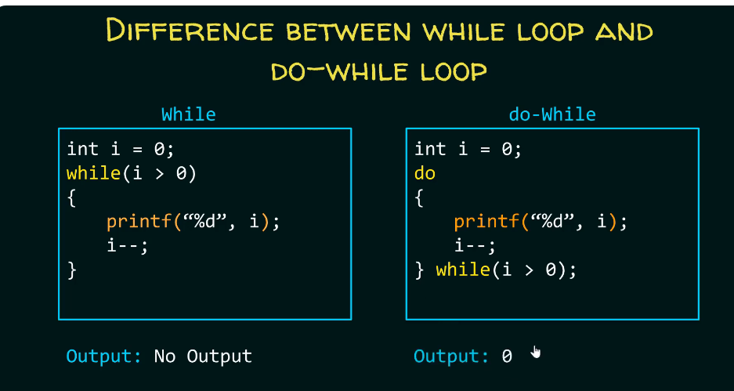

Slide 45
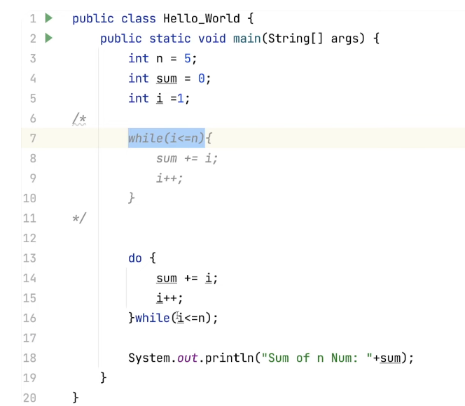
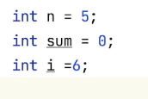

Slide 46
The do statement
do
program statement
while ( loop_expression );
Loop with the test at the end !
Body is executed at least once !
3
1
Statement(s)
yes
loop_expression
2
No
Next statement
4
Notes:
Explanation
Exit controlled loop.
After do statement, program executes the body of the Loop.
At the end of the loop, the Loop_expression or test condition is evaluated.
If it is yes or true, body of the loop is executed once again & this process continues as long as the condition is true.
When condition becomes no or false, the loop will be terminated.
Body of the loop is executed at least once.
do … while loop can be nested.

Slide 47
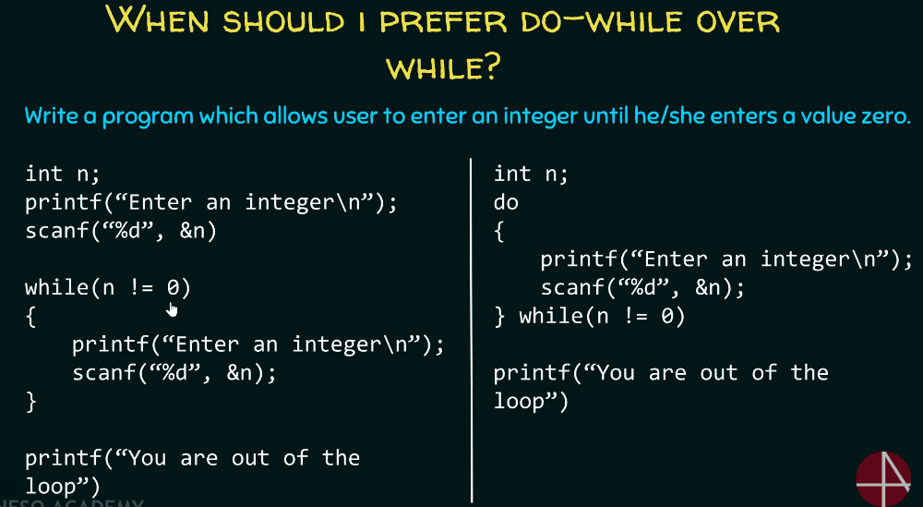

Slide 48
Example: Finding sum of natural numbers up to 100
#include <stdio.h>
int main()
{
int n;
int sum =0;
n=1;
while (n<=100)
{
sum=sum+n;
n = n +1;
}
printf(“%d”,sum);
return 0;
}
#include <stdio.h>
int main()
{
int n;
int sum=0;
n=1;
do
{
sum = sum + counter;
counter = counter +1;}}
} while (counter < 100);
printf(“%d”,sum);
return 0;
}
do
{
sum = sum + n;
n = n +1;
} while (n < =100);

Slide 49
Program to reverse the digits of a number
#include <stdio.h>
int main()
{
int number, rev=0, right_digit;
printf(“Enter your number.\n“);
scanf(“%d”,&number);
do
{
right_digit = number % 10;
rev=rev*10 + right_digit;
number = number / 10;
}
while ( number != 0 );
printf(“The reversed number is %d“,rev);
return 0;
}
#include <stdio.h>
int main()
{
int number, rev=0, right_digit;
printf(“Enter your number.\n“);
scanf(“%d”,&number);
while ( number != 0 )
{
right_digit = number % 10;
rev=rev*10 + right_digit;
number = number / 10;
}
printf(“The reversed number is %d“, rev);
return 0;
}

Slide 50
Which loop to choose ?
Criteria: category of looping
Entry-controlled loop -> for, while
Exit-controlledloop -> do
Criteria: Number of repetitions:
Indefinite loops ->while
Counting loops -> for
You can actually rewrite any while as a for and vice versa !

