Slide 1

Structures

Slide 2
Objectives
To learn and appreciate the following concepts
Basic operations and programs using structures
Advantages of structures over array

Slide 3
Session outcome
At the end of session one will be able to
Understand the overall ideology of structures
Write programs using structures
Understand the array of structures
Write programs using array of structures

Slide 4


Slide 5
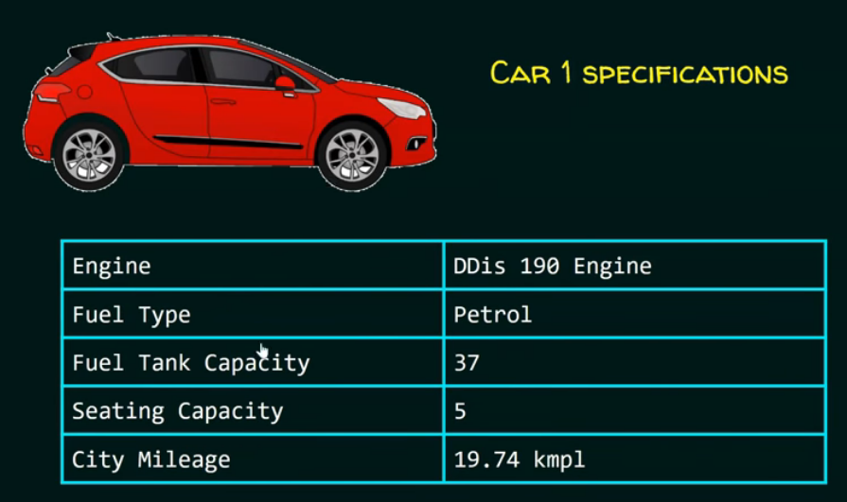

Slide 6
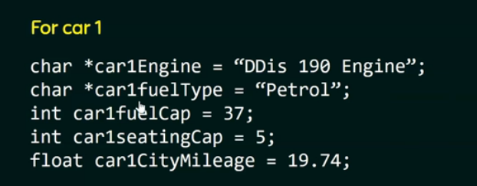

Slide 7


Slide 8
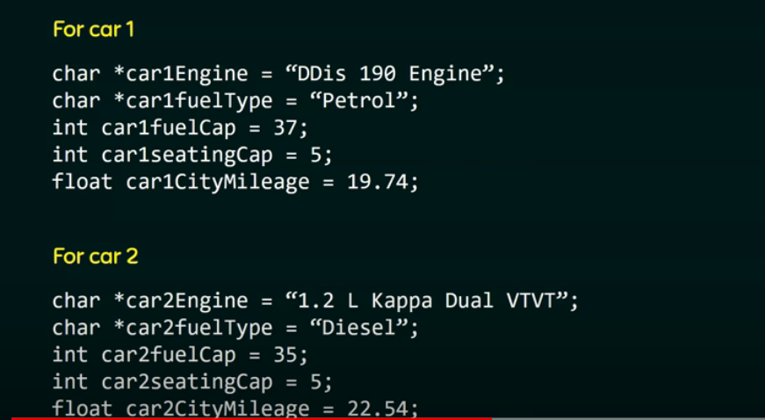
Drawback Time consuming

Slide 9
Introduction
We’ve seen variables of simple data types, such as float, char, and int.
We saw derived data type, arrays to store group of related data.
Variables of such types represent one item of information: a height, an amount, a count, or group of item with same data type: list[10] and so on.
But, these basic types does not support the storage of compound data.
Eg. Student {name, address, age, sem, branch}
Notes:
We have used variables in our C++ program to store value but one variable can store only single piece information (an integer can hold only one integer value) and to store similar type of values we had to declare many variables. To overcome this problem we used array which can hold numbers of similar data type. But array too have some limitations, like in our real world application we deal with set of dissimilar data types and single array cannot store dissimilar data.
For example think about storing book information or product information, a product can have different information to store like product code (an integer), product name (a char array), product price (a float) etc. And to store 20 products information we can declare integer array for product code, 2D character array for storing product name and float array to store product price. This approach definitely achieves your goals, but try to consider these things too. What if you wanted to add more products than 20, what if you want to add more information on products like stock, discount, tax etc? It will become difficult to differentiate these variables with other variables declared for calculation etc.
When you design a program, it is important to choose an optimal way to represent the data that the program processes. In simple cases, scalar variables and arrays are sufficient. However in practical programming context, you need a new form of variable that reflects the real world. For example, in your program, you may want to refer to an address that holds multiple fields including house number, street, zip code, state and country.

Slide 10
Introduction
C provides facility to define one’s own type (user-defined) that may be a composite of basic types (int, char, double, etc) and other user-defined types.
Structures
Notes:
To solve this problem, C++ language has a user defined data type called Structure. C++ structure is nothing but collection of different related data types. We are combine different related data types in one group so that we can use and manage those variables easily. Here related data type means, a structure holding information about book will contains variables and array related to book.
C++ structure allows you to wrap related variables that has different data types into a single variable. A structure can contain any valid data types such as int, char, float, array, pointer or even other structures. Each variable in the structure is called structure member.

Slide 11


Slide 12


Slide 13
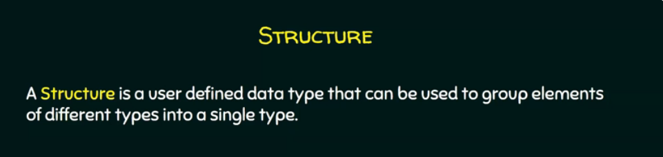
Introduction
Definition:
collection of one or more variables, possibly of different types, grouped together under a single name for convenient handling
A structure type in C is called struct.
Notes:
A structure is a collection of one or more variables, possibly of different types, grouped together under a single name for convenient handling. The variables in a structure can be int, some can be float, and so on. This is unlike the array, in which all the variables must be the same type. The data items in a structure are called the members of the struct
C++ provides facilities to define one’s own types. These may be a composite of basic types (int, double, etc) and other user-defined types. The most common user-defined type is a structure, defined by the keyword struct.

Slide 14
Structures
Structures hold data that belong together.
Examples:
Student record: student id, name, branch, gender, start year, …
Bank account: account number, name, address, balance, …
Address book: name, address, telephone number, …
In database applications, structures are called records.
Notes:
Ideally Structure is collection of different variables under single name.. Basically Structure is for storing the complicated data. A structure is a convenient way of grouping several pieces of related information together.
Structures are user-defined aggregate types.
They assist program organisation by
Grouping logically related data, and giving this set of variables a higher-level name and more abstract representation.
Enabling related variables to be manipulated as a single unit rather than as separate entities.
Reducing the number of parameters that need to be passed between functions.
Providing another means to return multiple values from a function.

Slide 15
Structure versus Array
A struct is heterogeneous, that means it can be composed of data of different types.
In contrast, array is homogeneous since it can contain only data of the same type.

Slide 16
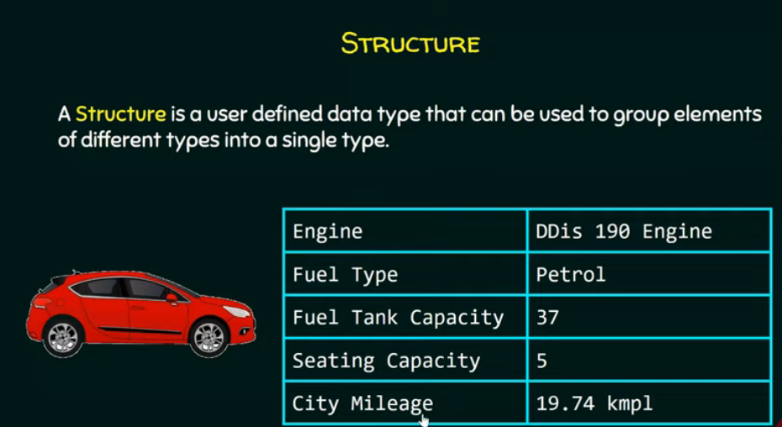

Slide 17
Structure Definition - Syntax
The general format of a structure definition
struct structure_name
{
data_type member1;
data_type member2;
…
};
Notes:
The general format of a structure definition is
struct tag_name
{
Data_type member1;
Data_type member2;
----------------
};
A structure type is usually defined near to the start of a file, allowing its use throughout the program. Here is an example structure definition.
struct student
{
char name[64];
char course[128];
int age;
int year;
};
This defines a new structure type called student using which we can declare variables as any built-in types
student st_rec;
Notice how similar this is to declaring an int or float. The variable name is st_rec, it has members called name, course, age and year. A structure definition begins with struct keyword and with a space we need to provide a structure name. Within open and closed curly braces we can declare required and related variable, you can see it in our example structure declaration. And most important point to remember in case of C++ structure is that it ends with semicolon (;).
Rules for defining structure:
The structure template is terminated with a semicolon.
While the entire declaration is considered as a statement, each member is declared independently for its name and type in a separate statement inside the template.
The tag name such as student can be used to declare structure variables of its type, later in the program.

Slide 18
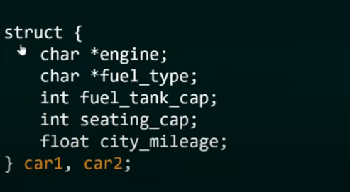

Slide 19
Structure Definition - Examples
Example:
struct Date
{
int day;
int month;
int year;
} ;
Members of the structure Date
Notes:
Some Important Points Regarding Structure in C Programming :
Struct keyword is used to declare and define the structure.
Members of structure are enclosed within opening and closing braces.
Declaration of Structure reserves no space.
It is nothing but the “ Template / Map / Shape ” of the structure .
Memory is created , very first time when the variable is created / Instance is created.

Slide 20
struct examples
Examples:
i) struct StudentInfo{
int Id;
int age;
char Gender;
double CGA;
};
ii) struct Employee{
char Name[15];
char Address[30];
int Age;
float Basic;
float DA;
float NetSalary;
};
The “StudentInfo” structure has 4 members
of different types.
The “Employee” structure has 6 members
Notes:
Here 2 structures have been defined with different types and no. of members. As you can see, by defining a structure, we can group together or collect the data about a particular entity like Employee, Student, Address, Date etc. A structure, thus provides a convenient way for groping together logically related data items under a single name.

Slide 21
Important Points Regarding Structures
Definition of Structure reserves no space.
It is nothing but the “ Template / Map / Shape ” of the structure .
Memory is created, very first time when a variable of structure type is created / Instance is created.
Notes:
Normally, structure definitions appear at the beginning of the program file, before any variables or functions are defined.
They may also appear before main. In such cases, the definition is global and can be used by other functions as well.
When a structure is defined, it creates a user-defined type but, no storage is allocated.

Slide 22
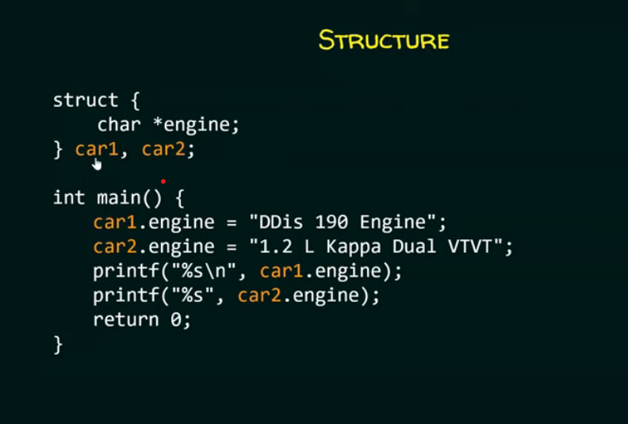

Slide 23
Declaring Structure Variables
Declaration of a variable of struct type using struct tag name, after structure definition:
<struct-type> <identifier_list>;
Example:
StudentInfo Student1, Student2;
Student1 and Student2 are variables of StudentInfo type.
Name
Id Gender
Dept
Name
Id Gender
Dept
Student1
Student2
Notes:
Different Ways of Declaring Structure Variable :
Way 1 : Declare Variables using structure tagname
struct date {
int date;
char month[20];
int year;
};
date today;
where “date” is name of structure and “today” is name of the structure variable.
Way 2 : Immediately after Structure Template
struct date {
int date;
char month[20];
int year;
}today; // 'today' is name of Structure variable
Way 3 : Declaring Multiple Structure Variables
struct Book {
int pages;
char name[20];
int year;
}book1,book2,book3;
We can declare multiple variables separated by comma directly after closing curly.

Slide 24
Declaring Structure Variables
Declare them at the time of structure definition:
struct student
{
int rollno;
int age;
char name[10];
float height;
}s1, s2, s3; /* Defines 3 variables of type student */
Members of a structure themselves are not variables. i.e. rollno alone does not have any value or meaning.
Notes:
We can declare variables of type structure immediately after the closing bracket of structure definition. Each variable must be separated by comma. Usually this method of declaration is used when declaring global variables of structure type. In the above declaration, s1,s2 and s3 are 3 variables of type student.
Note: Members of a structure themselves are not variables.
They do not occupy any memory until they are associated with the structure variables such as s1, s2, s3 etc.

