Slide 1
Group No 16
Tribonacci Matrix Coding
Supervisor : Bibhas Chandra Dhara Sir
Swapnil Ghosh-001911001067
Karan Raj Bagri-001911001036
Chiraj Jaiswal-001911001066
Referred from the research paper ( “TRIBONACCI MATRICES AND A NEW CODING THEORY” ) by MANJUSRI BASU and MONOJIT DAS.

Slide 2
CONTENT
Why Do we need Tribonacci Matrix Coding
Tribonacci Numbers :
Tribonacci Coding, Decoding Matrix
Some Properties of MK matrix
Tribonacci Coding Theory :
Encoding
Decoding
Detection Of Error Using Code Matrix (E)
Error Detection and Correction
Progress So Far :
Single Error Correction Procedure
How Does the likelihood of undetected or miscorrection of this errors change with k
Simulation
In The Future

Slide 3
Why do we need this method?
M
SENDER
RECEIVER
(may receive M’ != M)
Unreliable medium
(may cause corruption of bits in the transmitted message due to attenuation, noise, interference, etc.)

Slide 4
Why do we need this method? (contd.)
To ensure reliable communication over unreliable media, we need to
Be able to detect the corruption when it occurs - Error Detection
Be able to correct the error caused by this corruption, either at the receiver’s end itself (forward error correction) or by asking the sender to send the message again (backward error correction) - Error Correction
The forward corrective ability of the Tribonacci Matrix Coding method is what stands out.

Slide 5
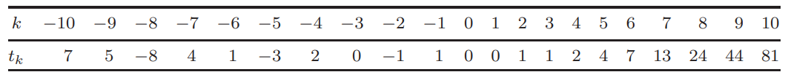
Tribonacci numbers
The Tribonacci numbers t_{k} (k = 0, 1, 2, 3,...) are the generalization of the Fibonacci numbers defined by the recurrence relation

Slide 6
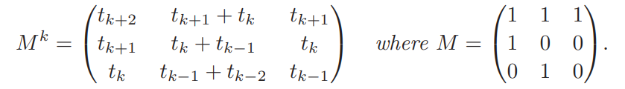
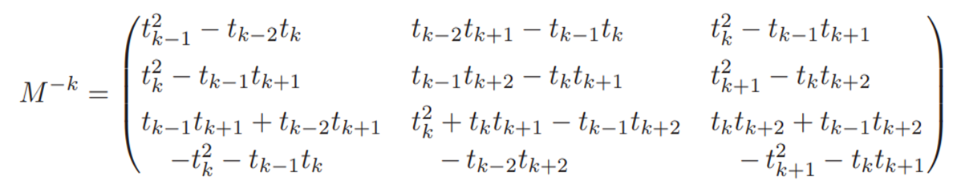
Tribonacci Coding, Decoding Matrix
Tribonacci Matrix / Coding Matrix :
Inverse Of Tribonacci Matrix / Decoding Matrix :

Slide 7
Some Properties of M^{k} Matrix

Slide 8
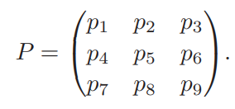
Tribonacci Coding Theory
Message Matrix (P) :
The desired message that we want to send to end-user in the channel.
The message is represented using a matrix of order 3.
All elements of the matrix are non-negative integer.

Slide 9
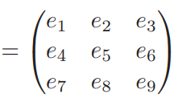

Encoding
This Encoding process is done at sender side.
We are encoding the Message Matrix (P) by multiplying with the Tribonacci Matrix ( M^{K}).
The encoded matrix is called as Code Matrix (E).

Slide 10
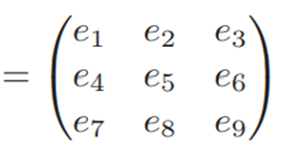
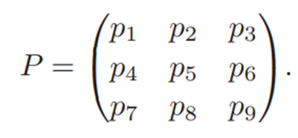


Decoding
This decoding process takes place at receiver side.
We take the Tribonacci Matrix Inverse (M^{-k}) and multiply it with the received Code Matrix (E) .
The decoded matrix is our Message Matrix (P) if and only if there is no error in the transmission channel.

Slide 11

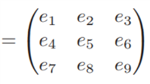

Detection of error in Code Matrix (E)
Sender is sending the Code Matrix (E) and also the Determinant of the Message Matrix (P) .
The sole reason for sending determinant of Message Matrix (P) is so that the receiver can verify that the received message is error free or not.
,

Slide 12
The error is checked using this relation,
This relation means when that the determinant of the Code Matrix (E) received is equals to the determinant of the Message Matrix (P).
When this relation is holds that means our received Code Matrix (E) is error free otherwise error is present in our Code Matrix (E).

Slide 13









Error Detection and Correction
Detection of type of error is important as it helps to recover the Code Matrix (E) and eventually the Message Matrix (P).
The inter-relation among the Code Matrix (E) elements are as follows : -
, , , , ,
, , and

Slide 14
Using the relations mentioned previously we try to correct different folds of error.
We can correct up to 8 folds of error.
We can achieve an accuracy of 99.80 %.
=
0.9980

Slide 15
Progress so far…
Created a class whose object is maintained at each node, which stores M^{k} and M^{-k} [k is constant across all the nodes].
This object encodes/decodes messages, detects and corrects errors.
Done till single error correction.
Receive E, |P|
Check E
Correct E (if reqd.)
P’ = decode(E)
E
E = encode(P)
Send E, |P|
|P|
SENDER
RECEIVER

Slide 16
Single Error Correction Procedure
Find the cofactors for all the positions in the matrix.
Recalculate the value for each position using
|E_{received}| = |P|
If a value is an integer, then it is a possible correction. Store all the possible corrections.
count(possible_corrections) > 0
No
Yes
Find/Accept the correction which best approximates the checking relations.
Minimize |c1/c3 - 𝝰| + |c2/c3 - (𝝰+1)/𝝰| + |c1/c2 - (𝝰²/𝝰+1)|
Try double error correction.

Slide 17
Two Challenges with this procedure:
Undetected errors:
What if E_{received} != E but |E| == |E_{received}| ?
For example,
E =
Here, |E| = |E_{received}| = 421104
E_{received}=
376 345 214
426 284 215
528 352 256
376 345 778
426 284 215
528 352 256

Slide 18
Two Challenges with this procedure (contd.):
2) Mis-Corrected Error:
We need to find the best correction out of a number of possible corrections?
How do we measure this?
Currently,
Minimize |c1/c3 - 𝝰| + |c2/c3 - (𝝰+1)/𝝰| + |c1/c2 - (𝝰²/𝝰+1)|
[ci = value at column i of the row where the correction is made]

Slide 19
Two Challenges with this procedure (contd.):
For example,
E = E_{received}=
Three possible corrections: [(1, 0, 214), (2, 0, 59095), (2, 1, 576)]
E_{corrected}=
471 300 203
471 300 203
386 186 126
386 186 126
701 576 350
701 447 350
Selected
Should have been selected
471 300 203
214 186 126
701 447 350

Slide 20
How does the likelihood of undetection or miscorrection of these errors change with k?
Let's run a simulation to find out.
For k in 2..9:
Repeat 1,000,000 times:
Generate a random message matrix with each number being 8-bits long.
Encode it.
Induce 1 random error in the encoded matrix.
Receive the corrupted encoded matrix.
Detect the error and correct it.
If msg matrix != decoded matrix, classify the problem that took place (whether undetected or miscorrected). Maintain a count of the errors.

Slide 21
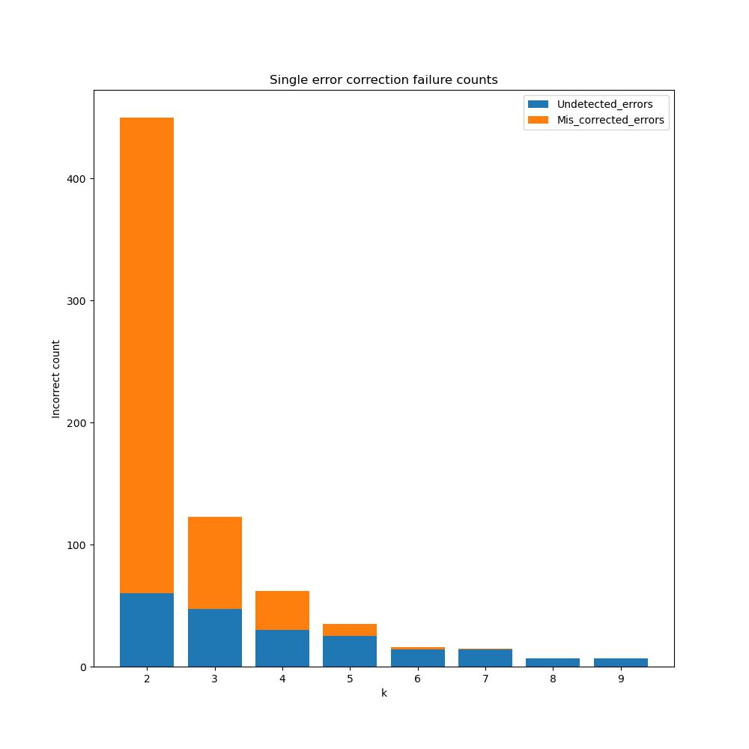
Simulation results

Slide 22
Simulation - Inference
Exponential decrease in the number of erroneous situations with increase in k.
Why?
k increases => magnitude of elements in Mk increase => mag. of elements in E increase => number space increases => possibility of getting specific numbers (that cause undetected errors) decreases and the “checking relations” hold true to a greater extent.
But can’t increase k too much – too many extra bits.

Slide 23
IN THE FUTURE…
Implement upto 8-fold error correction.
Achieve 100% error detection and 100% error correction accuracy for 1-8 fold error correction.
Explore the real-life application scenarios for this coding-decoding method.

Slide 24
THANK YOU

