Slide 1

Problem Statement Title : Ear Electronic Device for Tinnitus Frequency Finding and Adjusting to Provide Relief to Tinnitus Suffering Patient Team Name: AlphaTech Team Leader Name:Karankumar Nevage Institute Name : MGM'S Jawaharlal Nehru Engineering College
Theme : Medical

Slide 2
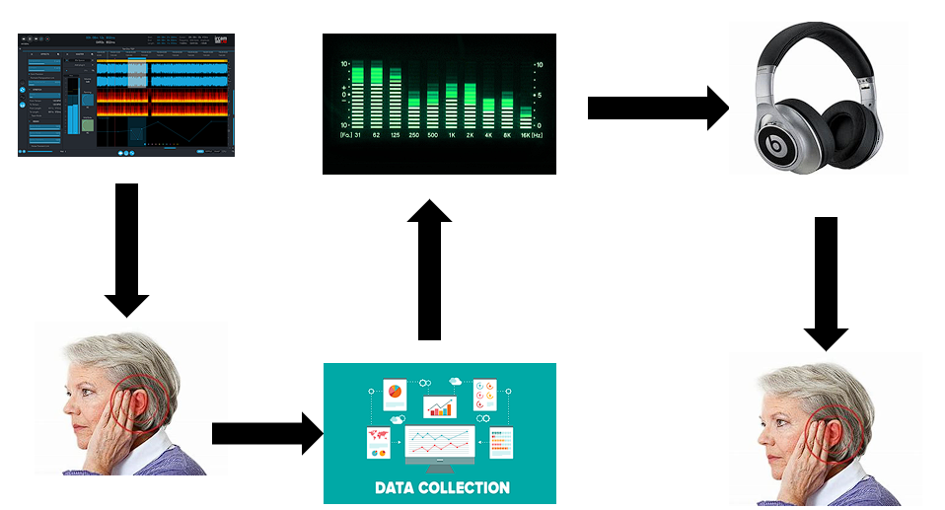
Idea/Approach Details
Different audio frequency
Suppressing the affecting tinnitus frequency
Suppressed audio
Our idea :
Tinnitus Frequency Finding(Approach hit and trial)
Tinnitus can occur at almost any frequency.
Set the frequency of the tone to match patients tinnitus frequency.
Note the actual value of identified tinnitus frequency.
Adjusting the tinnitus frequency
1. Notch Filter Design : Specific frequency to be suppressed, the bandwidth of the notch, and the required level of suppression.
2. Filter Implementation : Once the filter is designed, it can be implemented using various electronic components such as RLC,LPF,HPF. For each patient suppress filter is developed according to frequency detected. The exact implementation will depend on the design of the filter.
Patient
Gathering Data
Patient with relief
Technology stack :
Identifying Frequency
Software Synthesizers / Tone Generators Creating a library of various tinnitus sounds
Database for different sounds and tones
Application for the matching frequency with patient
Circuit designer
Matlab / scilab

Slide 3

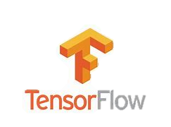
Introducing Google Tech
Google Cloud Machine Learning Engine: Utilize this to create machine learning models to identify and match the tinnitus frequency of patients effectively.
Google Cloud Storage: Store the library of various tinnitus sounds and tones securely and access them efficiently.
Google’s TensorFlow: Implement this open-source software library for dataflow and differentiable programming across a range of tasks, helpful in filter design and implementation.
Google Data Studio: Use this for visualizing the data and analytics, making it easier to analyze the effectiveness of different frequencies on tinnitus.

Slide 4
Idea/Approach Details
Use Cases
Dependencies
Generate Different tinnitus frequency
Tones Library
Audio and tone generator
System Design
Volunteer for testing
Regulatory Approvals
Clinical Validation
Electronic Hardware
High power’s power source for large time
User friendly Software
Provide the sound to patient
Rectify the Sound frequencies
Design a system for canceling those frequencies
Place the new tinnitus sound filter system in the ear of patient
Provide audio to user after the suppressing

