Slide 1
To Predict if a student would go to college.
Karan Punjabi
ITE 5201 Humber College

Slide 2
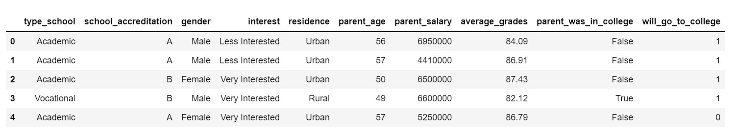
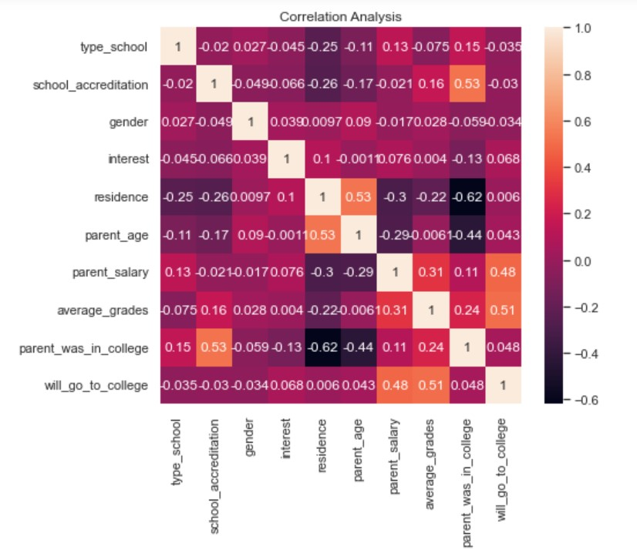
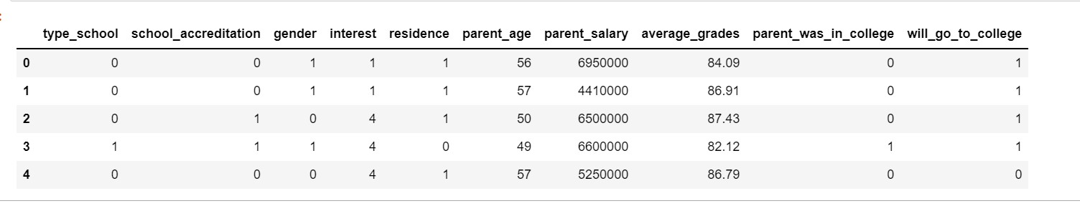
Problem Statement and Dataset Discussion
Problem Statement: To predict if a student would attend college or not based upon various features like Interest, Average Grades, Residence, and Parent was in college.
DataSet:

Slide 3
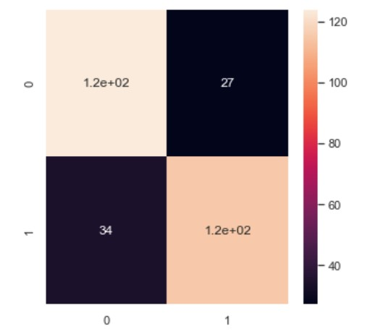
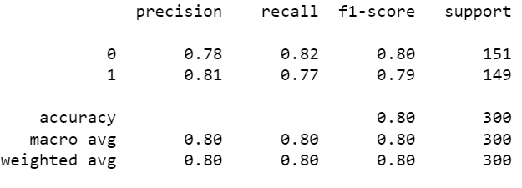
Proposed Analytical/Predictive Model
Predictive Model
Logistic Regression Model:
    Confusion Matrix: Classification Report:

Slide 4
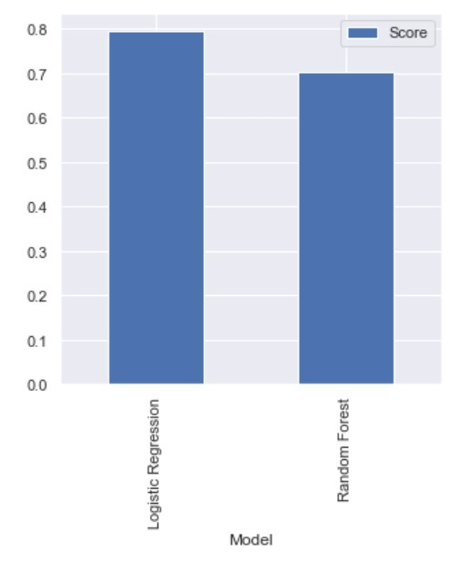
Results and Discussion
Results: So, the accuracy of Logistic Regression, to predict if a student would attend college or not is 80% while on the other hand, accuracy of Random Forest Classifier is 70%.
Comparing both the models: So, it can be said
that accuracy to predict, if a student would attend
College or not, of Logistic Regression model is more
when compared to Random Forest Classifier.

