Slide 1
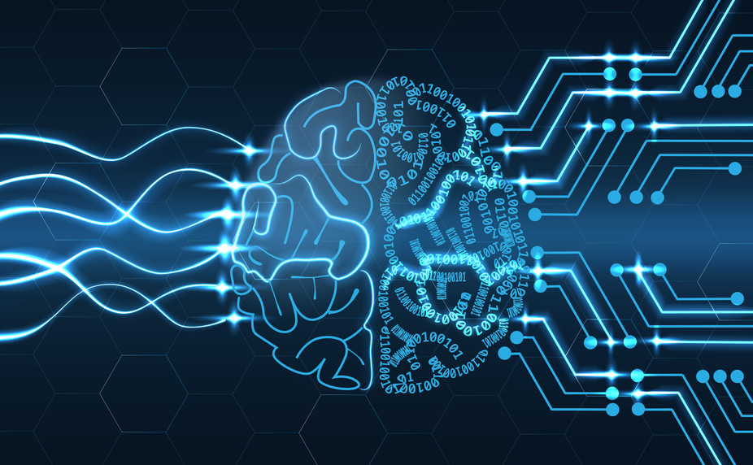
Artificial Intelligence End Semester Project: Detect and Analyze physical wounds using ML
Group Members:
Muhammad Kumail (242308)
Hurarah Bashir (193415)
Masab bin Nasir (216886)

Slide 2
Introduction
Artificial intelligence is a fast grown technique to tackle modern problems
In which Medical industry is using immersive knowledge of
Especially Convolutional Neural Networks (CNN’s)
This lead, us to combine the medical and images processing techniques to devise a potential solution is diagnosing categories in the realm of pigmented lesions.

Slide 3
Wound Analysis
ISIC 2018 Competition
The HAM10000 dataset, a large collection of multi-source dermatoscopic images of common pigmented skin lesions
Objective: Identify classification of skin cancer from wounds on a human skin

Slide 4
Dataset
We used a dataset of potentially skin cancerous pateints having lesions and pigments on their skins based on following parameters:
Age of the patient
Initial suggestion
Gender
Localization (which part of the body it was found):
Eg: Scalp, ear, face, back, truck, chest, genital, or unknown at some places.

Slide 5
Data Augmentation
Reshaping
Normalization
Horizontal Flipping
Random Affine

Slide 6
Train/Test Split
Train: 72%
Test: 28%
Total images: 10000 approx

Slide 7
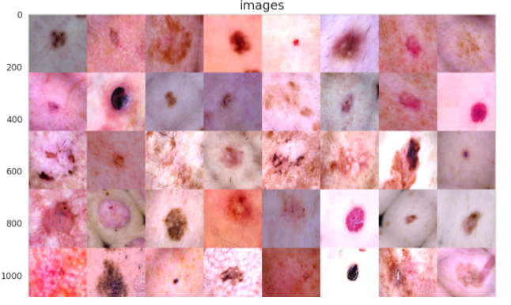
Training batch

Slide 8
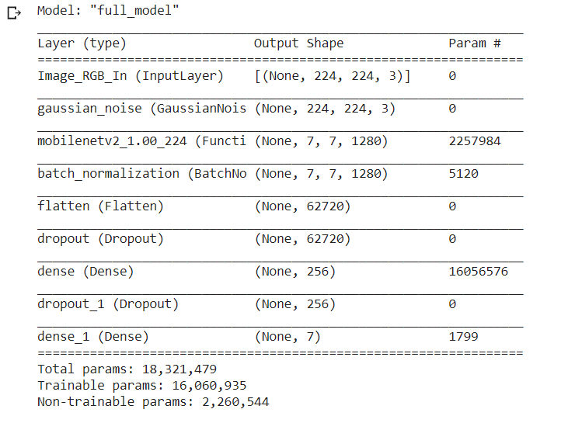
Architecture

Slide 9
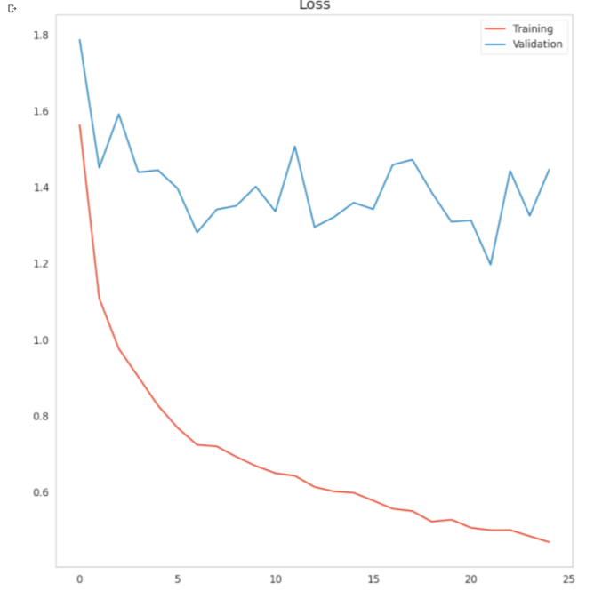
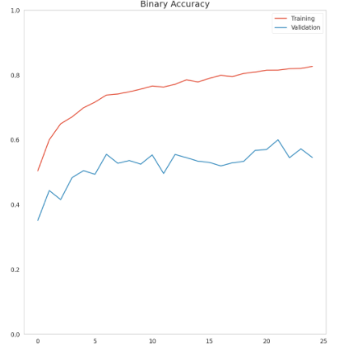
Training Progress

Slide 10
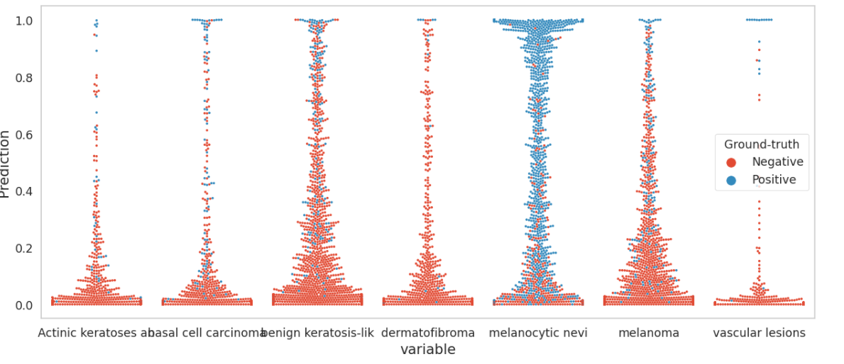
Test accuracy

Slide 11
Challenges
Overfitting
Small dataset
Class Imbalance

Slide 12
Thank you!

