Slide 1

Capstone Project | Fraud Detection
A machine learning approach to detecting fraudulent transactions
by Karan Parmar
KP

Slide 2
Objective: Build a model to detect fraudulent transactions
Challenge: High recall is crucial to minimize false negatives. Missing fraudulent transactions can have severe consequences.
Impact: Effective fraud prevention saves financial institutions from significant financial losses and protects customers.

Slide 3
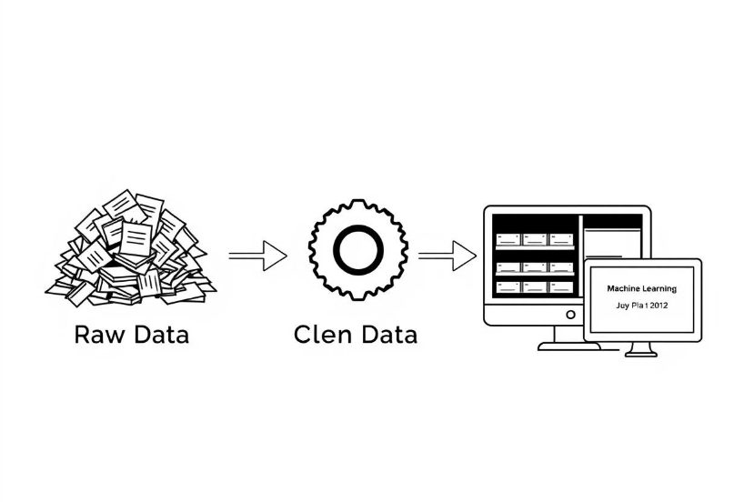
Data Collection and Preprocessing
Exploratory Data Analysis (EDA)
Preprocessing (Handling missing values, encoding, transformations)
The dataset is described in detail. Techniques handle missing data, outliers, and class imbalances. Feature engineering enhances model performance. These preprocessing steps are crucial for optimal performance.

Slide 4
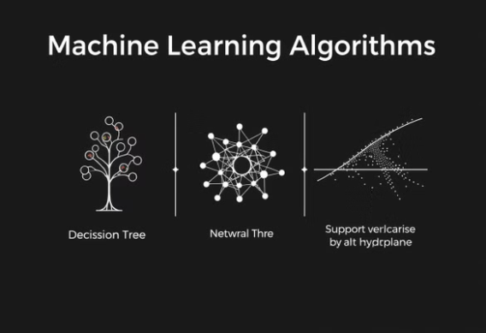
Model Selection and Implementation
We considered various algorithms. The final model architecture was chosen carefully. Implementation details are described using Python and scikit-learn.

Slide 5
Model Optimization
Define Parameters
Evaluate Models
Identify the key parameters to tune, such as regularization strength and number of trees.
Train multiple models with different parameter combinations and evaluate their performance.
1
2
3
Set Ranges
Specify the range of values to test for each parameter.
Model optimization is an important step to improve the effectiveness of your fraud detection system. By systematically testing different configurations, you can find the optimal settings to enhance the model's performance.

Slide 6
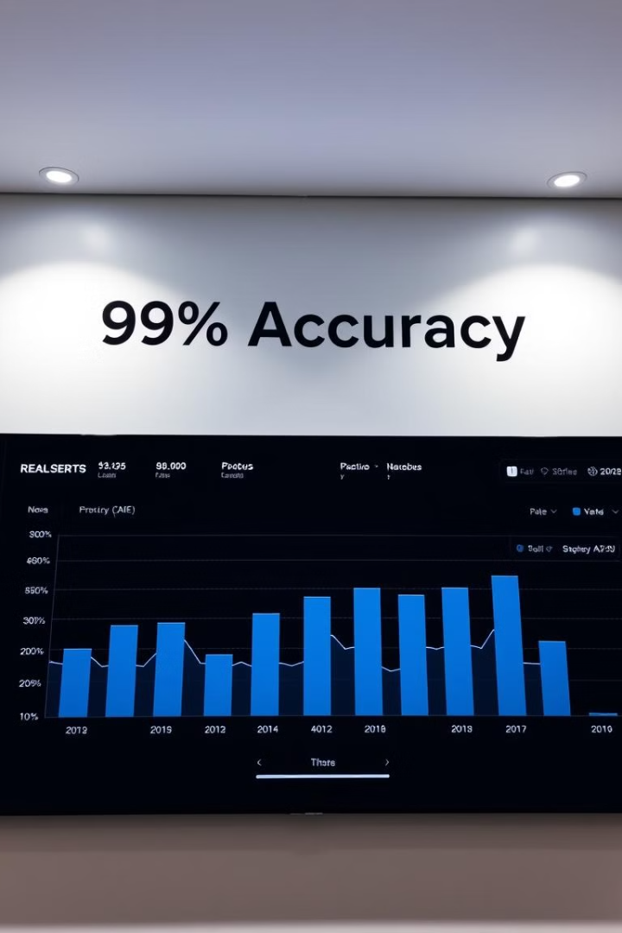
Results and Performance Analysis
The model achieved over 99% accuracy. Detailed results include precision, recall, and F1-score. Performance is consistently high.

Slide 7
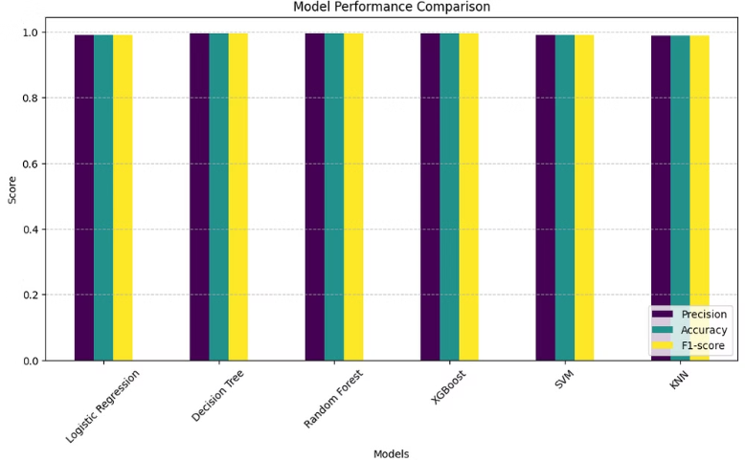
Evaluation Metrics
Precision
Precision identifies correctly predicted fraud cases. Minimizes false positives.
Discussion of metrics beyond accuracy. These include precision, recall, F1-score, and the AUC-ROC curve. Each metric is important for fraud detection.

Slide 8
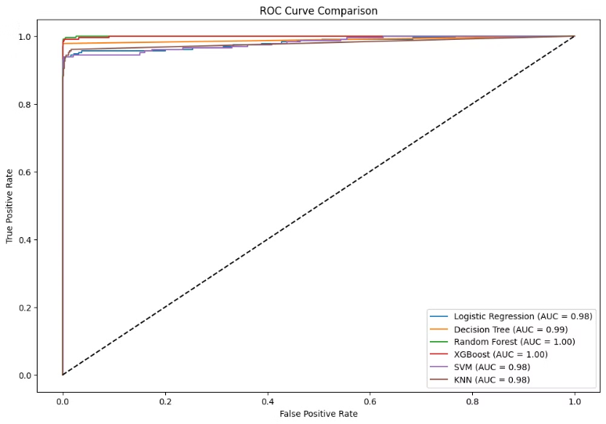
ROC - AUC Comparison
This ROC curve comparison demonstrates the performance of different fraud detection models. Noticeably, Random Forest and XGBoost achieve outstanding Area Under the Curve (AUC) scores of 1.00, indicating perfect discrimination between fraudulent and non-fraudulent transactions. The Decision Tree model follows closely with an AUC score of 0.99, while the remaining models perform strongly at 0.98, showcasing good discriminatory power.

Slide 9

CONCLUSION
In conclusion, the fraud detection models achieved outstanding accuracy levels, exceeding 99% across all algorithms. This result demonstrates the models' effectiveness in identifying fraudulent transactions with high reliability and minimal errors.

Slide 10
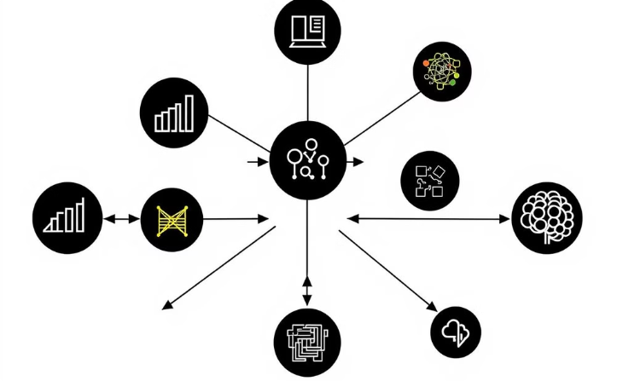
Potential Improvements and Future Work
Enhanced Techniques
Explore advanced techniques to improve model precision.
We can further improve the model's performance. Exploring more advanced machine learning techniques. Incorporate real-time data and feedback loops.

