Slide 1

DEPARTMENT OF INFORMATION TECHNOLOGY
Padmashri Annasaheb Jadhav Bhartiya Samaj Unnati Mandal’s
B.N.N. COLLEGE
(Arts, Science, Commerce & Self-Funded Course)
(Affiliated to University of Mumbai)
BHIWANDI, MAHARASHTRA-421302
2023-2024

Slide 2
SentimentScout: Web App For Sentiment Analysis
Presented By: Mr. Karan Mehta
Developed For: Bsc IT Semester 5 & 6 Project
Seat No: 1071457
Guide: Prof. Sravanti Gajjelli
PRN No:2021016400296187

Slide 3
Abstract
In a world where user-generated content are abundant on platform like YouTube, it's important to tap into the pulse of public sentiment and opinions. Enter "SentimentScout," our user-friendly web application that empowers you to uncover valuable insights from video comments.

Slide 4
With "SentimentScout," getting started is a breeze. Simply log in, or register if you are new. For YouTube, just paste the video URL. Behind the scenes, our application harnesses advanced APIs to gather comments, and then applies sentiment analysis to reveal the emotional tone and viewpoints within the text.

Slide 5
The results of sentiment analysis are presented in visual formats, including sentiment pie charts, sentiment over time trends, bar charts highlighting the top keywords, that provide comprehensive insights into the sentiments expressed in the content. "SentimentScout" not only simplifies the process but also securely stores your data and search history in a cloud-based MySQL database, enhancing your overall experience..

Slide 6
Technology used:
Frontend : HTML, CSS and JavaScript
These fundamental web technologies are used for creating the frontend of "SentimentScout" because they provide the building blocks for structuring web pages, styling them, and adding interactive features.
Backend :Python Flask (Web Framework)
Flask was chosen for the backend because of its simplicity and flexibility. It provides essential tools for building web applications, making it well-suited for this project.
MySQL (Database):
MySQL is employed as the database system to securely store user profiles and search history.

Slide 7
Amazon API and YouTube API:
These external APIs are integrated to fetch product reviews and video comments.
NLTK (Natural Language Toolkit) or spaCy:
These NLP libraries are used for sentiment analysis. They offer pre-trained models and tools for text analysis, simplifying the process of categorizing sentiments within textual data.
Data Visualization: Matplotlib and Seaborn
These Python libraries are employed to create visualizations such as pie charts, histograms, bar charts, and stacked bar charts.

Slide 8
Development Environment:
Replit a web based IDE and Visual Studio Code is chosen for coding, debugging, and project management, as it provides a convenient development environment for Python-based projects.

Slide 9
Implementation Approaches:
Methodology:
The development of the project followed an agile methodology, with a focus on iterative development and continuous feedback. However, the project was primarily driven by individual effort, without strict adherence to formal Scrum practices.

Slide 10
The project was implemented using Python with the Flask web framework. The primary focus was on creating a web application for sentiment analysis of YouTube comments. For data storage, the project utilized an AWS RDS free MySQL database. This choice was made to ensure data integrity and security while also considering the cost-effectiveness of the solution. The database I connected and manipulated using MySQL Workbench.

Slide 11
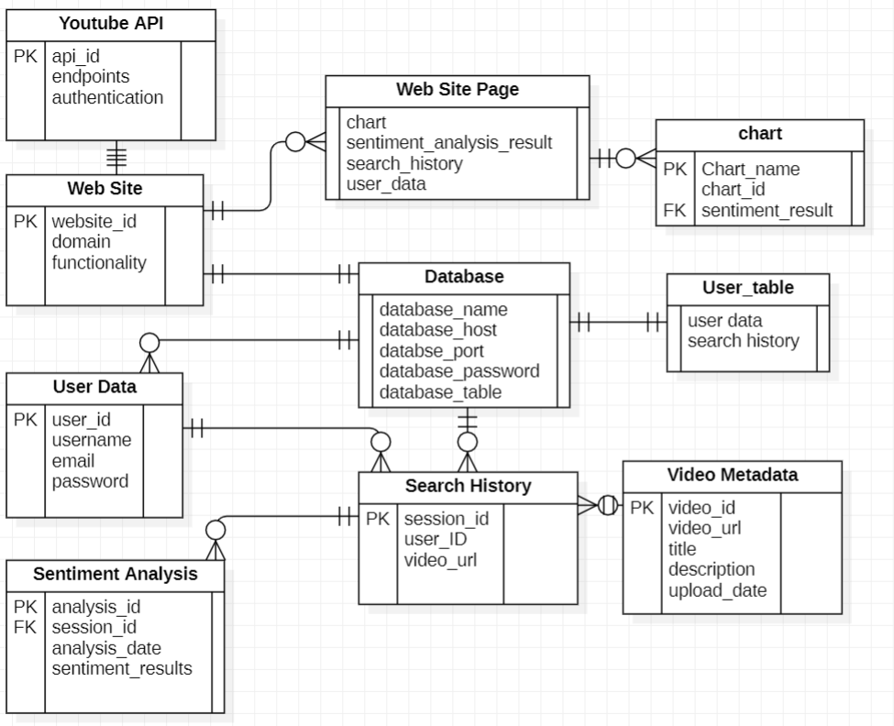
ER Diagram:

Slide 12
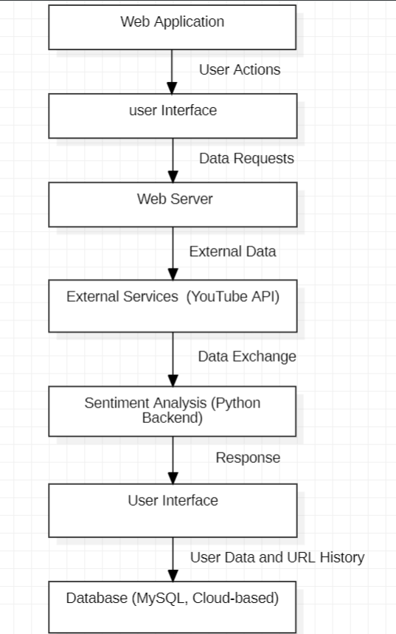
Data Flow Diagram:

Slide 13
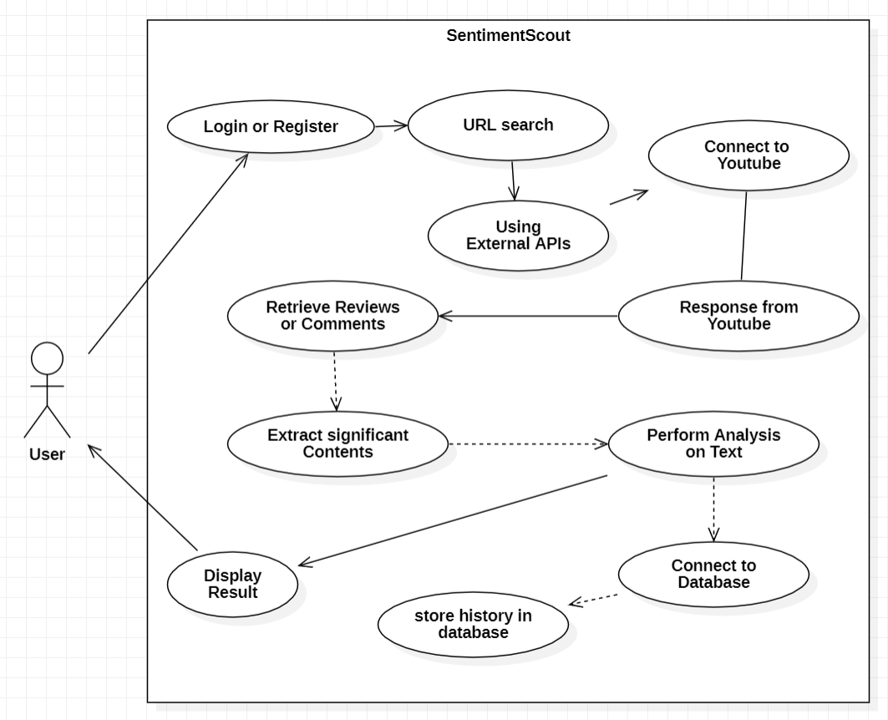
Use Case Diagram:

Slide 14
Sentiment Analysis:
Sentiment analysis is performed using the NLTK library, specifically the VADER (Valence Aware Dictionary and sEntiment Reasoner) sentiment analysis tool. Here's a breakdown of the process:
NLTK Setup: The NLTK library is used for natural language processing tasks. It provides various tools and resources for text analysis, including sentiment analysis.
VADER SentimentIntensityAnalyzer: This class from NLTK's nltk.sentiment.vader module is used to perform sentiment analysis. It provides a polarity_scores method that returns the sentiment scores for a given text.
Text Preprocessing: Before performing sentiment analysis, the comments are preprocessed to remove emojis, stopwords, and special characters. This preprocessing helps improve the accuracy of the sentiment analysis.

Slide 15
Sentiment Analysis: The get_sentiment function takes a text as input and returns the sentiment of the text (positive, negative, or neutral) based on the sentiment scores calculated by the SentimentIntensityAnalyzer.
Sentiment Distribution: The get_sentiment_distribution function calculates the distribution of sentiments (positive, negative, neutral) in the comments. It counts the number of comments with each sentiment and stores the counts in a dictionary.

Slide 16
Conclusion
In conclusion, the development of Sentiment Scout has been a fulfilling and educational journey.
Throughout the development process, several key components were implemented, including user authentication, YouTube API integration, sentiment analysis using natural language processing techniques, and data visualization of sentiment distribution. The use of Flask, NLTK, scikit-learn, and other libraries facilitated the creation of a robust and efficient application.

Slide 17
Future Scope of the Project
Enhanced Sentiment Analysis: Integrating more advanced sentiment analysis techniques, such as deep learning models, could improve the accuracy of sentiment detection, especially for complex or nuanced comments.
Real-time Comment Analysis: Implementing real-time comment analysis would allow users to view sentiment analysis results as comments are posted, providing more timely insights.
Integration with Other Platforms: Expanding the tool to work with comments from other platforms, such as Twitter or Facebook, would increase its usefulness and applicability beyond YouTube.

Slide 18
Advanced Data Visualization: While basic data visualization features were implemented, more advanced visualization options, such as interactive charts or graphs, were not explored fully.
Improved User Interface: Enhancing the user interface with more interactive features, better visualizations, and improved usability could make the tool more intuitive and engaging for users.

Slide 19
Thank You

