Slide 1


Customer Segmentation using RFM Clustering
Karandeep Singh
Nishtha Shandilya

Slide 2

Contents
Project Overview
Exploratory Data Analysis (EDA)
Key Performance Indicators (KPIs)
Modelling
Summary

Slide 3
Coming up next
Project Overview
Exploratory Data Analysis (EDA)
Key Performance Indicators (KPIs)
Modelling
Summary

Slide 4
Project Overview
Objective
Build an unsupervised learning model which can enable your company to analyze their customers via RFM (Recency, Frequency and Monetary value) approach.
Dataset
Data related to the e-Commerce transactions. This data contains the date-time of sale, customer shipping location, and price of single unit from 2016 to 2017.
Outcome
Create an unsupervised model that generates the optimum number of segments for the customer base
Success Criteria
Segments generated can be interpreted and transposed into business actions

Slide 5

What is RFM Analysis?
Recency - Given a current or specific date in the past, when was the last time that the customer made a transaction
Frequency - Given a specific time window, how many transactions did the customer do during that window
Monetary Value or Revenue - Given a specific window, how much did the customer spend

Slide 6
Coming up next
Project Overview
Exploratory Data Analysis (EDA)
Key Performance Indicators (KPIs)
Modelling
Summary

Slide 7
Exploratory Data Analysis
Data Overview
Data Engineering
Data Processing

Slide 8
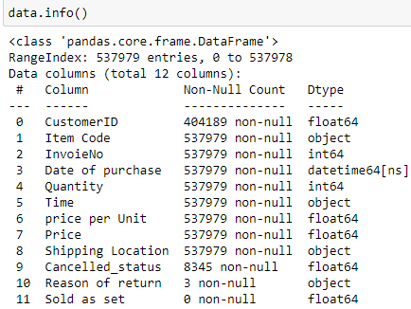
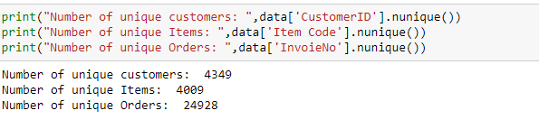
Data Overview
11 key features
CustomerID ~ 4349
Orders (InvoiceNo) ~ 24928
Items(Item Code) ~ 4009
Date of purchase
Min – 02nd Dec, 2016
Max – 19th Dec, 2017

Slide 9
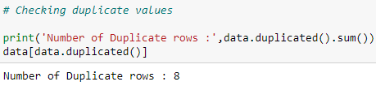
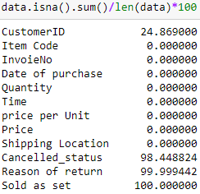
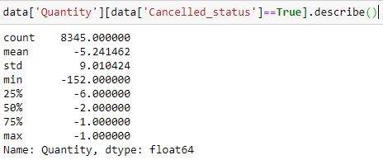
Data Overview
Duplicated Entries
Overall ~ 8
[‘InvoiceNo’,’Item Code’] ~ 10148
Missing Values
CustomerID ~ 24.86%
Cancelled_status ~ 98.44%
Reason of Return ~ 99.99%
Sold as set ~ 100.00%
Where ever the order is cancelled (i.e. True), we have a negative quantity.

Slide 10
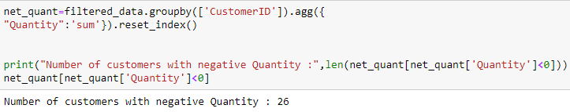
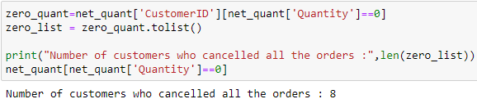
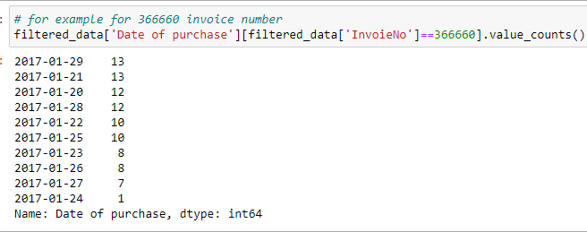
Data Overview
Customers with overall negative quantity (ordered less, cancelled more)
26
Customers with Zero Quantity (Returned whatever they ordered)
8
ISSUE – For some orders, Same Invoice is used for multiple dates, which is also not possible. 10 dates taken(with one original date of order)
Solution - we will take min or max of the dates given for each Invoice after grouping by InvoiceNo.

Slide 11
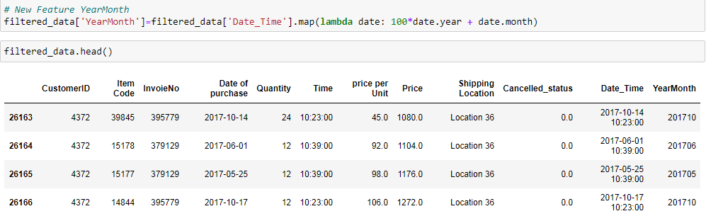
Feature Engineering
Datetime
YearMonth

Slide 12
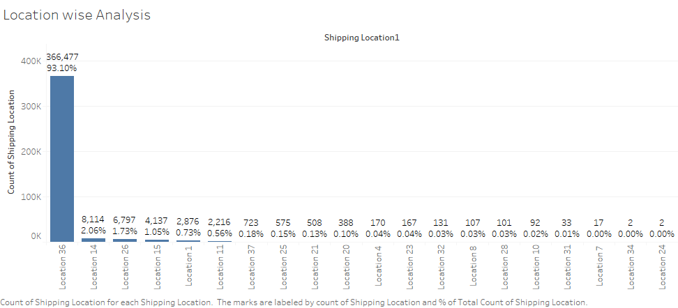
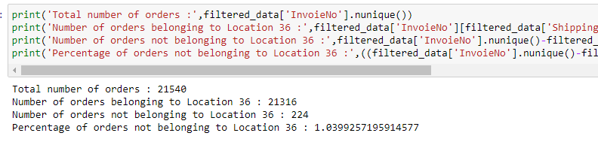
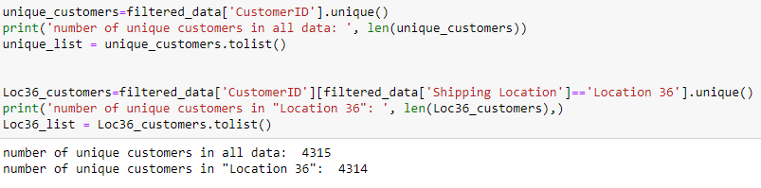
Pre-processing & Analysis
Location Wise Analysis
93.1% Data belonged to just 1 shipping location ~ “Location 36”
Around 99% of orders(unique Invoice Numbers) are covered under "Location 36“ (21316 of 21540)
Only one customers is not shipping at Location 36

Slide 13
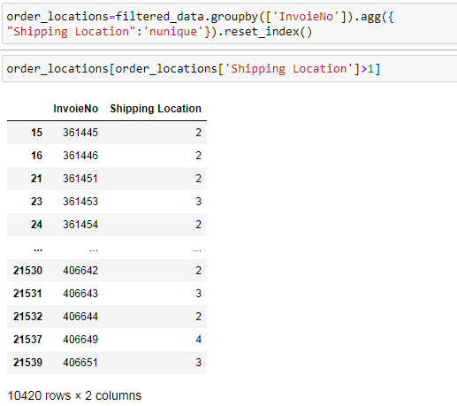
Pre-processing & Analysis
Location Wise Analysis
Also there were orders that had more than 1 shipping location
We decided to keep “location 36” for such orders as the max orders belonged to this location
Further analysis only includes data belonging to the “location 36”

Slide 14
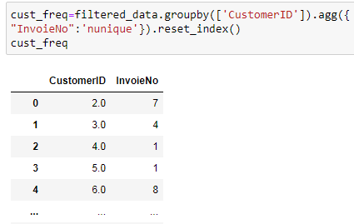
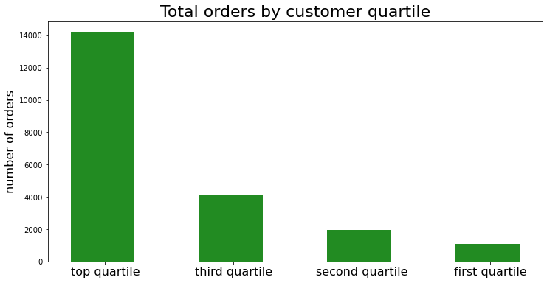
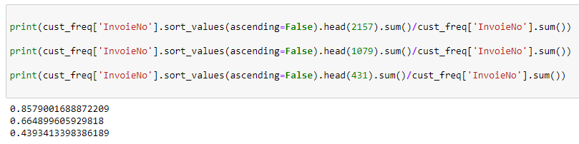
Pre-processing & Analysis
Orders by Customer Quartile
The top half of customers places 85.7% of the total orders.
The top 25% of customers contribute 66.4% of the total orders.
The top decile of customers contribute 43.93% of the total orders.

Slide 15
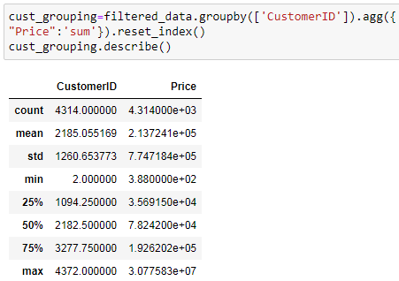
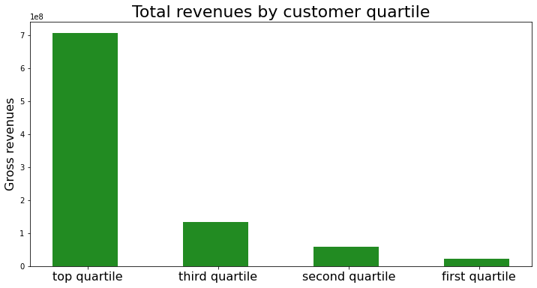
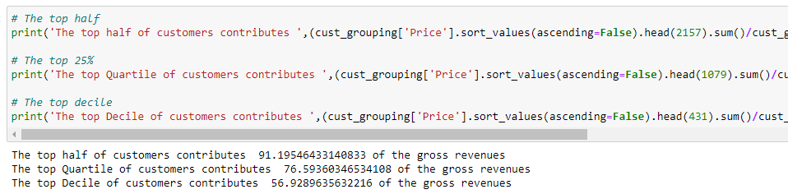
Pre-processing & Analysis
Revenue by Customer Quartile
The top half of customers contribute 91.2% of the gross revenues
The top 25% of customers contribute 76.6% of the gross revenues
The top decile of customers contribute 56.9% of the gross revenues

Slide 16
Coming up next
Project Overview
Exploratory Data Analysis (EDA)
Key Performance Indicators (KPIs)
Modelling
Summary

Slide 17
Key Performance Indicators
Transactional KPIs
Customer KPIs
Product KPIs

Slide 18
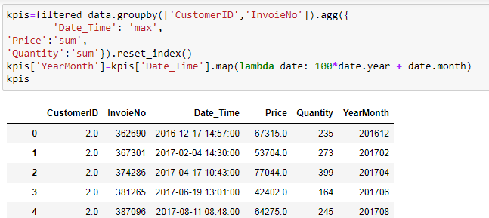
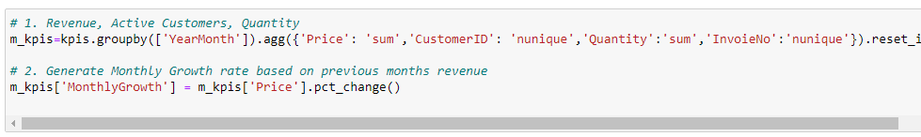
Transactional KPIs
10 Dates issue - solved by considering the most recent transaction among the 10 dates as the original date of order.
To analyze monthly trends of Revenue and Orders placed, data is grouped on “Yearmonth” column and sum of Price and nunique of InvoiceNo is taken.
Monthly growth of Revenue is also calculated

Slide 19
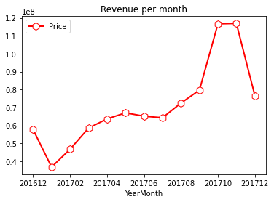
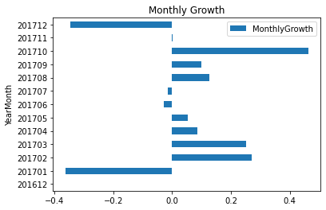
Transactional KPIs
Revenue per month ~ Constant Increase with small dip in January and sudden Spike from September.
Q4(Oct –Dec) is most benefitting
Revenue growth ~ For most months Positive Growth Rates have been observed, with big decline in January.
Note ~ For December 2017, data is available only till 20th. Which might be the reason for declining trends observed in December 2017.

Slide 20
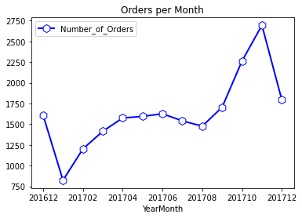
Transactional KPIs
Number of orders per month ~ Same Pattern as observed while analysing revenues.

Slide 21
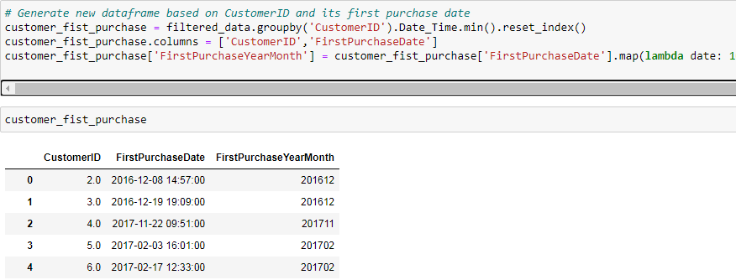
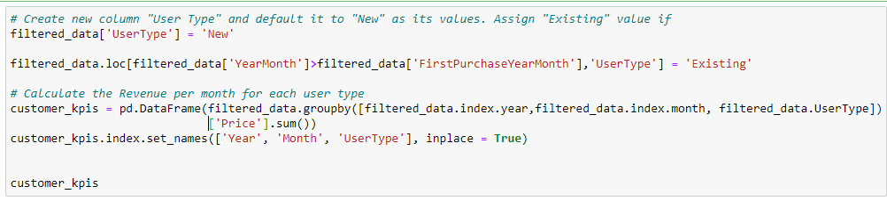
customer KPIs
New vs Existing Customers
Firstly, for each customer, first date of purchase was derived.
If the month of current order is greater than the month of first purchase, the customer is “existing”, else the customer is “new”

Slide 22
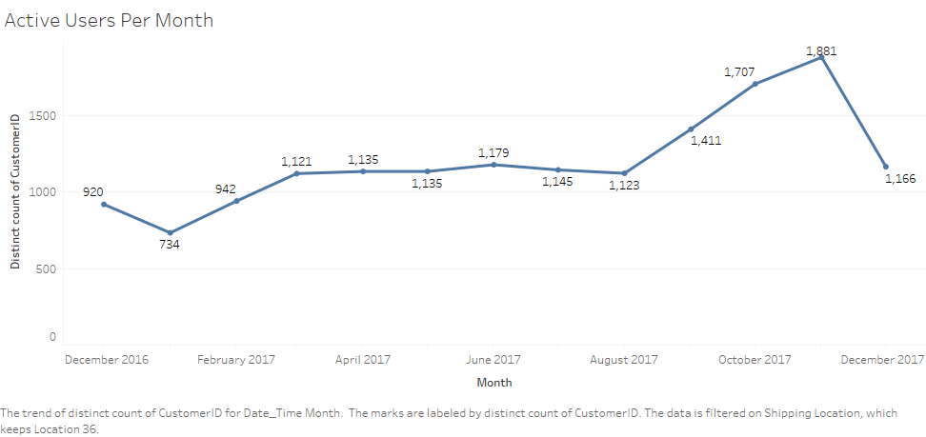
customer KPIs
Active Customers ~ Active customer base is growing with a sharp spike from September (Dec 2017 doesn’t have complete data).

Slide 23
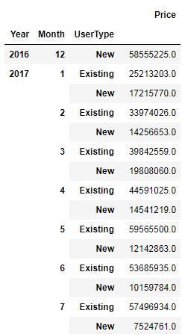
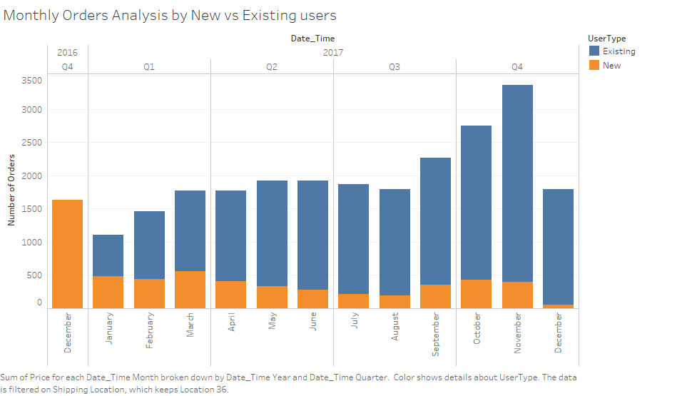
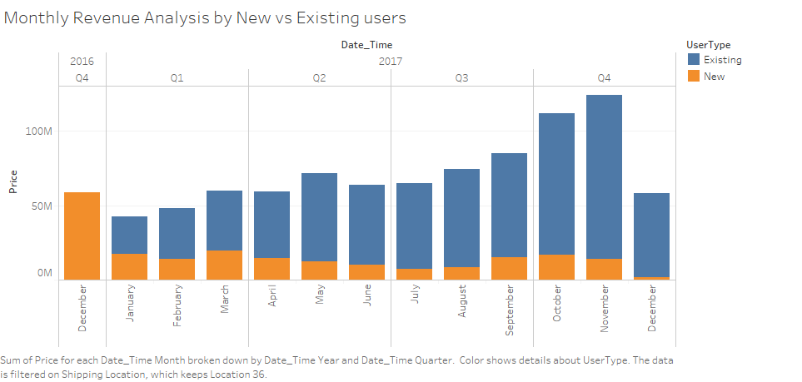
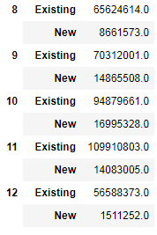
Customer KPIs
New vs Existing Customers
A healthy increase in number of orders by the existing customer base.
Revenue growing with time, backed by existing customers base

Slide 24
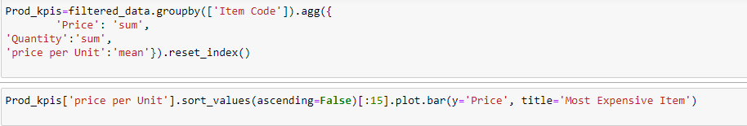
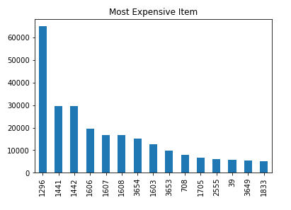
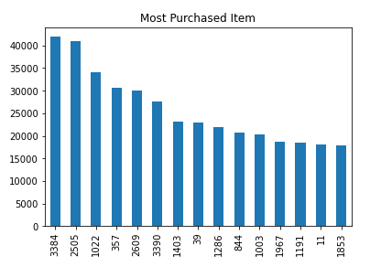
Product KPIs
Most Valuable Product
Most Purchased Item

Slide 25
Coming up next
Project Overview
Exploratory Data Analysis (EDA)
Key Performance Indicators (KPIs)
Modelling
Summary

Slide 26
Modelling & Evaluation
K-Means Clustering
RFM Analysis
Segments Mapping & Business Actions

Slide 27
Recalling RFM Analysis
Recency - Given a current or specific date in the past, when was the last time that the customer made a transaction
Frequency - Given a specific time window, how many transactions did the customer do during that window
Monetary Value or Revenue - Given a specific window, how much did the customer spend

Slide 28
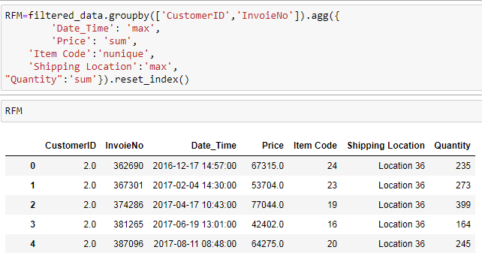
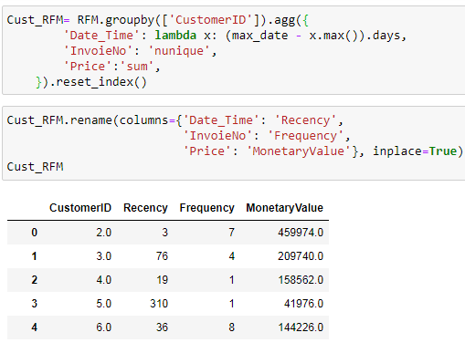
RFM Analysis
Recency ~ max date in data – max date for customer
Frequency ~ Unique count of orders (InvoiceNo) placed by the customer
Monetary Value ~ Sum of Revenue (Price) generated by each customer
For frequency and monetary, the higher the values the better the ranking, unlike recency

Slide 29
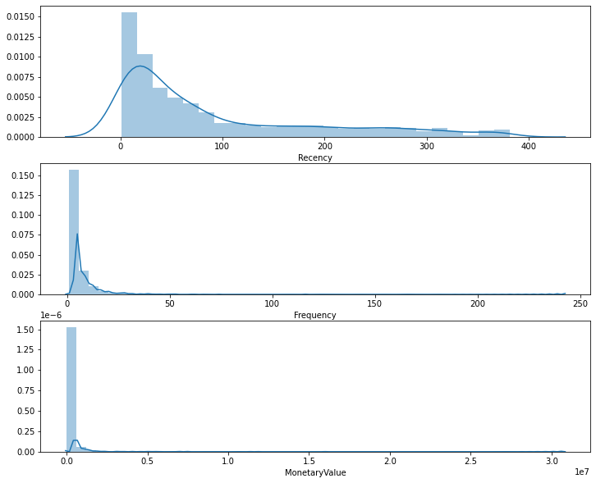
RFM Analysis
Histograms
Recency
Frequency
Revenue

Slide 30
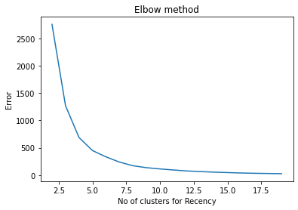
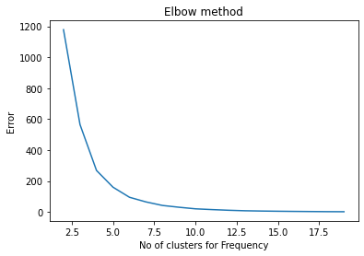
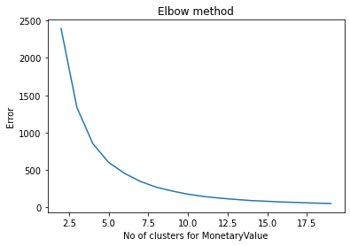
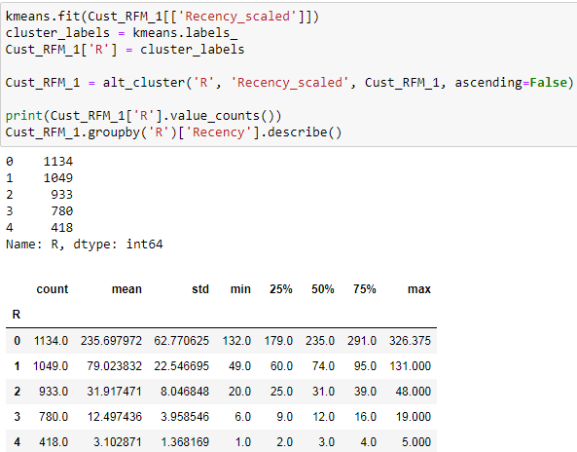
K-Means Clustering method ~ I
Creating separate clusters for each of three (Recency, Frequency, Monetary)
We create a 5 labels(clusters), where 4 is the “best” and 0 the “worst”
Sum our scores(labels) to a single number and define RFM levels for each score range.
Optimal K=5 or 6 By Elbow Method

Slide 31
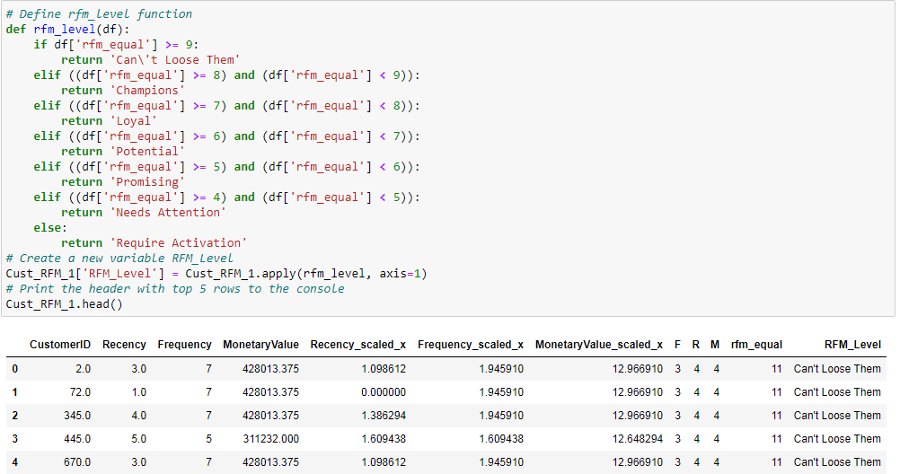
K-Means Clustering method ~ I
Composite equal-weighted RFM score

Slide 32
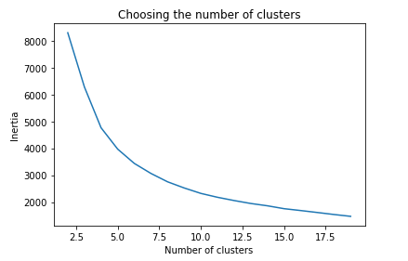


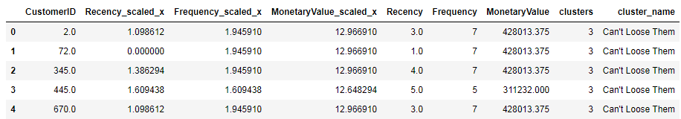
K-Means Clustering Method ~ II
Creating combined clusters for (Recency, Frequency, Monetary)
Cluster labels lie between 0-6 (7 n_clusters), but the numbers here do not give any rank.
Only after studying the mean of each group, we named our clusters accordingly
Optimal K=6-8 By Elbow Method

Slide 33
Segments Mapping
Which method to Chose??

Slide 34
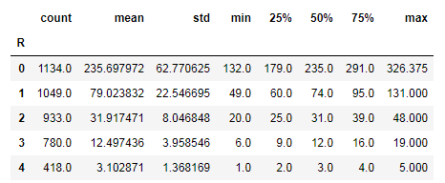
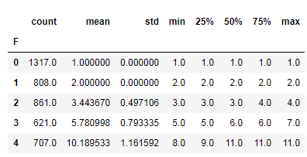
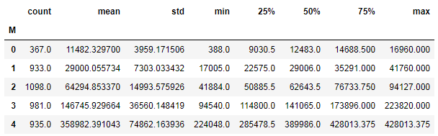
Segments Mapping
Which method to Chose??

Slide 35
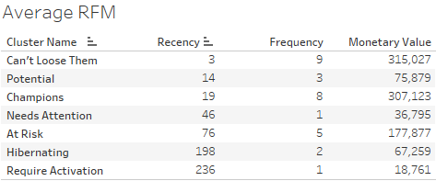
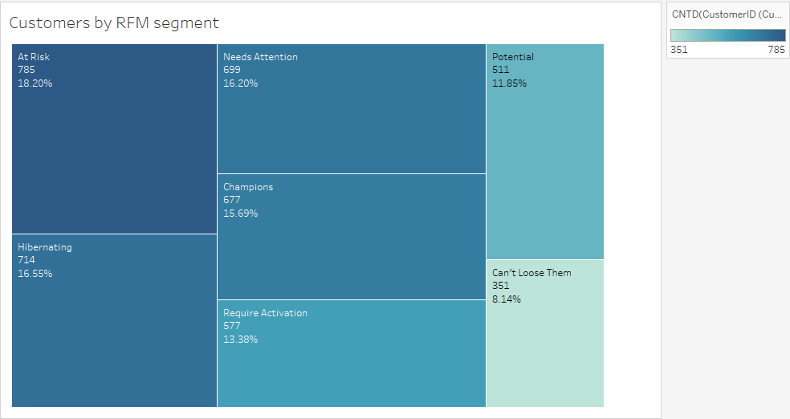
Segments Mapping
Average RFM for each segments

Slide 36
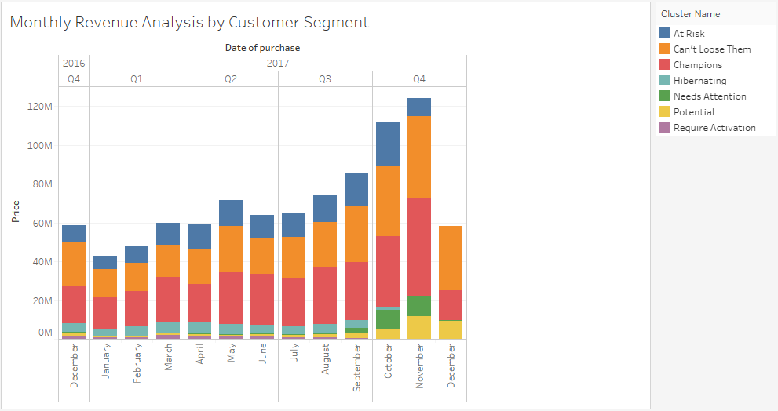

Segments Mapping
Monthly revenue Analysis by Customer Segments
Monthly analysis of orders placed by Customer segments
Customers are most active in Q4(Oct-Dec)

Slide 37


Segments Mapping
Orders by Customer Segments
61.64% of the total orders are placed by just 23.83% top-tier Customers (Can’t loose them, Champions).
Revenue by Customer Segments
Again these 23.83% customers contributes 70.42% of the total Revenue.

Slide 38
Business Actions
Can’t lose them:
The most valuable assets. Reward them. They can become preachers and early adopters of our products
Champions:
Engage them. Ask for reviews, and Up-sell their products. Recommend them other products. Engage them in loyalty programs
Potential:
New Customers, and liking our service. high potential to enter our champions segments, Throw in some freebies on their next purchase to show that you value them!

Slide 39
Business Actions
At Risk:
Our loyal old customers with good quantity and value of their purchase but it has been a while since they last bought something from us. Let’s target them with their wish list items and a limited time offer discount
Needs Attention:
Again New Customers, but seems like they were not happy with the service. Was it a bad customer experience? Or product-market fit? Let’s spend some resource build our brand awareness with them.
Hibernating:
made some initial purchases but have not seen them since. Reactivate them. Recreate brand value. Offer relevant products and good offers. Share valuable resources.
Require Activation:
Poorest performers of our RFM model. They might have went with our competitors for now and will require a different activation strategy to win them back.

Slide 40
Coming up next
Project Overview
Exploratory Data Analysis (EDA)
Key Performance Indicators (KPIs)
Modelling
Summary

Slide 41
Summary
Data Review & Understanding
Feature Engineering & Processing
KPIs & Visualizations
RFM analysis & new features
Unsupervised learning K-Means clustering
Business Actions & Segments Mapping

Slide 42
Questions?
Questions??

