Slide 1


GROUP 13
MAY 12, 2024
WorkFlow
PB Project

Slide 2


1
Ebola Transcriptomic Pathways Analysis
WorkFlow Introduction
differential gene expression analysis
pathway enrichment analysis
1
Searching for suitable data
in geo database
2
3
Pathway Analysis on KEGG
GEO2R Analysis:
Exporting results
4
Result
Visualization
5

Slide 3
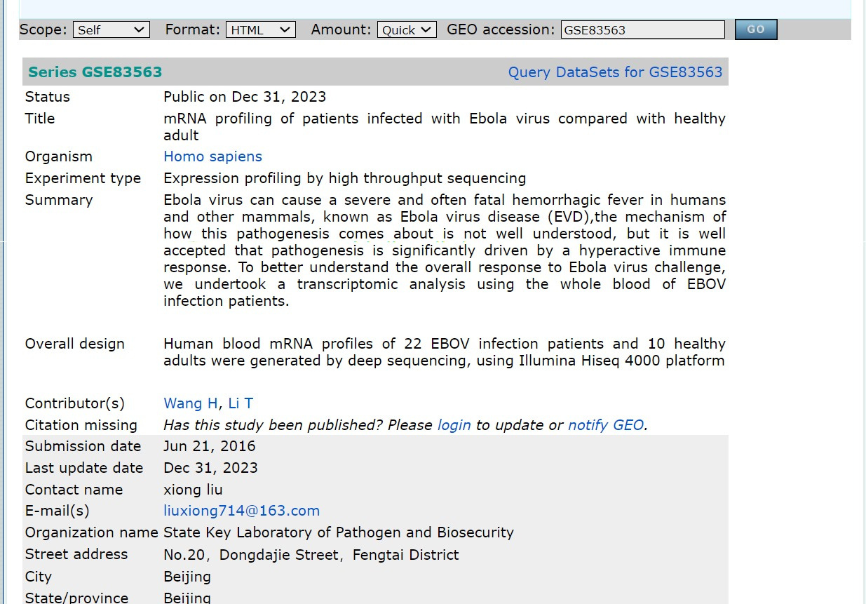

2
Searching Data
Access GEO database, search for Ebola-related datasets using keywords.
Identify datasets with relevant experimental conditions and sample types.
LINK

Slide 4
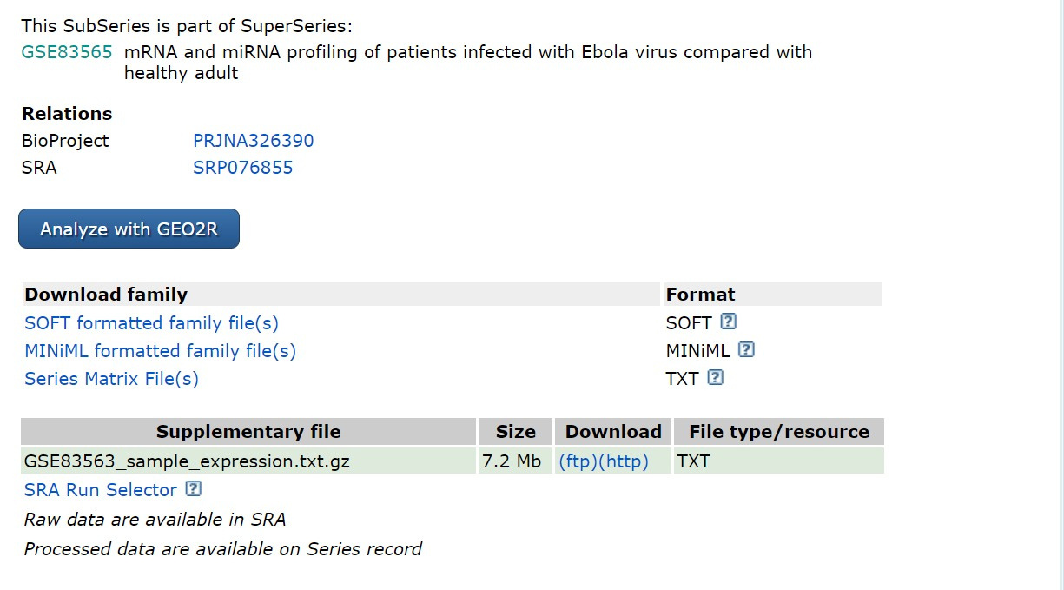

3
GEO2R Analyses
Utilize GEO2R tool to compare gene expression between experimental groups.
Identify genes that are significantly differentially expressed.

Slide 5
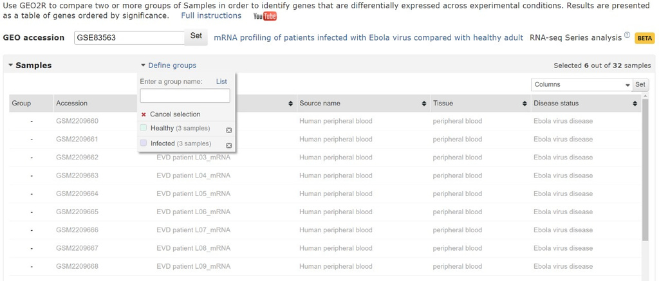

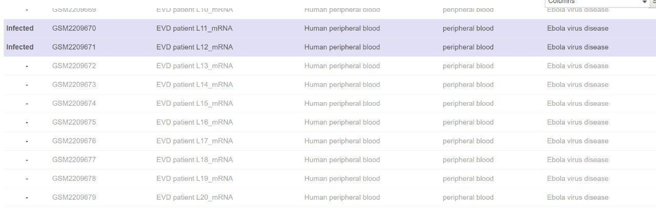
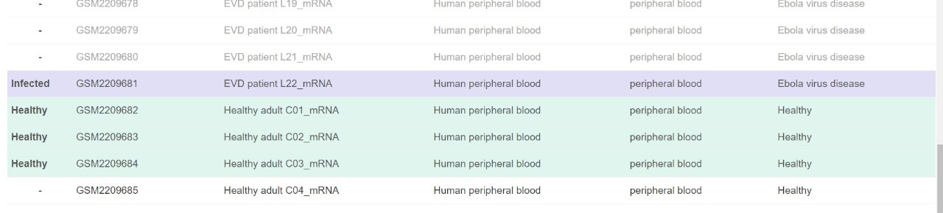

4
Grouping Healthy and infected data

Slide 6
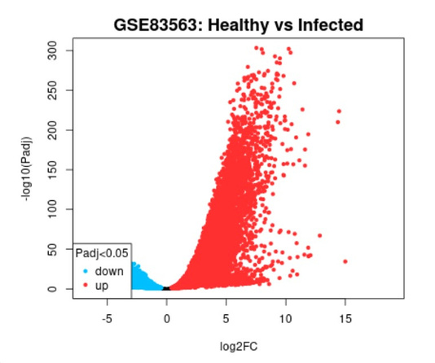
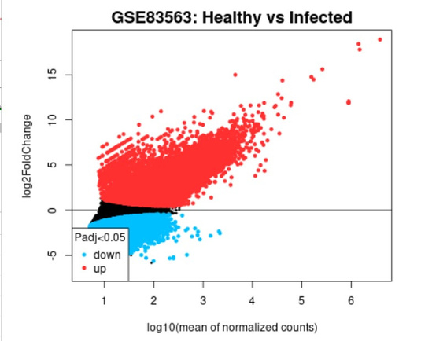
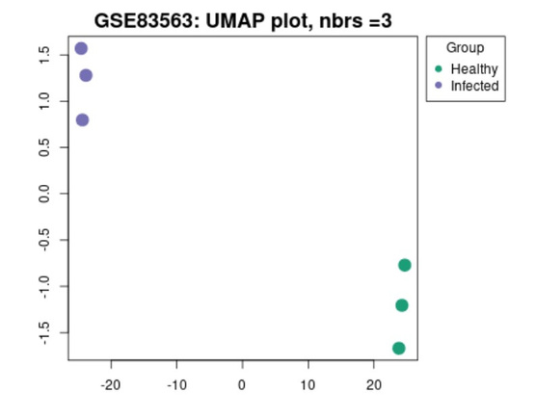
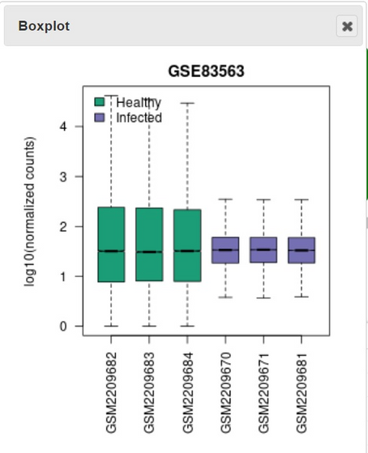
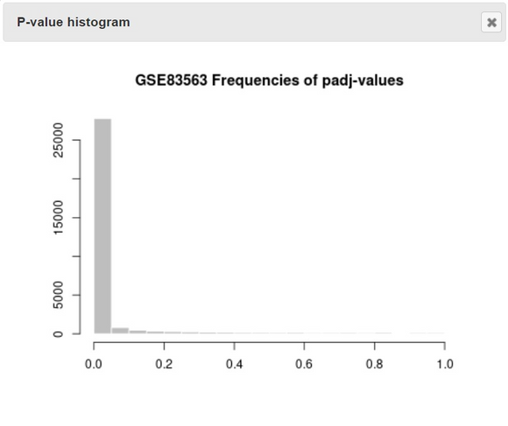

5
Healthy vs infected data
Volcano Plot
Mean Difference Plot
UMAP Plot
BOX Plot
P-Value Histogram

Slide 7
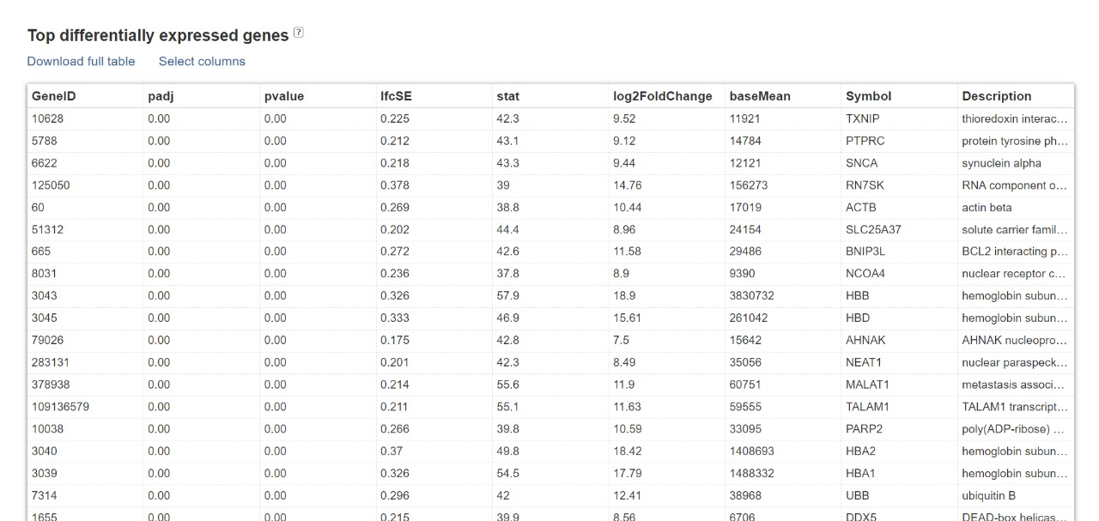

6
Differentially Expressed Genes

Slide 8
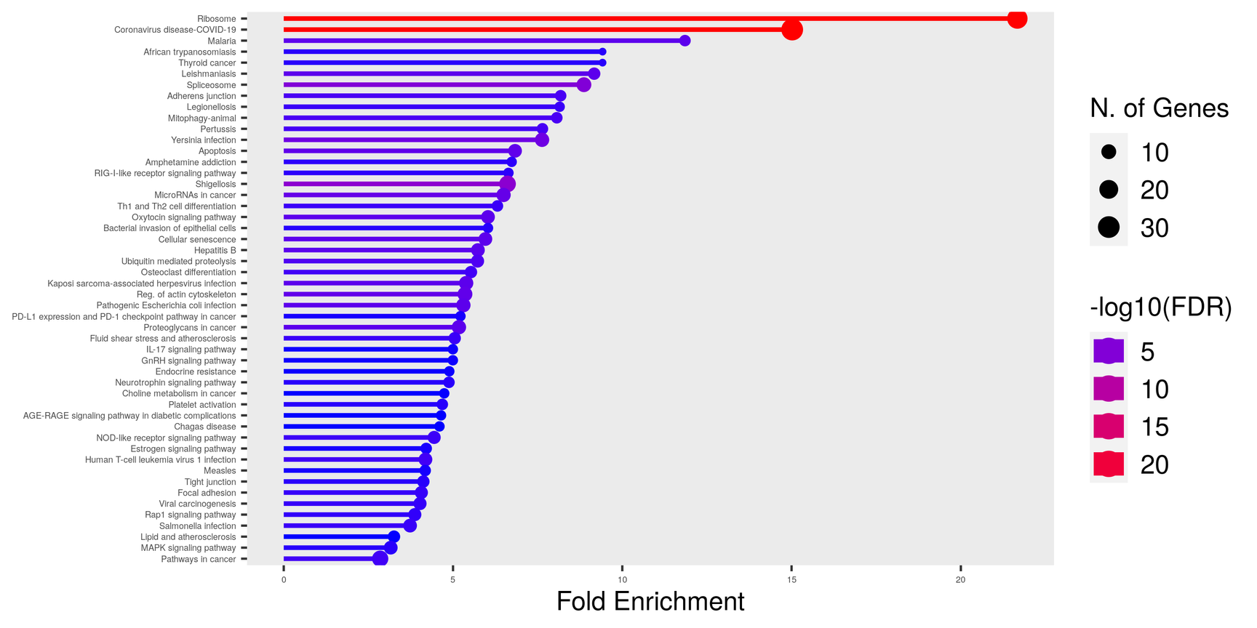
7
PathWay Analysis on KEGG
LINK

Slide 9
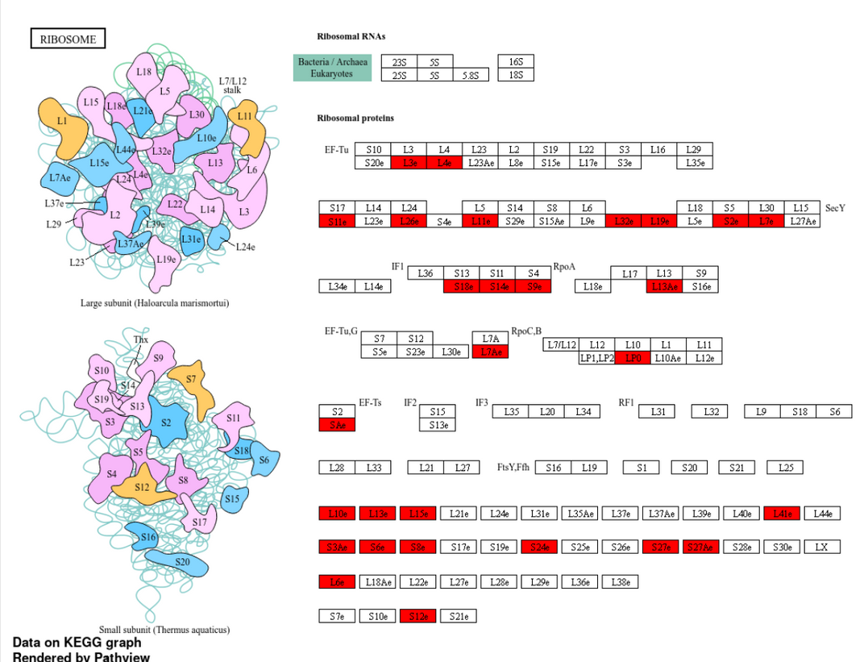
8
PathWay Analysis on KEGG
LINK

Slide 10
9
Results
Breakdown of some of the enriched pathways:
1) Ribosome: 2) Coronavirus disease-COVID-19:
Enrichment Significance: This pathway shows a significant enrichment with a Fold Enrichment of 21.7, suggesting its potential involvement in the Ebola virus replication process.
Interpretation: Ribosomes are cellular structures responsible for protein synthesis. The enrichment of this pathway could indicate that Ebola virus infection may hijack the host cell's protein synthesis machinery, potentially to facilitate its own replication and protein production.
Enrichment Significance: Surprisingly, this pathway also exhibits significant enrichment.
Interpretation: While Ebola virus and coronaviruses are distinct viruses, the enrichment of the COVID-19 pathway could suggest potential similarities or shared mechanisms between these viruses in terms of host response or pathogenesis. This could indicate common pathways activated by viral infections.

Slide 11
10
Results
Breakdown of some of the enriched pathways:
3) Malaria: 4) African trypanosomiasis:
Enrichment Significance: Although not directly related to Ebola virus, this pathway shows enrichment.
Interpretation: The enrichment of the malaria pathway may indicate shared host response pathways or co-infections in the studied population. It suggests that individuals infected with Ebola virus may also be predisposed to or co-infected with malaria, leading to the activation of pathways associated with both diseases.
Enrichment Significance: Similar to malaria, this pathway exhibits enrichment.
Interpretation: African trypanosomiasis, caused by Trypanosoma parasites, is another infectious disease. Its enrichment alongside Ebola virus pathways suggests potential interactions or co-morbidities with Ebola virus infection in the studied population. This could indicate shared host response mechanisms or co-infections that impact the observed pathway enrichment.

Slide 12
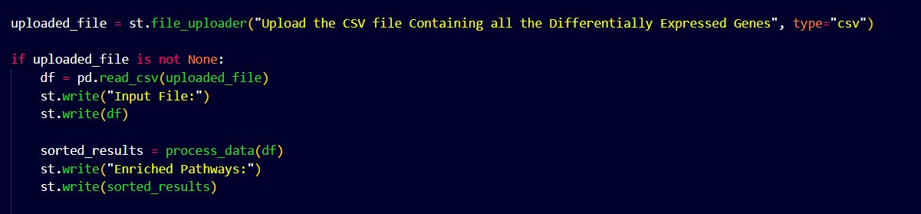
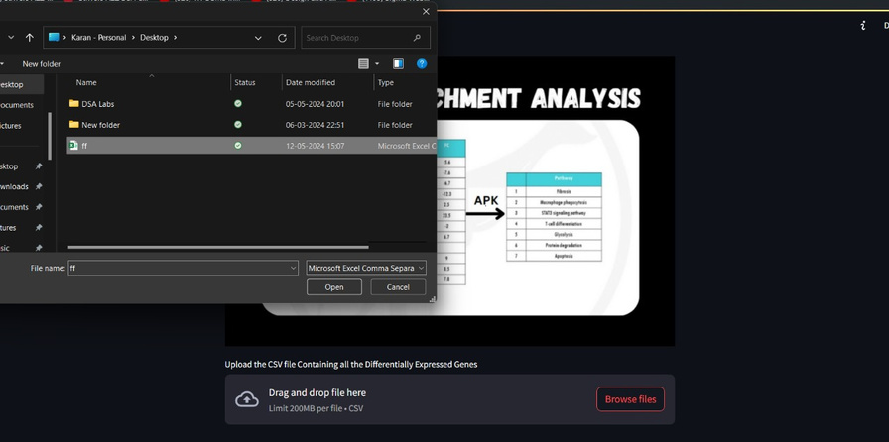
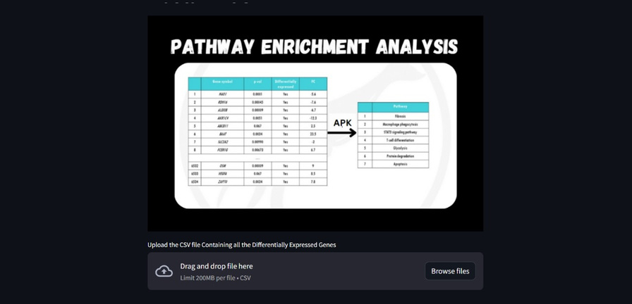

Python Snippet
11

Slide 13
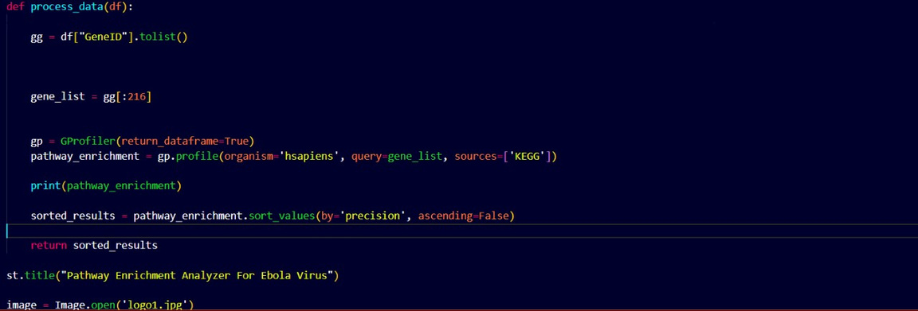
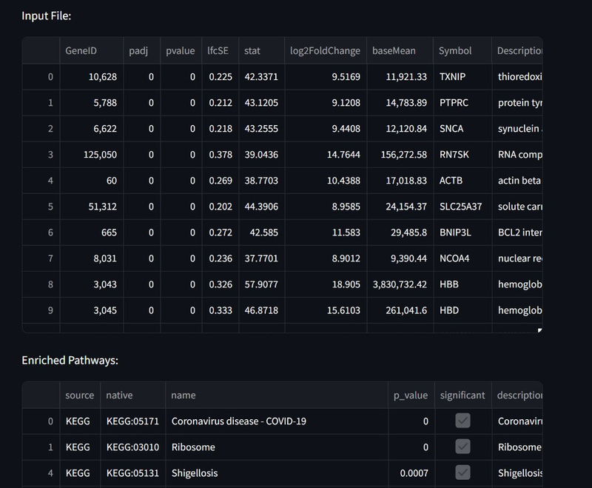
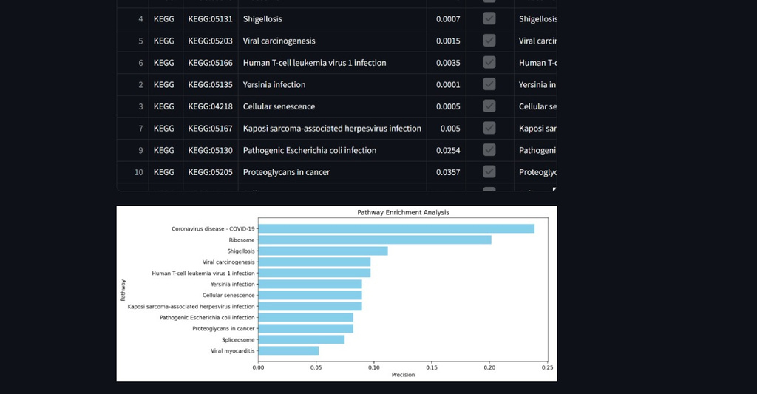
Python Snippet
12

Slide 14
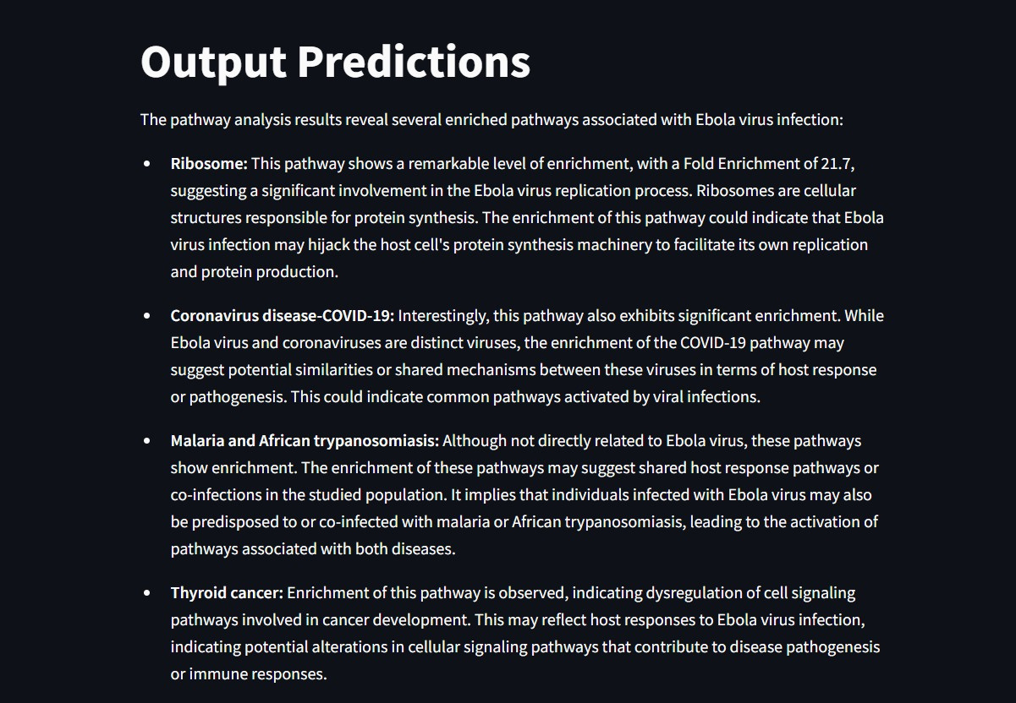
Python Snippet
13

Slide 15

14
Contribution
Karan Yadav(2022234):
Data collection, Pre-processing and
GEO2r Analysis
Manveet Singh(2022280):
KEGG Pathway Analysis, Result
Interpretation and Presentation
Mayank Gautam(2022283):
Python Code and Web Application
for Analysis
Satkeerat Singh Khokhar (2022459)
Arnav Dixit (2022099)
Sahil (2022428)
Areen(2022092)

Slide 16
THANK YOU

