Slide 1

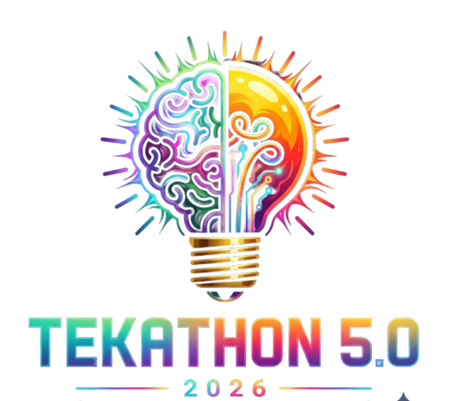
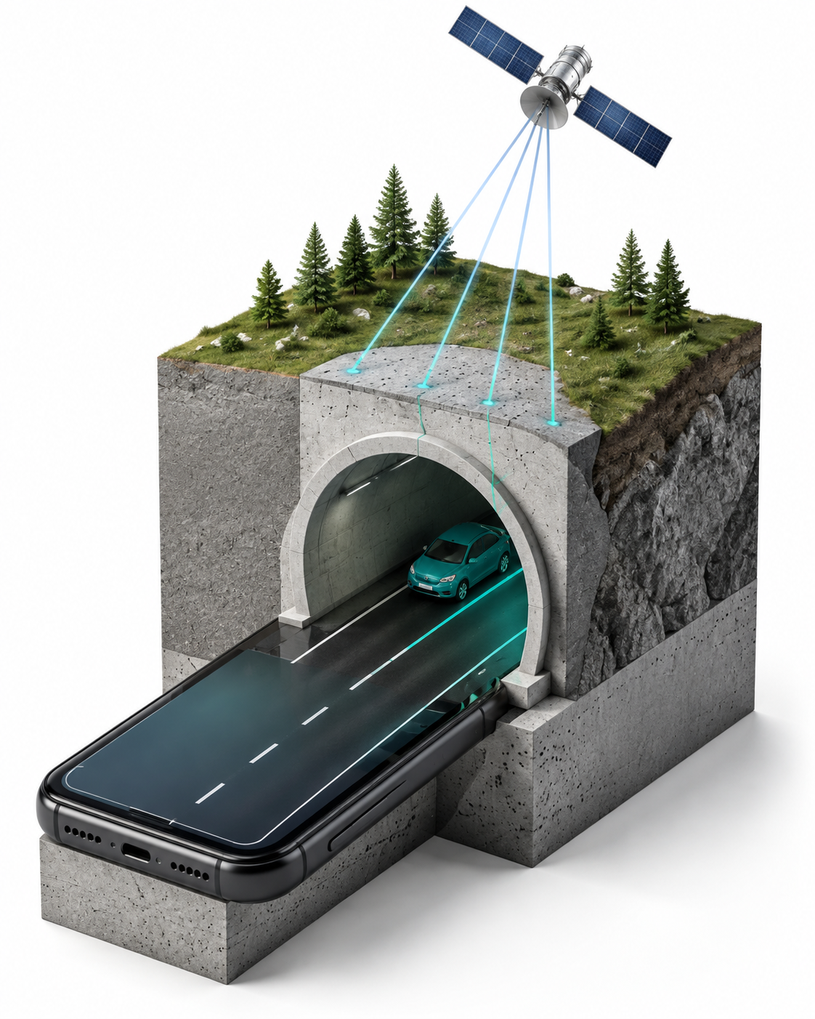
TEKATHON-5.0 · 2026
NavDR
Smartphone navigation
through GNSS outages
AI-ML based Intelligent Dead Reckoning
system for seamless navigation
Problem Statement 26168
ISRO • Software • Miscellaneous
Concept illustration
Notes:
Working title and event artwork retained from supplied template. Confirm current SIH branding, portal theme and registered team details before submission. Product name is NavDR; no team identity was invented. Illustration is conceptual.

Slide 2
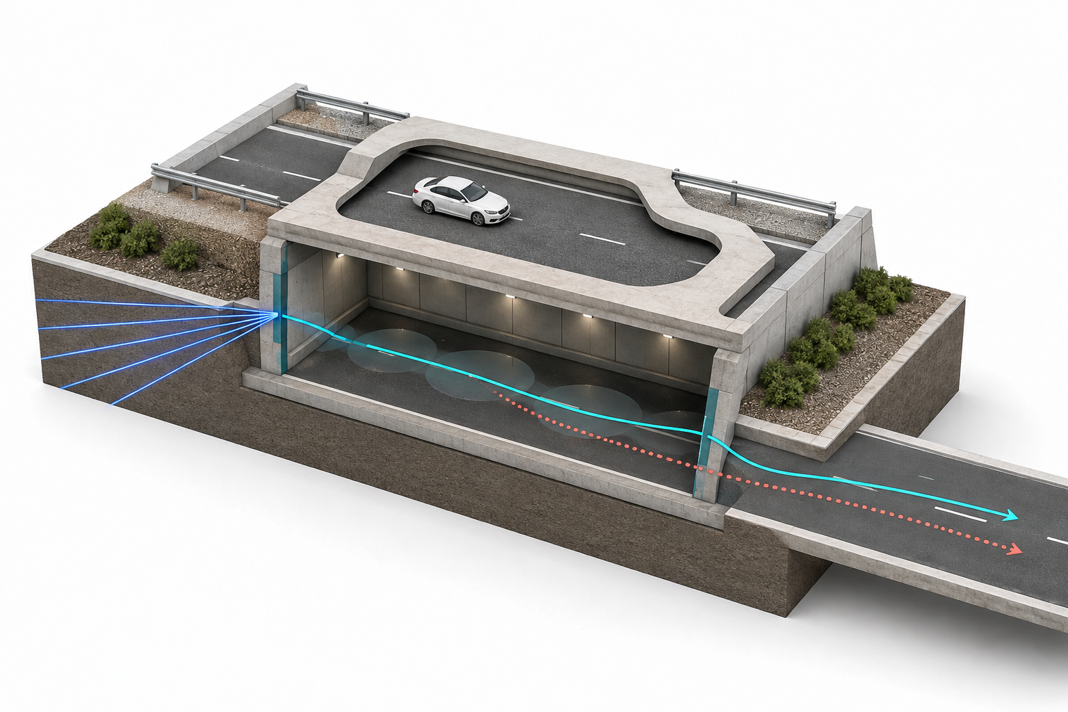
IDEA TITLE
Motion continuity when GNSS becomes unreliable
THE PROBLEM
GNSS loses coverage.
IMU bias builds position error.
THE RESPONSE
Combine phone motion sensors,
velocity estimates and road
constraints to bridge outages.
GNSS available
Dead reckoning
Recovery
Validation target: peak outage error below 10% of outage distance
NavDR / PS 26168
2
Notes:
Target is an internal validation objective, not a general field result or verified ISRO mandate. Paths in the illustration are conceptual. Proactive NavIC-aware handoff remains planned.

Slide 3
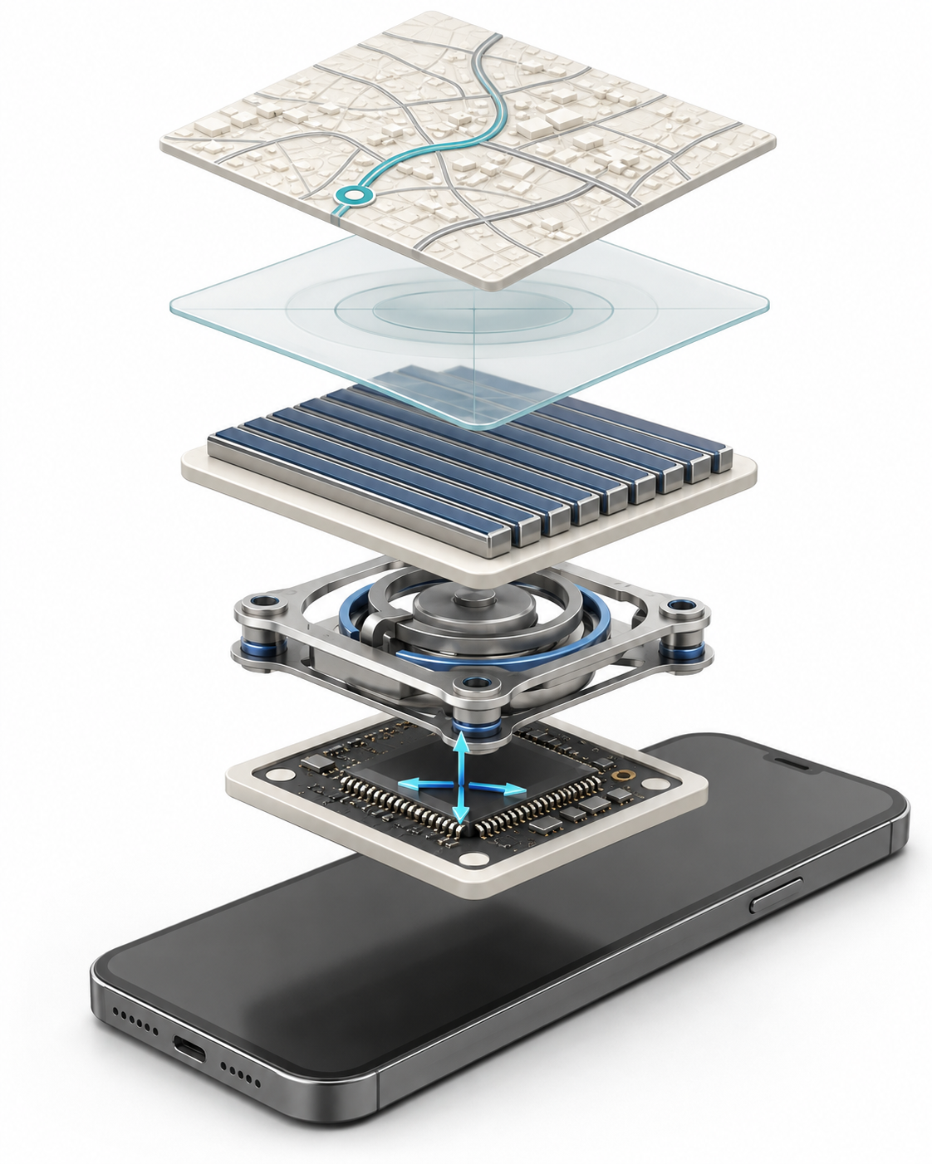
TECHNICAL APPROACH
01
Phone IMU
Acceleration and rotation
02
Frame alignment
Fixed mounting configuration
03
TCN velocity
49,665 parameters; untrained demo
04
Planar EKF
State estimation and GNSS gating
05
Road HMM
Road-constrained position output
Current: 100 Hz simulated IMU and replay
Next: trained weights and device validation
NavDR / PS 26168
3
Notes:
Conceptual processing layers, not additional phone hardware. Actual current system: untrained causal TCN, six-state planar EKF, imported OSM road matcher. TCN output uses explicit GNSS-anchor constraints, not learned drift suppression. Sources: https://arxiv.org/abs/1803.01271 ; https://valhalla.github.io/valhalla/meili/algorithms/ ; local implementation js/navigation-core.js and js/ai-motion-estimator.js.

Slide 4
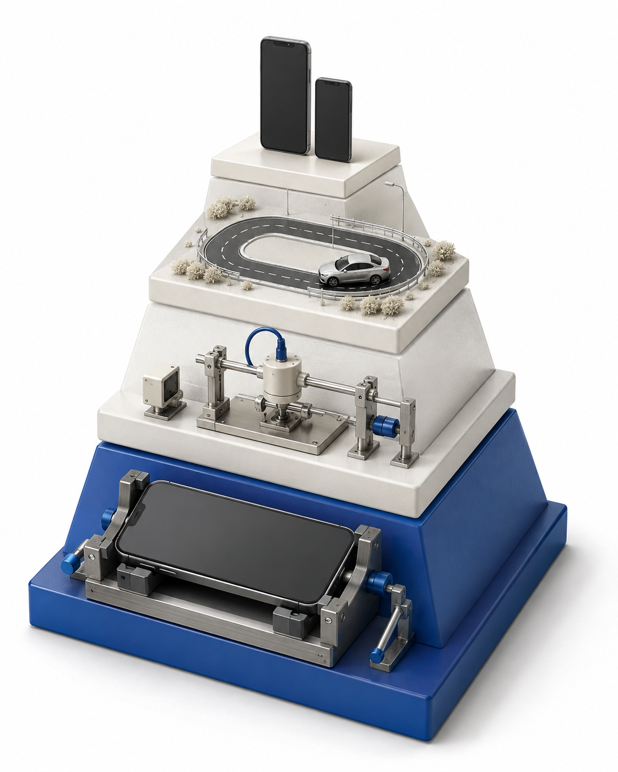
FEASIBILITY AND VIABILITY
Prototype to field validation
Risk | Response
Mounting changes | Detect and realign
GNSS multipath spike | Gate inconsistent fixes
Late IMU samples | Flag timestamp gaps
Unfamiliar routes / phones | Evaluate held-out data
Working now
Upper stages planned
Console, sensor simulation, EKF, road matching and replay
NavDR / PS 26168
4
Notes:
Pyramid represents project maturity, not the neural architecture. Native Android code and model training require device and dataset validation. No field reliability claim is made.

Slide 5
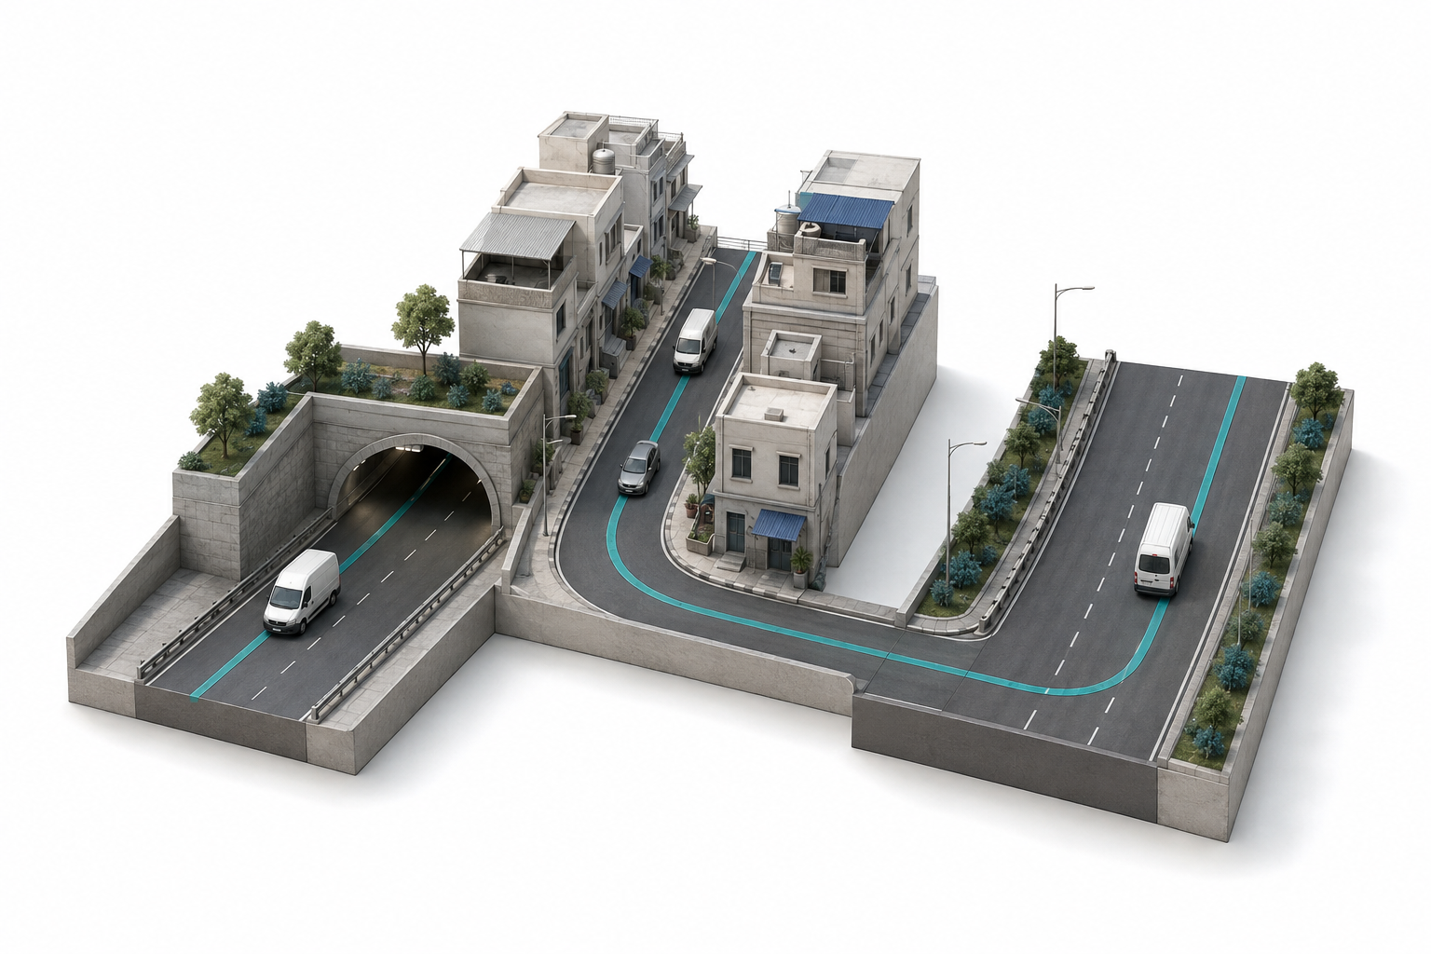
IMPACT AND BENEFITS
Navigation continuity using an existing phone
Drivers
Position awareness through
short GNSS outages
Fleets
Route continuity through
tunnels and dense streets
Deployment goal
No dedicated vehicle
sensor hardware
Measure error, recovery time, latency and phone energy use
NavDR / PS 26168
5
Notes:
Potential users and benefits, not deployed customers or measured safety outcomes. Field impact and budget-phone performance remain to be validated. No zero-cost or energy-saving claim.

Slide 6

RESEARCH AND REFERENCES
IO-VNBD
Vehicle and smartphone motion data
AI-IMU Dead-Reckoning
Learning-assisted inertial estimation
Temporal Convolutional Networks
Causal sequence modelling
Valhalla Meili
HMM map matching
Android GnssStatus
Satellite signal observations
Synthetic prototype. TCN untrained. Field validation pending.
YouTube Demo
GitHub Repository
youtu.be/GoU52CqyaNI
github.com/Sudhanshu-01-ui/gps
NavDR / PS 26168
6
Notes:
Research sources are linked in the slide. They do not establish equivalent NavDR performance. Project URLs supplied by the user: https://youtu.be/GoU52CqyaNI?si=BRUkPWE7Z4fjoDyq and https://github.com/Sudhanshu-01-ui/gps. Contents not independently verified in this session. Image generation prompts: docs/pitch/NavDR_Pitch_Blueprint.md.

