Slide 1
Ullman et al. : Database System Principles Notes 4: Indexing

Slide 2
Chapter 4
Indexing & Hashing
value
record
?
value

Slide 3
Topics
Conventional indexes
B-trees
Hashing schemes

Slide 4
A single-level index is an auxiliary file that makes it more efficient to search for a record in the data file.
The index is usually specified on one field of the file (although it could be specified on several fields).
One form of an index is a file of entries <field value, pointer to record>, which is ordered by field value.
The index is called an access path on the field.

Slide 5
The index file usually occupies considerably less disk blocks than the data file because its entries are much smaller
A binary search on the index yields a pointer to the file record
Indexes can also be characterized as dense or sparse
A dense index has an index entry for every search key value (usually every record) in the data file.
A sparse (or nondense) index, on the other hand, has index entries for only some of the search values
(typically one entry per data file block)

Slide 6
Sequential File
10
20
30
40
50
60
70
80
90
100

Slide 7
Dense Index
Sequential File
10
10
20
20
30
30
40
40
50
60
50
70
60
80
70
90
80
100
90
110
100
120

Slide 8
Sparse Index
Sequential File
10
10
30
20
50
30
70
40
90
110
50
130
60
150
70
170
80
190
90
210
100
230

Slide 9
Sparse 2nd level
Sequential File
10
10
10
90
30
20
170
50
30
250
70
40
90
330
50
110
410
60
130
490
150
570
70
170
80
190
90
210
100
230

Slide 10
Notes on pointers:
(1) Block pointer (sparse index) can be smaller than record pointer
BP
RP

Slide 11
Sparse vs. Dense Tradeoff
Sparse: Less index space per record can keep more of index in memory
Dense: Can tell if any record exists without accessing file
(Later:
sparse better for insertions
dense needed for secondary indexes)

Slide 12
Terms
Index sequential file
Search key ( ≠ primary key)
Primary index (on ordering field)
Secondary index (on non-ordering field)
Dense index (all Search Key values in)
Sparse index
Multi-level index

Slide 13
Next:
Duplicate keys
Deletion/Insertion
Secondary indexes

Slide 14
Duplicate keys
10
10
10
20
20
30
30
30
40
45

Slide 15
Dense index, one way to implement?
Duplicate keys
10
10
10
10
10
10
10
10
10
10
10
10
20
20
20
20
20
20
20
20
30
30
30
30
30
30
30
30
30
30
30
30
40
40
45
45

Slide 16
Duplicate keys
Dense index, better way?
10
10
10
20
30
10
40
20
20
30
30
30
40
45

Slide 17
Duplicate keys
Sparse index, one way?
10
10
10
10
20
10
careful if looking
for 20 or 30!
20
30
20
30
30
30
40
45

Slide 18
Duplicate keys
Sparse index, another way?
place first new key from block
10
should
this be
40?
10
10
20
30
10
30
20
20
30
30
30
40
45

Slide 19
Duplicate values, primary index
Summary
Index may point to first instance of each value only
File
Index
a
a
a
.
.
b

Slide 20
Deletion from sparse index
delete record 40
10
10
20
30
50
30
70
40
50
90
60
110
130
70
150
80

Slide 21
Deletion from sparse index
delete record 40
10
10
20
30
50
30
70
40
50
90
60
110
130
70
150
80

Slide 22
Deletion from sparse index
delete record 30
10
10
20
30
50
30
70
40
50
90
60
110
130
70
150
80

Slide 23
Deletion from sparse index
delete record 30
10
10
20
40
30
50
30
40
70
40
50
90
60
110
130
70
150
80

Slide 24
Deletion from sparse index
delete records 30 & 40
10
10
20
30
50
30
70
40
50
90
60
110
130
70
150
80

Slide 25
Deletion from sparse index
delete records 30 & 40
10
10
20
30
50
30
70
40
50
90
60
110
130
70
150
80

Slide 26
Deletion from sparse index
delete records 30 & 40
10
10
20
50
30
70
50
30
70
40
50
90
60
110
130
70
150
80

Slide 27
Deletion from dense index
delete record 30
10
10
20
20
30
30
40
40
50
50
60
60
70
70
80
80

Slide 28
Deletion from dense index
delete record 30
10
10
20
20
30
30
40
40
40
50
50
60
60
70
70
80
80

Slide 29
Deletion from dense index
delete record 30
10
10
20
20
40
30
30
40
40
40
50
50
60
60
70
70
80
80

Slide 30
Insertion, sparse index case
insert record 34
10
10
20
30
40
30
60
40
50
60

Slide 31
Insertion, sparse index case
insert record 34
10
10
20
30
40
30
60
34
40
50
our lucky day!
we have free space
where we need it!
60

Slide 32
Insertion, sparse index case
insert record 15
10
10
20
30
40
30
60
40
50
60

Slide 33
Insertion, sparse index case
insert record 15
10
10
20
15
20
30
40
30
20
60
30
40
50
Illustrated: Immediate reorganization
Variation:
insert new block (chained file)
update index
60

Slide 34
Insertion, sparse index case
insert record 25
10
25
10
20
30
40
30
overflow blocks
(reorganize later...)
60
40
50
60

Slide 35
Insertion, dense index case
Similar
Often more expensive . . .

Slide 36
Secondary indexes
Sparse index
Sequence
field
30
30
50
20
80
20
100
70
90
80
...
40
100
10
does not make sense!
90
60

Slide 37
Secondary indexes
Dense index
Sequence
field
10
30
20
50
30
40
20
70
50
80
60
40
70
...
100
10
90
60

Slide 38
Secondary indexes
Dense index
Sequence
field
10
30
20
50
10
30
40
20
50
70
90
...
50
80
60
sparse
high
level
40
70
...
100
10
90
60

Slide 39
With secondary indexes:
Lowest level is dense
Other levels are sparse
Also: Pointers are record pointers
(not block pointers)

Slide 40
Duplicate values & secondary indexes
one option...
10
20
10
10
10
Problem:
excess overhead!
disk space
search time
20
20
40
20
30
10
40
40
40
10
40
40
40
...
30
40

Slide 41
Duplicate values & secondary indexes
another option...
10
20
10
Problem:
variable size
records in
index!
20
20
40
10
40
30
40
10
40
30
40

Slide 42
Duplicate values & secondary indexes
20
λ
10
10
20
30
20
40
40
50
10
60
40
...
10
λ
40
Another idea: Chain records with same key?
30
λ
40
λ
Problems:
Need to add fields to records
Need to follow chain to know records

Slide 43
Duplicate values & secondary indexes
20
10
10
20
30
20
40
40
50
10
60
40
...
10
40
30
Pointers can be stored in separate blocks
40
buckets

Slide 44
Why “bucket” idea is useful
Indexes Records
Name: primary EMP (name,dept,floor,...)
Dept: secondary
Floor: secondary
See the following query

Slide 45
Query: Get employees in (Toy Dept) ^ (2nd floor)
Dept. index EMP Floor index
Toy
2nd
→ Intersect toy bucket and 2nd Floor bucket to get set of matching EMP’s

Slide 46
Summary so far
Conventional index
Basic Ideas: sparse, dense, multi-level…
Duplicate Keys
Deletion/Insertion
Secondary indexes

Slide 47
Conventional indexes
Advantage:
- Simple
- Index is sequential file
good for scans
Disadvantage:
- Inserts expensive, and/or
- Lose sequentiality & balance

Slide 48
Example Index (sequential)
continuous
free space
10
20
39
30
31
33
35
36
40
50
60
32
38
34
70
80
90
overflow area
(not sequential)

Slide 49
Clustering Index
Defined on an ordered data file
The data file is ordered on a non-key field.
Includes one index entry for each distinct value of the field; the index entry points to the first data block that contains records with that field value.
It is an example of non-dense index where Insertion and Deletion is relatively straightforward with a clustering index.

Slide 50
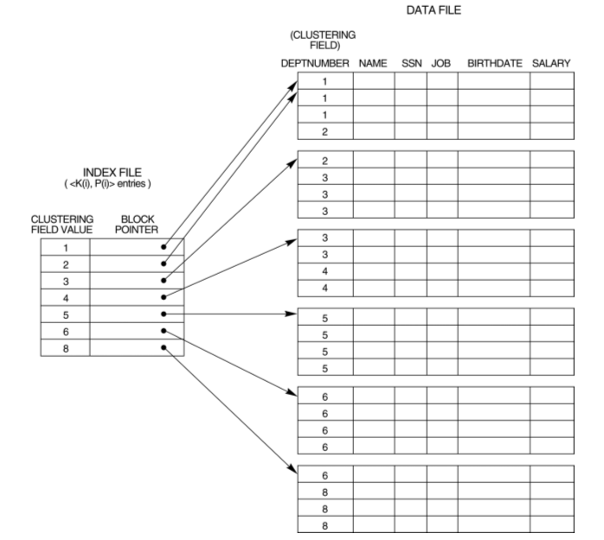
Clustering Index

Slide 51
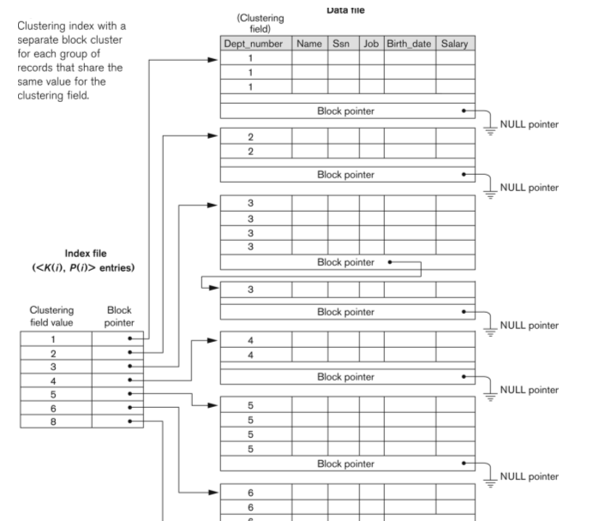
Clustering Index version 2

Slide 52
Outline:
Conventional indexes
B-Trees ⇒ NEXT
Hashing schemes

Slide 53
NEXT: Another type of index
Give up on sequentiality of index
Try to get “balance”

Slide 54
B+Tree Example n=3
Root
100
30
120
150
180
3
5
11
30
35
100
101
110
120
130
150
156
179
180
200

Slide 55
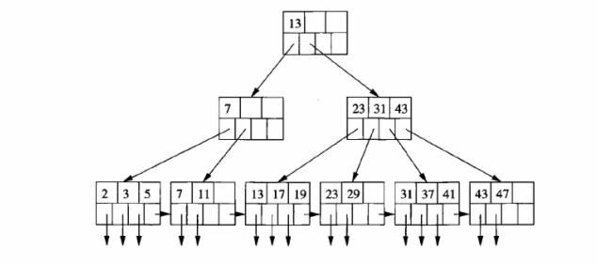
Lookup in a B+ tree Useful for range queries too SELECT * FROM R WHERE R.o >= a AND R.o <= b;

Slide 56
Sample non-leaf
57
81
95
to keys to keys to keys to keys
< 57 57≤ k<81 81≤k<95 ≥95

Slide 57
Sample leaf node:
From non-leaf node
to next leaf
in sequence
57
81
95
To record
with key 57
To record
with key 81
To record
with key 85

Slide 58
In textbook’s notation n=3
Leaf:
Non-leaf:
30
35
30
35
30
30

Slide 59
Size of nodes: n+1 pointers
n keys
(fixed)

Slide 60
Don’t want nodes to be too empty
Use at least
Non-leaf: ⎡(n+1)/2⎤ pointers
Leaf: ⎣(n+1)/2⎦ pointers to data

Slide 61
n=3
Full node min. node
Non-leaf
Leaf
120
150
180
30
3
5
11
30
35
counts even if null

Slide 62
B+tree rules tree of order n
(1) All leaves at same lowest level (balanced tree)
(2) Pointers in leaves point to records except for “sequence pointer”
(to next leaf)

Slide 63
(3) Number of pointers/keys for B+tree
Max Max Min Min
ptrs keys ptrs→data keys
Non-leaf
(non-root)
n+1
n
⎡(n+1)/2⎤
⎡(n+1)/2⎤- 1
Leaf
(non-root)
n+1
n
⎣(n+1)/2⎦
⎣(n+1)/2⎦
Root
n+1
n
1
1

Slide 64
Insert into B+tree
(a) simple case
space available in leaf
(b) leaf overflow
(c) non-leaf overflow
(d) new root

Slide 65
(a) Insert key = 32
n=3
100
30
3
5
11
30
31

Slide 66
(a) Insert key = 32
n=3
100
30
3
5
11
30
31
32

Slide 67
(a) Insert key = 7
n=3
100
30
3
5
11
30
31

Slide 68
(a) Insert key = 7
n=3
100
30
3
5
3
5
11
30
31
7

Slide 69
(a) Insert key = 7
n=3
100
30
7
3
5
3
5
11
30
31
7

Slide 70
(c) Insert key = 160
n=3
100
120
150
180
150
156
179
180
200

Slide 71
(c) Insert key = 160
n=3
100
120
150
180
150
156
179
160
179
180
200

Slide 72
(c) Insert key = 160
n=3
100
120
150
180
180
150
156
179
160
179
180
200

Slide 73
(c) Insert key = 160
n=3
100
160
120
150
180
180
150
156
179
160
179
180
200

Slide 74
(d) New root, insert 45
n=3
10
20
30
1
2
3
10
12
20
25
30
32
40

Slide 75
(d) New root, insert 45
n=3
10
20
30
1
2
3
10
12
20
25
30
32
40
40
45

Slide 76
(d) New root, insert 45
n=3
10
20
30
40
1
2
3
10
12
20
25
30
32
40
40
45

Slide 77
(d) New root, insert 45
n=3
30
new root
10
20
30
40
1
2
3
10
12
20
25
30
32
40
40
45

Slide 78
Deletion from B+tree
(a) Simple case - no example
(b) Coalesce with neighbor (sibling)
(c) Re-distribute keys
(d) Cases (b) or (c) at non-leaf

Slide 79
(b) Coalesce with sibling
Delete 50
n=4
10
40
100
10
20
30
40
50

Slide 80
(b) Coalesce with sibling
Delete 50
n=4
10
40
100
10
20
30
40
50
40

Slide 81
(c) Redistribute keys
Delete 50
n=4
10
40
100
10
20
30
35
40
50

Slide 82
(c) Redistribute keys
Delete 50
n=4
10
40
100
35
10
20
30
35
40
50
35

Slide 83
(d) Non-leaf coalese
Delete 37
n=4
25
10
20
30
40
25
26
1
3
10
14
20
22
30
37
40
45

Slide 84
(d) Non-leaf coalese
Delete 37
n=4
25
10
20
30
40
25
26
1
3
10
14
20
22
30
37
40
45
30

Slide 85
(d) Non-leaf coalese
Delete 37
n=4
25
10
20
30
40
40
25
26
1
3
10
14
20
22
30
37
40
45
30

Slide 86
(d) Non-leaf coalese
Delete 37
n=4
25
new root
10
20
30
40
25
40
25
26
1
3
10
14
20
22
30
37
40
45
30

Slide 87
B+tree deletions in practice
Often, coalescing is not implemented
Too hard and not worth it!

Slide 88
Speaking of buffering…
Is LRU a good policy for B+tree buffers?
→ Of course not!
→ Should try to keep root in memory at all times
(and perhaps some nodes from second level)

Slide 89
Variation on B+tree: B-tree (no +)
Idea:
Avoid duplicate keys
Have record pointers in non-leaf nodes

Slide 90
to record to record to record
with K1 with K2 with K3
to keys to keys to keys to keys
< K1 K1<x<K2 K2<x<k3 >k3
K1 P1
K2 P2
K3 P3

Slide 91
B-tree example n=2
65
125
25
45
85
105
145
165
10
20
30
40
50
60
70
80
90
100
110
120
130
140
150
160
170
180

Slide 92
B-tree example n=2
sequence pointers
not useful now!
(but keep space for simplicity)
65
125
25
45
85
105
145
165
10
20
30
40
50
60
70
80
90
100
110
120
130
140
150
160
170
180

Slide 93
Note on inserts
Say we insert record with key = 25
10
20
30
n=3
leaf

Slide 94
Note on inserts
Say we insert record with key = 25
10
20
30
n=3
leaf
Afterwards:
–
20
–
10
25
30

Slide 95
So, for B-trees:
MAX MIN
Tree Rec Keys Tree Rec Keys
Ptrs Ptrs Ptrs Ptrs
Non-leaf
non-root n+1 n n ⎡(n+1)/2⎤ ⎡(n+1)/2⎤-1 ⎡(n+1)/2⎤-1
Leaf
non-root 1 n n 1 ⎣n/2⎦ ⎣n/2⎦
Root
non-leaf n+1 n n 2 1 1
Root
Leaf 1 n n 1 1 1

Slide 96
Tradeoffs:
☺ B-trees have faster lookup than B+trees
☹ in B-tree, non-leaf & leaf different sizes
☹ in B-tree, deletion more complicated

Slide 97
Tradeoffs:
☺ B-trees have faster lookup than B+trees
☹ in B-tree, non-leaf & leaf different sizes
☹ in B-tree, deletion more complicated
➔ B+trees preferred!

Slide 98
But note:
If blocks are fixed size (due to disk and buffering restrictions)
Then lookup for B+tree is actually better!!

Slide 99
Outline/summary
Conventional Indexes
Sparse vs. dense
Primary vs. secondary
B trees
B+trees vs. B-trees
B+trees vs. indexed sequential
Hashing schemes --> Next

