Slide 1

Bluestock Mutual Fund Analytics Capstone Project
End-to-End Mutual Fund Analytics Solution
Using Python, SQL, Power BI & Advanced Analytics
Karan Taynak
Data Analyst Intern

Slide 2
Business Problem & Objective
Problem Statement:
Investors and fund managers need a data-driven way to evaluate
mutual fund performance, investor behavior, portfolio risk,
and SIP trends.
Large volumes of fund and investor data make manual analysis difficult.
Objectives
• Build an end-to-end analytics pipeline
• Analyze fund performance
• Study investor behavior
• Measure portfolio risk
• Create interactive dashboards
• Generate actionable business insights

Slide 3
Data Sources
Datasets Used:
1. Mutual Fund Master Data
2. NAV History
3. Portfolio Holdings
4. Investor Transactions
5. SIP Transactions
6. Industry Folio Data
7. Benchmark Data
Data Volume:
5000 Investors
40 Mutual Funds
Thousands of Transactions
Multiple Years of NAV History

Slide 4
Project Architecture
Work Flow
Raw Data
↓
Data Cleaning
↓
Feature Engineering
↓
EDA Analysis
↓
Performance Analytics
↓
Advanced Analytics
↓
Power BI Dashboard
↓
Business Insights
Tools Used
Python
Pandas
NumPy
Matplotlib
SQL
Power BI
GitHub

Slide 5
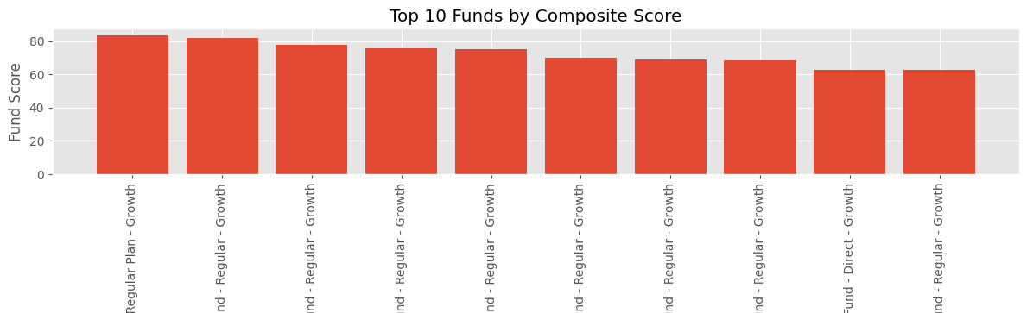
EDA Highlights
• Equity funds dominate AUM
• Large variation in fund returns
• Some funds show significantly higher Sharpe Ratios
• Expense ratios vary across categories
• Fund scores help identify top-performing schemes

Slide 6
Investor Analytics
• Majority of investors belong to Tier-1 cities
• Digital payment modes dominate
• Investor participation varies across age groups
• SIP remains the preferred investment method

Slide 7
Performance Analytics
Fund Performance Metrics
Sharpe Ratio
Alpha
Beta
Max Drawdown
Fund Score
Insights
• Top funds consistently show high Sharpe ratios
• Lower drawdowns contribute to better scores
• Alpha provides additional return generation

Slide 8
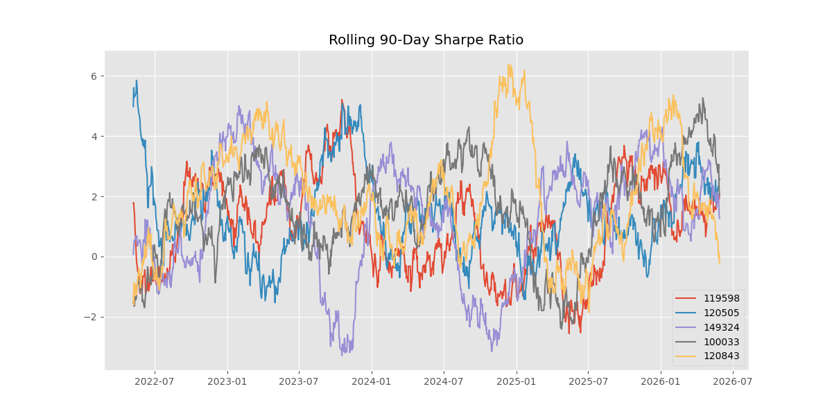
Advanced Analytics
Risk Analytics:
Historical VaR (95%)
Conditional VaR (CVaR)
Rolling Sharpe Ratio
Sector Concentration (HHI)
Benefits:
Better risk assessment
Improved fund comparison

Slide 9
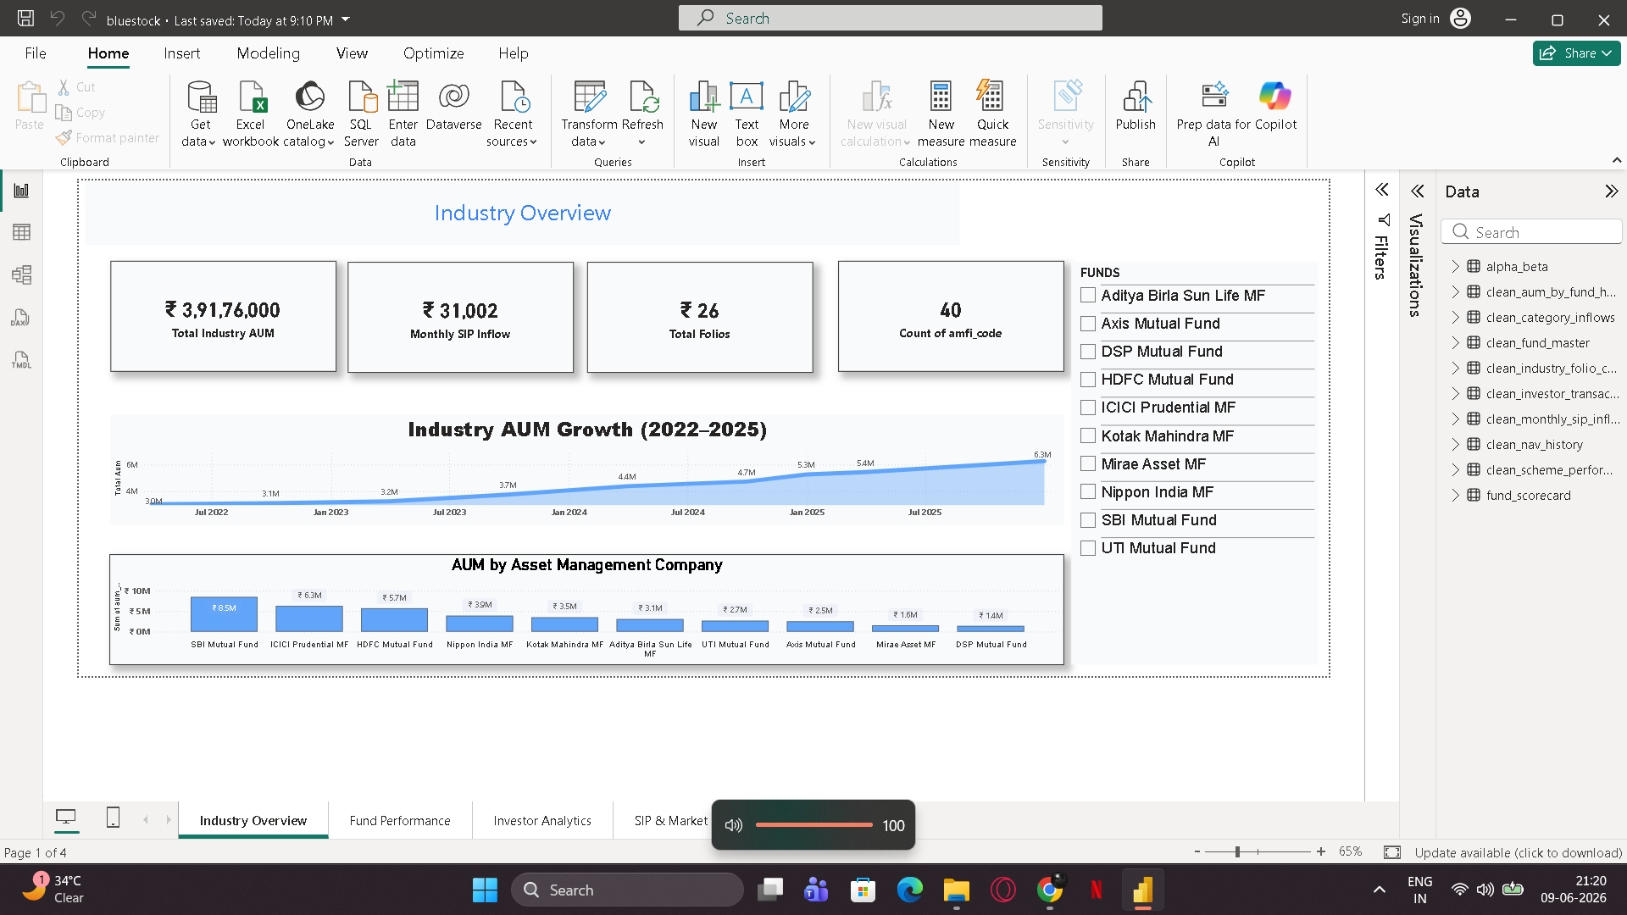
Dashboard Overview
Features:
Market Trends
AUM Analysis
Category Distribution
Industry Insights

Slide 10
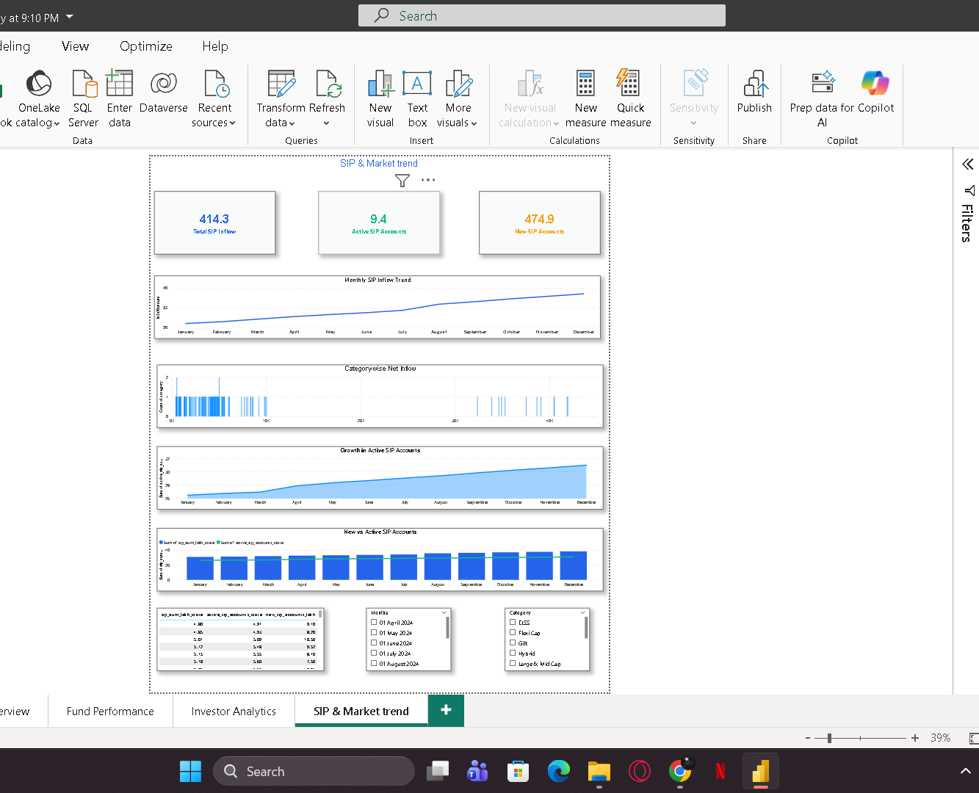
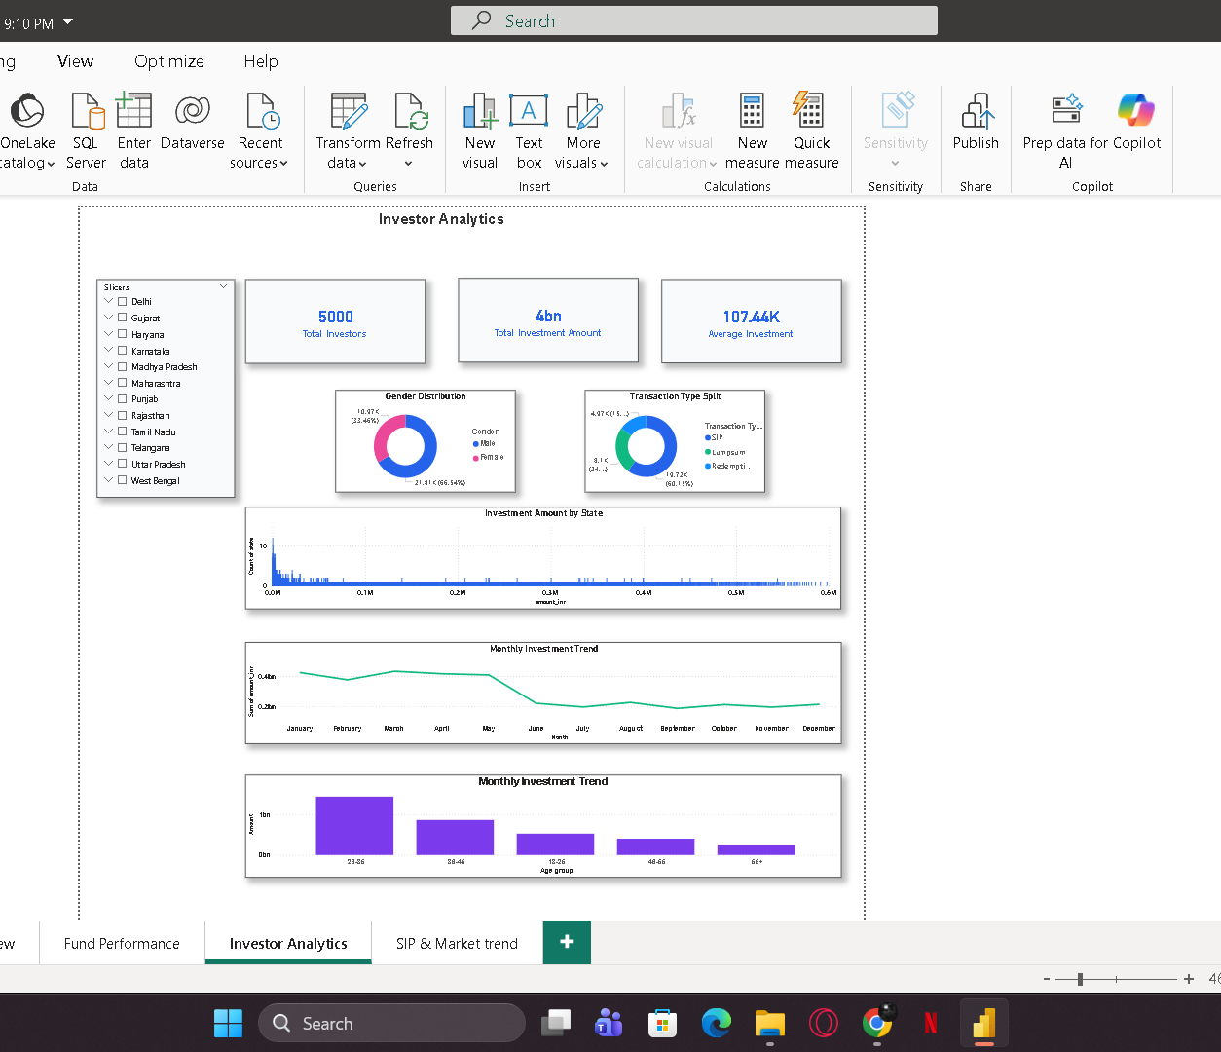
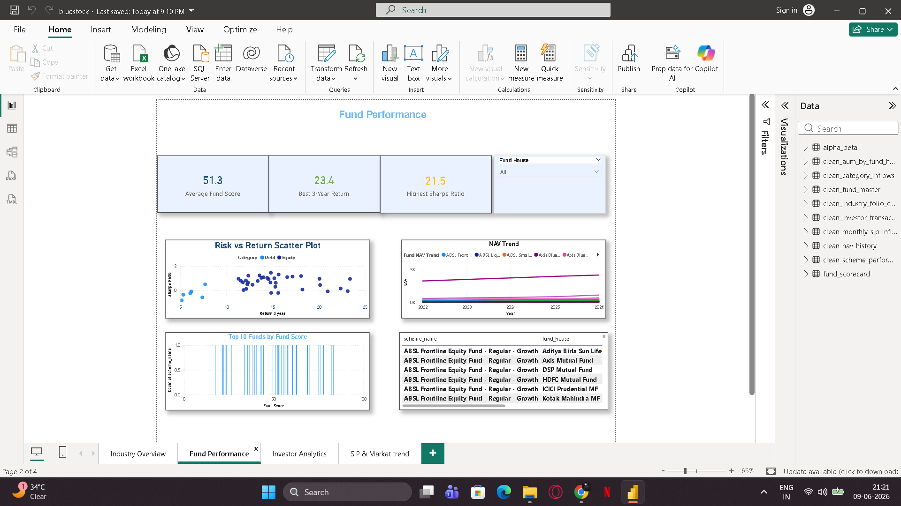

Slide 11
Key Business Insights
1. High Sharpe Ratio funds deliver superior risk-adjusted returns.
2. Certain funds show elevated VaR and require risk monitoring.
3. Most investors prefer SIP-based investing.
4. Tier-1 cities contribute the majority of investments.
5. Portfolio concentration varies significantly across funds.

Slide 12
Thank you
Project Summary
✔ ETL Pipeline Developed
✔ Exploratory Data Analysis Completed
✔ Advanced Analytics Implemented
✔ Interactive Power BI Dashboard Created
✔ Business Insights Generated

