Slide 1


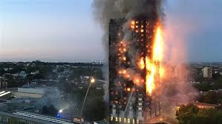
GMIT BHAVNAGAR
SCREENING PRAPOSAL PRESENTATION

Slide 2
Nature Of Project: Technical
Objective
Focusing on fire & hazardous situations
Develop Technology in safety & Fire Hazards
Low cost Ergonomic system for common personal
Universally used in multiple situations
In Fire, Earthquake,, collapse of Building etc.
Save life from hazards by people carrying away

Slide 3
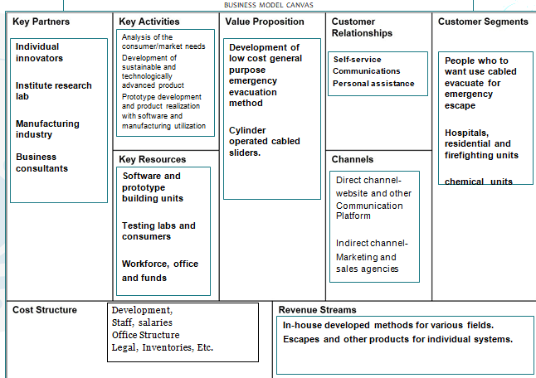

Slide 4
Problems:
Compiling Problem(S) to be Solved:
In Present Not Quick Responsive
Passages Blocked by Objects
No Ergonomic Design Exist.
Not For Common Multiple Usage
System For Industrial Mostly
People can’t handle & panic
Impractical Device For Less Injury

Slide 5
Children Not Able to Use Present Device
User Can not use Multiple Times
Optimization With Nominal Cost
Lacking in Design and Construction

Slide 6
What’s the Pain or Need that Your Potential Customers have?
present there is a void in the market for the Evacuation which Are usable/viable for the common purpose.
one person who uses the system he/she escapes area with zero injuries is question or need factor of safety.
Multiple users are questionable.
The suitable speed reduction or brake is required for this operation.

Slide 7
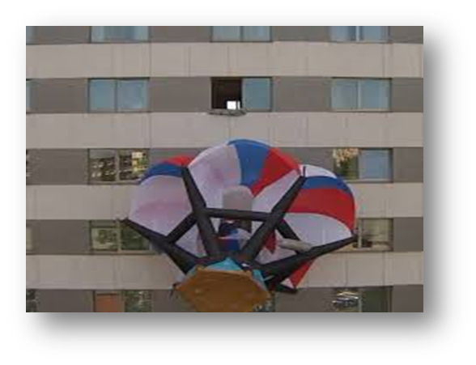

The Solution
1. SOS Parachute
Commonly Made from Nylon & Silk
When all ways Chocked-up then it is used.
It require Min. 75 to 100 Ft. Height
Easy Operation & need Air Presser.
Not Effective and Occurs Injuries

Slide 8
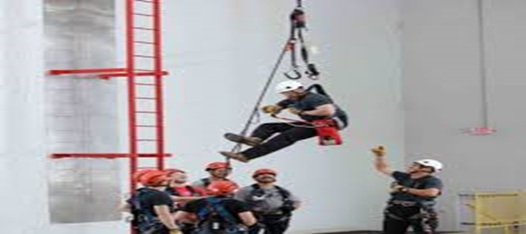
2. Our Developed System:
Robust Design and Less Working Component.
Reusable For Multiple Times
In Multi Situations.
Earthquake, Fire, Collapse of Structure is used.
Speed Range and Ergonomic Design.
First time, Escape with Zero Injuries.

Slide 9
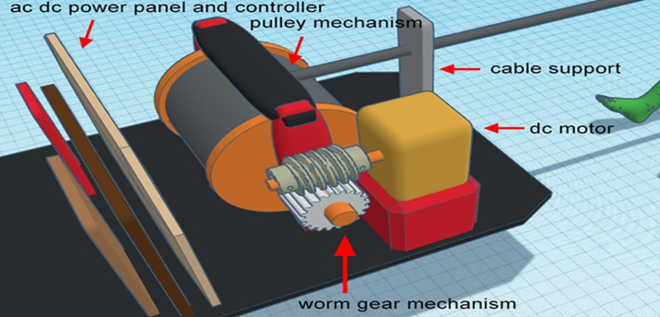
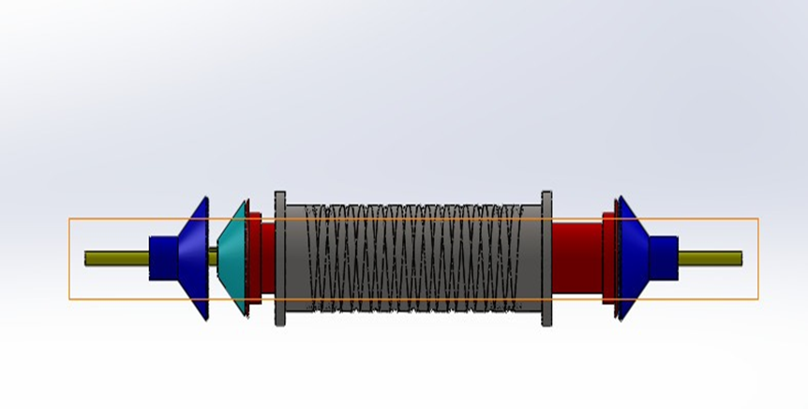
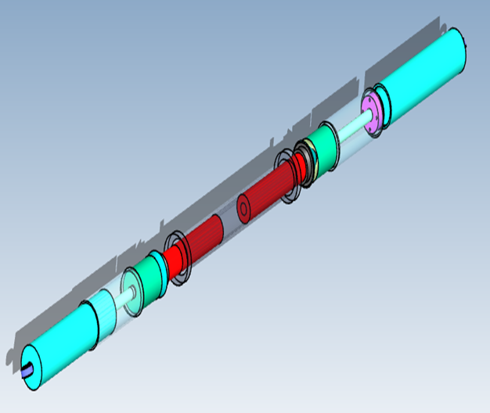
Constriction & Design Phase
Phase: 01
Phase: 02
Phase: 03

Slide 10
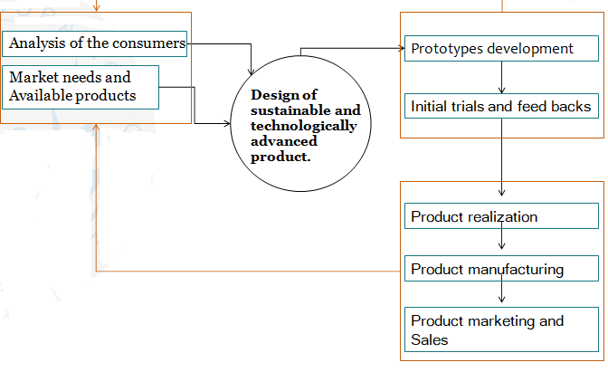
Plan Of Work

Slide 11
Components:
Cylinder/Main Shaft
Left-End Screw
Right-End Screw

Slide 12
Lifter Suspension
Clutches
Bearing

Slide 13
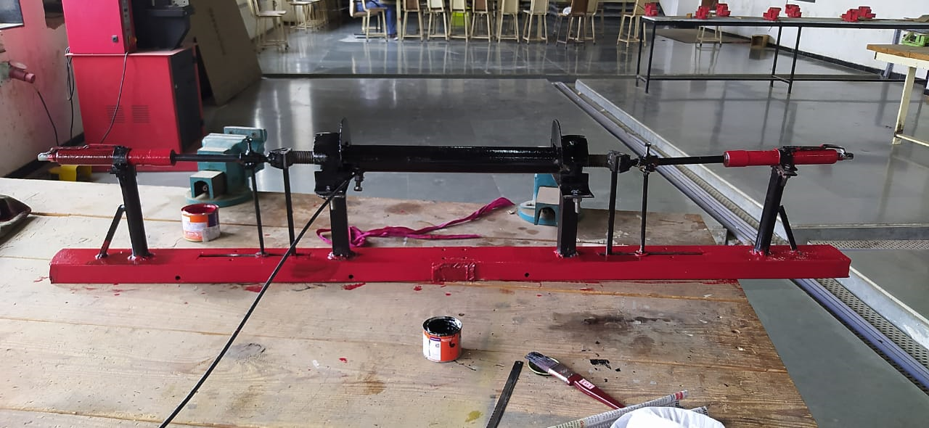
Working
https://youtu.be/XuvFeHj6ZlU

Slide 14
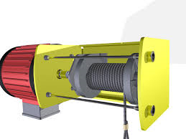
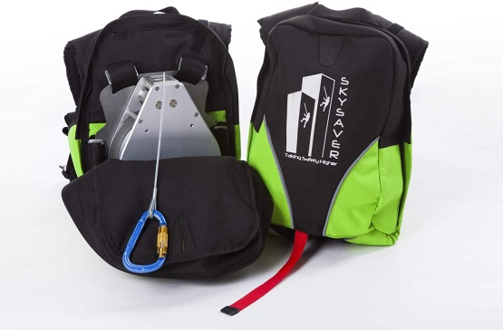
MARKET
Companies like skylotec, RUNVA and are specialized in making the cabled evacuates. Their evacuates are widely made in china.
This kind of evacuation system are used in various fields like,
Chemical and metal industries
High rise building like BURJ-KHALIFA
plant Maintenance

Slide 15
MARKET SIZE
it forecasts the global incident and emergency management market size grow from USD 117.2 billion In 2020 to USD 156.1 billion by 2025. ET
Market is estimated to grow at a pace of around 7.55% by each year – ET.
Growing fire hazards amount in India is a one of the major reason for increase in the Market.
Maintaining the costly evacuating system is becoming the prime concern in safety &Maintained system
Thus we are not limiting this project to only one product and want to do more in this particular field by offering various solutions ranging from evacuate to universal systems.

Slide 16
INNOVATION/UNIQENESS
Q1: Why is your project or business unique? What is the innovation in it?
As stated in solution slide the project is unique and innovative because of It’s novel Design and the universal purpose for all age.
Q2: How are you better or different than your competitors?
Our evacuates will be more focused on the general purpose usage.
Rope materials for the system as well as the industrial applications will Is more sustainability focused?
Q3: Do you have a unique team, partner, invention, intellectual property, insights, or Expertise that others don’t have?
Unique invention which can be leaded to patent.

Slide 17
ADVANTAGES
Many Time Use In Multi Situations
High Load Capacity
Easy Operation
Lesser Maintenance
Zero Injuries

Slide 18
APPLICATIONS:
Residential Apartments
Hospitals
Schools/Collages
Commercial Complex/Offices

Slide 19
Further Plan
Is Your Team Completed? Yes
Is Your Business Plan Completed? Yes
Have you filed for intellectual property, such as technical patent or design Patent? – Not yet
Have you leased office space, or setup home office? – No
Have you acquired first customers? – No
Have you lined up key partners and business advisors? – No
Have you raised previous funding from investors? – No

Slide 20
The Team
Innovator/Guide:
Prof. Jay Bhatt Sir.
Developers:
Trivedi Karan
Jani Jatin
Patel Aakash
Pathak Jaypal

Slide 21



