Slide 1
Private dataset access workflow (python)
Karan Bhut (2020202015)
Nisarg Sheth (2020201049)
Pujan Ghelani (2020201083)

Slide 2
Work done
User Authentication (Registration, Login, Logout)
Database design
Separate tables for Accepted, Rejected, Pending requests.
Dataset_info table.
Consumer page (Request / Cancel / View)
Publisher page (Accept / Reject)

Slide 3
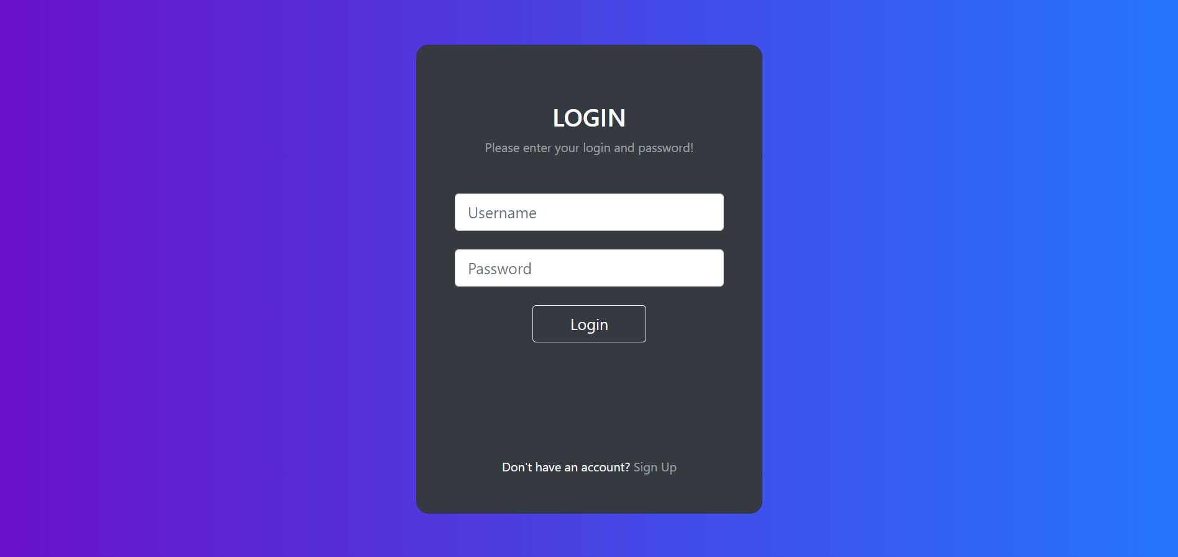
Screenshots
1. Login form

Slide 4
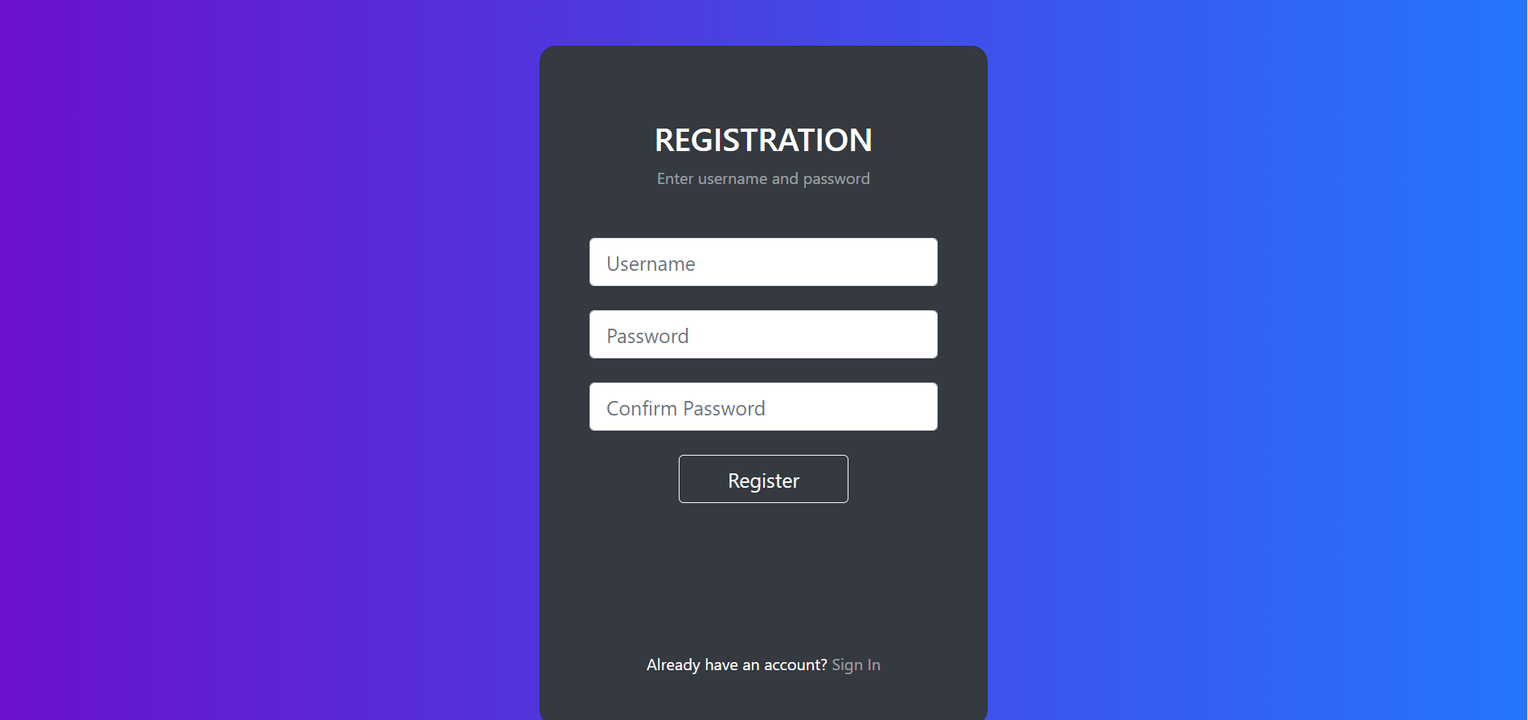
2. Registration form

Slide 5
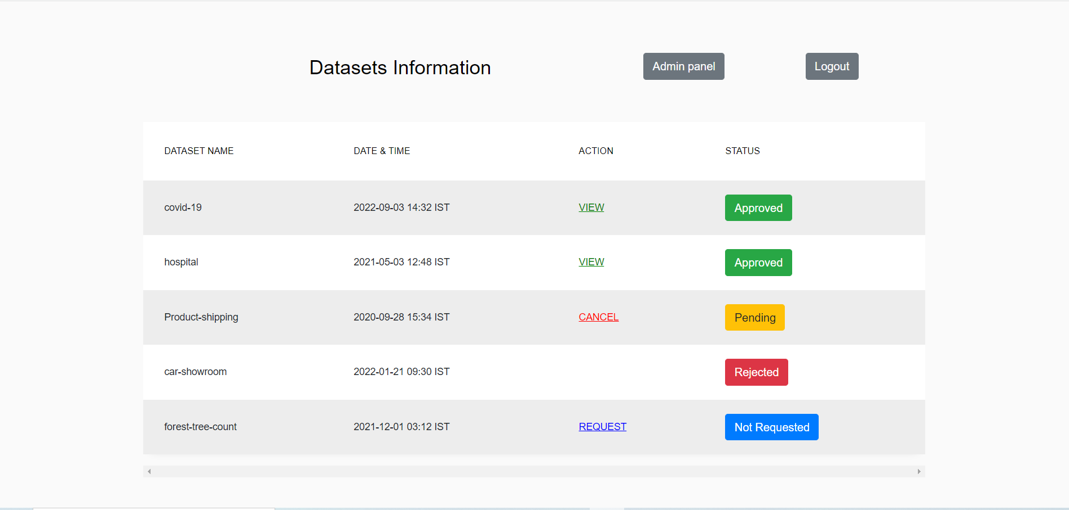
3. Dataset Consumer home page

Slide 6
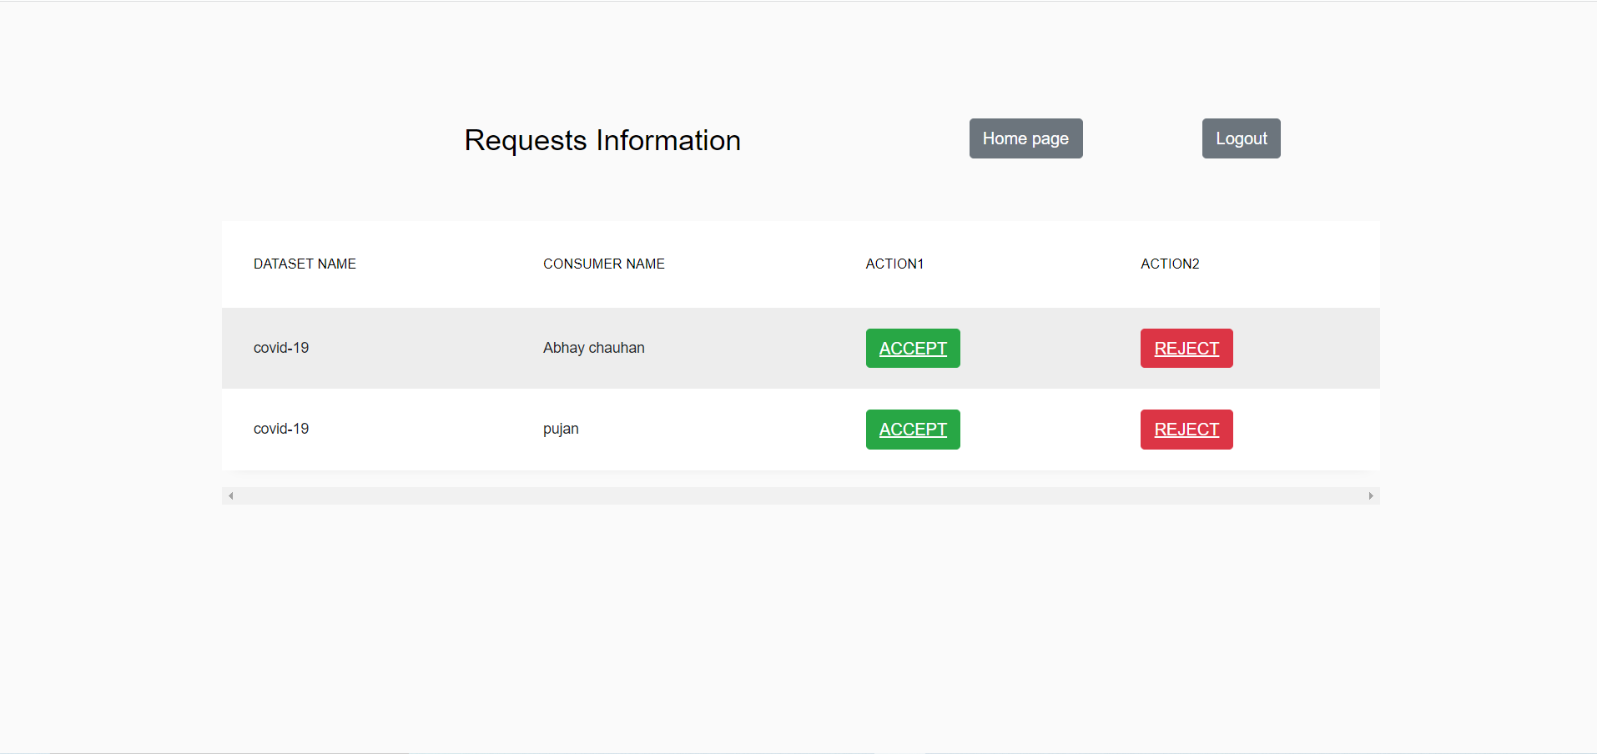
4. Dataset publisher page

Slide 7
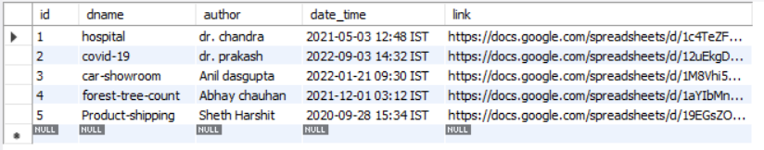
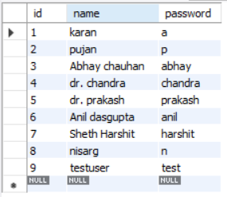
MySQL workbench table contents
dataset_info:
user_details:

Slide 8
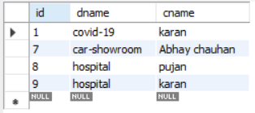
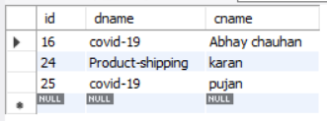

MySQL workbench table contents
approved_req:
pending_req:
rejected_req:

Slide 9
Future work
User Agreement need to be added.
Public dataset should be accessed to all consumers.
Publisher should be able to change requirements to access his dataset.

Slide 10
Individual Contribution
Karan Bhut: UI schema design, UI implementation
Nisarg Sheth: UI schema design, user authentication
Pujan Ghelani: UI schema design, Database schema

