Slide 1
Adaption, Analysis and Evaluation of State-of-the-Art Wav2Vec2 Models on Air Traffic Control Communication Data
Karan Chand s1033357

Slide 2
Content
Introduction
Related work
Methods
Experiments
Results
Discussion
Conclusion

Slide 3
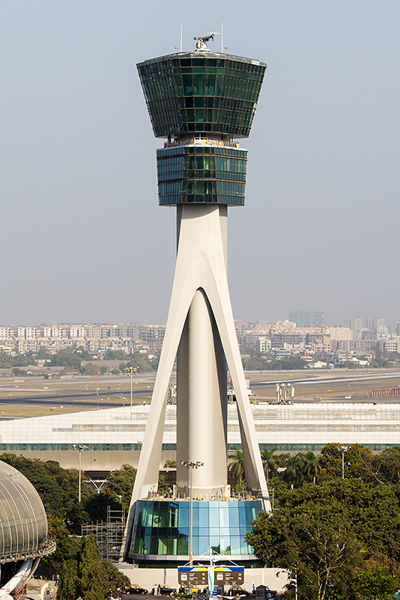
Introduction
Controlling safe and efficient traffic in aviation
Callsigns and commands
Automatic Speech Recognition (ASR)
Decrease workload by a factor of 3 (Helmke et al., 2016)
Source: https://en.wikipedia.org/wiki/Air_traffic_control

Slide 4

“without the dataset, the article is useless”
“speedbird one five six contact rhein one two seven three seven”
Differences of ATC speech compared to regular speech:
ATC data is more noisy
ATC communication does not follow regular speech conventions – callsigns
Standard ASR models perform poorly
Transcribed ATC data is scarce – non-transcribed is not

Slide 5
Motivation
Different model architectures exist:
ANN, HMM and RNN - (Trentin & Gori, 2001)
Wav2Vec2 transformer model:
Lower Word Error Rate (WER)
Insufficiently studied in the ATC domain
State-of-the-art (SOTA) models are still not able to achieve 0% WERs, which is essential in ATC communication

Slide 6
Research questions
How robust are pretrained and fine-tuned ASR models on ATC data?
How does a language model affect the performance of a fine-tuned XLS-R model on ATC data?
How does the amount of data used to fine-tune affect performance of a fine-tuned XLS-R model on ATC data?

Slide 7
Related Work
Fine-tuning on low resource datasets – (Yi et al., 2020) Performance is universal over languages (flexible).
Domain-specific Wav2Vec2 Feasibility of real-time ASR for ATC (Zuluaga-Gomez et al., 2022) WER Reduction (WERR)
Accents in XLS-R - (Babu et al., 2021)

Slide 8
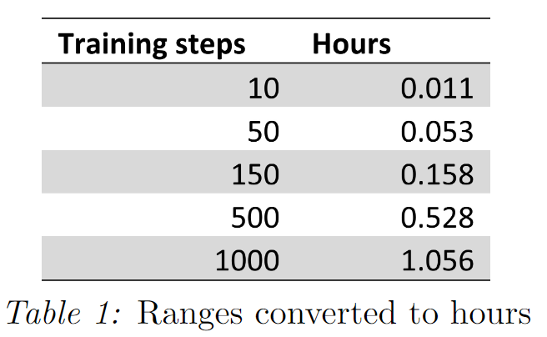
Methods
HuggingFace
SOTA models
Accessibility
Development
Google Colab
Limited resources
Local
Evaluation
WER and Character Error Rate (CER) – not Glue or Bleu
Evaluation → fine-tuning → evaluation → LM → evaluation
Language model
5-gram ARPA file
Only 743 unigrams
Variable LMs out of scope
Fine-tuning
No hyperparameter tuning
Low-medium-high ranges of training data

Slide 9
Models
Pulled from HuggingFace
All Pretrained, some fine-tuned
Base Wav2Vec2 model - Clean
Robust Wav2Vec2 model - Noisy + Clean
XLS-R model - Multilingual + Multi-accent
huBERT model - Improves or matches Wav2Vec2 performance
Choice for research on only XLS-R model:
Accents in ATC
Regularly updated model
Low resources

Slide 10
Experiments
Data
10 hours of speech – average of 3.8s per utterance
Simulated real-time ATC
For public use
Mean perplexity datasets:
Google/fleurs: 35.98
ATCOSIM: 175.08

Slide 11
Data augmentation
Undesirable rows were removed/augmented on conditions:
Rows containing transcriptions that exceed the maximal duration allowed for training and transcription
Transcription containing tags: [HNOISE], [FRAGMENT], [EMPTY], (<OT>. . .</OT>), [NONSENSE] and (<FL>. . .</FL>).
Characters found in transcriptions, separated by “\”: [\=\ ̃\@\,\?\.\!\-\;\:\”\“\%\‘\”\’]
Original ATCOSIM: 10078 rows After cleaning: 9397 rows
Train-validation-test split of 8:1:1 →7526:940:931 rows → 1000:50:931 rows

Slide 12
Settings
No tuning of hyperparameters
Fine-tune for 7500 steps
100 step warm-up phase
Locally on Geforce GTX 1080
Effective batch size of 8
Linear learning rate of 3e-4

Slide 13
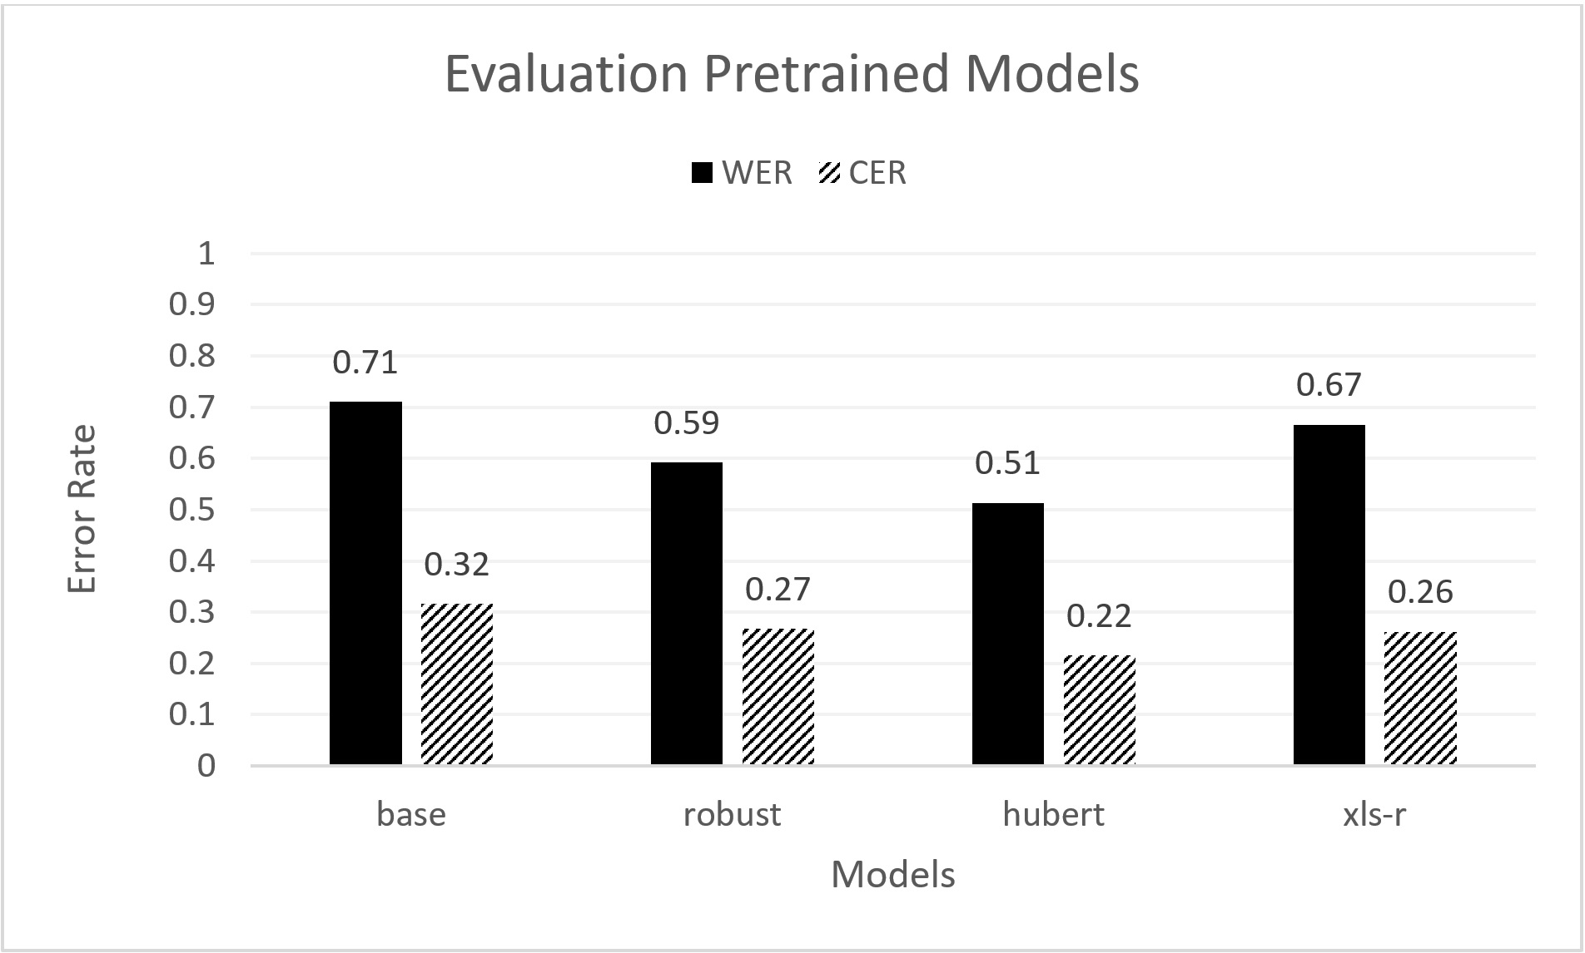
Results
Figure 1: Evaluation of pretrained models in WER and CER.

Slide 14
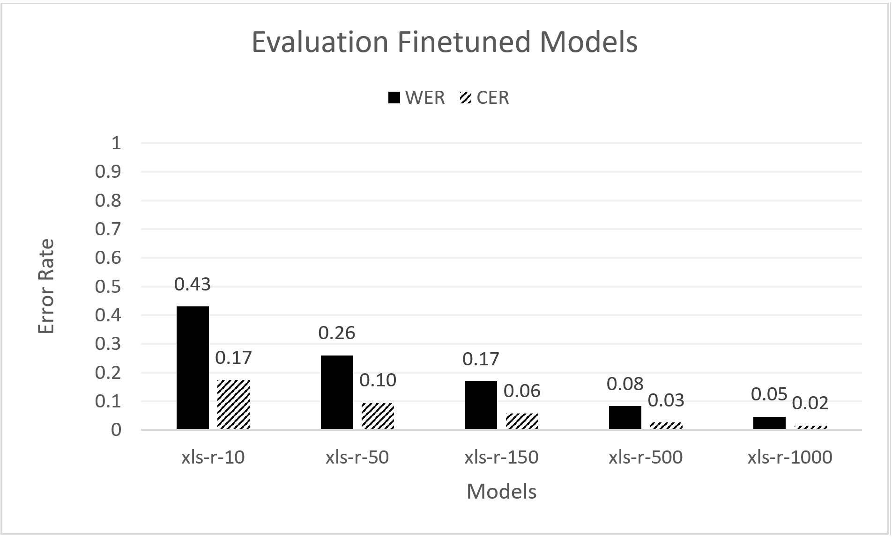
WERR of ~93% and CERR of ~92% for XLS-R-1000
Figure 2: Evaluation of the fine-tuned XLS-R models in WER and CER.

Slide 15
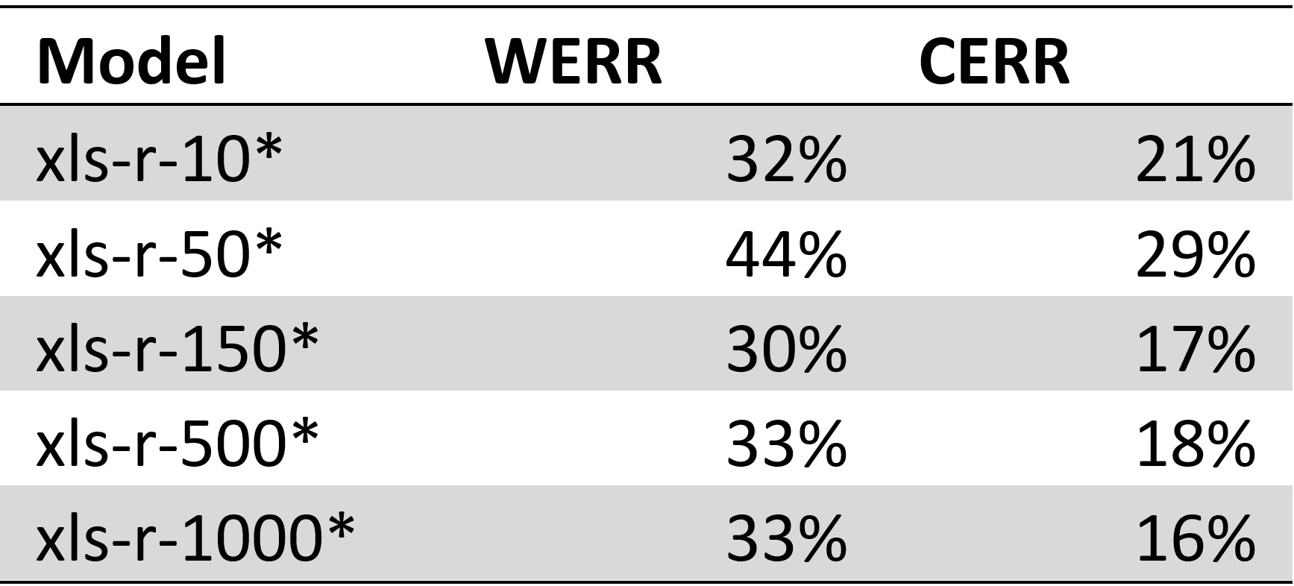
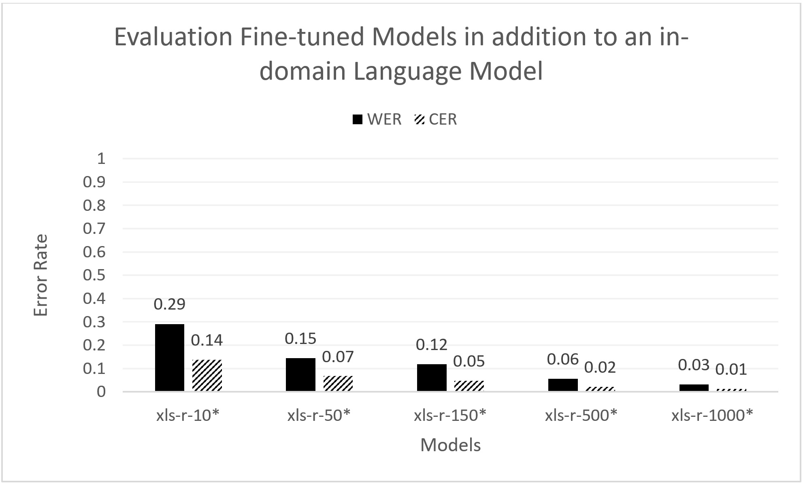
~33% WERR and ~20% CERR relative to fine-tuned models without an in-domain LM
Figure 3: Evaluation of the fine-tuned XLS-R models in addition to a LM in WER and CER.

Slide 16
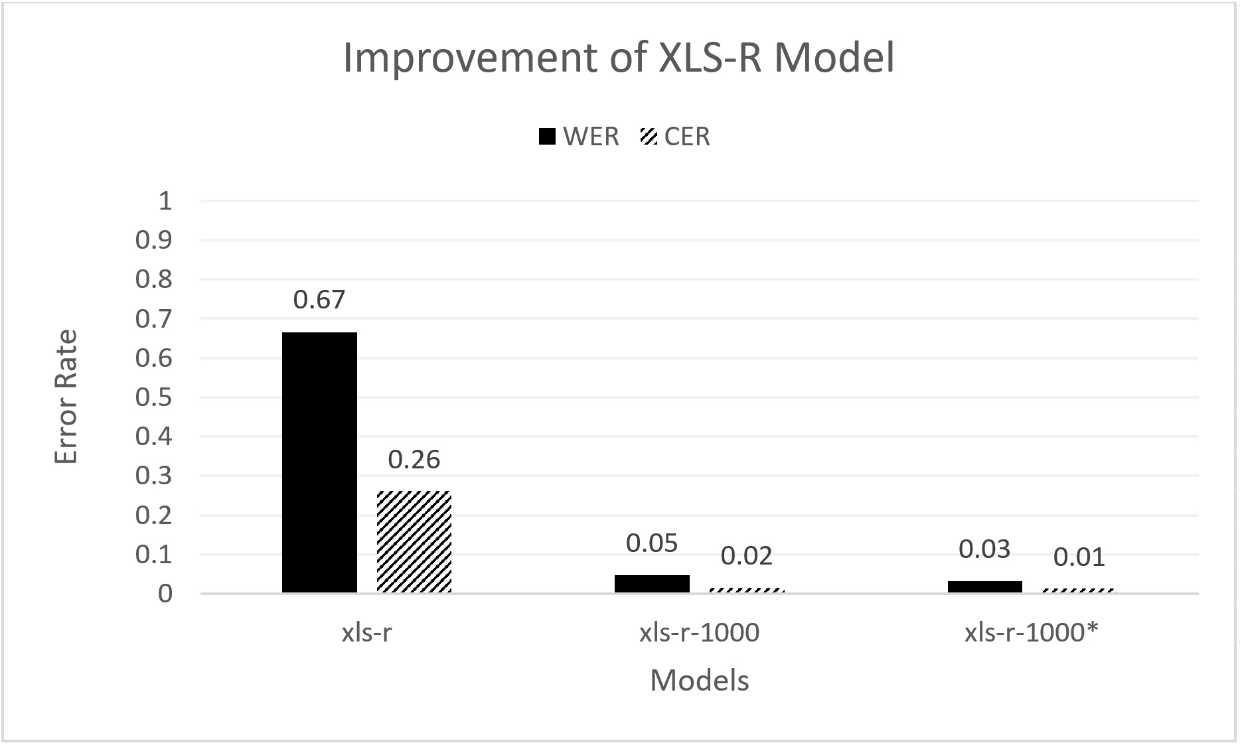
Figure 4: Improvement of the XLS-R model in WER and CER.

Slide 17
Discussion

Slide 18
Conclusion

Slide 19
References
Helmke, H., Ohneiser, O., Muhlhausen, T., & Wies, M. (2016). Reducing controller workload with automatic speech recognition. AIAA/IEEE Digital Avionics Systems Conference - Proceedings, 2016-December. https://doi.org/10.1109/DASC.2016.7778024
Hofbauer, K., Petrik, S., & Hering, H. (n.d.). The ATCOSIM Corpus of Non-Prompted Clean Air Traffic Control Speech
Trentin, E., & Gori, M. (2001). A survey of hybrid ANN/HMM models for automatic speech recognition. In Neurocomputing (Vol. 37).
Yi, C., Wang, J., Cheng, N., Zhou, S., & Xu, B. (2020). Applying Wav2vec2.0 to Speech Recognition in Various Low-resource Languages. http://arxiv.org/abs/2012.12121
Zuluaga-Gomez, J., Prasad, A., Nigmatulina, I., Sarfjoo, S., Motlicek, P., Kleinert, M., Helmke, H., Ohneiser, O., & Zhan, Q. (2022). How Does Pre-trained Wav2Vec2.0 Perform on Domain Shifted ASR? An Extensive Benchmark on Air Traffic Control Communications. http://arxiv.org/abs/2203.16822
Babu, A., Wang, C., Tjandra, A., Lakhotia, K., Xu, Q., Goyal, N., Singh, K., von Platen, P., Saraf, Y., Pino, J., Baevski, A., Conneau, A., & Auli, M. (2021). XLS-R: Self-supervised Cross-lingual Speech Representation Learning at Scale. http://arxiv.org/abs/2111.09296

