Slide 1
Adaption, Analysis and Evaluation of State-of-the-Art Wav2Vec2 Models on Air Traffic Control Communication Data
Karan Chand s1033357

Slide 2
Content
Introduction
Related work
Methods
Experiments
Results
Discussion
Conclusion

Slide 3
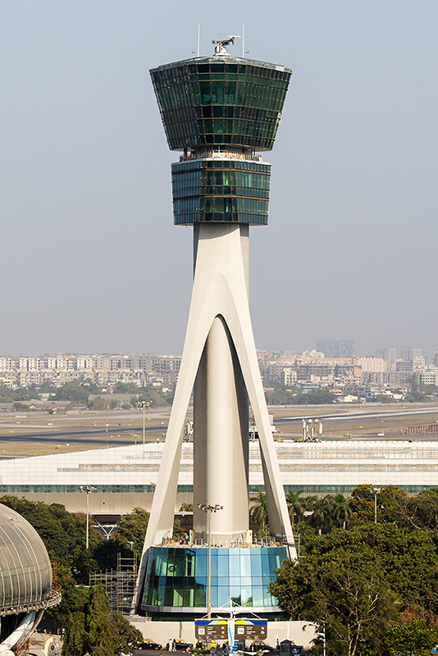
Introduction
Controlling safe and efficient traffic in aviation
Callsigns and commands
Automatic Speech Recognition (ASR)
Decrease workload by a factor of 3 (Helmke et al., 2016)
Source: https://en.wikipedia.org/wiki/Air_traffic_control

Slide 4

“without the dataset, the article is useless”
“speedbird one five six contact rhein one two seven three seven”
Differences of ATC speech compared to regular speech:
ATC data is more noisy
ATC communication does not follow regular speech conventions - callsigns
Transcribed ATC data is scarce – non-transcribed is not
Standard ASR models perform poorly

Slide 5
References
Helmke, H., Ohneiser, O., Muhlhausen, T., & Wies, M. (2016). Reducing controller workload with automatic speech recognition. AIAA/IEEE Digital Avionics Systems Conference - Proceedings, 2016-December. https://doi.org/10.1109/DASC.2016.7778024

