Slide 1
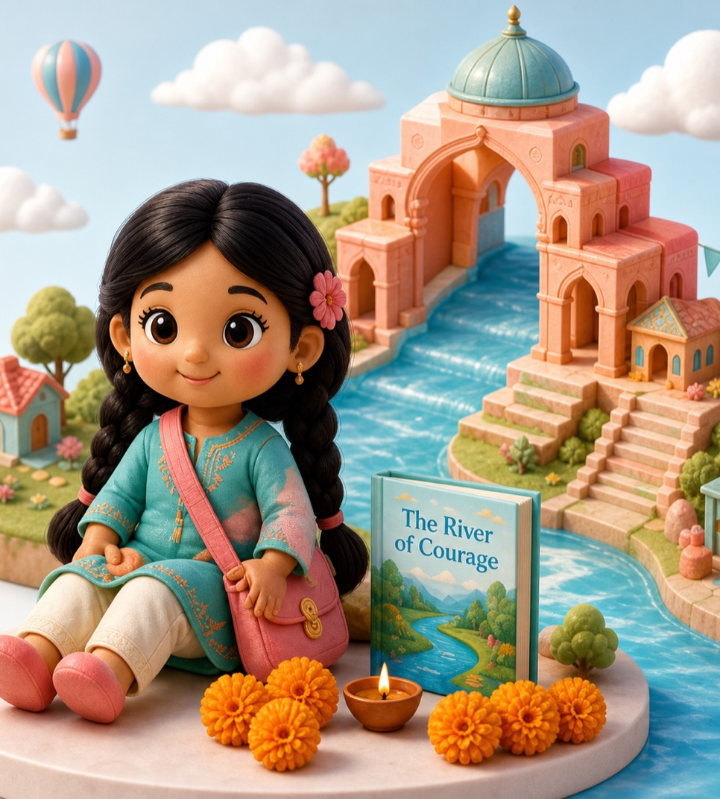
Maitri Dolls
A story-first companion universe inspired by remarkable women from India.
Investor & strategic partner deck
Built around one disciplined first wedge: children fall in love with Manu; parents see meaning, learning, and trust.
Prepared from Maitri project materials and current public market references.
01
Notes:
Sources: Maitri README; Strategy Working Brief; Maitri Circle website assets.

Slide 2
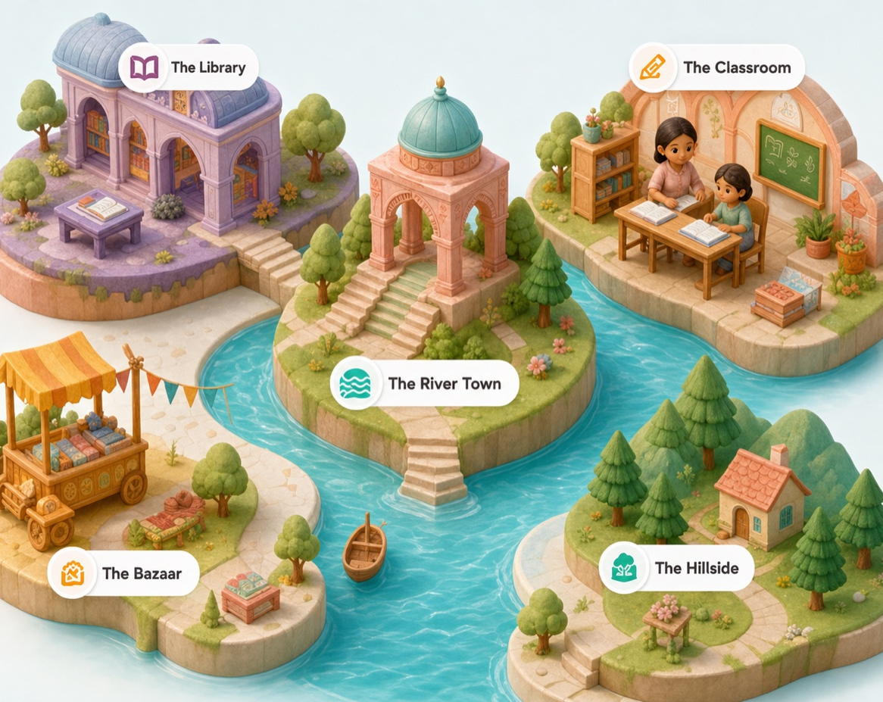
THE BIG IDEA
Make children befriend
Indian heroines before
they own the doll.
The project is designed as a character-led world, not a toy SKU waiting for inventory.
Companion
The doll is a friend first, not a collectible first.
Story
The book creates attachment, recall, and repeat play.
Culture
Indian faces, regions, values, history, and family contexts.
Validation
Community signals before inventory-heavy commitments.
Source: Maitri Strategy Working Brief.
02
Notes:
Sources: Maitri Strategy Working Brief, sections 1-2 and 15.

Slide 3
WHY NOW
A growing toy market is meeting a deeper parent need.
Maitri sits between premium play, cultural identity, learning, and story-led community.
$1.9B
$4.7B
8.14%
Indian toys market value in 2024
Projected Indian toys market value by 2033
Projected CAGR for India educational toys, 2026-2034
Premium parents are not only buying entertainment; they are looking for meaning, learning, and identity.
Maitri can enter with an emotional wedge before scaling manufacturing depth.
Market data: IMARC Group, 2025/2026 public summaries.
03
Notes:
Sources: IMARC Indian Toys Market page accessed 2026-06-20; IMARC India Educational Toys Market page accessed 2026-06-20.

Slide 4
THE PROBLEM
Children can access global doll worlds, but Indian story-led companion worlds remain underbuilt.
For parents, the gap is not only product availability. It is trust, representation, and meaningful repeat use.
Representation gap
Learning gap
Trust gap
Premium doll ecosystems rarely center Indian faces, regions, clothing, languages, and values.
History often feels too textbook-like for young children or too disconnected from play.
Parents need safety, quality, age-fit, cultural sensitivity, and credible product readiness.
Source: Maitri strategy interpretation from founder context.
04
Notes:
Sources: Shwethika Maitri Context; Maitri Strategy Working Brief.

Slide 5
THE SOLUTION
A doll box that behaves like a relationship, not a one-time purchase.
Doll
Storybook
The first box is designed to be complete enough to gift, focused enough to validate, and expandable when demand is proven.
First Manu Box
Doll + story + activities
Letter
Activities
Stickers
Source: First Doll Box Blueprint.
05
Notes:
Sources: Maitri First Doll Box Blueprint; Launch Decision - Start With One Complete Doll Box.

Slide 6
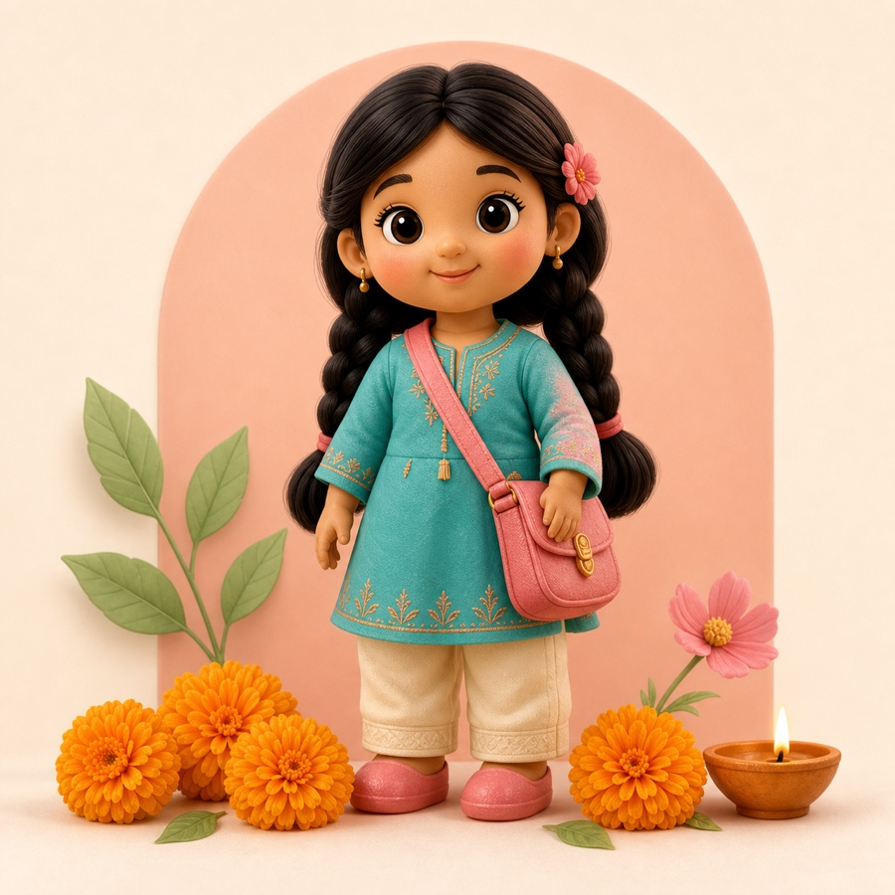
FIRST CHARACTER
Manu is the emotional anchor for launch.
Inspired by Rani Laxmibai's childhood, Manu gives children courage through a friend they can understand.
Brave
Patient
Curious
Kind
Observant
Core message
Before she was a queen, she was a girl who asked why.
Child takeaway: courage begins before you feel ready.
Source: Manu Character Bible v1.
06
Notes:
Sources: Manu Character Bible v1; Maitri Strategy Working Brief.

Slide 7
THE STORY ENGINE
Book 1 turns history into a child-sized emotional arc.
The first story avoids rushing into the full queen narrative. It starts with one defining childhood moment.
Act 1
Act 2
Act 3
Act 4
Manu feels different
The horse nobody could ride
Manu must prove herself
Courage and patience win
It is okay to ask brave questions.
Courage can be quiet and patient.
Being brave does not mean being fearless.
Real courage helps others feel safe too.
Source: Manu 32-page Storybook Blueprint.
07
Notes:
Sources: Manu 32-Page Storybook Blueprint.

Slide 8
BUSINESS ARCHITECTURE
The first box proves the core; add-ons expand only after attachment is visible.
This avoids day-one SKU complexity while preserving a much larger product roadmap.
First Box
Doll, 32-page storybook, letter, activities, stickers
Proof of child love + parent trust
Small Add-ons
Sticker packs, journals, cards, simple outfits
Low-friction repeat purchase
Play Sets
Badal horse, warrior kit, foldable scenes
Imaginative play and margin
Premium + Learning
Fort playset, map game, workshops
Higher-value ecosystem
Guardrail: the story creates demand for accessories, not the other way around.
Source: Add-On Revenue Roadmap.
08
Notes:
Sources: Maitri Add-On Revenue Roadmap; First Doll Box Blueprint.

Slide 9
AUDIENCE
The buyer is the parent. The brand must win the child.
Maitri's early system has to speak to family emotion and parent trust at the same time.
Primary buyer
Gift buyer
Institutional
Urban and semi-urban parents of children around 5-10 seeking meaningful, culturally rooted play.
Grandparents, relatives, and NRI families looking for Indian identity gifts that feel premium.
Schools, libraries, book clubs, museums, cultural groups, and workshop organizers.
Source: Maitri Strategy Working Brief.
09
Notes:
Sources: Maitri Strategy Working Brief, Audience Segments.

Slide 10
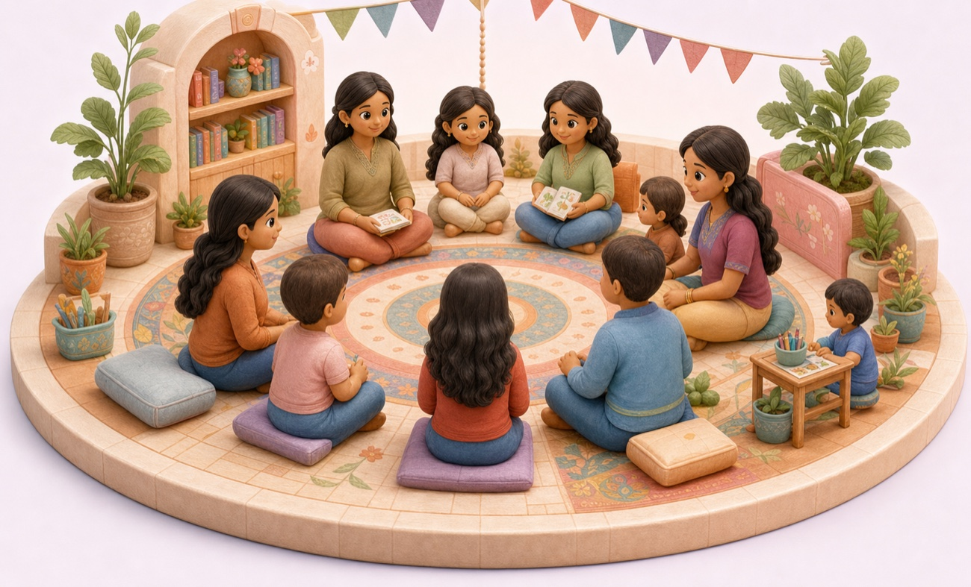
GO-TO-MARKET
Maitri Circle turns pre-launch attention into readable demand.
The first public motion is not a preorder push. It is story, community, and signal capture.
01
Website waitlist + parent survey
02
Instagram and YouTube story rhythm
03
Letters from Maitri newsletter
04
Beta readers and read-aloud feedback
05
School/workshop interest when signal appears
Source: Foundation Retainer Plan and Maitri Circle prototype.
10
Notes:
Sources: Foundation Retainer Plan; Live Interest Capture Plan; Maitri Circle website prototype.

Slide 11
DEMAND VALIDATION
The current plan measures quality of interest before inventory risk.
The waitlist and survey are designed to answer what investors will ask next.
Who is joining?
What do they want?
buyer segment, child age, NRI/gift/educator mix
story preference, beta-reader interest, school interest
Will they convert?
What should change?
preorder signal, price/safety questions, objections
monthly recommendation from evidence
Source: Live Interest Capture Plan and Monthly Signal Report Template.
11
Notes:
Sources: Live Interest Capture Plan; Monthly Signal Report Template.

Slide 12
AI-ASSISTED OPERATING SYSTEM
AI can help Maitri move faster without becoming the product promise.
The repo positions AI as a disciplined internal layer with human review for history, child language, safety, and founder approval.
Character Universe Builder
Story Development Assistant
Historical Claim Tracker
consistent dossiers from approved research
outlines, scenes, prompts, activities
separate verified facts from fiction
Content Engine
Feedback Analyzer
Waitlist Intelligence
reels, carousels, newsletters
cluster parent and child signals
segments, objections, launch decisions
Source: Maitri AI Workflows Map.
12
Notes:
Sources: Maitri AI Workflows Map.

Slide 13
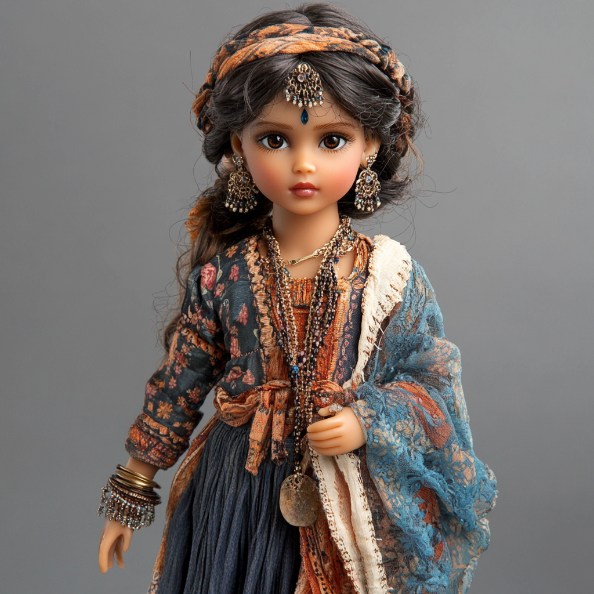
CURRENT ASSETS
The project already has the foundations of a credible first raise or partner conversation.
The repository contains strategy, product, validation, content, and prototype proof points.
Brand positioning and execution plan
Manu character bible v1
First doll box blueprint
32-page storybook blueprint
Month-one Instagram + YouTube calendar
Waitlist and parent survey plan
Monthly signal report template
Maitri Circle website prototype and generated assets
Source: Maitri repository project files.
13
Notes:
Sources: README; project_status; strategy, product, content, validation, and demo folders.

Slide 14
ROADMAP
Big vision, narrow first wedge.
The next phase should convert the existing creative foundation into measurable evidence and product readiness.
0-90 days
3-6 months
Launch gate
Scale
Maitri Circle validation, Manu content, social rhythm, beta-reader pipeline
Product trust, storybook draft, school interest, founder preorder readiness
Only proceed when compliance, cost, safety, price, and demand signals align
First box, add-ons, new characters, school/community programs
Source: Foundation Retainer Plan and Launch Decision.
14
Notes:
Sources: Foundation Retainer Plan; Launch Decision; Add-On Revenue Roadmap.

Slide 15
THE ASK
Use capital and partners to de-risk the first Manu box.
Tailor this slide by audience: VC, strategic partner, manufacturer, school network, or brand collaborator.
Product development
storybook production, prototype refinement, packaging, child testing
Manufacturing + compliance
materials, supplier readiness, BIS process, testing pathway
Community growth
content production, beta readers, parent panels, school pilots
Distribution partnerships
retail, gifting, education, NRI and cultural channels
To finalize: amount, round type, use-of-funds, milestones, and commercial terms.
Open data needed from founder: target raise, unit economics, production quotes, current traction.
15
Notes:
Sources: Derived from approved deck outline and repo risk/validation guardrails.

Slide 16
READINESS GUARDRAILS
Trust is part of the product.
Maitri should keep safety, historical accuracy, child language, and production readiness as explicit launch gates.
BIS pathway
Human review
Preorder discipline
Non-electric toys map to IS 9873; electric toys map to IS 15644 in BIS guidance.
Historical claims, fictionalization, child language, and safety claims need review.
Do not request payment or promise delivery until product readiness is clear.
Source: BIS toy certification guidance and Maitri review guardrails.
16
Notes:
Sources: BIS 10 steps to BIS Licence for Toys; Maitri Foundation Retainer Plan review guardrails.

Slide 17

Maitri's thesis
Build emotional attachment first. Prove demand second. Scale the product universe third.
The first Manu box gives Maitri a focused wedge: one lovable character, one parent-trusted promise, one measurable path to product-market evidence.
Maitri Circle -> Manu Box -> Character Universe
Source: Maitri strategy and first-box launch decision.
17
Notes:
Sources: Maitri Strategy Working Brief; Launch Decision; First Doll Box Blueprint.

Slide 18
SOURCES
Source base used for this deck.
Deck claims are drawn from Maitri repository materials and current public references.
Maitri repository: README, project status, foundation map, foundation retainer plan.
Founder context: Shwethika email context and first-box launch approach note.
Strategy: Maitri Strategy Working Brief and Restructured Execution Plan.
Product: Manu Character Bible v1, First Doll Box Blueprint, 32-page Storybook Blueprint, Add-On Revenue Roadmap.
Validation: Live Interest Capture Plan and Monthly Signal Report Template.
Prototype: Maitri Circle website assets and generated visuals.
External: IMARC Indian Toys Market public summary, Feb 2025; IMARC India Educational Toys Market public summary, accessed June 2026.
External: BIS 10 steps to BIS Licence for Toys PDF.
Prepared 2026-06-20.
18
Notes:
This appendix lists the source base used for the deck.

