Slide 1
AUTOMATION TESTING WITH BEHAVIORAL DRIVEN DEVELOPMENT (BDD)
Karan Khot

Slide 2
What is BDD?
Behavior-driven development (BDD) is a software development methodology in which an application is specified and designed by describing how its behavior should appear to an outside observer.
Invented by Dan North in 2003 as a response to test-driven development (TDD)
“BDD is a second-generation, outside-in, pull-based, multiple-stakeholder, multiple-scale, high-automation, agile methodology. It describes a cycle of interactions with well-defined outputs, resulting in the delivery of working, tested software that matters.”
- Dan North, 2009

Slide 3
How BDD Works?
In BDD, tests are explained as behavior of application and are more user focused.
A test case is called scenario. Scenarios are saved with .bdd extension in a project.
A scenario is written in plain descriptive English using verbs like: Given, When, Then , And. Each new sentence in a scenario becomes a test step.
Scenario template:
Given some initial context (the givens), When an event occurs, then ensure some outcomes.
Once a scenario is written, automation scripts are developed for every step inside a scenario. Every test step is then mapped to automation scripts.
Notes:
.bddin QAF; .feature with cucumber

Slide 4
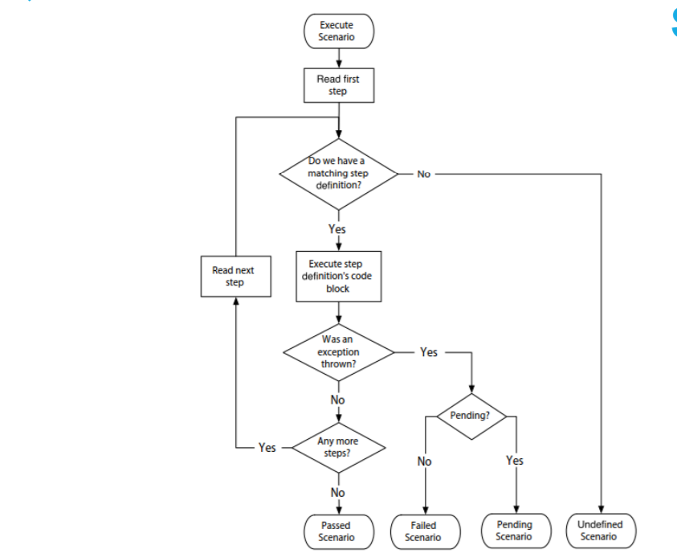
BDD Workflow

Slide 5
Features of BDD
Ubiquitous language: The ubiquitous language is understandable by all the members of the team, which reduces misconceptions and misunderstanding and makes it easier for new members to join the working process
Strong collaboration: With BDD, all the involved parties have a strong understanding of the project and they can all have a role in the communication and actually have constructive discussions. BDD increases and improves collaboration.
High code reusability: With BDD, test steps in a scenario can be re-used any number of times is different scenarios without writing even a single line of code.
High visibility: By using a language understood by all, everyone gets a strong visibility into the project’s progression.

