Slide 1

Analysis on Portuguese Bank Marketing Campaign
ALY 6020 Predictive Analytics
Faculty: Ms. Na Yu
Northeastern University
Submitted By,
Aneri Bharbhaya
Karan Kaushal Daiya
Naga Anil Kumar Ganti
Zhaojie He

Slide 2
Introduction
Data Set – Marketing Campaign of a Bank
Feature Engineering – Exploratory Data Analysis

Slide 3
Processing the data
Check for Missing Values.
Improving Model Performance and Comparing Actual vs. Predicted Values.
Building the Classifier, Making Predictions.
Exploring and Preparing the Data

Slide 4
Analysis
Naive Bayes Classification, Decision trees, random forest techniques
To get better comparison on the data, we have applied all the three mentioned techniques. Different accuracies were obtained.

Slide 5
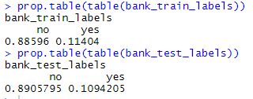

Naive Bayes Classification
Naive Bayes classifier assumes that the presence of a particular feature in a class is unrelated to the presence of any other feature..
Accuracy was observed to be 85.96%

Slide 6
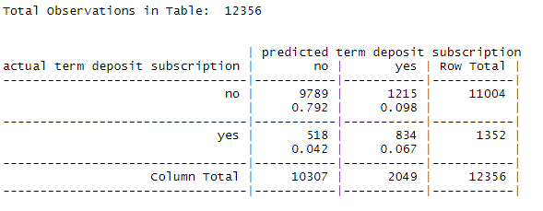

Results after improving model performance:
We tried to improve the performance of the model by including laplace value in the function.
Accuracy was observed to be 85.97%

Slide 7

Decision Tree
Decision Trees are a non-parametric supervised learning method used for both classification and regression tasks.
They are considered to be one of the best and mostly used supervised learning methods.
Constructed Decision Tree for training data with 10 trails and calculated error cost which eliminates False Positives.

Slide 8
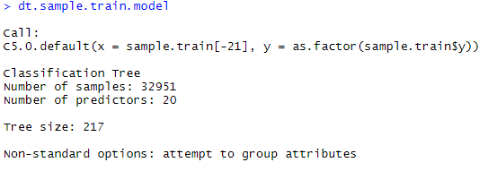
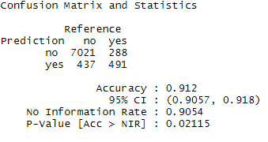
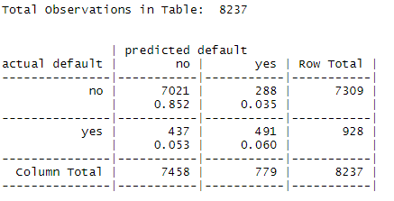
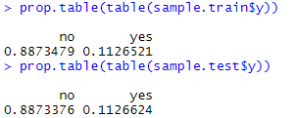
Decision Tree Results
Decision Tree of Training Dataset with 93.5% accuracy
Confusion Matrix of predicted Training and Test data
Proportion of Data

Slide 9
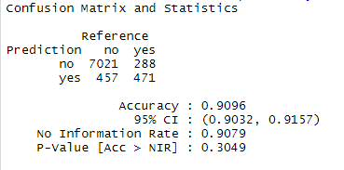
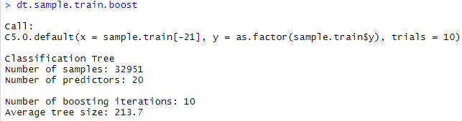
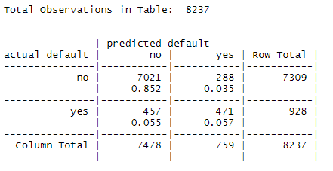
Performance Improvement by Boosting Training data with 10 trials
Confusion Matrix Of Predicted boosted model and Test Data with 10 trials

Slide 10
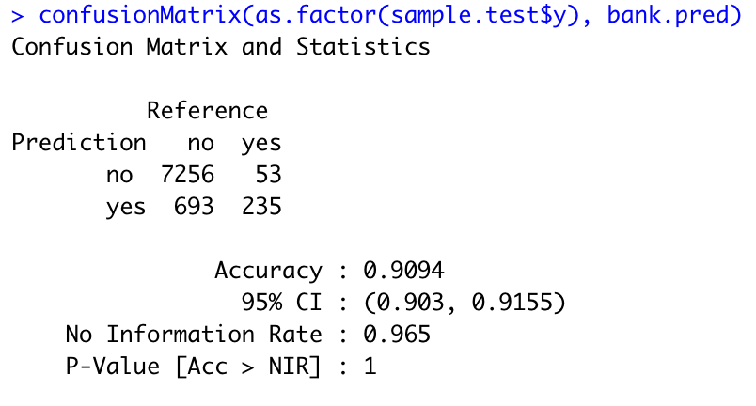
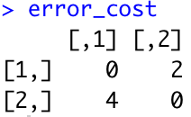
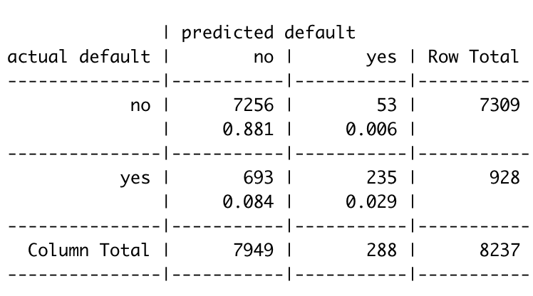
Cost Matrix: Types of mistakes vary each time.
In our previous model, nearly 288/7309 = 3.95% non-defaults were incorrectly classified, in this model, only 53/7309 = 0.7% of the non-defaults were predicted to be defaults. Finally we got an accuracy of 90.94%.

Slide 11

Random Forests
Random Forest (RF) is one of the many machine learning algorithms used for supervised learning.
They are used for learning from labelled data and making predictions based on the learned patterns.
Constructed Random Forest for banking data and performed 10-fold cross validations. Also identified variables importance for measures.

Slide 12
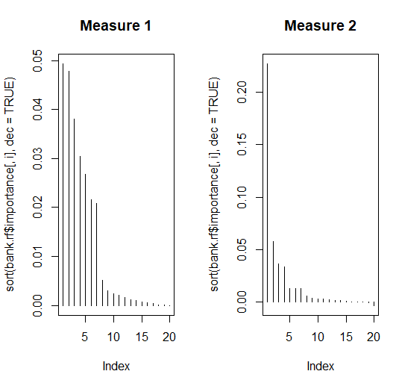
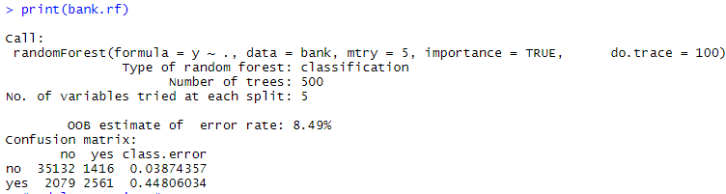
Random Forests Results
Random Forest of Training Dataset with 91.51% accuracy

Slide 13
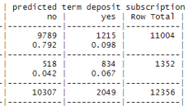

RESULTS
MODEL | ACCURACY | CONFUSION MATRIX
NAIVE BAYES | 85.96%
DECISION TREE | 90.94%
RANDOM FOREST | 91.51%

Slide 14
Conclusion
Based on the comparison results, it can be inferred that Random Forest came out to be a winner.
Accuracy, Sensitivity, Specificity are the factors that were considered to determine the best model.

