Slide 1

New York City Airbnb Project:
By: Karan Kaushal Daiya & Dishant Rajesh Modi

Slide 2
Dataset:
This Airbnb dataset for the 2019 year appeared to be a very rich dataset with a variety of columns that allowed us to do deep data exploration on each significant column presented.
Here in this project, we have outlined 3 main types of Data Analytics: Descriptive Analysis, Diagnostic Analysis and Predictive Analysis.
You can download this dataset by clicking on the below given link, https://www.kaggle.com/dgomonov/new-york-city-airbnb-open-data/download

Slide 3
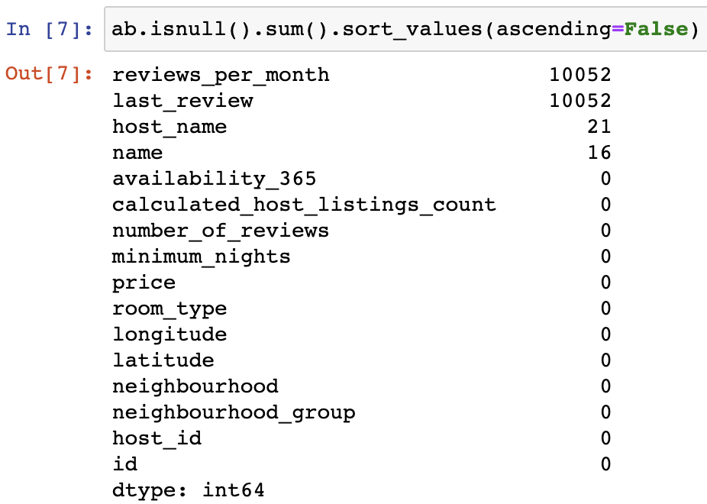
Checking for null values:

Slide 4
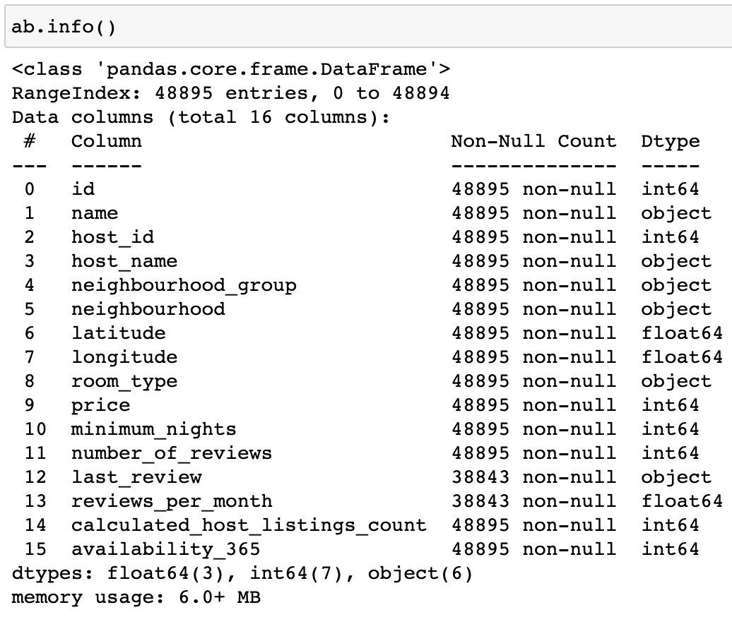
Understanding the Data:

Slide 5
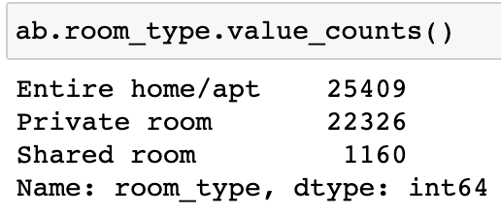
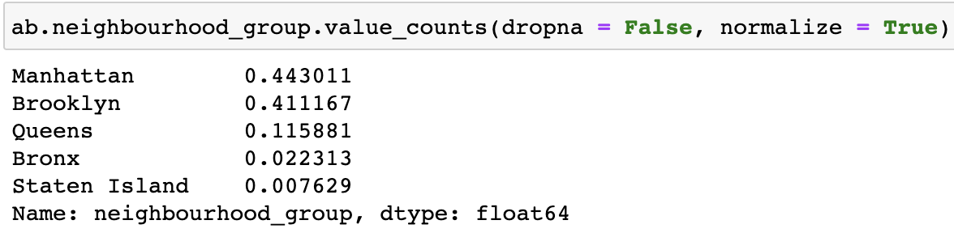
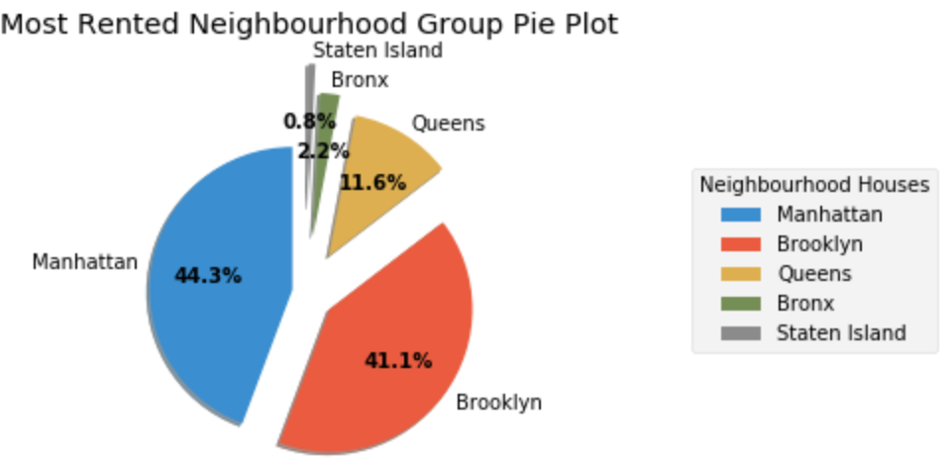
Number of room type available and percentage representation of neighborhood group:

Slide 6
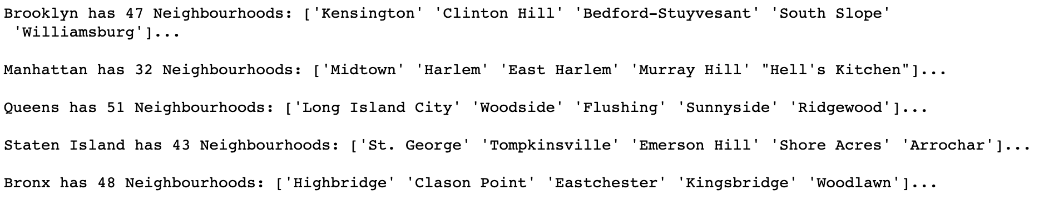
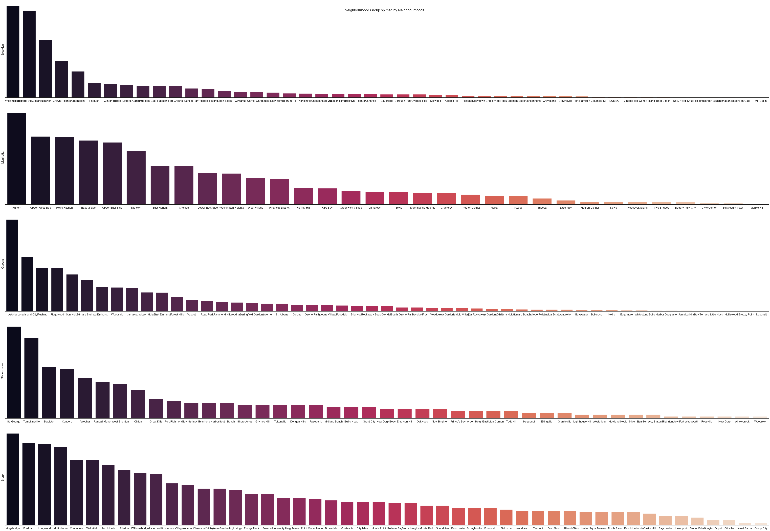
Neighbourhood group splitted by Neighbourhoods itself:

Slide 7
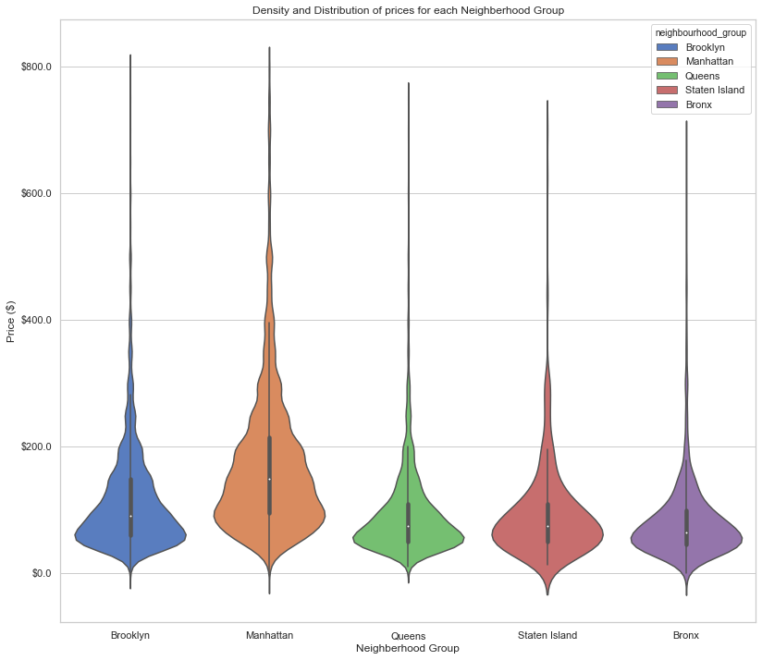
Density and Distribution of Prices for each Neighborhood Group

Slide 8
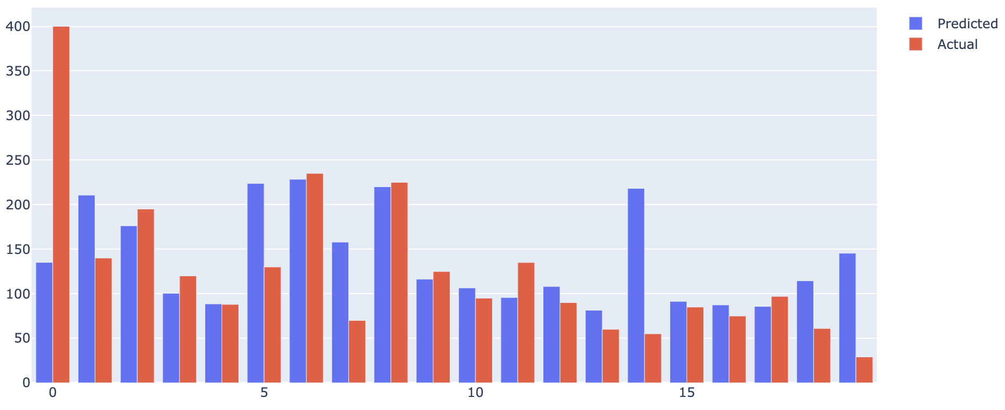
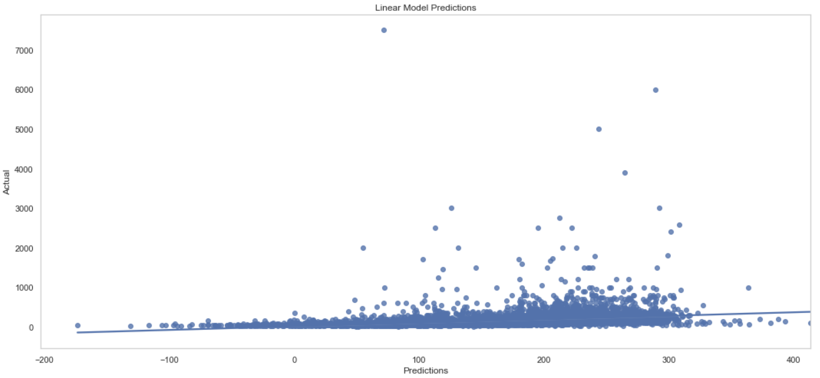
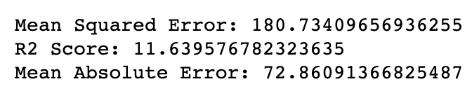
Linear Regression:

Slide 9
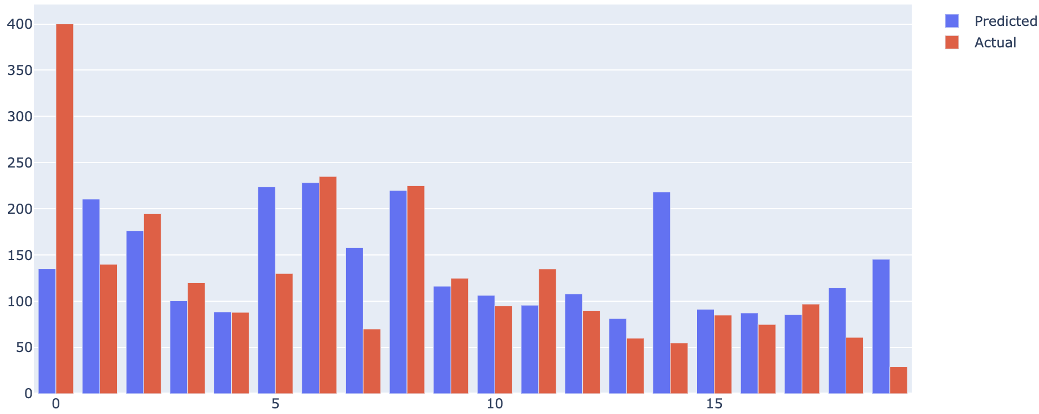
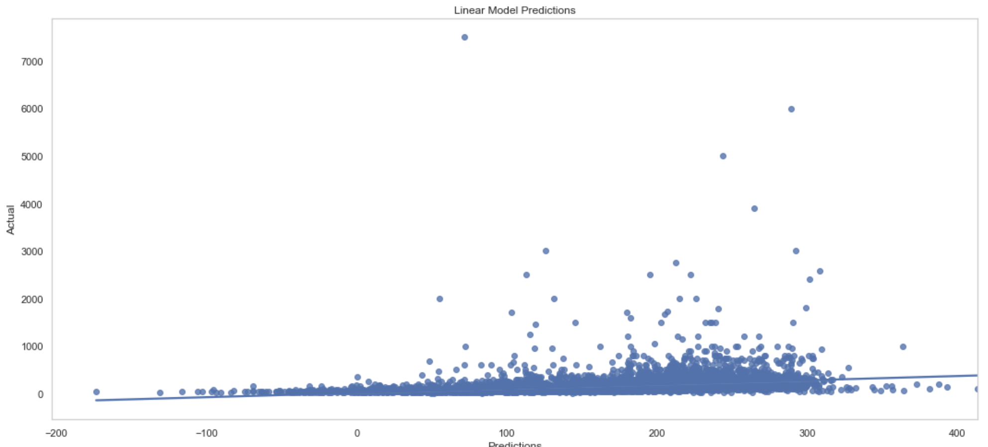
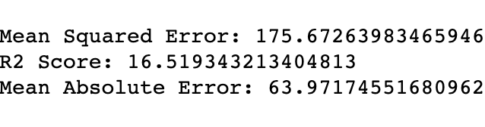
Gradient Boosting Regression

Slide 10
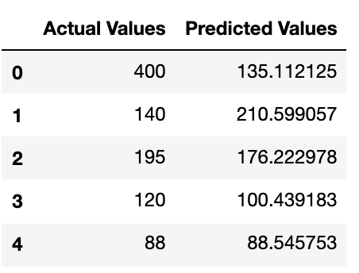
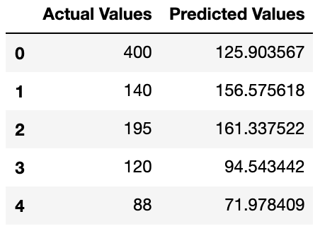
Linear Regression Model
Gradient Boosted Regression

Slide 11
Thank You

