Slide 1
Introduction
Sentimental Analysis On
Social Media

Slide 2
What is a Sentiment?
A sentiment is a view or opinion that is held or expressed.
Sentiment can also mean an emotion.
A sentiment can be either positive, negative or neutral.

Slide 3
SENTIMENTAL ANALYSIS ON SOCIAL MEDIA
Social media sentiment analysis takes the conversations your customers are around the social space and puts them into context.
Sentiment analysis digs into the positive, negative and neutral emotions surrounding the business mentions.

Slide 4
Motivation of Sentiment Analysis.
Reading all reviews is time consuming, therefore the need is for automation.
Sentiment analysis is defined as automatic assessment of the sentiment expressed in text.

Slide 5
Objectives to achieve
The main objective of developing this project was to get some hands-on experience of NLP(Natural Language Processing).
Also to work on basic concepts of Machine Learning and the various libraries and tools available for sentiment analysis.

Slide 6
Application of Sentiment Analysis
Companies can gain insight of the reputation of their brand.
They can also track specific topics and get relevant insights on how people are talking about those topics.

Slide 7
Application of Sentiment Analysis
Sentiment analysis is particularly useful for social media monitoring(mainly on Twitter, Facebook & LinkedIn).
Sentiment analysis can also be used by the company to stay ahead of their competitors.
It is used by the companies so that they can be aware of how their customers feel about their new product.

Slide 8
System Overview
We have mainly targeted the Huge social media platform where most of the people are putting their thoughts and opinions: Twitter.
We have created two kinds of models:-
1. Command line models.
2. Web based UI models.

Slide 9
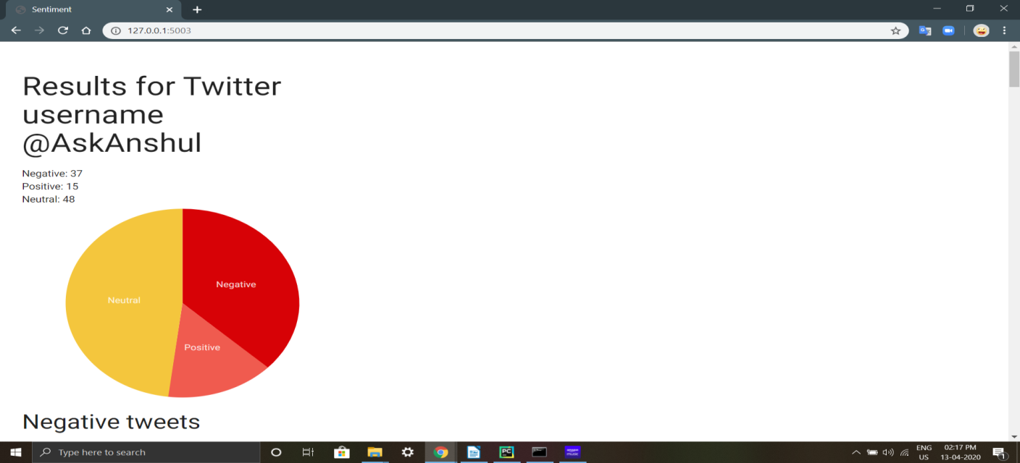
Code Snippet(Web)

Slide 10
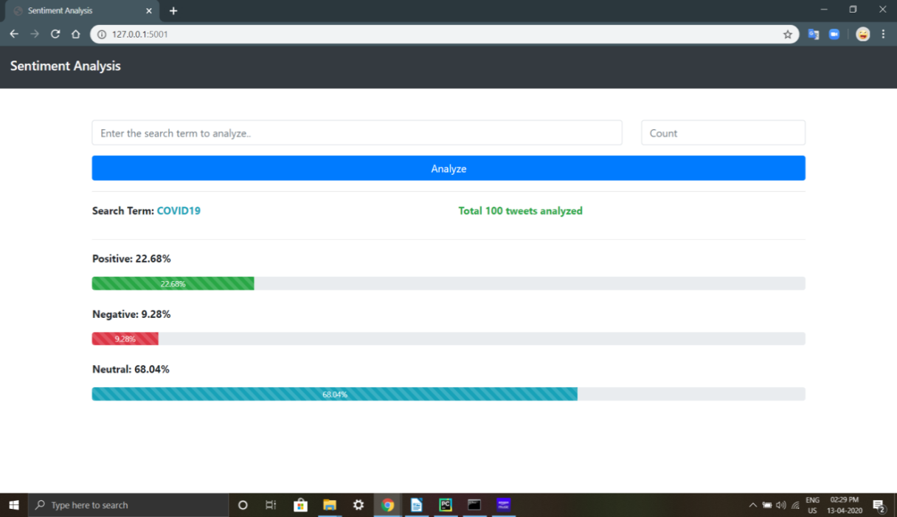
Code Snippet(Web)

Slide 11
System Overview
Tools and ML Libs we have used for the Development:
Flask- Python Web Framework
NLTK(Natural Language Processing Toolkit)
Tweepy
MatplotLib
TextBlob

Slide 12
Design
In design, we have decided on how to categorize user tweets and get the sentiment in best possible manner.
So we mainly categorized them in:
1.Positive tweets
2.Negative tweets
3.Neutral tweets

Slide 13
Testing
Software testing is the process of evaluation of a software item to detect differences between given input and expected output.
The testing strategy for the project is to test for the each of the features of the system manually by considering a number of test cases possible and to check for it’s accuracy.

Slide 14
Testing
So in username wise model we selected test case for public and private accounts.
In keyword based models we have tried out test for case sensitivity in different keywords.
In Web UI we have checked that the forward and backward proceedings working fine on defined ports.
We have also checked mix and merge of keywords along with different counts and got expected results.

Slide 15
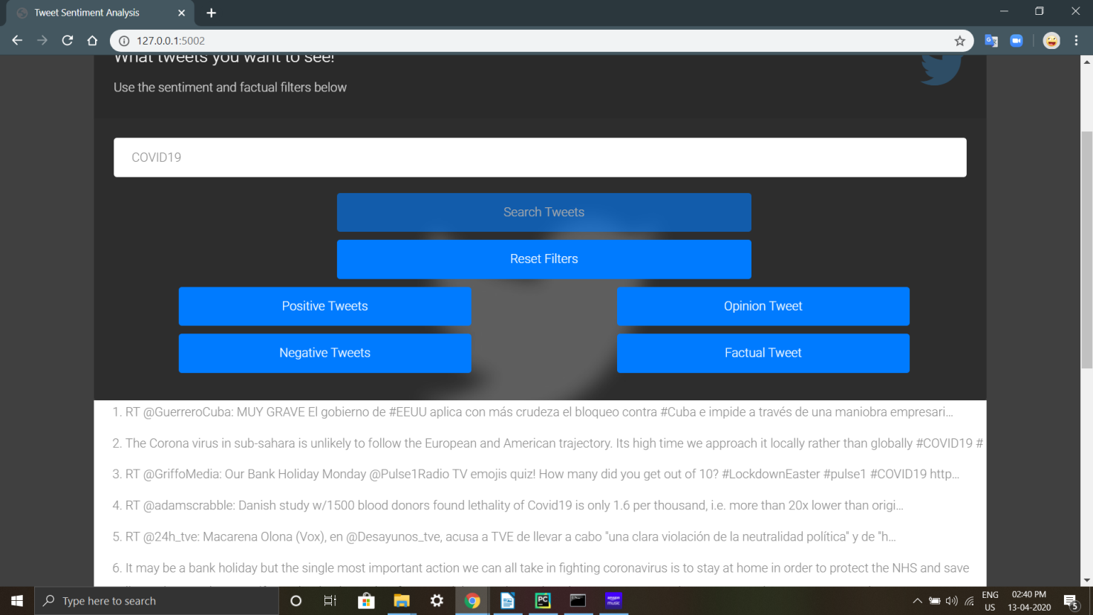
Code Snippet(Web)

Slide 16
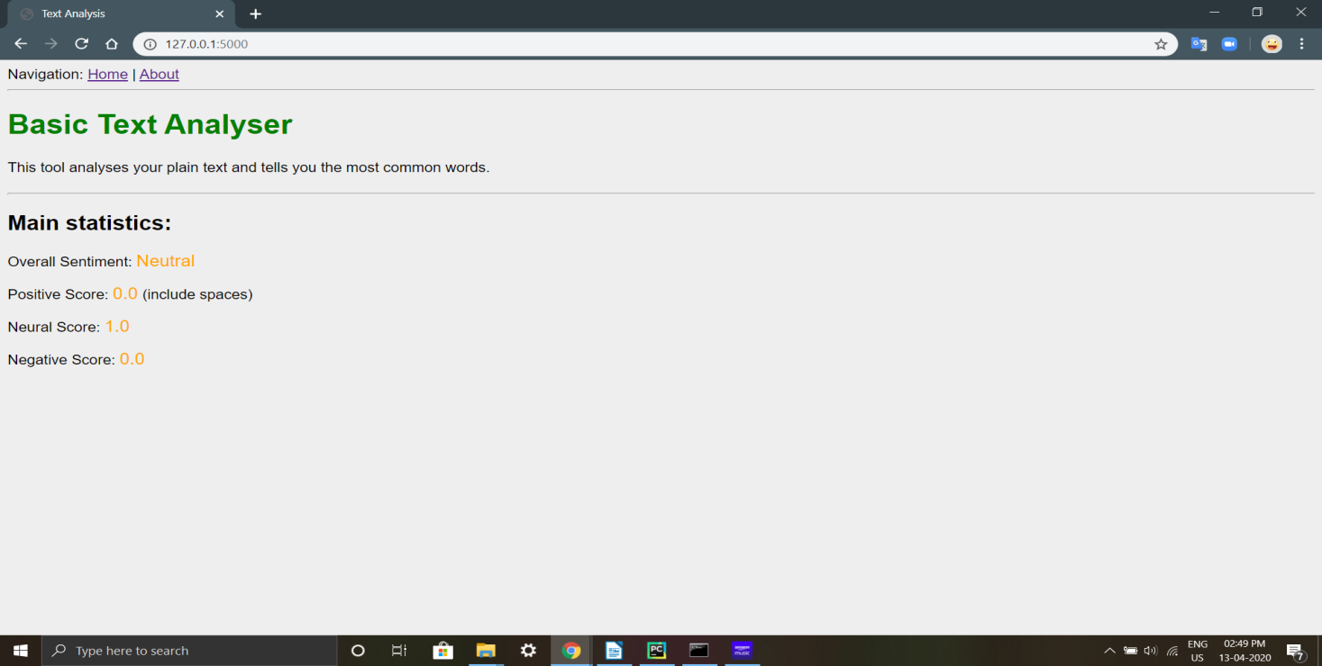
Code Snippet(Web)

Slide 17
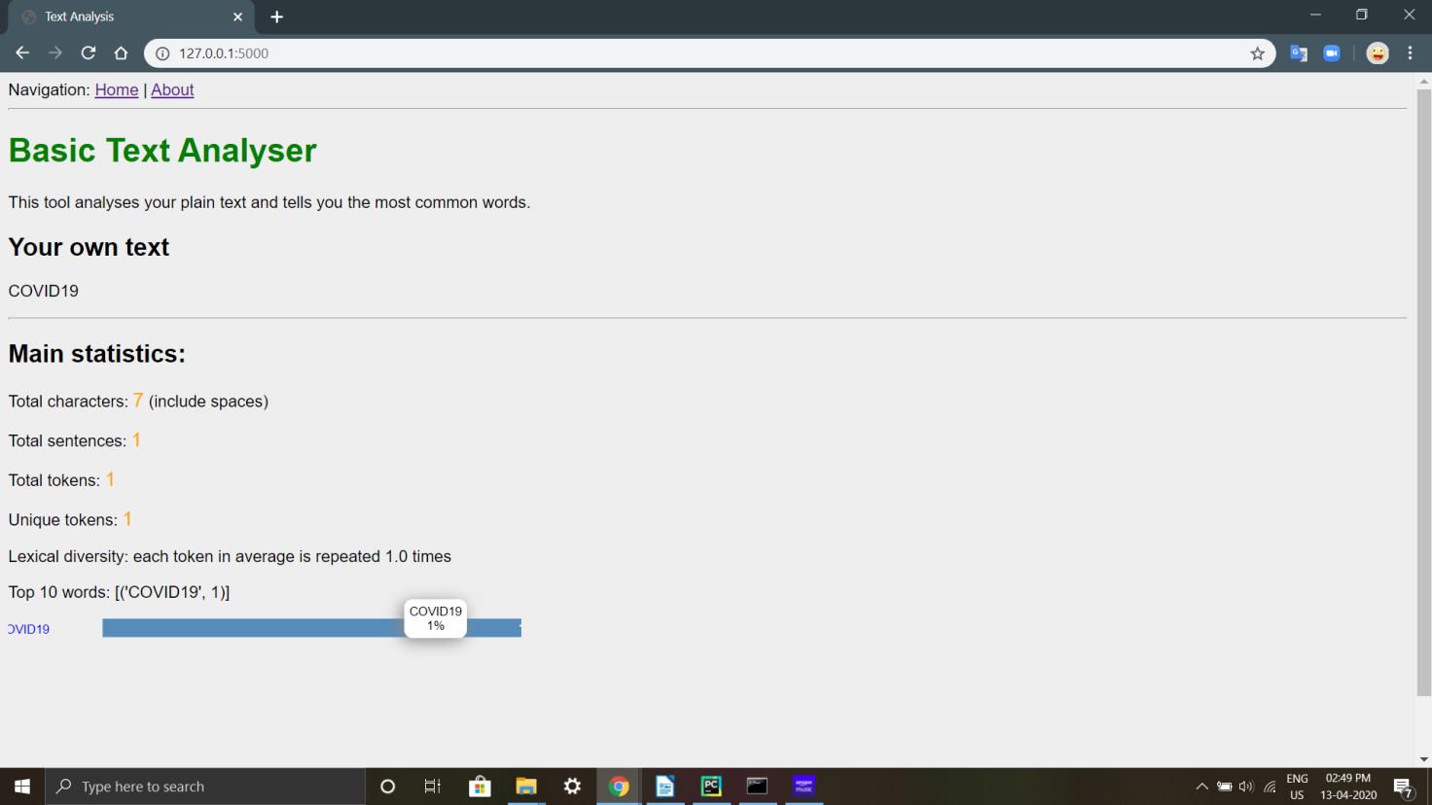
Code Snippet(Web)

Slide 18
Conclusion
Nowadays, sentiment analysis or opinion mining is a hot topic in machine learning.
We are still far from detecting the sentiments of corpus of texts very accurately because of the complexity in the English language.

Slide 19
Conclusion
By doing this project we came to know that we can understand people/customers by their feedback and point of view in a better way.
And can serve them in best possible manner so both sides of users are happy in the business. That is the main goal of analysis to solve real time problems.

Slide 20
Future Extensions
The feature that is worth exploring is whether the information about relative position of word in a tweet has any effect on the performance of the classifier.
In future we can try to find more sentiments from particular user, device and location wise world wide by using advanced Tech like G-Maps and Big Tables .

Slide 21
Thank You
Any Questions?

