Slide 1
Doorbell using Facial Recognition System Haar cascade classifier, OpenCV and AWS

Slide 2
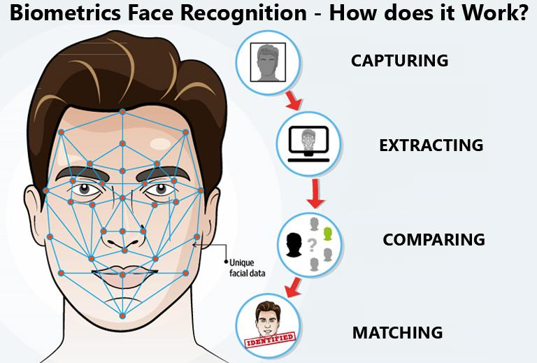
Abstract
A facial recognition system is a technology capable of matching a human face from a digital image or a video frame against a database of faces, typically employed to authenticate users through ID verification services, works by pinpointing and measuring facial features from a given image.

Slide 3
Introduction
In Facial recognition there are two categories of comparison :
Verification : The system compares the given individual with who they say they are and outputs a yes of no decision.
Identification : The system compares the given individual with all other individuals in the database and outputs a percentage match list.

Slide 4
Problem Statement
With increase in Frauds such as Robberies and Kidnapping; and simultaneously Security services getting costly, makes it difficult for a middle man to have access to basic security for peers safety.
The objective of this project is to introduce a doorbot which helps house owner keep a track of visitors, even remotely. Owner will be notified regarding who ever visits their house and warn owner before hand.

Slide 5
Why Facial Recognition?
Easy to use and socially acceptable.
No additional gear required to operate.
Only biometric, able to operate without user cooperation.
One of the most inexpensive biometric in the market and price expected to go down.
Tough to manipulate.

Slide 6
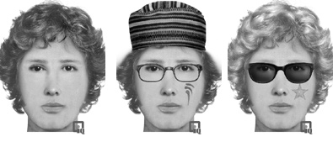
In order to manipulate the facial recognition system, You will need to modify the following features:
The shape of the face
The shape of the jaw
The shape of the eyes
The shape of the nose
The width of the neck
The shape & protrusion of the ears
The presence of facial piercing
The presence of facial hair, its color, & location
The presence of facial markings, such as scars or tattoos
Forehead or other facial lines
The presence of eyeglasses or sunglasses
The length, color, & texture of the person’s hair
And many more…

Slide 7
Applications
Airport security and Counter-terrorism
Voter verification
Residential Security
ATM Banking
Day Care
Immigration and Customs

Slide 8
Technology Stack
Amazon Rekognition : Cloud-based software used to extract metadata from image and video files
AWS S3 Buckets : Buckets used to store, protect and retrieve data
AWS Lambda : Event-driven and serverless computing platform that runs code in response to events and automatically manages computing resources.
Amazon SNS : Notification service provider
Haar Cascade Classifier : Feature based object detection algorithm used to identify faces in an image and real time video.

Slide 9
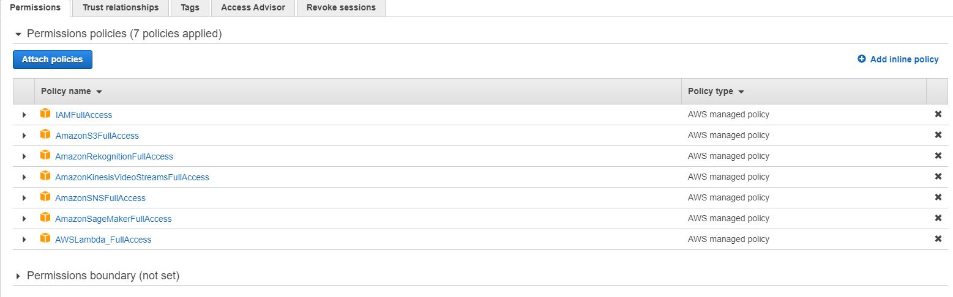
Technology Stack (Contd..)
Amazon SageMaker : Cloud machine-learning platform, enables developers to create, train and deploy machine learning models in the cloud.
Boto3 AWS : Provides a python API for AWS infrastructure services.

Slide 10

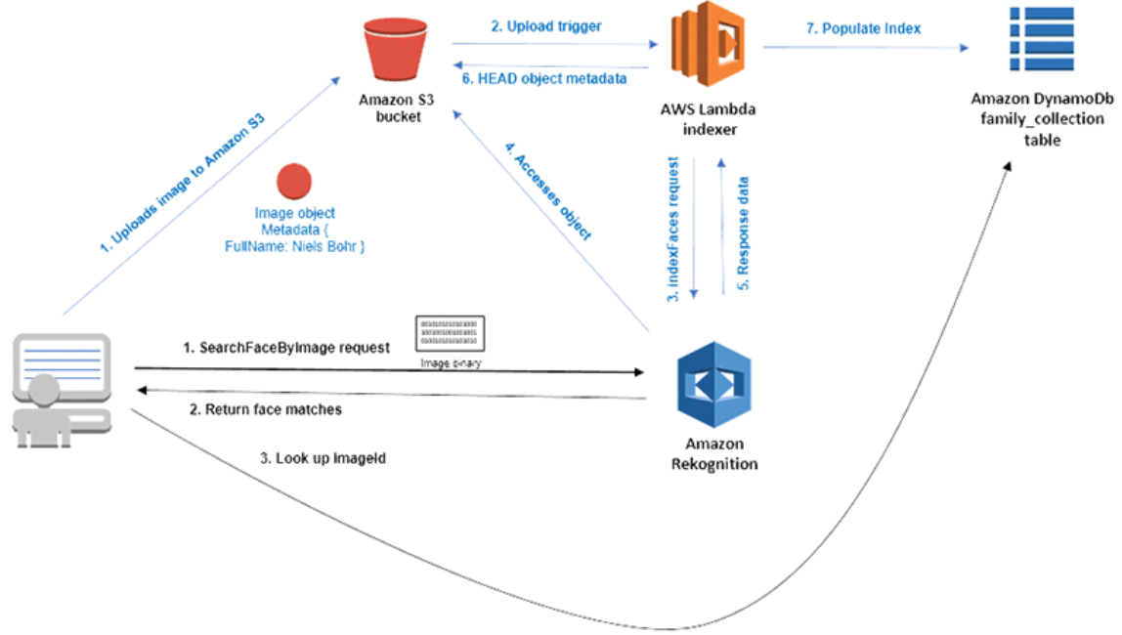
Workflow diagram

Slide 11
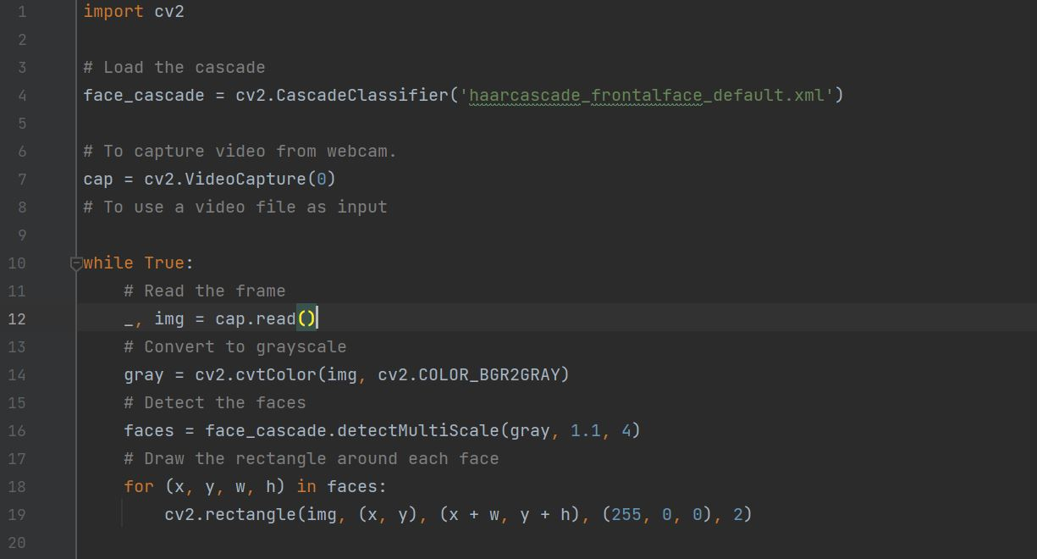
Image capturing and detection

Slide 12
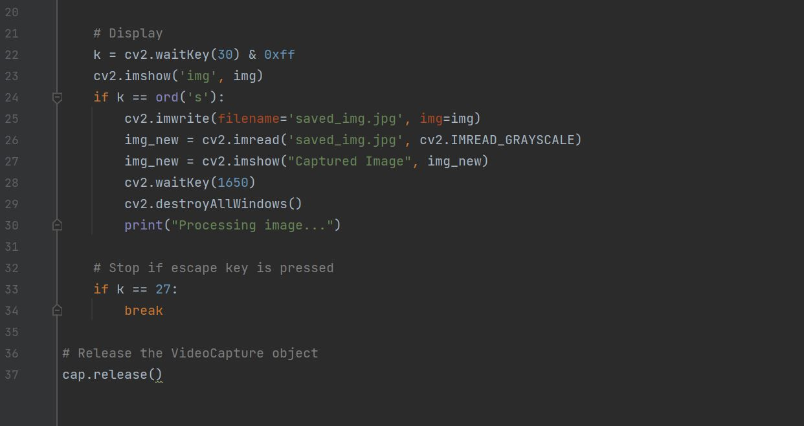

Slide 13
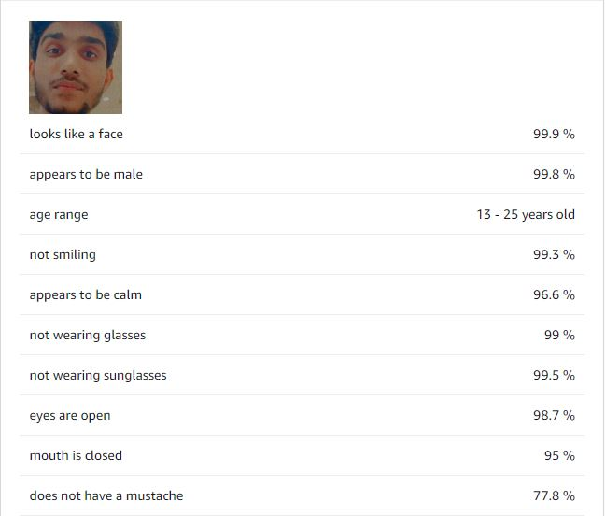
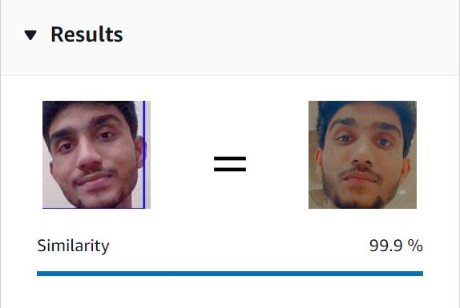
Results (Solo)

Slide 14
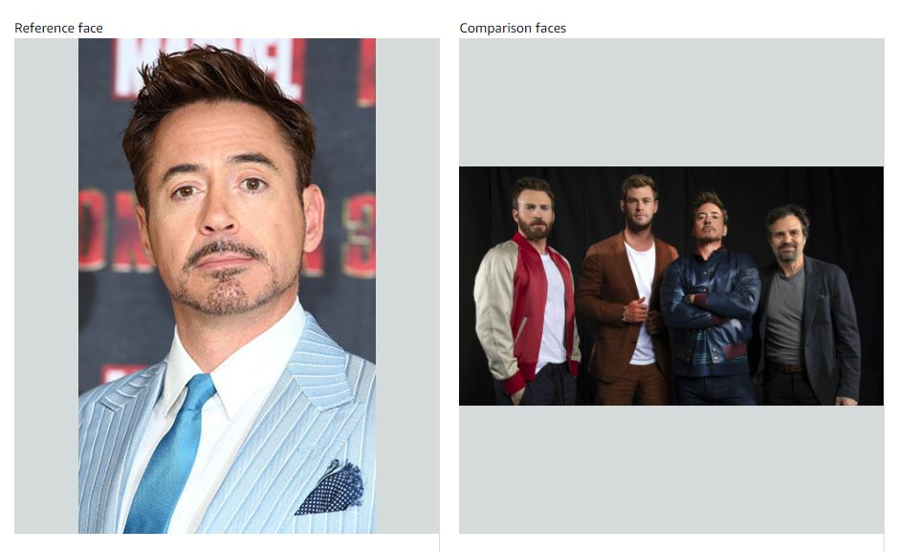
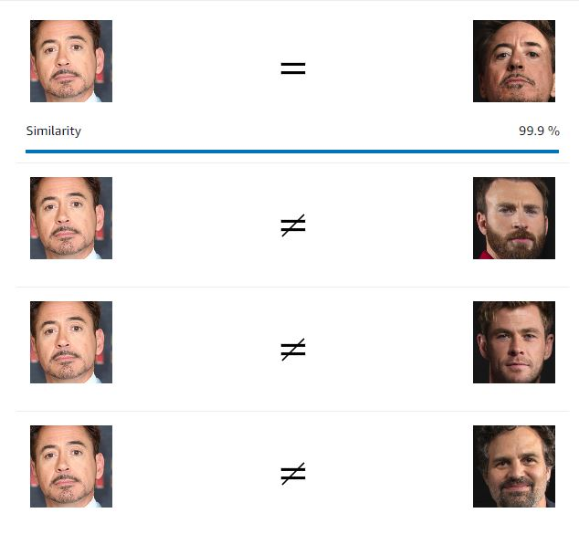
Results (Group)

Slide 15
Future Work
Add Chatbot to improve communication.
Include Raspberry Pi as an add-on attachment to improve results.
Identifying accessories, the visitor is carrying/wearing and determining his occupation. E.g. Visitor wearing a cap and a bag can be considered as delivery boy.
Identifying sharp objects in the frame and warning the owner before-hand.
Introduce AWS Polly to greet and welcome guests.

Slide 16
References
[1] Viola, Paul, and Michael Jones. "Robust real-time object detection." International journal of computer vision 4.34- 47 (2001): 4
[2] R. Lienhart and J. Maydt, "An extended set of Haar-like features for rapid object detection,“ Proceedings. International Conference on Image Processing, 2002, pp. II, doi: 10.1109/ICIP.2002.1038171
[3] A. Ben Thabet and N. Ben Amor, "Enhanced smart doorbell system based on face recognition," 2015 16th International Conference on Sciences and Techniques of Automatic Control and Computer Engineering (STA), 2015, pp. 373-377, doi: 10.1109/STA.2015.7505106
[4] Mane, S., & Shah, G. (2019), “Facial recognition, expression recognition, and gender identification” Data Management, Analytics and Innovation (pp. 275-290). Springer, Singapore
[5] “Amazon Rekognition guide” https://docs.aws.amazon.com/rekognition/latest/dg/what-is.html

Slide 17
Thank You!

