Slide 1


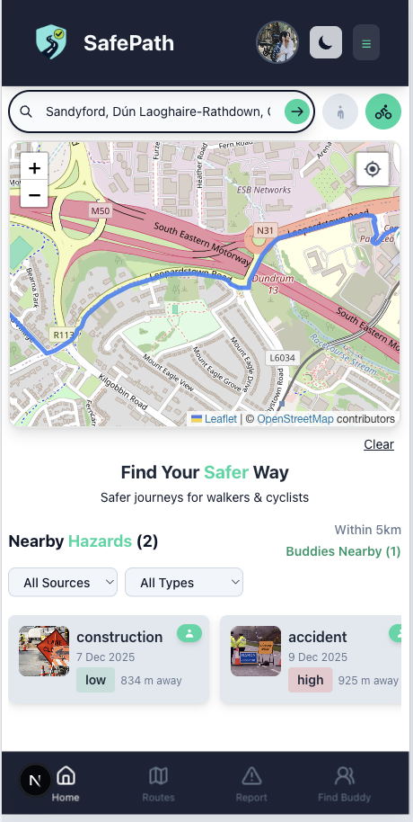
SafePath
Final Presentation
Mentors
Andrea Curley Brendan Tierney Damian Gordon
Group 2
Huda | D24126339
Hina | D24126048
Shalini | D24127853
Priyanka | D24125575
Karan | D24125555
More than Navigation, Smarter, Safer Journeys

Slide 2
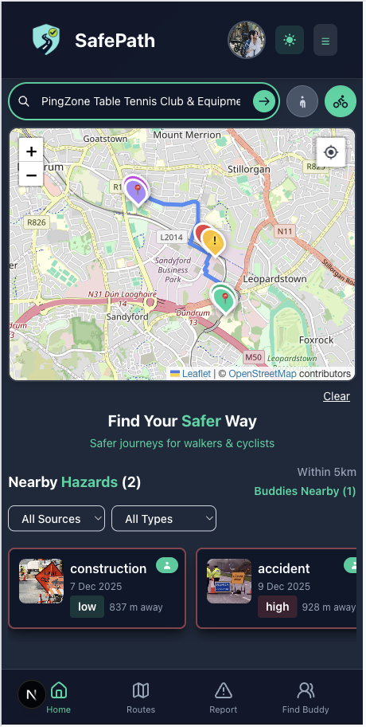
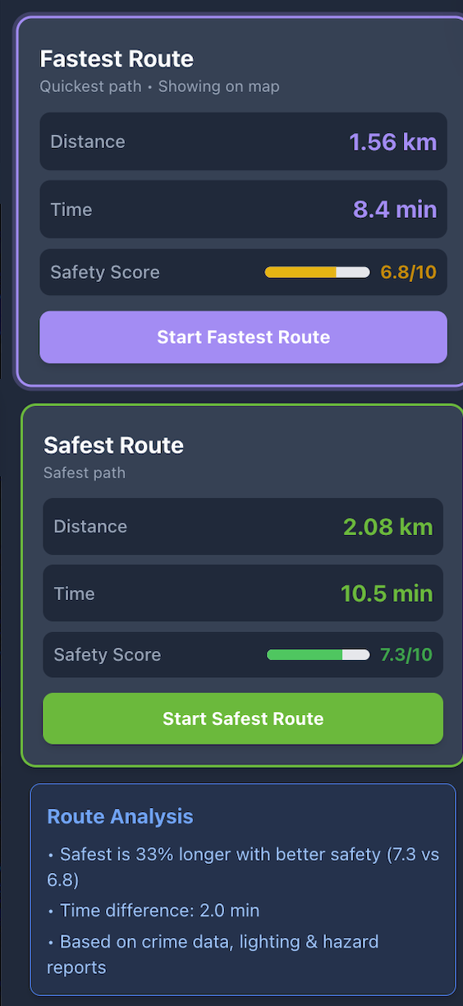
Project Vision: Safer Routes, Not Just Faster Ones
What we’re trying to do
Help walkers and cyclists choose safer routes, not only the fastest ones.
Combine crime, lighting and hazard data into one safety-first navigation app.
Reduce fear and uncertainty when travelling, especially after dark.

Slide 3


Project Vision: Safer Routes, Not Just Faster Ones
Who We Serve
School and university students walking or cycling home, especially after dark.
Everyday walkers and cyclists (commuters, families, night-shift workers).
Vulnerable users: new residents, older adults, people with reduced mobility.
Delivery riders who spend hours on the street.
City Planners & Safety Decision Makers
Why They Need it
Existing apps optimise for time, not personal safety.
Hard to see crime hotspots, dark streets, or recent hazards on a normal map.
Many users feel unsafe travelling alone at night or in unfamiliar areas.
Our survey shows users are willing to add minutes to the trip for a route that feels safer.

Slide 4
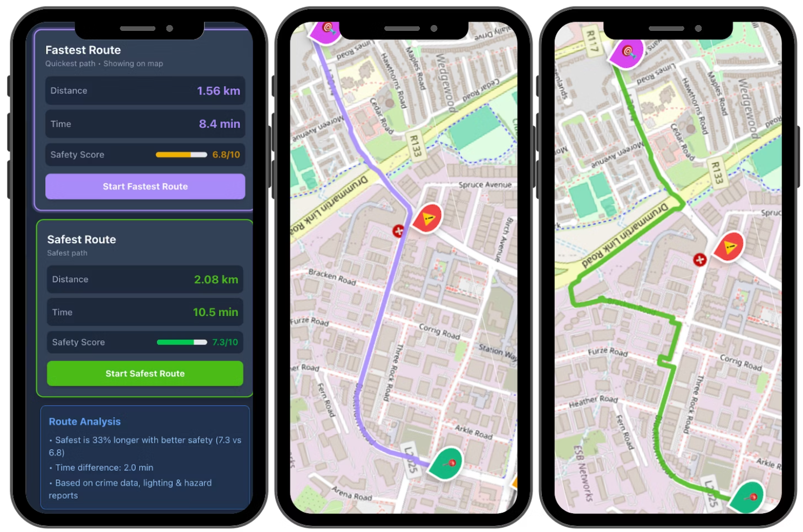
Scenario – Avoiding User Reported Hazards
Scenario: Student walking home at night in an unfamiliar area.
Problem: Normal maps send them through streets with recent hazard reports.
SafePath: Shows a safer alternative route that avoids user-reported hazards, even if it takes a few extra minutes.
Result: User feels more confident choosing the safer route.

Slide 5
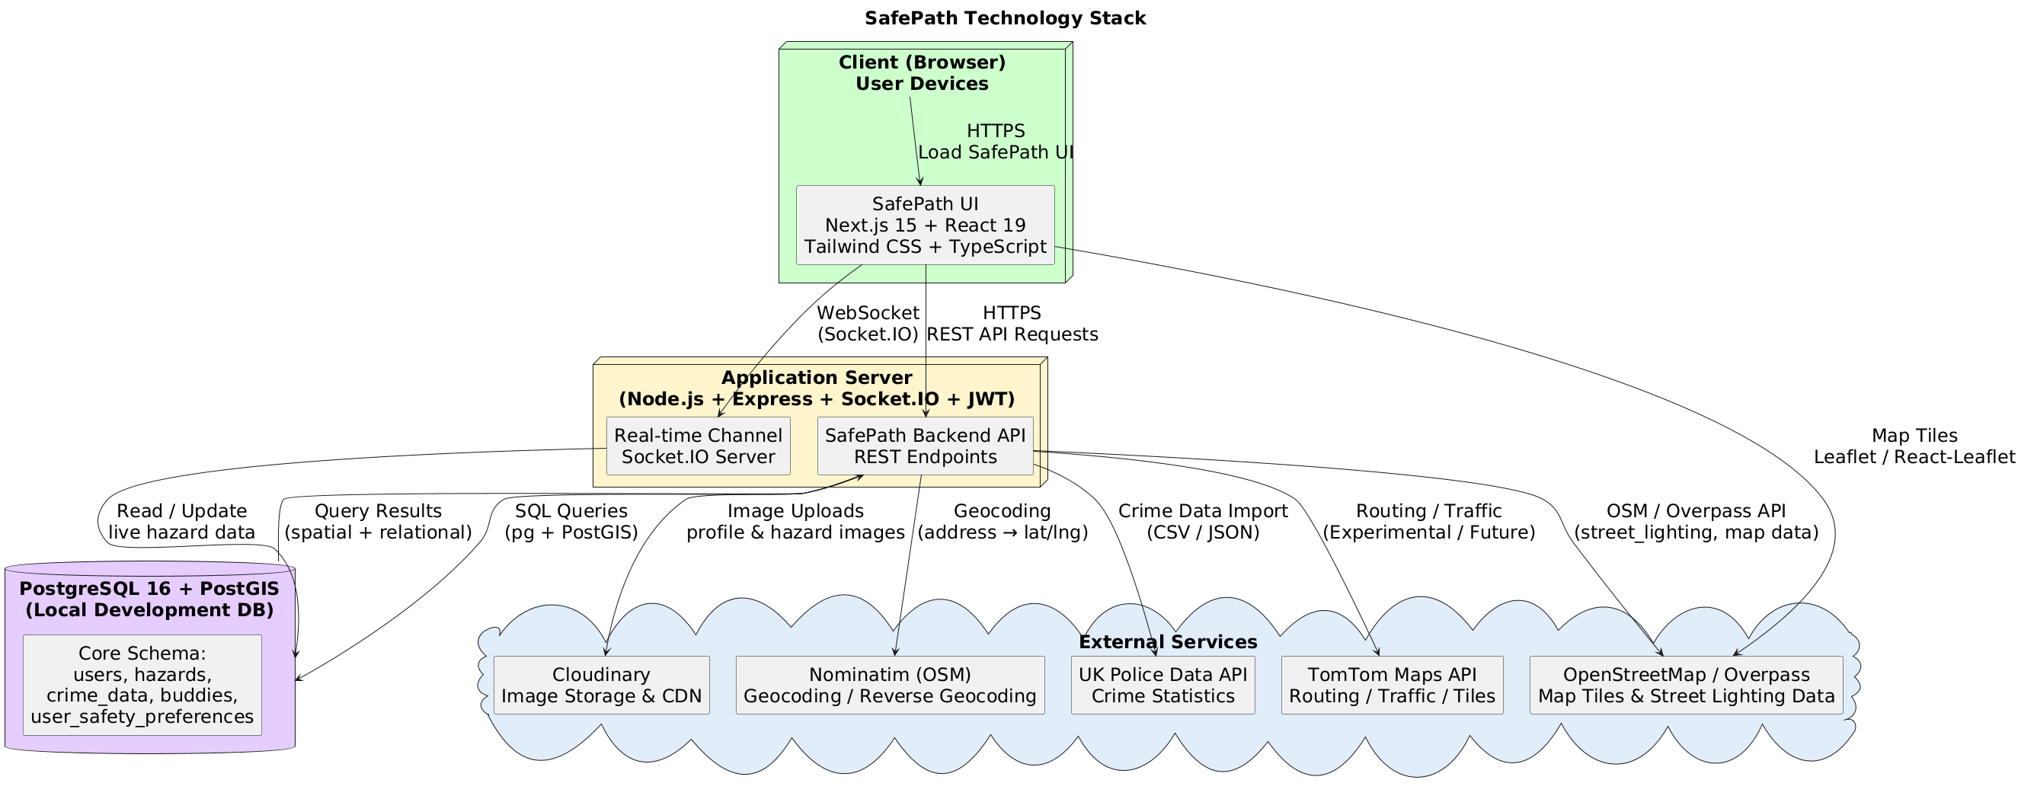
Technology Stack

Slide 6
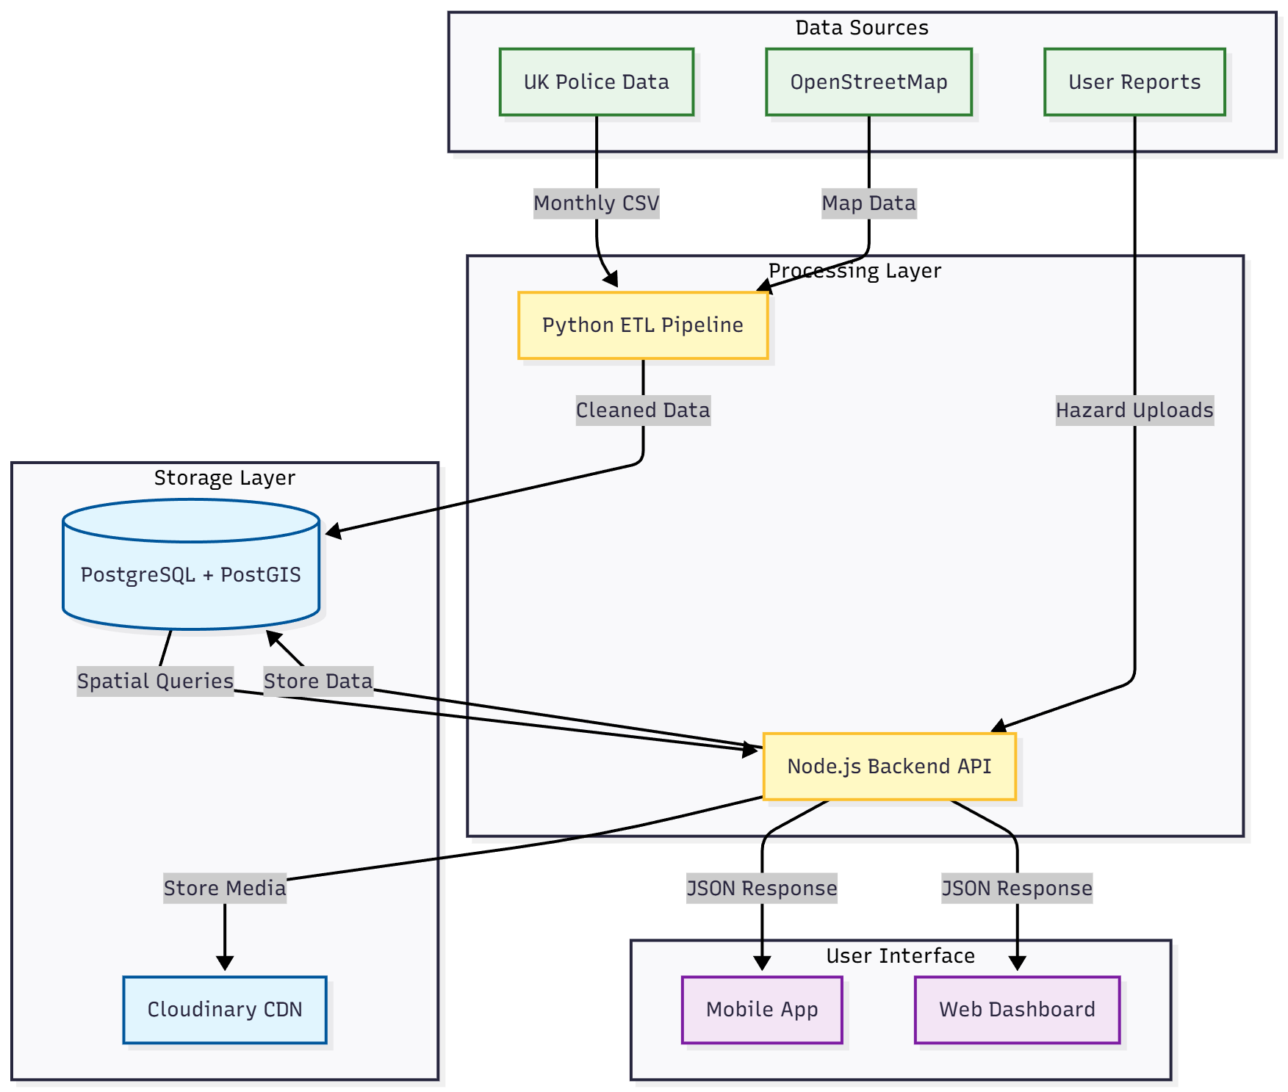
Data Stack
Notes:
What are the key data resources you are using and how are you collecting, storing and accessing them?
Crime data ingested from the UK Police Data API (street-level, geo-tagged incidents).
Real-time hazards streamed via the TomTom API and visualised on the map.
Lighting coverage & base map geometry sourced from OpenStreetMap (OSM).
Community hazard reports captured directly in the SafePath app (photos + precise GPS locations).
Python ETL pipeline cleans, enriches, and normalises crime, lighting, and hazard datasets.
Node.js backend handles hazard uploads, safety-first route requests, and real-time updates (e.g. new reports).
PostgreSQL + PostGIS power spatial queries and store high-volume geospatial data efficiently.
Cloudinary CDN hosts hazard images and serves optimised media URLs to the client.
SafePath web/mobile UI consumes safety-scored routes and live hazard alerts to guide users in real

Slide 7
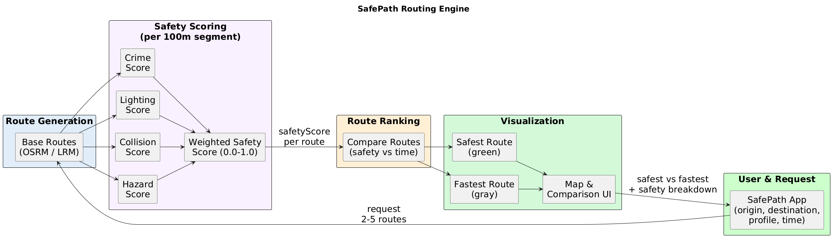
Routing Engine

Slide 8
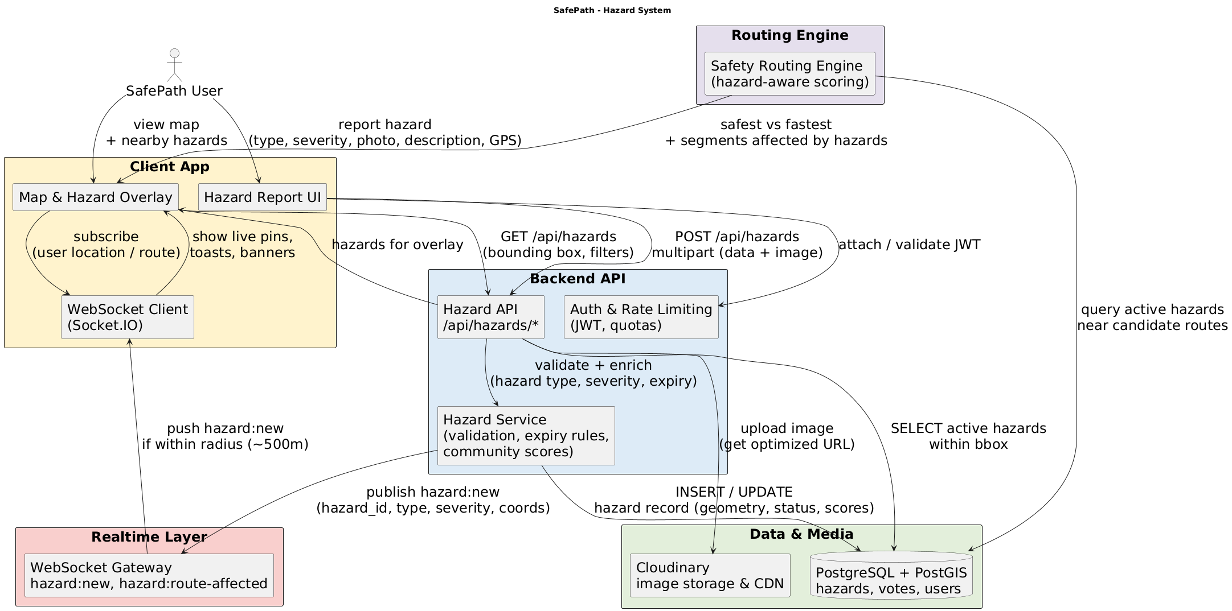
Report Hazard

Slide 9
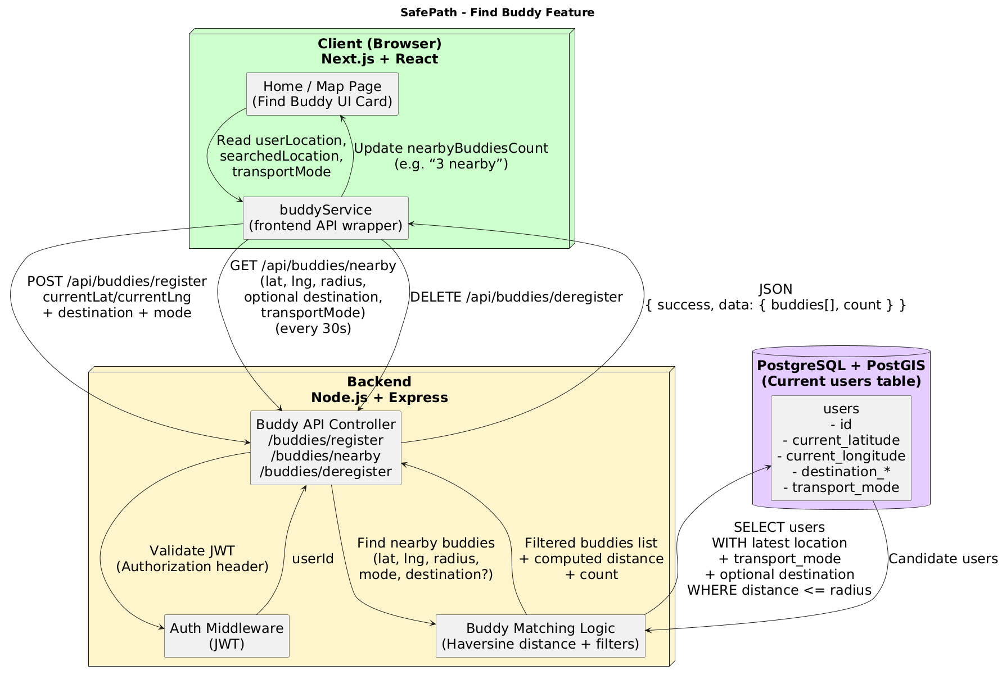
FindBuddy

Slide 10
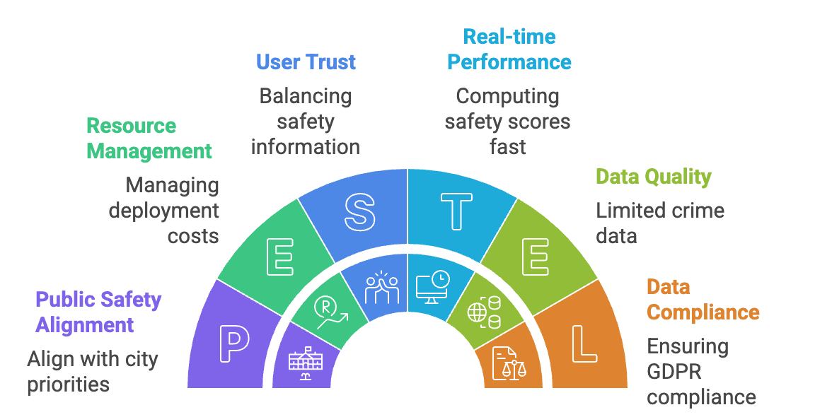
Project Key
Challenges
Notes:
Key App Challenges
UX for Safety Without Clutter Designing a map-first interface that surfaces crime heatmaps, lighting quality, hazards, and safest/fastest route comparisons without overwhelming users. The challenge is to keep core actions (“Go Safe”, “Report Hazard”, “FindBuddy”) obvious while hiding advanced safety details until needed. challenges
Multi-Factor Safety Scoring Combining crime exposure, street lighting, collision risk, and live hazards into a single safety score per route segment. Each factor has a different scale, level of uncertainty, and spatial distribution, making normalization, weighting, and explanation of the score non-trivial. challenges
Geospatial Performance at Scale Running corridor queries and safety calculations across many 100 m segments for multiple candidate routes, while keeping response times “app fast”. This includes tuning PostGIS indexes, avoiding heavy queries along the whole route, and preparing pre-computed structures (e.g. heatmaps) so that users don’t see loading spinners instead of routes. challenges
Real-Time Hazards & Buddy Features Making the map feel “live” with WebSocket-based hazard updates and buddy presence, without flooding the client or overloading the backend. The system has to decide which events to stream, how often to refresh, and how to gracefully handle users joining/leaving areas so the UI stays responsive. challenges
GDPR & Data Protection Compliance Handling sensitive data (location traces, crime context, user-reported hazards, and account details) under GDPR constraints is a core challenge. The app must respect data-minimisation, purpose limitation, retention limits, and user rights (access/erasure), while still storing enough history to compute meaningful safety scores and show past hazards on routes.
Account Security & Email Verification Implementing robust email verification to prevent fake or throwaway accounts, while keeping the sign-up flow simple. This includes generating secure, expiring verification tokens, handling edge cases (resend links, expired links, already-verified emails), and making sure unverified users cannot access safety-critical features such as hazard reporting or buddy matching.
Deploying Externally Across Multiple Services Deploying a full stack (Next.js frontend, Node/Express backend, PostgreSQL/PostGIS on Neon, WebSockets, and Cloudinary) on external hosting platforms introduces challenges around CORS, environment variables, HTTPS/WebSocket configuration, and free-tier limitations (cold starts, ephemeral storage, connection limits). Keeping routing performance, real-time updates, and image delivery reliable in this distributed setup is an ongoing operational challenge.

Slide 11
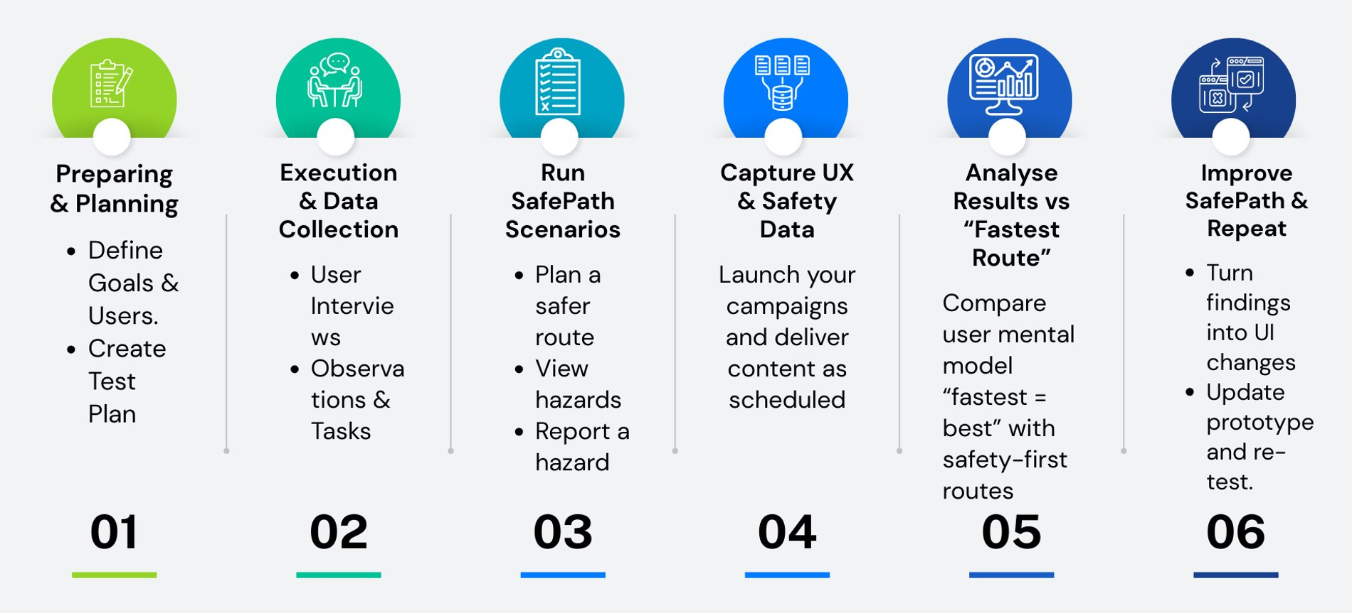
User Evaluation Process

Slide 12
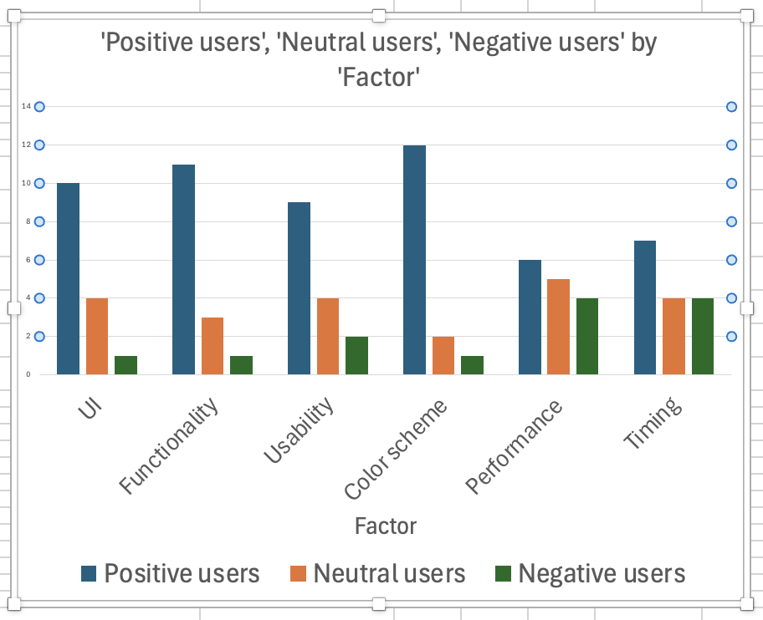
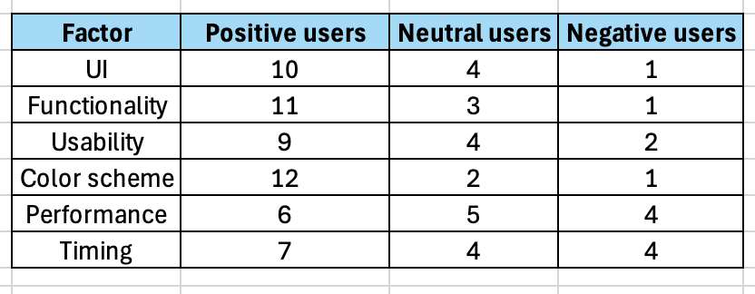
Evaluation Findings
SafePath User Feedback – (N = 15)

Slide 13
System Review
What We Solved | What We Improved
No safety-aware routes, only fastest time | Safety-scored routing
No real-time hazards reporting by community | Live hazard layer
No visibility of dark / high-crime streets | Crime hotspots & lighting layers
Feeling unsafe travelling alone, especially at night | FindBuddy, group journeys, nearby buddies, live location sharing
Safety data scattered across many systems | Unified data: TomTom, OSM, UK Police, lighting, traffic hazards
Clumsy, generic UX for walkers/cyclists | Mobile-first UX, dark mode, real-time updates
Low trust in apps (privacy, reliability, access) | Secure auth (JWT, email verify),

Slide 14

Future Work
AI-powered hazard prediction based on historical patterns
Voice navigation for hands-free operation
Offline mode for areas with poor connectivity
Wearable device integration for cyclists
Emergency contact alerts when traveling alone
Route history for tracking safe paths
Community safety ratings for neighborhoods
Integration with local authorities for faster hazard resolution

Slide 15
Conclusion
Teamwork
What we learnt
What we would
do different
Clear roles: backend, frontend, data, UX
Used GitHub branches + PRs to collaborate
Regular check-ins with mentors and within team
Shared design files so everyone stayed aligned
Safety routing is harder than “fastest only”
Users need clear explanations, not just features
Multiple data sources = performance + complexity issues
GDPR, email verification and location consent are essential
Lock a smaller MVP earlier
Test “risky” features sooner (routing, hazards, buddies)
Run user tests in several short rounds, not just once
Keep better ongoing documentation and task ownership

Slide 16

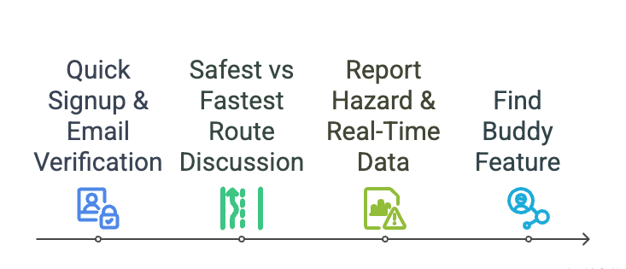
Demo Agenda

