Slide 1


Group 2 Team SafePath App Interim Presentation
Team Members
D24126339 – Huda Ibrahim
D24127853 – Hina Kausar
D24126048 – Shalini Kuruguntla
D24125575 – Sai Priyanka Basa Shanker
D24125555 – Karan Joseph

Slide 2

Project Vision

Slide 3
Project Objective
Safety First Navigation
Live Road Hazards
Accessibility-aware Paths
Find Buddy
User Reports Road Hazards
Mobile-first UI
Notes:
Deliver Safest / Fastest route options with transparent safety scores
Provide live and up-to-date road hazards and avoid them when planning your route.
Provide accessibility-aware paths (step-free, curb ramps, surface quality).
Offer Find Buddy for companion matching that elevates both confidence and protection
Empower communities to report hazards with lightweight, privacy-respecting tools.
Present a clean, mobile-first UI for quick, confident decisions.
Provide anonymised safety heatmaps and hazard trends to help councils prioritise lighting, crossings, and maintenance.
Offer an authority dashboard + API with hotspot analysis (near-misses, surface defects, demand) to guide investment and evaluate interventions.
Share open, privacy-safe insights so transport agencies can target fixes faster and track before/after impact.

Slide 4

Target Users
Commuters in unfamiliar areas
Women traveling alone at night
Elderly pedestrians
Recreational cyclists
Delivery workers & rideshare drivers
Urban planners & transport authorities
School / College Students

Slide 5
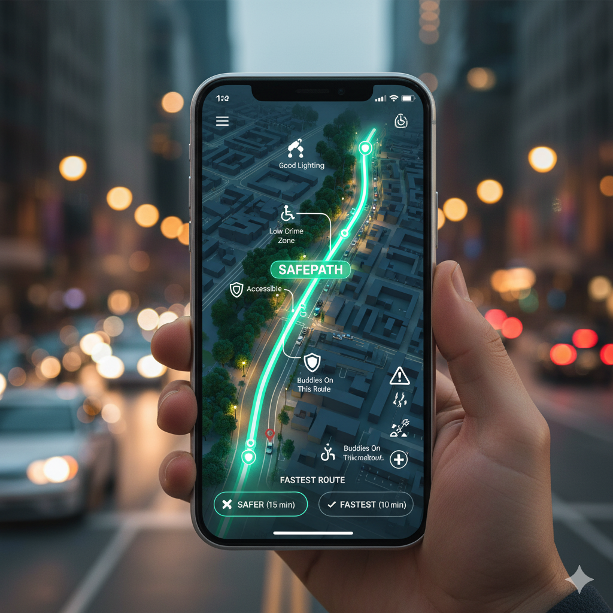
A Navigation App That Prioritises: Safety Crime, Lighting, Hazards, Accessibility, and Buddies Not just speed
Needs of SafePath
Notes:
For avoiding crime hotspots
For avoiding dark, poorly lit roads at night
For seeing live hazards (roadworks, potholes, debris, closures, bad weather)
For accessibility-aware routes (step-free, curb ramps, smoother surfaces)
For traveling with a buddy when you want extra confidence
Because most navigation apps optimise for speed, not safety
Because current apps offer pieces of this, but not all in one place with clear, explainable safety scores

Slide 6

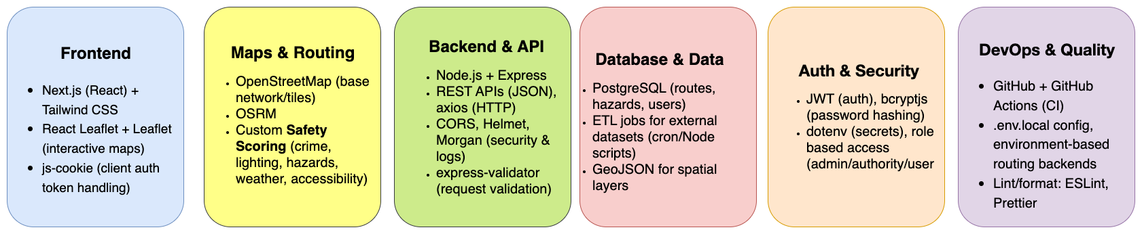
Technology Stack

Slide 7
Data Stack
What are the key data resources you are using and how are you accessing them?
2
3
4
5
6

Slide 8
Evaluation
How will you evaluate your system?

Slide 9
Current Prototype Demo
Outline the progress you have made so far and demo your current prototype

Slide 10
Immediate Next Steps & Project Roadmap
What are the immediate next steps you are taking?
Include reference to the biggest challenge currently facing the project
What is the overall roadmap for the rest of the time available?

