Slide 1
Mickey Mouse Learning: Discourses of the Vocational/Technical in Higher Education
Richard Sanders and Harriet Richmond
Newman University

Slide 2

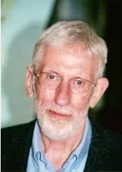


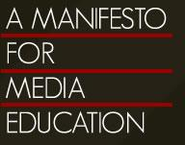
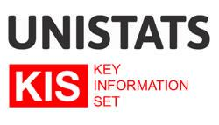
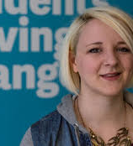
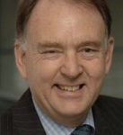
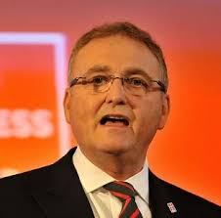
Introduction
Context and methodology
Article from the THES
Expression of reform agendas
Case studies: Media Studies and work-based learning
Recommendations to prompt discussion

Slide 3
Context and Methodology
Paper represents a Critical Discourse Analysis (CDA) approach to analysing case studies:
Problem Orientated (Fairclough, 2009), inspecting discursive meaning configurations (ibid, 1995)
Inspecting how discourse transforms down from political reform agendas to HE institutions via ‘Grey Literature’ (Alberani et al, 1990, p.358).
Our position: Primarily concerned with learners - needs to fit with all stakeholders

Slide 4
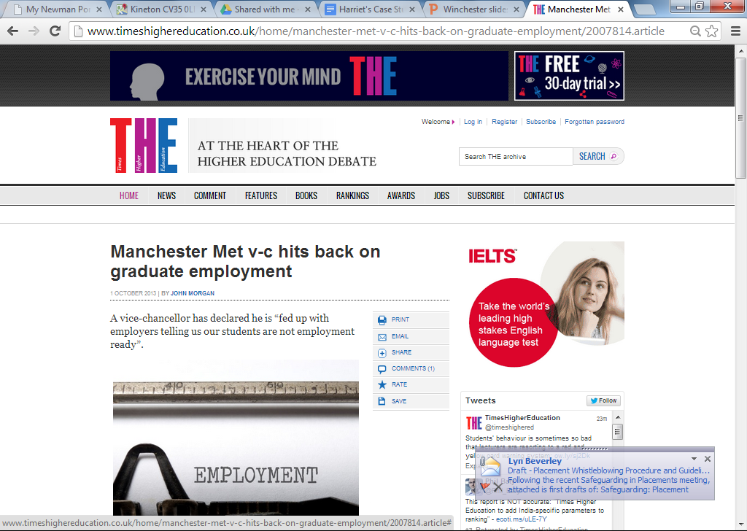
THES Article: Employability Tensions
The article highlights the problematic nature of the discourse
There is little common ground between those cited in the article
We agree with Mr. Longworth’s assessment that everyone is getting too defensive over ‘employability’
Times Higher Education Supplement (THES)
(Morgan, 2013)

Slide 5
Position 1: Students don’t have the skills employers want
John Longworth:
There were problems around graduates “being ready for work and having the softer skills needed: a range of communication skills, punctuality, motivation – which businesses often complain about. And actually complain about with good reason as well.” (Morgan, 2013)

Slide 6
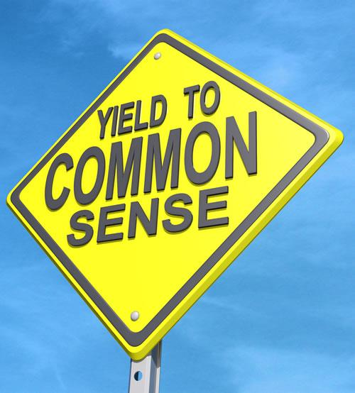
Analysis of position 1
In the context of work-based learning
The discourse of deficit: ‘Common-sense’ labelling and simplification
‘Learning as becoming’ and ‘boundary crossing’ (Hager and Hodkinson, 2009, p.635) rather than learning transfer
In the context of Media Studies ‘Mickey Mouse’ marginalisation
Problems with addressing stakeholder needs, e.g. digital competencies
Incongruence between critical media literacy and subject marginalisation

Slide 7
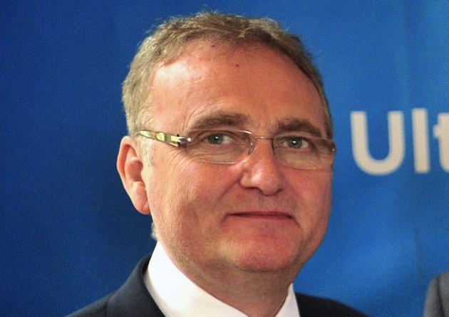
Position 2: Students are not studying the right degree subjects
John Longworth:
Mr Longworth countered that “if students come out of universities with the wrong degrees and/or are not ready for work, like it or not, they won’t be employed. It’s as simple as that.” (Morgan, 2013)

Slide 8

Analysis of position 2
Positioning of subjects such as Media Studies as lacking value (or ‘Mickey Mouse’ and ‘pub chat’)
‘Short-hand’ for describing perceived problems with other subjects (Berger & McDougall, 2013, p.6)
Detailed defence can be found at: http://www.manifestoformediaeducation.co.uk/
Reasons?
Lack of fit with ‘common sense’ ‘vocational’ and ‘academic’ labelling – is this a strength?
Do we want students to be able to think (academic criticality) and ‘use skills’ (vocational)?
can support creativity, entrepreneurism, innovation and Digital Literacies (McDougall and EC Report) - also empowers student.

Slide 9
Position 3: Students have been ‘sold’ employability as a solution to tuition fees
Toni Pearce:
Ms Pearce said the real problem was that students expecting to graduate into a secure job if they studied hard had been “sold a bit of a lie”. (Morgan, 2013)

Slide 10
Analysis of position 3
Two dimensions of the learner experience of employability in higher education:
Learners associate HE with improved employment opportunities, i.e. Futuretrack
Employability is a measure of H.E. performance rather than graduate effectiveness in the workplace, e.g. UNISTATS

Slide 11
Position 4: Who owns it? Where does it belong?
Prof. John Brookes:
“I’m fed up with employers telling us our students are not employment-ready. I think…that employers are not graduate-ready.” He argued that modern graduates, with an “independent, autonomous approach to learning and their understanding of technology, frankly scare employers”. (Morgan, 2013)

Slide 12
Analysis of position 4
Two tensions:
Who is responsible for ensuring that ‘our students’ are ‘work-ready’?
Deliberate separation of subject from skill, and academia from vocation
A resistant response to an incongruent agenda?
Headlines in the THES:
‘Employment Skills Don’t Fit with Academic Degrees’ (Matthews, 2013b)
‘Beware the Student Employability Agenda’ (Matthews, 2013a).

Slide 13
Recommendations / Discussion
The consideration and use of subjects by stakeholders for skills development (McDougall – EC Report)
Reflection for all stakeholders
‘Professional activism’ to ‘look inside each others castles’ (Sachs, 2000, p.81-82) - accepting and working with explicit stakeholder positions
Re-evaluation of the boundaries between vocational and academic – problematic for all stakeholders
Going beyond the deficit model
Peach (2010, p.456) ‘socially critical vocationalism’

Slide 14
References
Alberani, V., De Castro Pietrangeli, P. & Mazza, a M. (1990) ‘The use of grey literature in health sciences: a preliminary survey’, Bulletin of the Medical Library Association, 78 (4), pp.358–63.
Berger, R. & McDougall, J. (2013) ‘Editorial: What Is Media Education For?’, Media Education Research Journal, 3 (1), pp.5-20.
Fairclough, N. (1995) Critical Discourse Analysis. London: Longman.
Fairclough, N. (2009) ‘A dialectical – relational approach to critical discourse analysis in social research’ in Wodak, R. & Meyer, M. (eds.) Methods of Critical Discourse Analysis. London: SAGE, pp.162-186.
Hager, P. & Hodkinson, P. (2009) ‘Moving beyond the metaphor of transfer of learning’, British Educational Research Journal, 35 (4), pp.619–638.
Matthews, D. (2013a) ‘Beware the student employability agenda’, Times Higher Educational Supplement, 19 Feb [online]. Available at: http://www.timeshighereducation.co.uk/beware-the-student-employability-agenda-debate-hears/2001677.article (Accessed: 14 January 2014).
Matthews, D. (2013b) ‘Employment skills don’t fit with academic degrees’, Times Higher Educational Supplement, 28 Nov [online]. Available at: http://www.timeshighereducation.co.uk/news/employment-skills-dont-fit-with-academic-degrees/2009378.article (Accessed: 14 January 2014).
Morgan, J. (2013) ‘Manchester Met v-c hits back on graduate employment’, Times Higher Education Supplement, 1 October [Online]. Available at: http://www.timeshighereducation.co.uk/home/manchester-met-v-c-hits-back-on-graduate-employment/2007814.article (Accessed: 26 December 2013).
Peach, S (2010) ‘A curriculum philosophy for higher education: socially critical vocationalism’, Teaching in Higher Education, 15 (4), pp.449-460.
Sachs, J. (2000) ‘The Activist Professional’, Journal of Educational Change, 1 (1), pp.77-95.

