Slide 1
Capstone Project
Web Scraping
With EDA
- Karan K. Karle
PCAI Feb 2021 Batch

Slide 2
Contents
Introduction
Objectives
Python Packages
Creating Data frame
Data Analysis
Result & Conclusion

Slide 3
Introduction
Web Scraping is a technique to extract large amounts of data from the Web.
This technique is mostly used in comparing Prices of same category products.
Requests a library in Python used for making HTTP requests to allowing us to get HTML.
BeautifulSoup library is used to Parse the unstructured HTML or XML data.
BeautifulSoup is the most common technique used for Scraping the data.

Slide 4
Objectives
The Objective of the project is to give the suggestion of best Television in the price range of ₹40000 to ₹50000 with nearly 50-55 inch in size and with other good features like 4K Screen Resolution, with Best in Quality speakers Output.
Select the Televisions which are Newly Launched from E-Commerce website i.e. Flipkart.com
Scrape details of Televisions from that website like Brand, Price & Features of that particular Newly launched section
Cleanup the extracted data.
Visualize & Analyse the data

Slide 5
Python Packages The necessary Packages or libraries used in this Project
requests
BeautifulSoup
pandas
numpy
regex
seaborn
matplotlib

Slide 6
Creating Dataframe
After scraping & parsing data, Cleanup the data to get attributes for creating a Dataframe

Slide 7
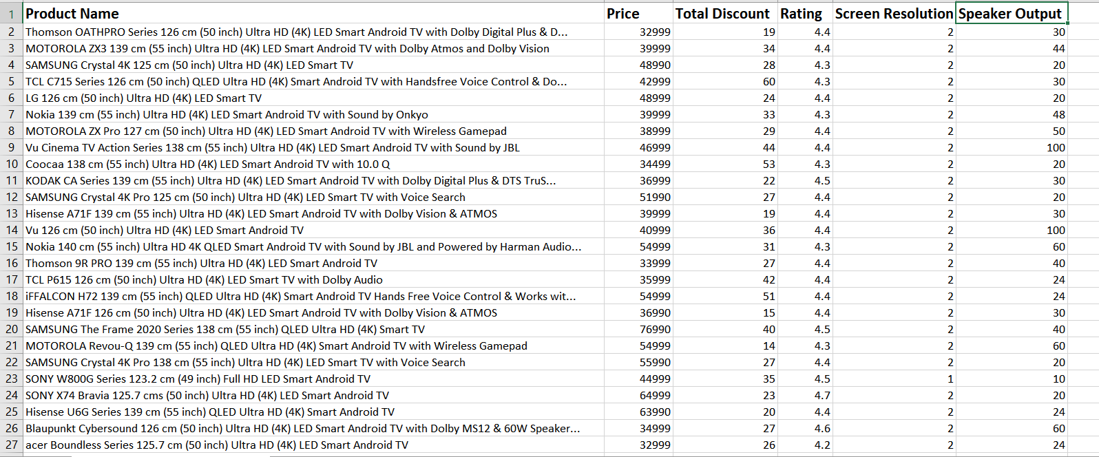
Attributes in Dataframe
Product Name
Price
Total Discount
Rating
Screen Resolution
Speaker Output

Slide 8
Data Analysis
Analysing Data by using Heatmap & Barplot

Slide 9
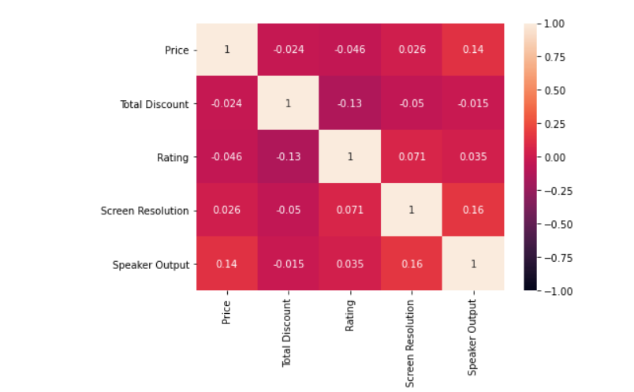
Heatmap
By using Heatmap we can Analyse the Correlation of between Data Attributes
Here, Screen Resolution and Speaker Output are having impact on Price

Slide 10
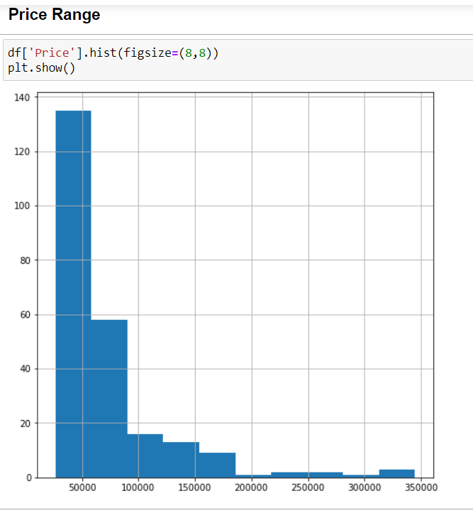
Barplot
Barplot of Price Distribution,
Most of the TV set’s have our Desired price range

Slide 11
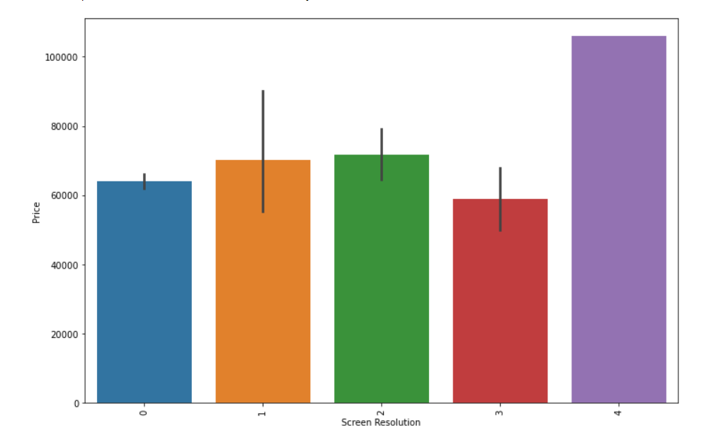
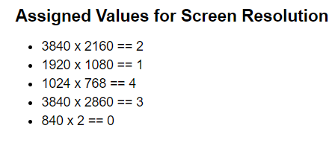
Barplot Price Vs Screen Resolution
Barplot showing Screen Resolutions (pixels) have Correlation with Price

Slide 12
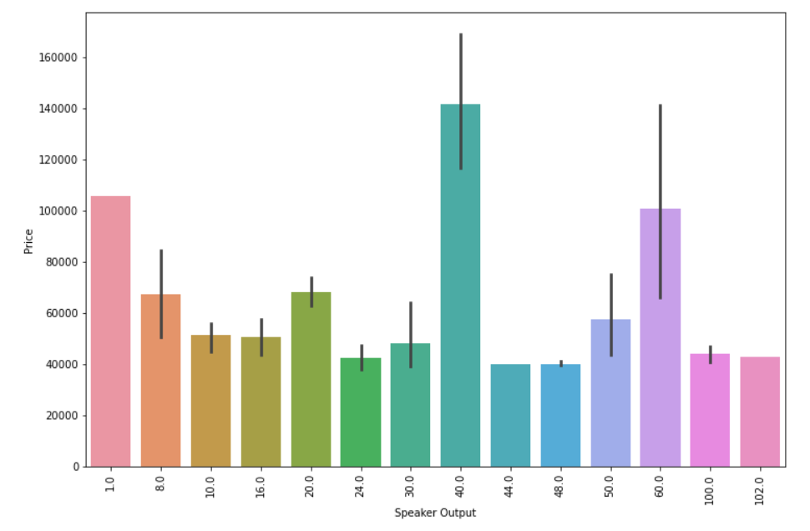
Barplot Price Vs Speaker Output
Here the Televisions within desired price range are having high Capacity Speaker Output
For more clearance we should go with Screen Resolution Vs. Speaker Output Vs. Price

Slide 13
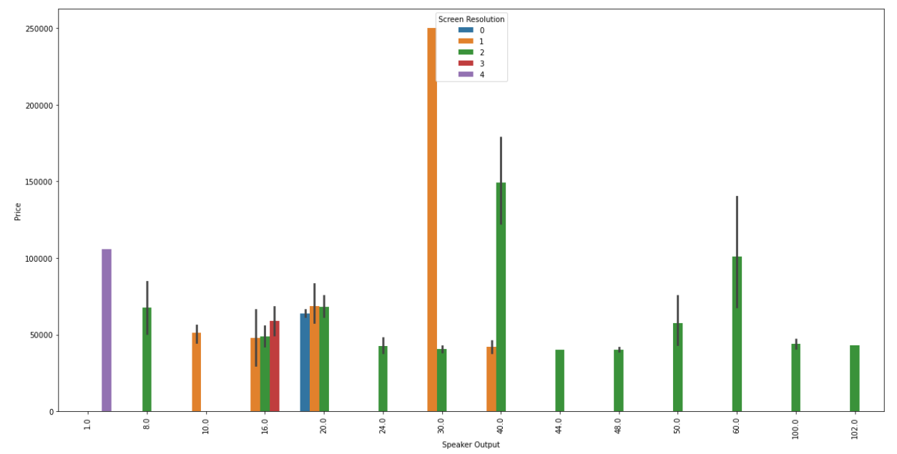
Barplot Price Vs Speaker Output Vs Screen Resolution
Here we can see 2 TVs which are within desired price Range having advanced Pixel Resolutions and nearly 100 Watt Speaker Output Which are best in price range

Slide 14
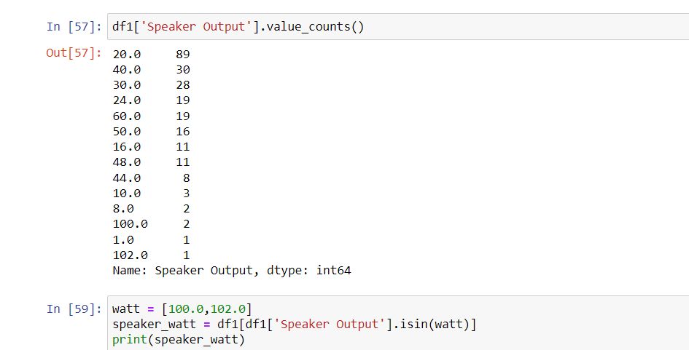
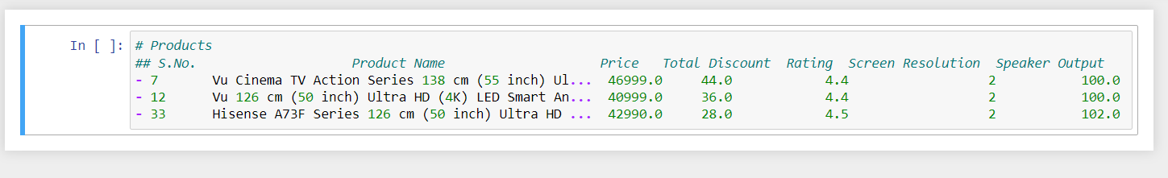
Products Display Products having 100+ Watt
With 4K Resolutions
Here we can see those 3 products Brand names which having advanced Pixel Resolutions and high Watt Sound outputs with other advanced Features.
Differences in between those 3 TVs
1) Vu Cinema TV Action Series 138 cm (55 inch) 4K Screen Resolution with 44% discount and 100 Watt Speaker Output ,
2) Vu 126 cm (50 inch) Screen Resolution with 36% discount and 100 Watt Speaker Output ,
3) Hisense A73F Series 126 cm (50 inch) Screen Resolution with 28% discount and 102 Watt Speaker Output.
So we can go with 1st one

Slide 15
Result & Conclusion

Slide 16
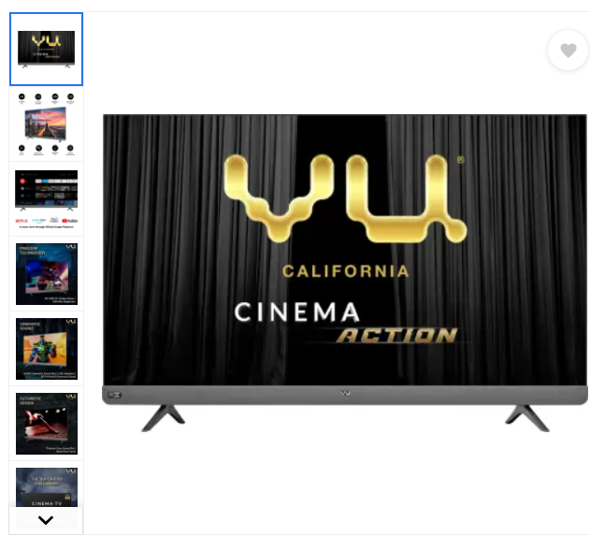
Result
After all analysis we can conclude that Best final suggestion in Price range with all New Features is
With Total Discount of approx. 44%* on MRP ₹46999* It has 100 Watt Sound Output and product having best Ratings 4.4 out of 5.0 from E-Commerce website Flipkart.com
# Direct Link to Product:- Vu Cinema TV Action Series 138 cm (55 inch) Ultra HD (4K) LED Smart Android TV with Sound by JBL (55LX) Online at best Price In India on (Flipkart.com)
# Press Ctrl and then Click on Link
* Price and Discount may change time to time

Slide 17
Conclusion
Here Objectives of project has been successfully completed in provided requirements and Instructions of Capstone Project on Web Scraping.
THANK YOU

