Slide 1

Snap Inc.'s IPO
A Case Study Analysis by
Alexander Blais, Carrie Clifton,
Karan Kirpalani,
Lily Pearl Poirier, Maria Teixeira

Slide 2


Snap
Background/Facts
Creators of Snap: Evan Speigel, Bobby Murphy, and FRank REginald
Created at Standford University in 2010.
Snapchat originally called picaboo
Snapchat: Communication with camera
Known for ghost logo
Is a Camera Company that gives so many advantages of texting/Lenses/Stories/so much more.

Slide 3
Question 1
What are the key challenges and opportunities of Snap’s business model?

Slide 4
Key Challenges
The main challenge of Snap was competing for and engaging with daily active users (DAU)
There were two other significant challenges:
low product loyalty & finances

Slide 5
Key opportunities
A general and continuing growth in the global ownership of mobile devices
Use of social media on those devices
Younger generations being integrated into using technology and social media at younger ages
Access to capital via outside investment

Slide 6
Question 2a
What is driving Snap’s decision to go public in March 2017?
What factors lead Snap to believe that the market conditions are optimal for a large technology IPO in March 2017?

Slide 7
factors driving Snap's decision to go public
Initial success in growing the user base.
The Timing was right.

Slide 8
Question 2b
Compare the statistics and performance of Snap to its competitors at the time of their IPO’s?

Slide 9
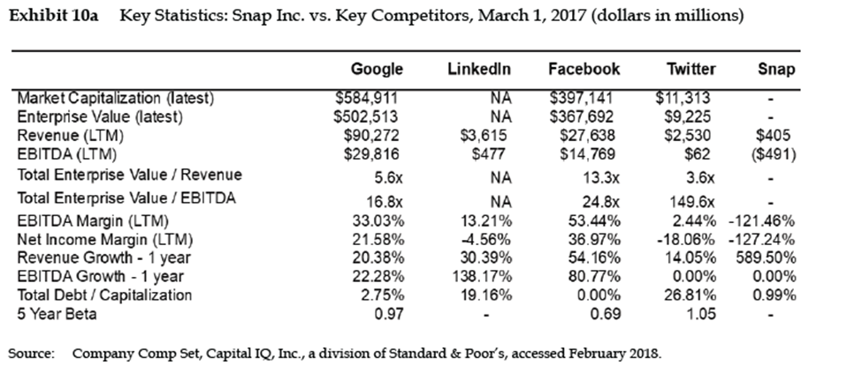
Stats and performance comparisons

Slide 10
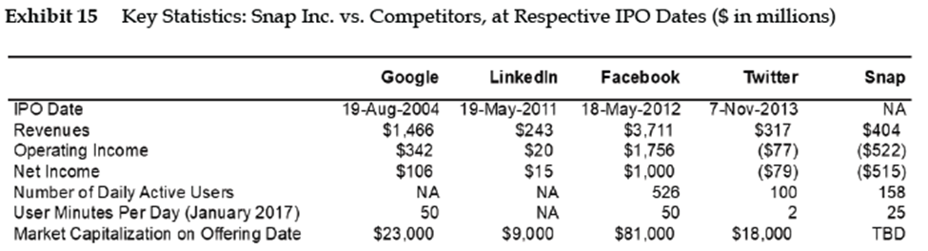
Stats and performance comparisons

Slide 11
Question 3
What are some of the reasons for a company to stay private longer?

Slide 12
Why companies stay private
held accountable to a smaller group of shareholders.
have more control over the business regarding direction, operations and finance.
can keep finances private and can conduct accounting as they see fit.
do not have to report to / are not subject to the rules of the SEC.
can access capital from banks, lines of credit and other outside investments.
companies that stay private tend to do it to maintain control of operational and financial aspects of their business.

Slide 13
Question 4
A Morgan Stanley Analyst produced the financial forecasts provided in the Snap Supplemental Workbook shortly after the offering. The analyst assumed a WACC of 9.7% and 1404 shares outstanding. Under these assumptions what would be the discounted cash flow estimate of Snap stock’s fair market value on a per share basis?

Slide 14
Discounted Cash Flow
The objective of the Discounted Cash Flow (DCF) analysis is to estimate the present value of a company based on its projected future cash flows. For a high-growth company like Snap, it's common to start with negative FCFs due to significant upfront investment and gradually move to positive FCFs as the company scales and operations become more efficient.

Slide 15
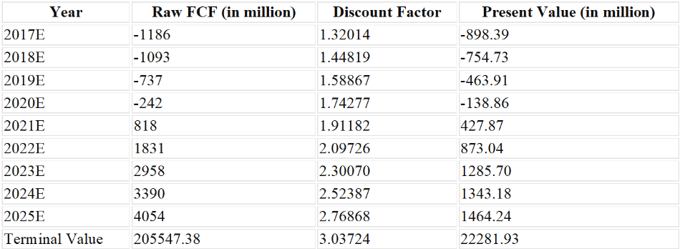
· The sum of the present values of the projected FCFs from 2017E to 2025E is $3,138.14 million.
· The present value of the terminal value is $29,415.26 million.
· Therefore, the total present value of Snap's projected future cash flows is $32,553.40 million.
· Dividing this by the number of outstanding shares (1,404), we get a per-share value of approximately $23.19.

Slide 16
Question 4a&c
How sensitive is the estimate of Snap’s stock price to assumptions about growth and WACC?
Analyze Snap’s DCF value under alternative assumptions of WACC and growth rates.

Slide 17
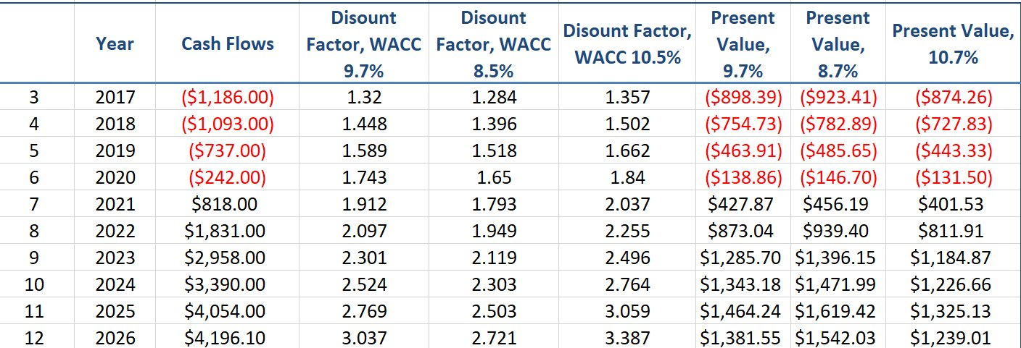
Sensitivity of Stock Price, using growth & WACC

Slide 18
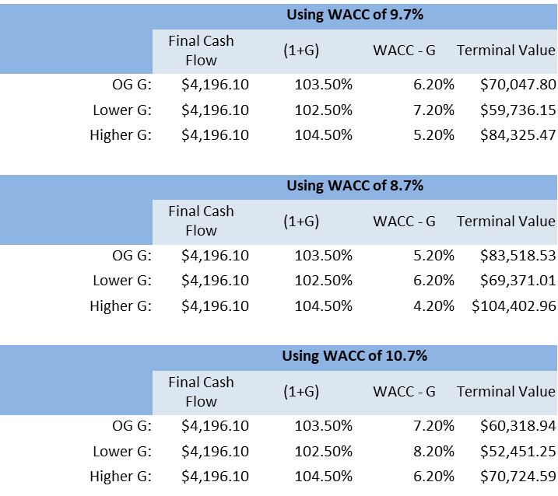
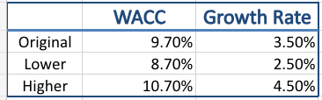

Slide 19
Question 4b
Do the assumptions and forecasts appear reasonable? What data would you use to assess that?

Slide 20
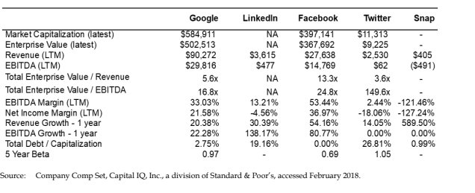
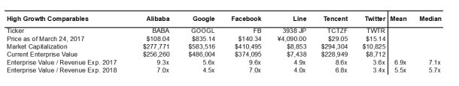

Slide 21
Question 4c1
What important changes would you make to the forecasts provided in the Snap Supplemental Workbook if any?

Slide 22
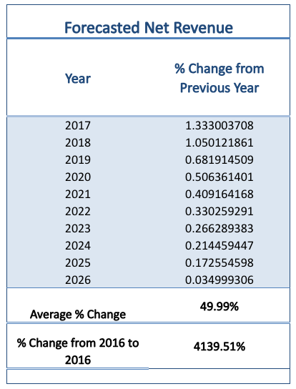
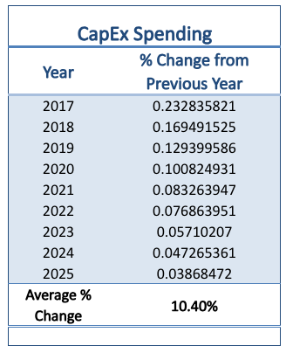
Too Optimistic?
Forecasts in the workbook provide an almost too optimistic outlook for revenues and expenses
WHY?
J.P. Morgan Bias
Greenshoe Provision for the Snap IPO underwriters
Notes:
The forecasts provided in the Supplemental Workbook provide a very, almost too, optimistic outlook for the revenues and expenses of the tech company. By looking into Snap’s income statement with data for the past 2.5 years, we see a company that has failed to return a net income. Each year the net loss has only increased, and at the half year mark for 2017 the company was already reporting a loss of -$2651.9 million with revenues of $331.3 million. In the workbook, the 2017 revenue is forecasted as $943.7 million, the following year $1,934.7, then $3,254 million, and so on. This is a massive increase from the actual 2016 revenues of $404.5 million dollars. Capital expenditure is also forecasted to be growing at an average of 10.4% each year, which is low considering the rate and breadth of new tech innovations that Snap is planning to create.
This optimism might be caused by the creator of the document being biased, that is, wanting to see Snap’s IPO succeed for their own gain. The credited creator of the Supplemental Workbook, Morgan Stanley, could potentially be an underwriter for the company. As there is a greenshoe provision for the Snap IPO that would allow underwriters to buy up to 15% of the company’s shares “at the offering price if the demand exceeded expectations.” (CASE PG 5) It is possible the inflated revenues were forecasted so Morgan Stanley could invest in Snap. To fix (or verify) the supplemental workbook, we would need to formulate more realistic forecasts from an independent source – not a potential investor in the company.

Slide 23
Question 4c2
What WACC would you recommend? Assume a long-term government bond rate of 3.16%?

Slide 24
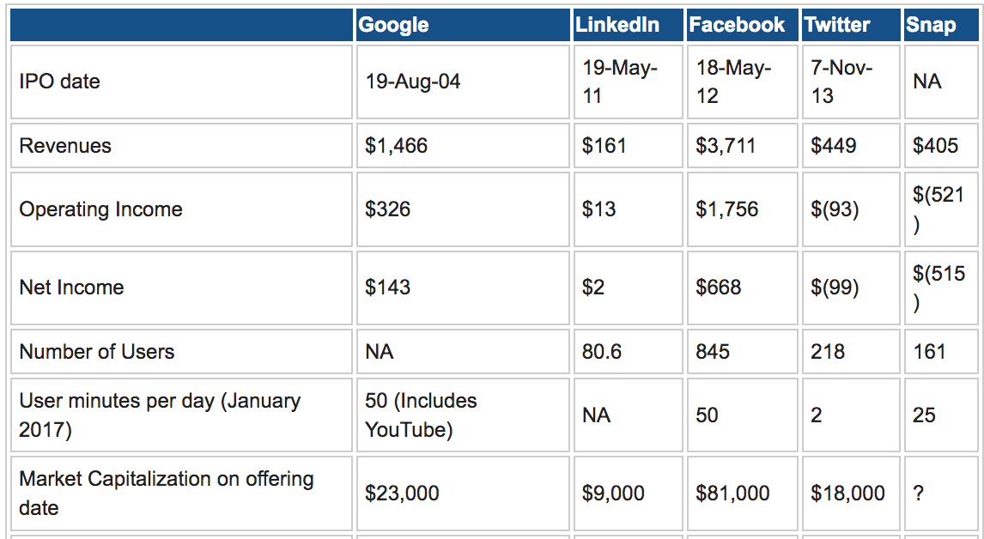




The competitive Market
Key Takeaways:
Smallest Revenue, largest expenses
Longest user engagement time
Damodaran, A. (2017, February 17). My Snap Story: Valuing Snap ahead of it's IPO! Musings on Markets. Retrieved April 16, 2024, from https://aswathdamodaran.blogspot.com/2017/02/a-snap-story-valuing-snap-ahead-of-its.html

Slide 25
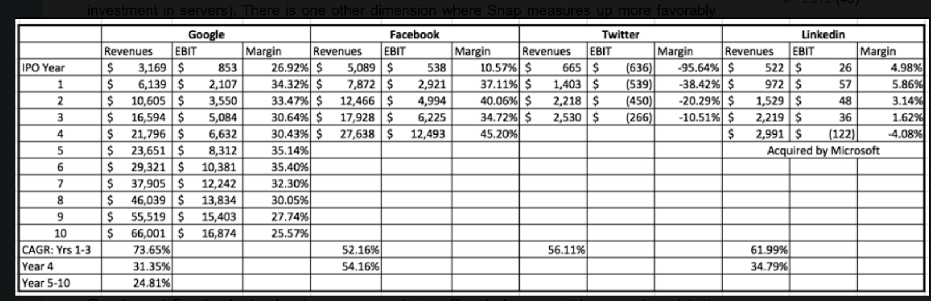
The competitive Market
Key Takeaways:
Facebook & Google maintain high revenues and profit margins
Twitter struggling, likely due to issues with monetization of the platform
LinkedIn sees modest revenue growth, but decreasing profit margin
Damodaran, A. (2017, February 17). My Snap Story: Valuing Snap ahead of it's IPO! Musings on Markets. Retrieved April 16, 2024, from https://aswathdamodaran.blogspot.com/2017/02/a-snap-story-valuing-snap-ahead-of-its.html

Slide 26
The competitive Market: Recommendations
Learning from Twitter:
Monetizing the platform is crucial to long term revenue growth and increasing profit margins
Snap will need to make adjustments to their business model to better their chances after the IPO.
More online advertising on the platform and other products, as that is the only current way that the company can organically generate revenue.
Target both the current younger age of users, 18 to 24, and diversify to include the next age range, 25 to 34.
Focusing on how to keep users on the platform longer by adding more features for users to explore and generate content with, as this is their current competitive advantage in the market.

Slide 27
The competitive Market: Recommendations
J.P. Morgan Forecast:
Very positive outlook on Snap's revenues and expenses that would place them on par with top players in the market like Facebook and Google
Uses/Recommends a WACC of 9.7%
Prof. A. Damodaran Forecast:
Realistic analysis of Snap, predicting that the company can achieve operating margins close to Google (25%), but not as high as Facebook (45%)
Weighs the risk of Snap not being able to effectively monetize their platform
Recommends a WACC of 10%
Keep the WACC within the range of 9.5% to 10.5%

Slide 28
Question 4c3
How would you deal with the uncertainty regarding Snap’s future growth.

Slide 29

Dealing with Growth Rate Uncertainty
Forecasted Growth Rate: 3.5%
Operations
Focus on products and features on offer
Improve marketing spend & quantity
Diversify target market
Financially
Increase the interest rate for the IPO
Notes:
In dealing with the uncertainty in Snap’s forecasted growth rate of 3.5%, there are two approaches: financially and operationally. By focusing on the core operation of the company, that is, the products and features they offer to their user base, Snap will be able to maintain and grow their business just based on user satisfaction and the resulting word of mouth buzz that comes with new and improved products. One strategy for doing so is to improve marketing quantity and spending to be more comparable to direct competition and more visible to the global market. Snap can also work to diversify their target market, both in age (older people) and location (global).
Financially, standard practice for dealing with uncertainty in growth rates is dealt with by increasing the interest rate for the IPO. This is done because an investment in a potentially risky company, such as Snap, lacks appeal for investors. Increasing the interest rate is a way for companies to compensate for an investor's risk. This increased interest rate will impact Snap’s cost of debt, and cost of equity – two key factors in calculating a company's WACC. As a result of higher interest rates, companies will have a higher WACC; which can be seen in the forecast for Snap done by J.P. Morgan. The recommendation, therefore, is to move forward with a higher than standard (as judged by competitors) WACC and interest rate to deal with the uncertainty regarding Snap’s future growth.

Slide 30
Question 5
Do you believe that the Snap IPO is underpriced? If so, why might it have been done and do you agree with the decision (you will need to do some research on IPO’s.

Slide 31
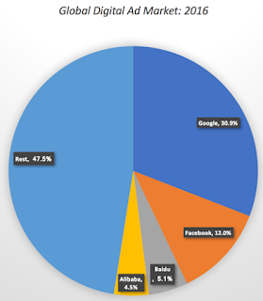
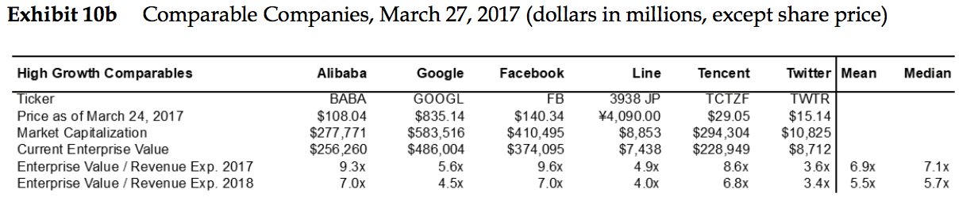
EXHIBIT 10B AND 12C
Top 2 Companies: Facebook and Google: count for 43 % Digital Ad market
Hard to tell if Snap's market is growing
Prices change from each company evaluating its High Growth Rate
Research: Twitter smaller
than Snapchat and still maintained a High IPO with good profitability.
Large Company= Less Risk

Slide 32
Is Snap IPO Underpriced ?
No financial Capacity to compete with bigger companies
Snap company : Unprofitable (spent most sales in 2016.)
Two Biggest Competitors with higher IPO and high profitability
Low Dua growth rate

