Slide 1

NAME: KARAN KOUNDINYA JANAKIRAM
STUDENT NUMBER: 10602768
COURSE TITLE: MASTER OF SCIENCE IN DATA ANALYTICS
PROJECT NAME: PLAYER POTENTIAL PREDICTION SYSTEM USING MACHINE LEARNING TECHNIQUES
DISSERTATION COORDINATOR NAME: DR. ANDREW BROWNE
SUPERVISOR NAME: MR PIERPAOLO DONDIO
MODULE/SUBJECT TITLE: B9DA113 APPLIED RESEARCH PROJECT (B9DA113_2223_TMD3)

Slide 2
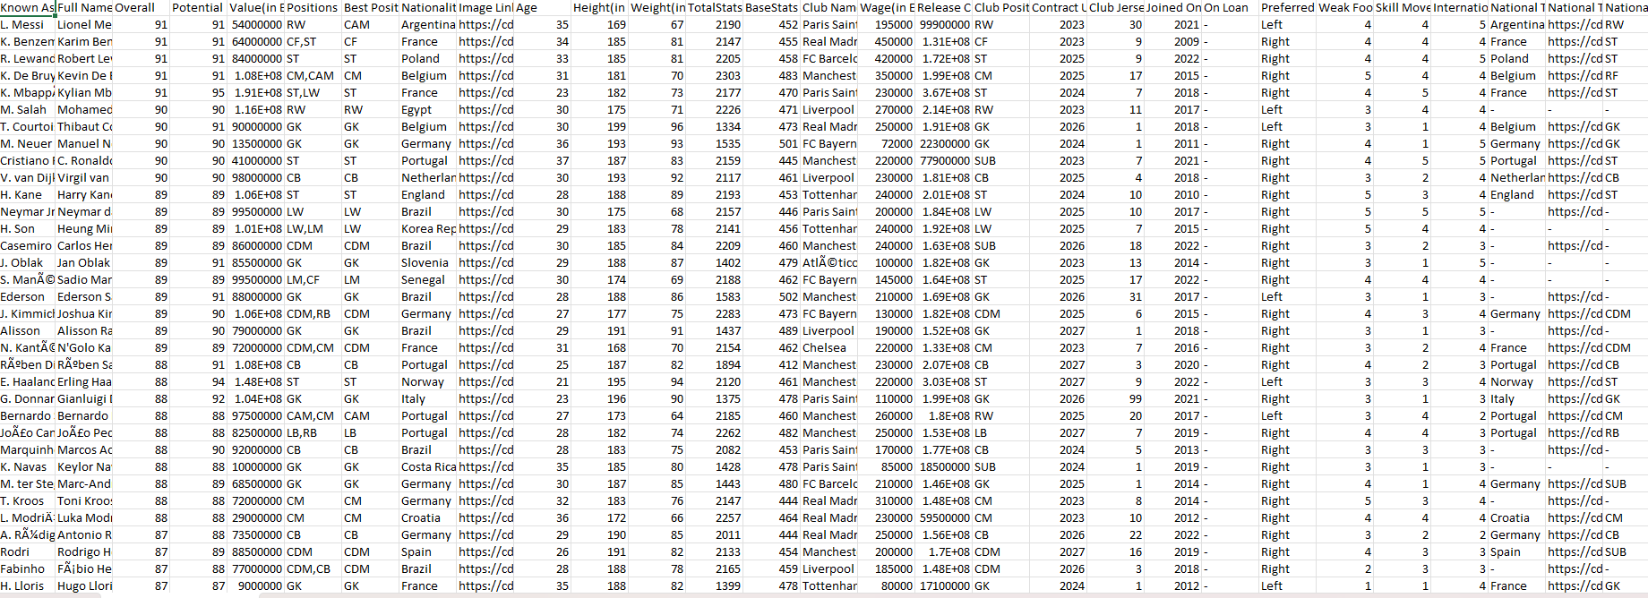
INTRODUCTION
This thesis is embarked on a noble endeavor, motivated by a single goal: to uncover the complex network of potential players in football
I have used the power of data and machine learning to learn up to what extent can machine learning models reliably anticipate the potential of football players by leveraging their attributes within the FIFA dataset? Furthermore, how do the five different prediction models perform, and what variations exist among them within this context.
The Five data models selected are Linear Regression, K Nearest Neighbours, Support Vector Regression, Gradient Boosting Regression and Random Forest regression
Here is a snapshot of the dataset under consideration

Slide 3
Additionally what patterns can emerge concerning key performance indicators and data relationships that influence player potential?
The insights that can be gleaned from key performance indicators (KPIs) and data relationships is on the basis of these questions
Question 1: Player BMI and Physical Attributes
Question 2: Continental Comparison of Physical Attributes
Question 3: Relationship between International Reputation and Player Attributes
Question 4: Relationship between Age and Player Attributes
Question 5: Future Value Prediction and Club/Country Analysis

Slide 4
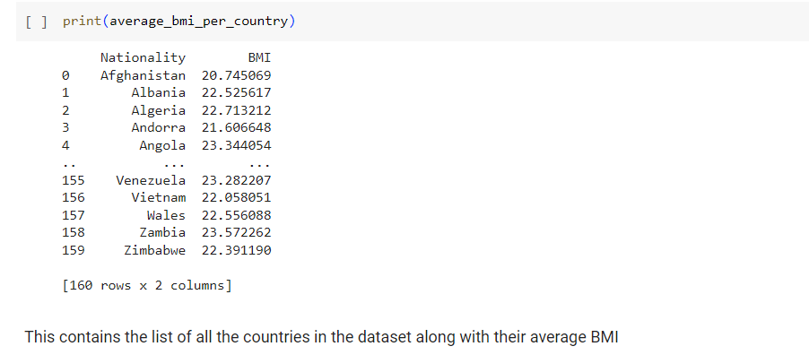
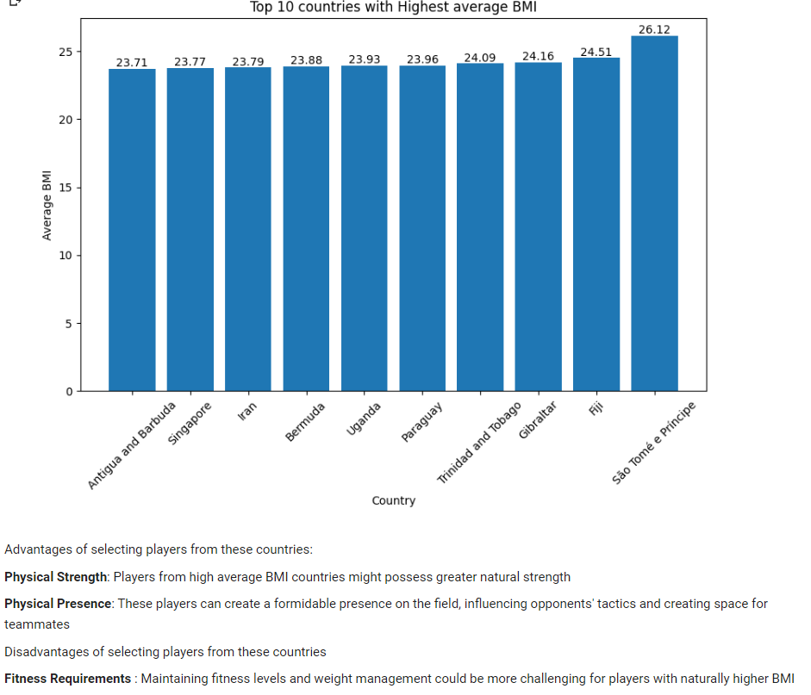
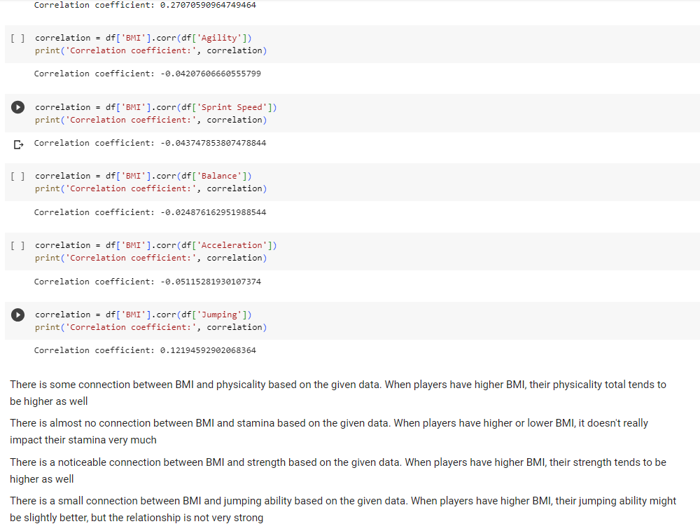
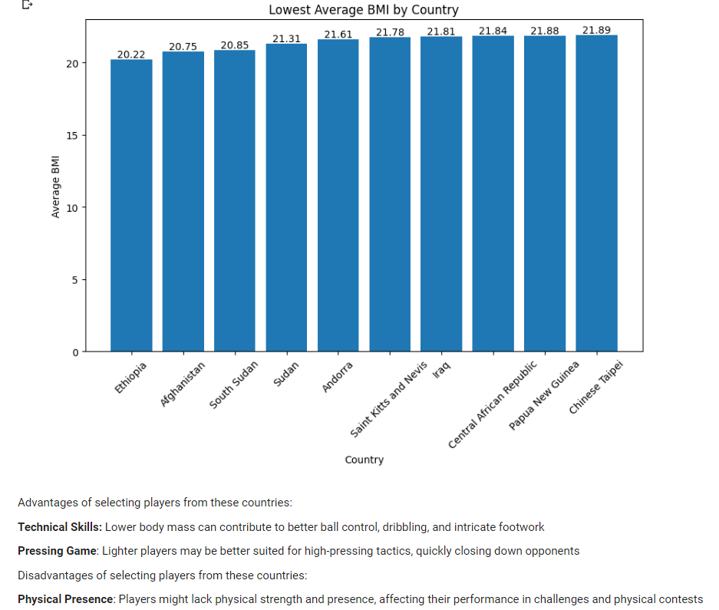
QUESTION 1: PLAYER BMI AND PHYSICAL ATTRIBUTES
a) Calculate the average BMI of each country
b) Calculate and visualize 10 countries with highest average BMI
c) Calculate and visualize 10 countries with lowest average BMI
d) Player with the lowest BMI
e) Player with the highest BMI
f) Correlation between BMI and other physical features

Slide 5
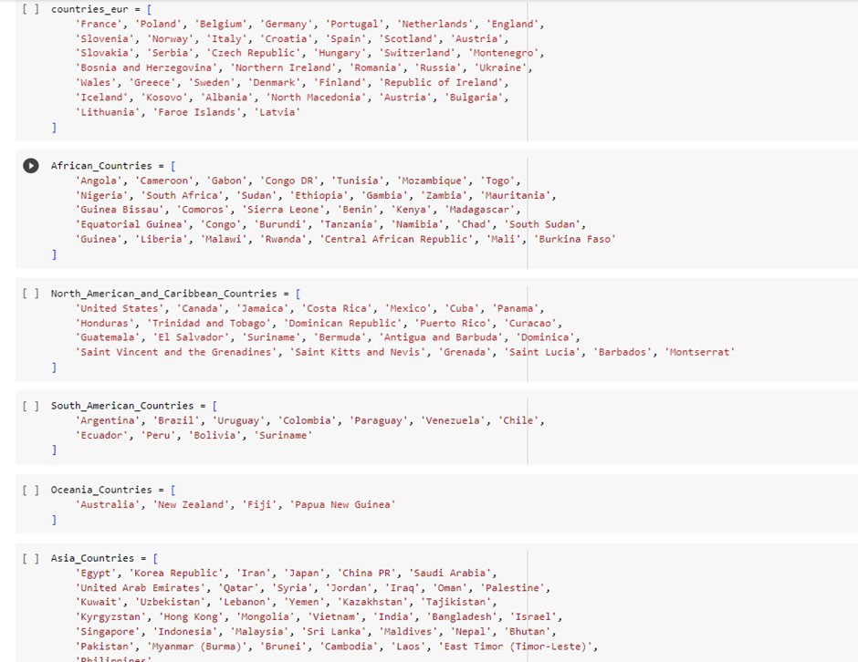
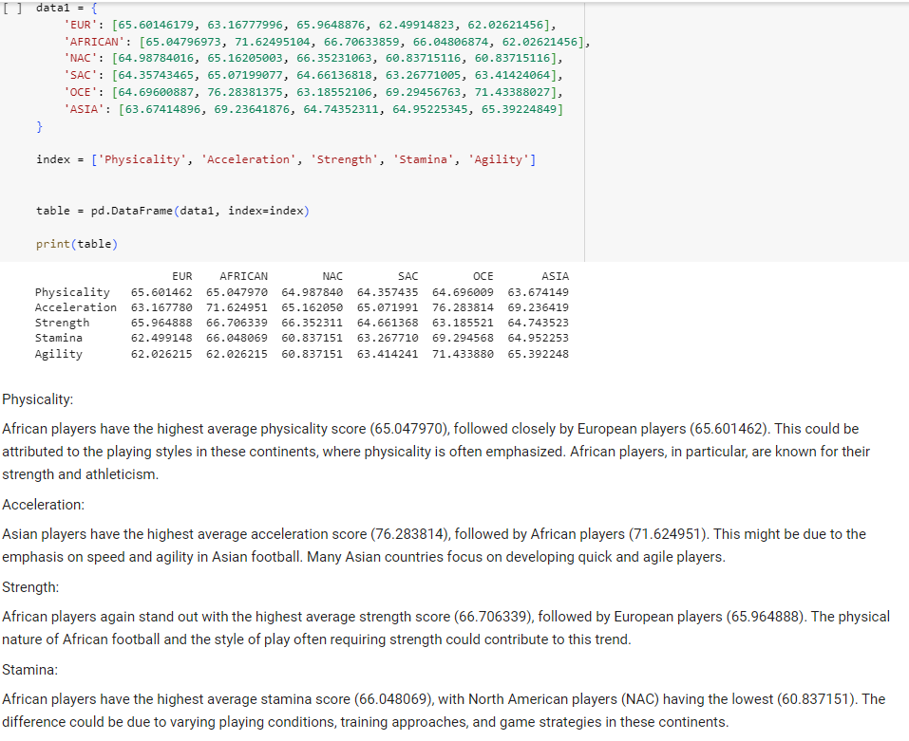
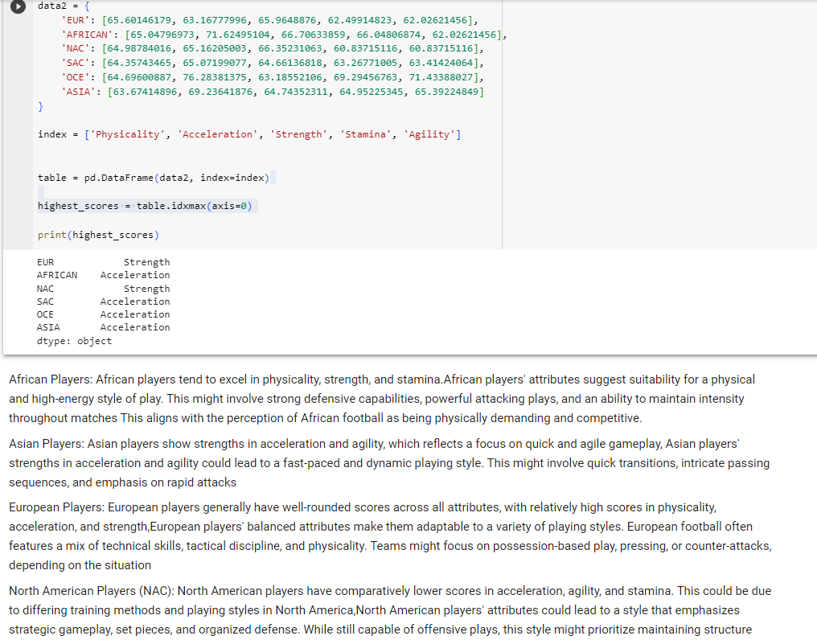
QUESTION 2:
What are the differences in physicality, stamina, strength, stamina and acceleration among continents, and how do they compare to determine which continent excels in these aspects.
Since we have a list of countries, we have to segregate the countries as per their continents, I have divided them into six continents
Europe, Africa, North America and Caribbean, South American, Oceanic and Asia

Slide 6
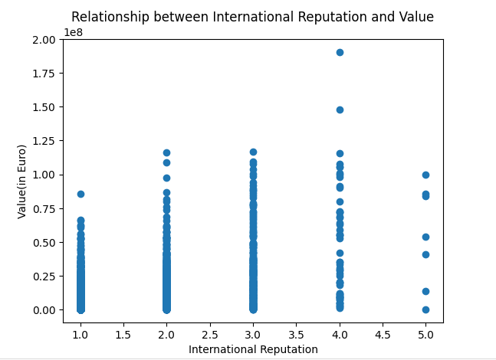
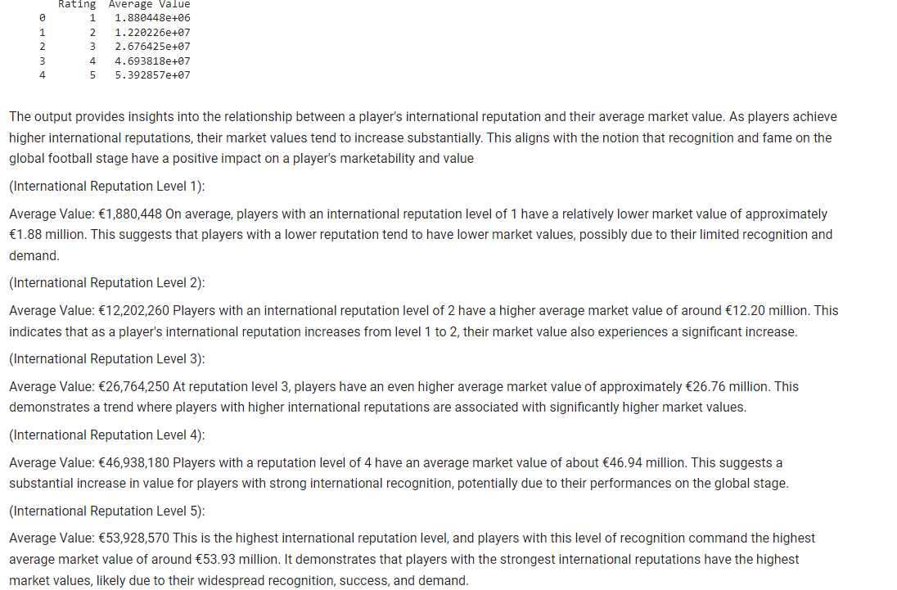
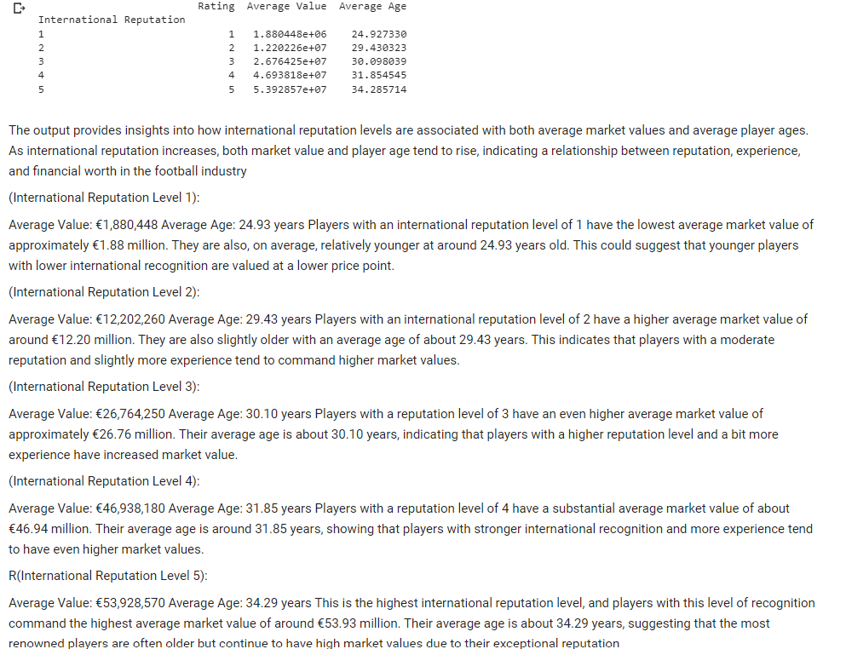
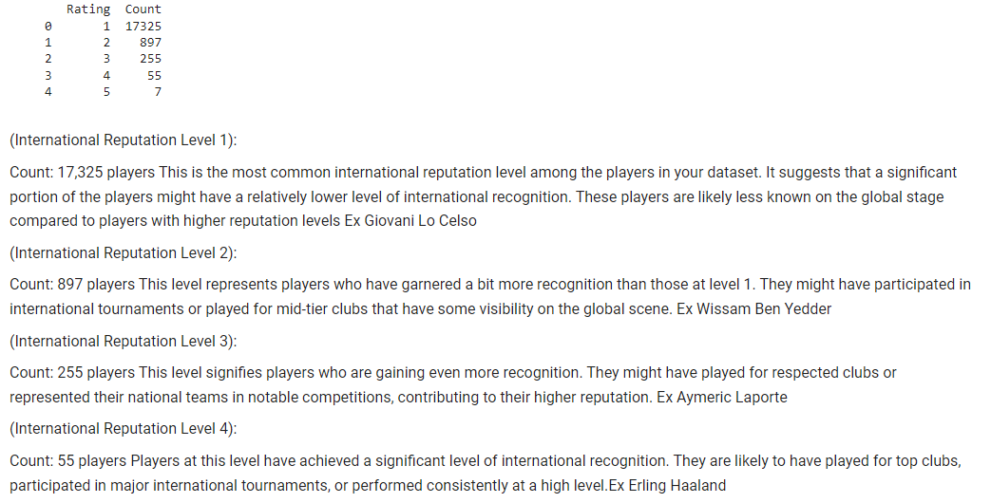
QUESTION 3:
How does the international reputation of players relate to their wage, count, value, and age? Compare it for these attributes to analyse the relationships.
Equating international reputation to revenue terms in football involves estimating how a player's reputation on the global stage can impact the financial aspects of the sport

Slide 7
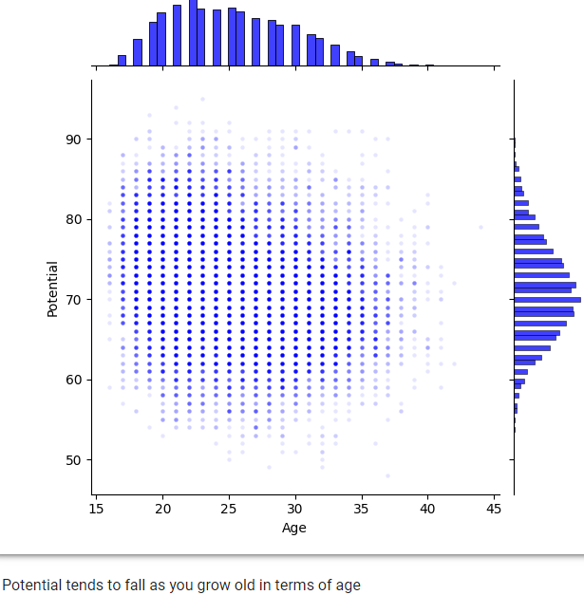
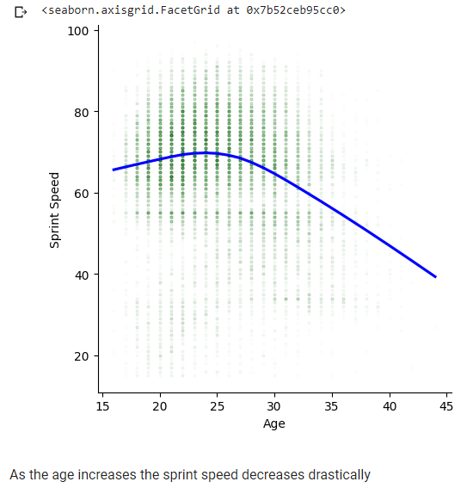
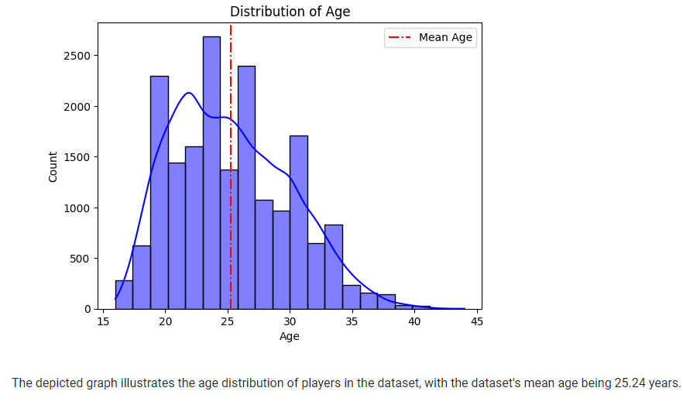
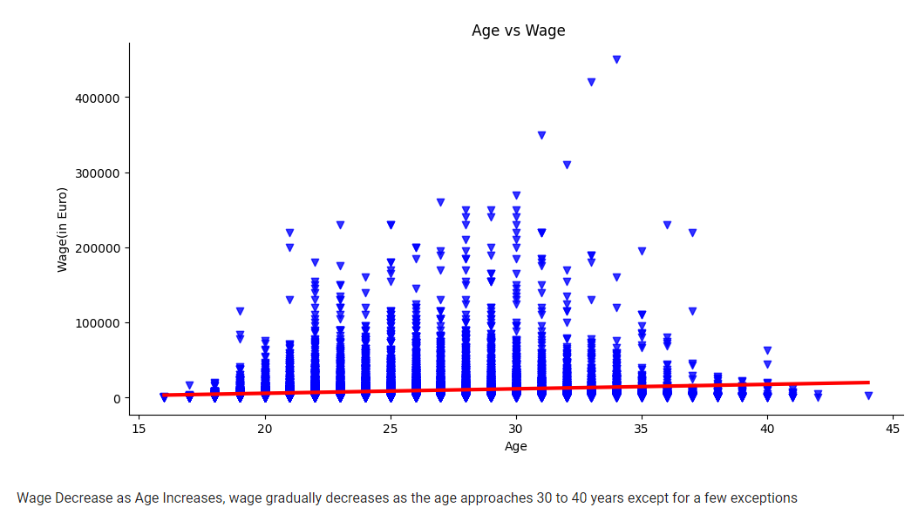
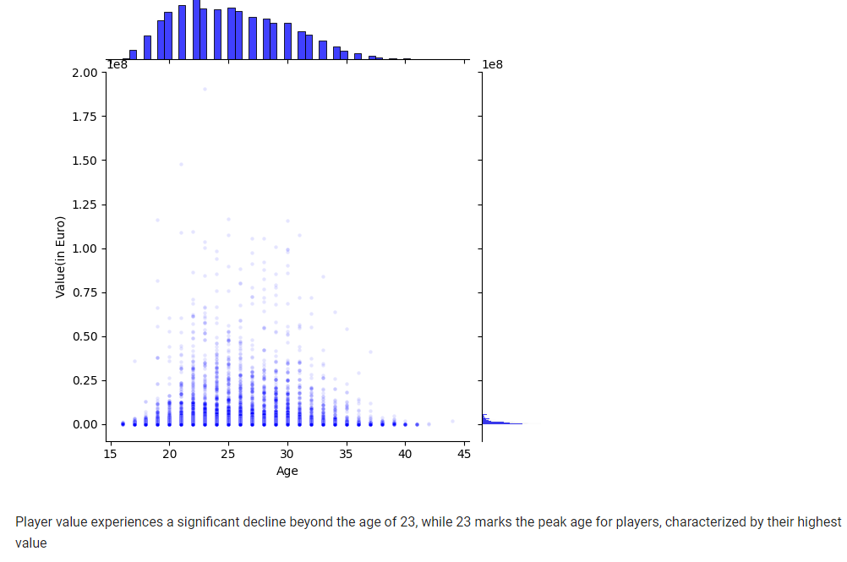
QUESTION 4:
How does the age of players relate to their wage, potential, value, and sprint speed? Compare these attributes to analyze the relationships

Slide 8
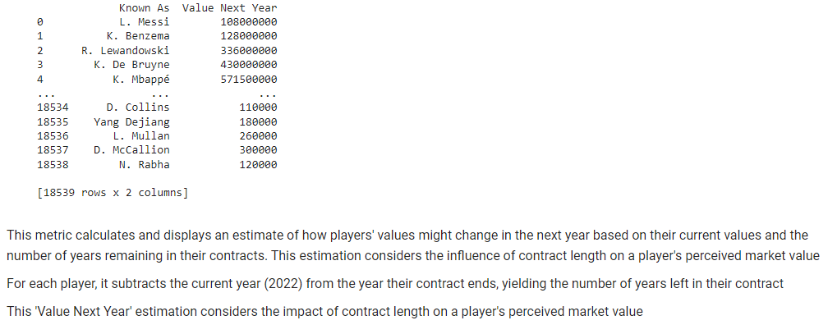
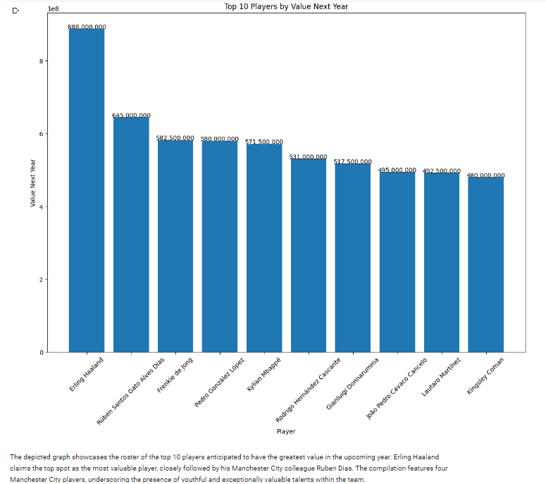
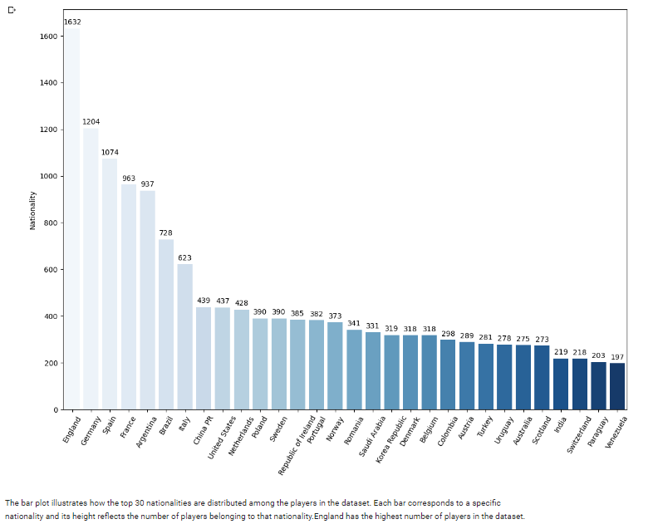
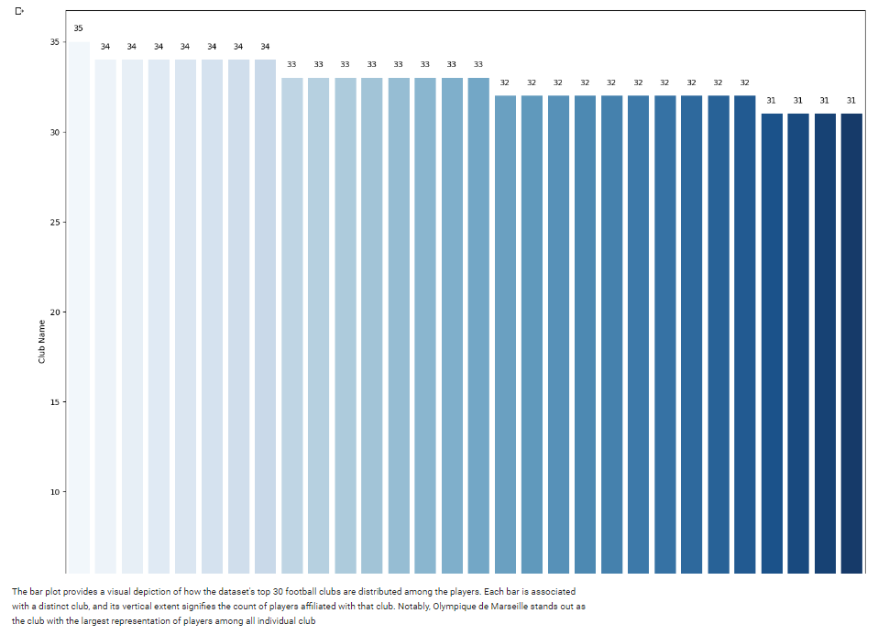
QUESTION 5:
a) Create a metric called as Value next year, that give's the player's expected value next year
b) Visualize the top 10 players with highest expected values for next year
c)Countries with the greatest number of players
d)Clubs with the greatest number of players as present in the dataset

Slide 9
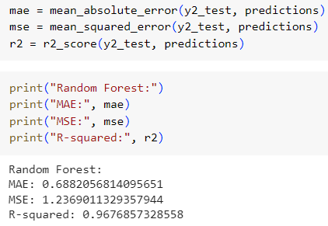
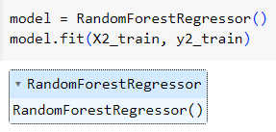

MODEL BUILDING AND IMPLEMENTATION OF RESULTS
The basic steps of all the models involve the following common steps
Our machine learning model can be trained on X_train and y_train following this data split, and its performance can then be evaluated on X_test and y_test to determine how well it reacts to new data
After this we use our predictor variables X and Y, this code builds the model and fits it, enabling the model to discover the link between them, below are the screengrab for Random Forrest Regression Model
Following these steps, we have to now calculate the metrics which assess the performance and the accuracy of the Random Forest Regression on the test dataset
The three metrics under consideration are MAE, MSE and R SQUARED

Slide 10
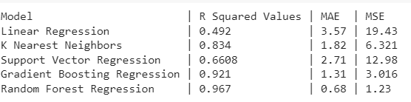
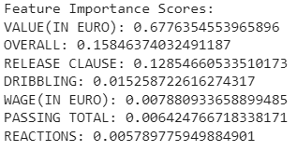
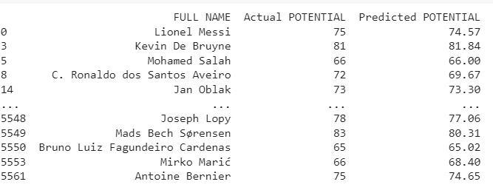

RESULT AND CONCLUSION
The following are the results of all the five algorithms
The Random Forest Regression model has the R-squared value for the Random Forest Regression model is 0.967, which indicates that the model fits the data very well and it also has the lowest MAE and MSE, which indicates that it is the most accurate model
Now since we know Random Forest is the best performing model, we need to know which features contribute the most towards achieving the highest accuracy score
Now, we need to acquire a list that showcases the player's name, along with their actual potential and predicted potential, to assess how well it performs in terms of ratings.
If our objective is to choose a specific player and conduct an analysis by contrasting their real and forecasted values, we have the option to do that as well

Slide 11
The Random Forest prediction model effectively addresses the challenges in the FIFA dataset, providing a data-driven solution for assessing football player potential. With an impressive R-squared score of 0.967, it demonstrates a remarkable ability to capture complex relationships between player attributes and future potential. Its low Mean Absolute Error (MAE) of 0.68 and Mean Squared Error (MSE) of 1.23 underscore its precision in predicting player ratings
FUTURE DEVELOPMENTS
Examine how expected player ratings affect fan engagement, such as whether there are more discussions and community involvement
Study how predictive models can be included into the e-sports environment
Sports organizations can help you build and validate your model in practical settings. For example, work with the football groups
Player Development Insights: Analyse how the projections of the model can influence player development plans, examine how clubs and academies might use this knowledge to properly develop emerging talents.

Slide 12
THANK YOU

