Slide 1
SentiMentor Every SentiMent you need to know

Slide 2
Objective :
The main goal is to connect on Twitter and search for the tweets that contain a particular keyword and then evaluate the polarity of the tweets as positive, negative or neutral.

Slide 3
Sentiment Analysis
◆ Sentiment analysis is contextual mining of text which identifies and extracts subjective information in source material, and helping a business to understand the social sentiment of their brand, product or service while monitoring online conversations.
◆ It is the most common text classification tool that analyses an incoming message and tells whether the underlying sentiment is positive, negative or neutral.

Slide 4
Flowchart
The following flowchart shall be followed while implementing the undertaken project.
Pre-processing Steps:
Filtering
Tokenization
Removal of Stop words
Twitter API
Data Streaming
Tweet classified as positive, negative or neutral
Applying desired classification algorithm to classify the tweets.

Slide 5
Web Application
Why we choose web Application?
Front-end: html5, CSS3, Bootstrap, Java Script
Back-end: Django framework
Other: twitter API

Slide 6
Twitter API
◆ An application program interface (API) is a set of protocols and tools for building software applications. Basically, an API specifies how software components should interact. Additionally, APIs are used when programming graphical user interface (GUI) components.
◆ The Twitter API is simply a set of URLs that take parameters. They URLs let you access many features of Twitter, such as posting a tweet or finding tweets that contain a word.
◆ Tweepy is open-sourced library, hosted on GitHub and enables Python to communicate with Twitter platform and use its API.

Slide 7
Data Streaming
◆ Data streaming is the process of transferring a stream of data from one place to another, to a sender and recipient or through some network trajectory. Data streaming is applied in multiple ways with various protocols and tools that help provide security, efficient delivery and other data results.
◆ Twitter presents two kinds of APIs to extract the tweets:
Search API is used for dumping old tweets . The training dataset is built for sentiment classification.
Streaming API used for dumping live Sentiments . The current result will be displayed using this.

Slide 8
Pre-processing Steps
◆ In this step of the project , tweets are mined using Twitter Streaming API . Initially ,it cleans the unstructured textual data into structured textual data by removing punctuations and additional symbols.
Filtering : In this step , the special words , user names in twitter are removed.
Tokenization : is the act of breaking up a sequence of strings into pieces such as words, keywords, phrases, symbols and other elements called tokens.
Removal of Stop Words : Articles and other stop words are removed in this step.

Slide 9
Graph with Matploatlib
We added graph of analysis as output.
So how we generate that graph ??

Slide 10
How we did connectivity between data from python script to Html Page???
Django
What is Django?

Slide 11
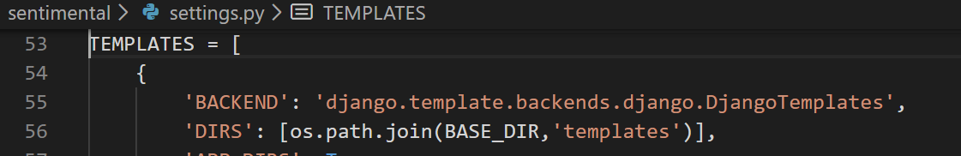
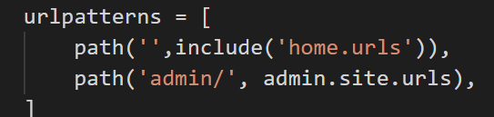
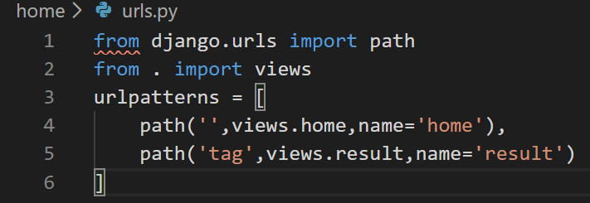
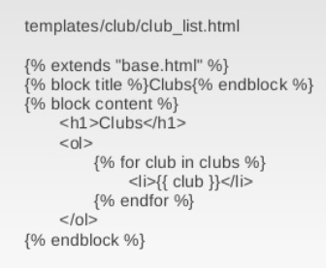
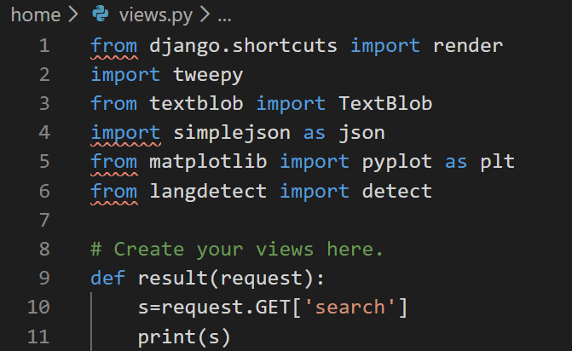

Slide 12
Conclusion
◆ We will obtain a classification of polarities (of sentiments into positive , negative or neutral) and prepare a plot of the same using python module like matplotlib.

Slide 13
THANK YOU

