Slide 1

Cryptography and Information Security
Malware and its Allied Research
Presented By
Subinoy Sikdar
Under the Guidance of
Dr. Malay Kule
Enrolment Number: 2021CSP002
Registration Number: 2023CSPR006
Department of Computer Science and Technology
Indian institute of Engineering Science and Technology, Shibpur

Slide 2
Malware
Malware Definition
Any application that is malicious to the systems.
Types of Malware
i. Trojan ii. RAT iii. Ransomware iv. Dropper v. Keylogger vi. Spyware vii. Adware etc.
Malware Analysis
Study of malware- behaviors, functionality etc.
Static Analysis
Dynamic Analysis
Code Analysis
Behavioural Analysis
Analyze without executing or running the application
Extract information -> PE header
File structure, type, characteristics
Analyze while executing the malware
What changes are made to the system while it is running.
Understanding the malware code
Analyze the malware after execution
Malware Detection
i. Power consumption ii. Memory utilization iii. Memory dump iv. Network traffic analysis etc.
Malware Prevention
i. Antivirus ii. Firewall iii. Honeypot etc.

Slide 3
Introduction
Obfuscated malware detection frameworks.
CIC-MalMem-2022 dataset [obfuscated malware dataset].
Classify the dataset accurately.
Problem Statement
Detection of malware and its group.
Prevent the execution of these malwares as soon as it is detected.
If the ransomware was successfully run in the victim's system prior to prevention, we should begin cryptanalysis of the ransomware attack to retrieve the material without paying the ransom demand.
Research Goal
Our Contributions
Hybrid threat detection model [ML+ NIA].
DTACO, DTPPA, DTCSA.
Obtained the optimized feature set.
Three hybrid Threat Detection Model.
Outcomes
2

Slide 4
Literature Review
Developed an obfuscated malware detection framework using memory feature engineering.
Extracted features from memory dump files with VolMemLyzer to create the MalMemAnalysis-2022 dataset.
The dataset was used to train a stacked ensemble machine learning model, with the best individual classifier, Random Forest, achieving 97% accuracy.
Tristan Carrier et al.

Slide 5
Dataset Information
Table 1: Malware Split
CICMalMem-2022 Dataset.
Memory dump files VolMemLyzer Feature Extracted .
26 types of memory features, 56 individual features.
58596 instances, 29298 benign, 29298 malicious memory dumps.
Dataset-1, Dataset-2, Dataset-3
Malware Class | Malware Descent | Count
Trojan Horse | Zeus | 195
 | Emotet | 196
 | Refroso | 200
 | Scar | 200
 | Reconyc | 157
Spyware | 180Solutions | 200
 | Coolwebsearch | 200
 | Gator | 200
 | Transponder | 241
 | TIBS | 141
Ransomware | Conti | 200
 | MAZE | 195
 | Pysa | 171
 | Ako | 200
 | Shade | 220
Table 2: Feature List
Feature Type | Malfind |  |  | Ldrmodule |  |  | Handles |  |  |  |  |  |  |  |  |  |  | Process View |  |  |  |  |  | Apihooks
Feature List | commitCharge | Protection | uniqueInjections | avgMissingFromLoad | avgMissingFromInit | avgMissingFromMem | port | file | event | desktop | key | thread | directory | semaphore | timer | section | mutant | pslist | Psscan | thrdproc | pspcid | session | deskthrd | nhooks | nhookInLine | nhooksInUsermode

Slide 6
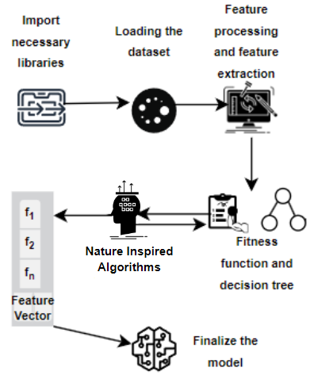
Proposed Methods
Obfuscated Malware Detection Models
Revisited Machine Learning Algorithms
Machine Learning and Nature Inspired Algorithms
Decision Tree
Random Forest
DTACO
DTPPA
DTCSA
Fig. 1: Workflow of the Entire Research
Fig. 2: Flow Diagram of the Proposed Hybrid Algorithm

Slide 7
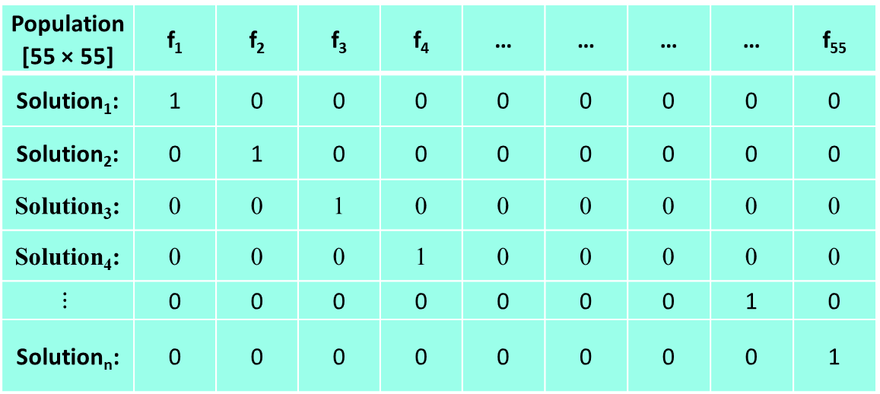
Proposed Methods
Three ML and NIA based Malware Detection Algorithms :
i. DTACO ii. DTPPA iii. DTCSA
Two Common steps for the proposed algorithm above
Population Generation
Fitness Evaluation
Fitness Function:
For a given feature vector, a Decision Tree classifier is applied.
Accuracy of the DT represents the fitness value of the corresponding feature.
$Accuracy= \frac{TP+TN}{TP+TN+FP+FN}$ (1)
Population Generation
Table 3: Population Matrix
Algorithm 1: Fitness Evaluation Algorithm
function fitness(feature_vector):
if not any(feature):
return 0
X_train, X_test, Y_train, Y_test = split_dataset()
model = DecisionTreeClassifier()
model.train(X_train, Y_train)
Y_pred = model.predict(X_test)
accuracy = calculate_accuracy(Y_test, Y_pred)
return accuracy
Population [55 × 55] | f₁ | f₂ | f₃ | f₄ | … | … | … | … | f₅₅
Solution₁: | 1 | 0 | 0 | 0 | 0 | 0 | 0 | 0 | 0
Solution₂: | 0 | 1 | 0 | 0 | 0 | 0 | 0 | 0 | 0
Solution₃: | 0 | 0 | 1 | 0 | 0 | 0 | 0 | 0 | 0
Solution₄: | 0 | 0 | 0 | 1 | 0 | 0 | 0 | 0 | 0
$$⋮$$ | 0 | 0 | 0 | 0 | 0 | 0 | 0 | 1 | 0
Solution_{n}: | 0 | 0 | 0 | 0 | 0 | 0 | 0 | 0 | 1

Slide 8
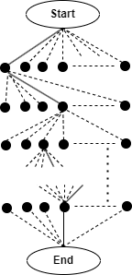
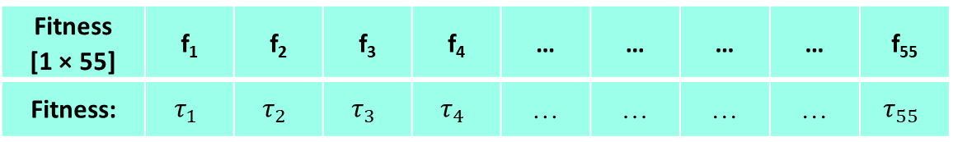
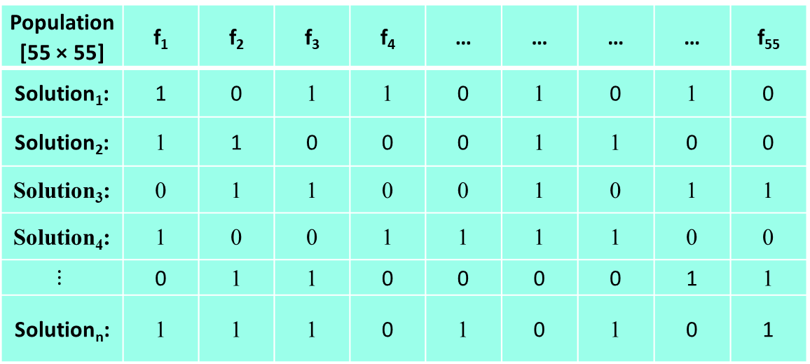
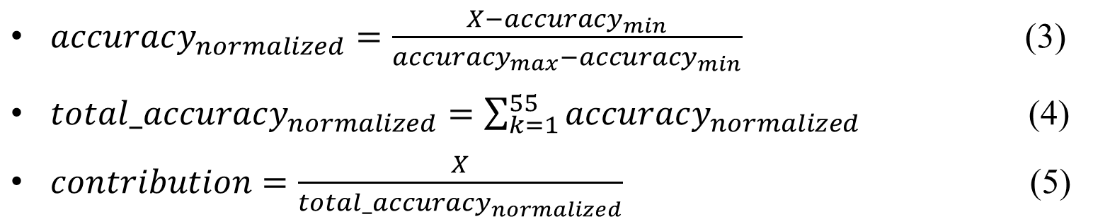
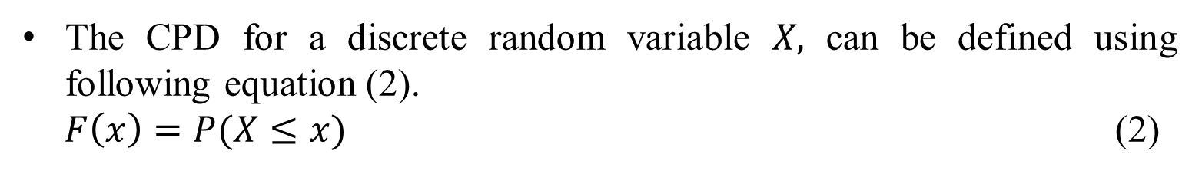
Decision Tree + Ant Colony Optimization
Algorithm 2: Proposed Malware Detection Algorithm using ACO based Hybrid Classifier (DTACO)
For each feature (f_{i})
While feature_count != 54
Select the next feature with highest fitness using cumulative distribution
If new_fitness > old_fitness
Include the feature into the feature_vector
End if
Increment feature_count
End while
End for
Return the population matrix
Find out the best feature_vector for which the accuracy is maximum
Fig 3: Solution Representation in ACO
Table 4: Pheromone Matrix
Fitness [1 × 55] | f₁ | f₂ | f₃ | f₄ | … | … | … | … | f₅₅
Fitness: | $$τ_{1}$$ | $$τ_{2}$$ | $$τ_{3}$$ | $$τ_{4}$$ | … | … | … | … | $$τ_{55}$$
The CPD for a discrete random variable 𝑋, can be defined using following equation (2).
$F\left(x\right)=P(X≤x)$ (2)
Table 5: Optimized Population Matrix
This pheromone matrix is scaled to 1 to find out the contribution of each feature out of 1.
Population [55 × 55] | f₁ | f₂ | f₃ | f₄ | … | … | … | … | f₅₅
Solution₁: | 1 | 0 | 1 | 1 | 0 | 1 | 0 | 1 | 0
Solution₂: | 1 | 1 | 0 | 0 | 0 | 1 | 1 | 0 | 0
Solution₃: | 0 | 1 | 1 | 0 | 0 | 1 | 0 | 1 | 1
Solution₄: | 1 | 0 | 0 | 1 | 1 | 1 | 1 | 0 | 0
$$⋮$$ | 0 | 1 | 1 | 0 | 0 | 0 | 0 | 1 | 1
Solution_{n}: | 1 | 1 | 1 | 0 | 1 | 0 | 1 | 0 | 1
$accuracy_{normalized}=\frac{X−{accuracy}_{min}}{{accuracy}_{max}−{accuracy}_{min}}$ (3)
$total_accuracy_{normalized}=\sum_{k=1}^{55}{accuracy_{normalized}}$ (4)
$contribution=\frac{X}{total_accuracy_{normalized}}$ (5)

Slide 9
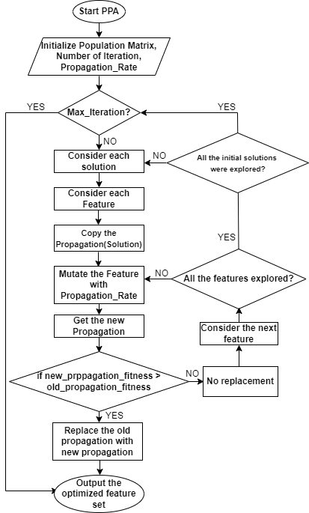
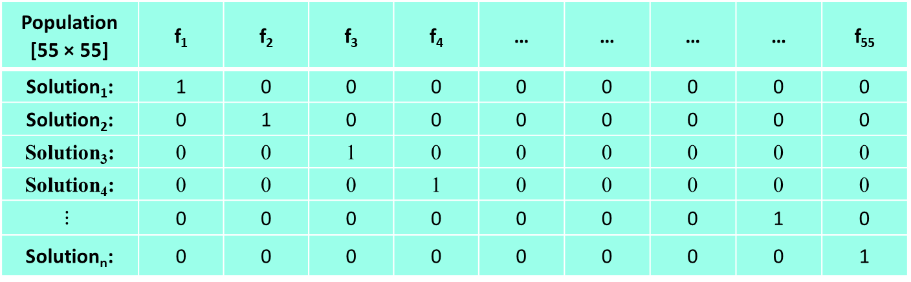
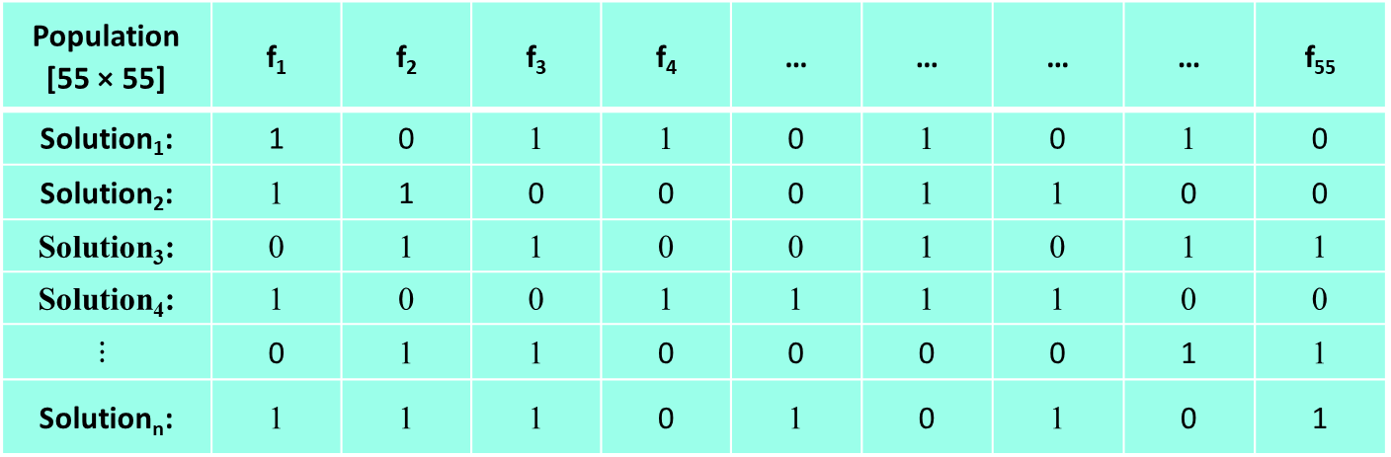
Decision Tree + Plant Propagation Algorithm (DTPPA)
Table 3: Population Matrix
Population [55 × 55] | f₁ | f₂ | f₃ | f₄ | … | … | … | … | f₅₅
Solution₁: | 1 | 0 | 0 | 0 | 0 | 0 | 0 | 0 | 0
Solution₂: | 0 | 1 | 0 | 0 | 0 | 0 | 0 | 0 | 0
Solution₃: | 0 | 0 | 1 | 0 | 0 | 0 | 0 | 0 | 0
Solution₄: | 0 | 0 | 0 | 1 | 0 | 0 | 0 | 0 | 0
$$⋮$$ | 0 | 0 | 0 | 0 | 0 | 0 | 0 | 1 | 0
Solution_{n}: | 0 | 0 | 0 | 0 | 0 | 0 | 0 | 0 | 1
Table 5: Optimized Population Matrix
Population [55 × 55] | f₁ | f₂ | f₃ | f₄ | … | … | … | … | f₅₅
Solution₁: | 1 | 0 | 1 | 1 | 0 | 1 | 0 | 1 | 0
Solution₂: | 1 | 1 | 0 | 0 | 0 | 1 | 1 | 0 | 0
Solution₃: | 0 | 1 | 1 | 0 | 0 | 1 | 0 | 1 | 1
Solution₄: | 1 | 0 | 0 | 1 | 1 | 1 | 1 | 0 | 0
$$⋮$$ | 0 | 1 | 1 | 0 | 0 | 0 | 0 | 1 | 1
Solution_{n}: | 1 | 1 | 1 | 0 | 1 | 0 | 1 | 0 | 1
Fig 4: Solution Representation in PPA

Slide 10
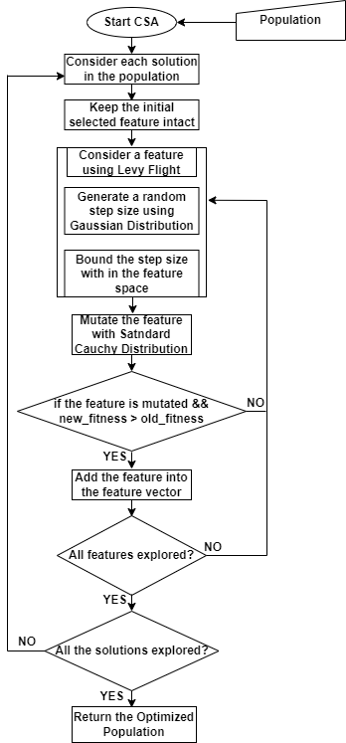
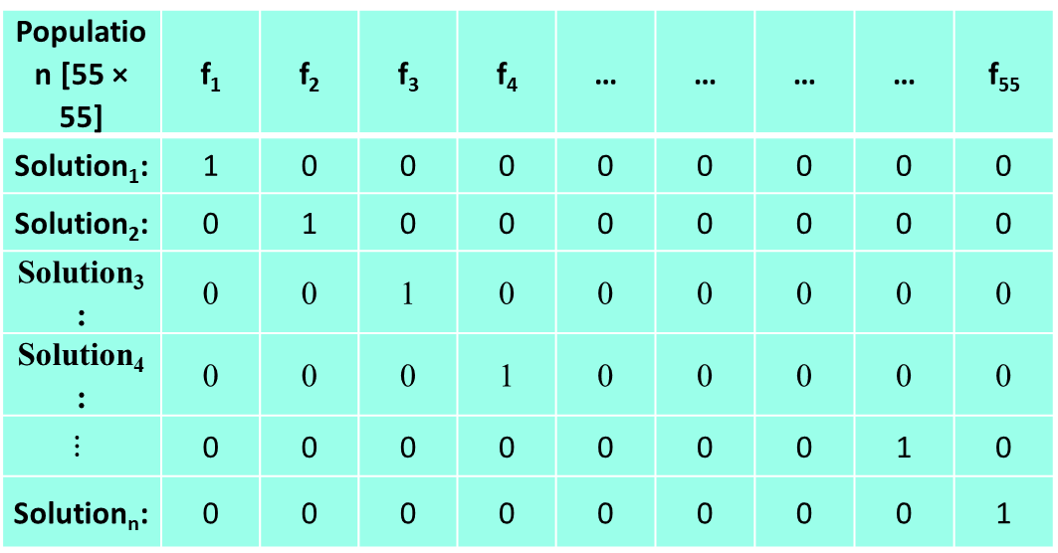
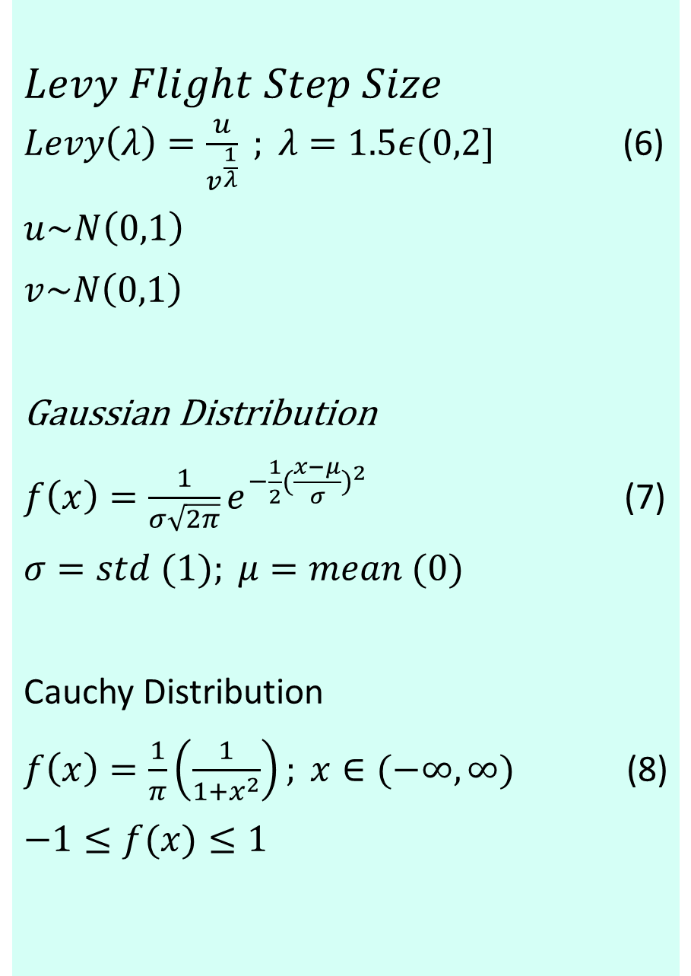
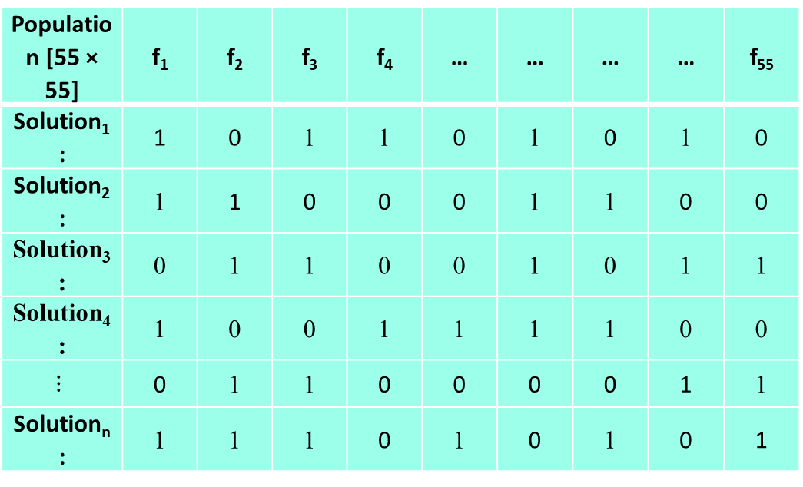
Decision Tree + Cuckoo Search Algorithm
Table 3: Population Matrix
$$Levy Flight Step Size$$
$Levy\left(λ\right)=\frac{u}{v^{\frac{1}{λ}}} ; λ=1.5ε(0,2]$ (6)
$$u\sim N\left(0,1\right)$$
$$v\sim N\left(0,1\right)$$
Gaussian Distribution
$f\left(x\right)=\frac{1}{σ\sqrt{2π}}e^{−\frac{1}{2}{(\frac{x−μ}{σ})}^{2}}$ (7)
$$σ=std (1); μ=mean (0)$$
Cauchy Distribution
$f\left(x\right)=\frac{1}{π}\left(\frac{1}{1+x^{2}}\right); x∈(−∞,∞)$ (8)
$$−1≤f(x)≤1$$
Population [55 × 55] | f₁ | f₂ | f₃ | f₄ | … | … | … | … | f₅₅
Solution₁: | 1 | 0 | 0 | 0 | 0 | 0 | 0 | 0 | 0
Solution₂: | 0 | 1 | 0 | 0 | 0 | 0 | 0 | 0 | 0
Solution₃: | 0 | 0 | 1 | 0 | 0 | 0 | 0 | 0 | 0
Solution₄: | 0 | 0 | 0 | 1 | 0 | 0 | 0 | 0 | 0
$$⋮$$ | 0 | 0 | 0 | 0 | 0 | 0 | 0 | 1 | 0
Solution_{n}: | 0 | 0 | 0 | 0 | 0 | 0 | 0 | 0 | 1
Table 5: Optimized Population Matrix
STEP- 1
STEP- 4
END
Population [55 × 55] | f₁ | f₂ | f₃ | f₄ | … | … | … | … | f₅₅
Solution₁: | 1 | 0 | 1 | 1 | 0 | 1 | 0 | 1 | 0
Solution₂: | 1 | 1 | 0 | 0 | 0 | 1 | 1 | 0 | 0
Solution₃: | 0 | 1 | 1 | 0 | 0 | 1 | 0 | 1 | 1
Solution₄: | 1 | 0 | 0 | 1 | 1 | 1 | 1 | 0 | 0
$$⋮$$ | 0 | 1 | 1 | 0 | 0 | 0 | 0 | 1 | 1
Solution_{n}: | 1 | 1 | 1 | 0 | 1 | 0 | 1 | 0 | 1
Fig 5: Solution Representation in CSA

Slide 11
Experimental Results
Table 6: Results Obtained from the Proposed Models
Proposed Algorithm | Accuracy (%) |  |  | Number of Features Selected in the Optimization Process |  |  | Model Execution Time
 | Dataset-1 | Dataset-2 | Dataset-3 | Dataset-1 | Dataset-2 | Dataset-3 | Dataset-1 | Dataset-2 | Dataset-3
Decision Tree | 98.28 | 84.35 | 87.86 | 55 | 55 | 55 | 1.5 Sec | 1.5 Sec | 2.3 Sec
Random Forest | 99.98 | 87.04 | 88.50 | 55 | 55 | 55 | 4.5 Sec | 8 Sec | 5.7 Sec
DTACO | 99.99 | 84.57 | 88.19 | 30 | 31 | 34 | 3 Min | 5.16 Min | 2.31 Min
DTPPA | 100 | 86.35 | 88.31 | 17 | 14 | 18 | 2.48 Min | 3.25 Min | 1.57 Min
DTCSA | 100 | 85.11 | 88.46 | 28 | 21 | 23 | 5 Min | 8.31 Min | 3.24 Min
9

Slide 12
Experimental Results
Fig. 6: Experimental Results: Accuracy, Number of Features and Execution Time

Slide 13
Experimental Results
The best feature vector obtained from the three hybrid models for dataset-1 are shown below.
Dataset-1:
Feature Vector obtained by proposed DTACO (30)
[1 1 0 1 0 1 1 0 0 0 1 1 1 1 1 1 0 0 0 0 0 1 0 1 1 0 1 1 0 0 0 1 0 1 0 1 1 1 1 0 0 1 1 0 0 1 1 1 0 1 0 0 1 0 1]
Feature Vector obtained by proposed DTPPA (17)
[0 1 1 0 0 0 0 0 0 0 0 0 1 0 0 0 1 0 0 0 0 0 1 0 0 0 0 1 1 1 1 0 0 0 0 0 1 0 0 1 0 0 0 1 0 1 1 1 0 0 1 0 0 0 0]
Feature Vector obtained by proposed DTCSA (28)
[1 0 0 0 0 1 0 1 0 1 1 0 1 0 1 0 0 0 1 1 1 1 0 0 1 1 1 0 1 1 0 1 0 0 1 1 0 0 0 1 0 1 0 0 1 0 0 1 1 1 0 0 1 1 1]
9

Slide 14
Experimental Results
The best feature vector obtained from the three hybrid models for dataset-2 are shown below.
Dataset-2:
Feature Vector obtained by proposed DTACO (31)
[1 0 0 0 1 1 1 0 1 1 0 1 1 1 0 0 1 1 1 1 1 1 1 1. 0 0 1 1 1 0 1 0 1 1 0 0 0 0 1 1 0 0 1 1 1 1 0 0 0 0 0 0 1 0 1]
Feature Vector obtained by proposed DTPPA (14)
[1 1 0 1 0 0 0 0 0 0 0 0 1 0 0 1 1 1 0 0 0 1 0 0 0 1 1 1 0 1 0 1 0 0 0 0 0 0 0 0 0 0 0 0 0 0 0 0 0 0 0 1 0 0 0]
Feature Vector obtained by proposed DTCSA (21)
[1 1 0 0 0 0 0 0 0 0 1 0 0 1 0 0 1 0 0 1 0 1 0 0 1 1 0 0 1 0 1 1 1 1 0 0 0 1 0 0 0 0 0 0 0 1 1 0 0 1 1 1 1 0 0]

Slide 15
Experimental Results
The best feature vector obtained from the three hybrid models for dataset-3 are shown below.
Dataset-3:
Feature Vector obtained by proposed DTACO (34)
[1 0 1 0 0 0 1 0 0 1 1 0 1 1 1 1 1 1 1 1 0 1 0 0 0 1 1 1 0 1 0 0 0 0 1 1 1 0 0 0 1 1 0 1 1 1 1 1 1 1 0 1 1 1 1]
Feature Vector obtained by proposed DTPPA (18)
[1 0 1 0 0 0 1 0 0 0 1 0 1 1 0 0 0 0 1 0 1 0 0 0 1 0 1 1 0 0 1 1 0 0 0 0 0 0 1 0 0 0 0 0 0 1 0 0 0 1 0 1 0 1 0]
Feature Vector obtained by proposed DTCSA (23)
[1 0 0 0 0 0 0 0 0 1 1 1 1 0 0 1 0 1 1 1 0 0 0 1 0 1 0 1 0 1 0 0 1 0 1 0 0 1 0 1 1 1 0 1 0 0 1 0 0 0 0 1 1 0 0]

Slide 16
Results Comparison
Table 7: Results Comparisons
Carrier et. al. [3] |  |  |  | Ebezener et. al. [17] |  |  | Sikdar et. al. (Proposed)
Individual Algorithm |  | Ensemble Algorithm |  | Individual Algorithm |  | Individual Algorithm | Individual Algorithm |  | Ensemble Algorithm
CICMalMem-2022 |  | CICMalMem-2022 |  | KDDTest |  | KDDTest-21 | CICMalMem-2022 |  | CICMalMem-2022
Algorithm | Accuracy(%) | Algorithm | Accuracy(%) | Algorithm | Accuracy(%) | Accuracy(%) | Algorithm | Accuracy(%) | Algorithm | Accuracy(%)
RF | 97 | [NB,LP,DT][SVM] | 95 | RF | 77.06 | 55.34 | Decision Tree | 98.28 | DTACO | 99.99
NB | 92 | [SVM,LP,DT][KNN] | 96 | NB | 77.75 | 58.12 | Random Forest | 99.98 | DTPPA | 100
DT | 97 | [NB,LP,RF][LR] | 97 | C4.5 | 81.01 | 63.95 |  |  | DTCSA | 100
KNN | 95 | [NB,RF,DT][LR] | 99 | ANN | 76.70 | 55.73
SVM | 90 |  |  | BPNN | 75.34 | 57.46
LP | 60 |  |  | SVM-ANN | 94.92 | 91.35

Slide 17
Conclusion
This paper presents a novel malware detection approach using a combination of machine learning and nature inspired algorithm.
The proposed hybrid approach reduced the dataset first by dropping a significant number of features and then considered only the main contributing features to do the same task with highest accuracy over the other machine learning algorithms.
This improved model may be used in the field of feature engineering to select the best features therein.
In future, we shall try to invent some effective cryptanalysis method to recover the data as well as design a method which can prevent the ransomware execution in a machine.

Slide 18
Research Works (Conferences)
Sl. No. | Authors | Paper Title | Conference Name
1 | Subinoy Sikdar, Malay Kule | Recent Trends in Cryptanalysis Techniques : A Review | The 3rd International Conference on Frontiers in Computing and Systems (COMSYS-2022), IIT Ropar, Springer
2 | Subinoy Sikdar, Joydeep Biswas, Malay Kule | Cryptanalysis of Markle Hellman Knapsack Cipher using Cuckoo Search Algorithm | The 3rd International Conference on Frontiers in Computing and Systems (COMSYS-2022), IIT Ropar, Springer
3 | Subinoy Sikdar, Malay Kule | A New Technique of Cipher Type Identification Using Convolutional Neural Networks | Computational Intelligence in Pattern Recognition, CIPR 2023, Techno India Main Saltlake, Springer
4 | Abhiroop Mukherjee, Arnab Sen, Krishnendu Bera, Rajdeep Ghosh, Swarnali Mondal, Sanjana Chakravarty, Subinoy Sikdar & Malay Kule | Detection of Cipher Types Using Machine Learning Techniques | Computational Intelligence in Pattern Recognition, CIPR 2023, Techno India Main Slatlake, Springer
5 | Subinoy Sikdar, Prashanjit Basu and Malay Kule | Honeypot Deception: A Clever Approach of Web Intrusion Detection and Prevention | The 4th International Conference on Frontiers in Computing and Systems (COMSYS-2023), IIT Mandi, Springer
6 | Subinoy Sikdar, Malay Kule | A Machine Learning and Nature Inspired Algorithm Based Hybrid Approach for Detection of IoT Attacks | The 4th International Conference on Computer, Communication, Control and Information Technology (C3IT ), 2024, Academy of Technology (AOT), IEEE

Slide 19
Research Works (Journals)
Sl. No. | Authors | Paper Title | Journal Name | Abstract & Indexing, Impact Factor | Status
1 | Subinoy Sikdar, Joydeep Biswas, Malay Kule | Cryptanalysis of Markle Hellman Knapsack Cipher using Nature Inspired Algorithms | International Journal of Applied Cryptography, Inderscience Publishers [vol. 5 no. 1] | Scopus | Published
2 | Subinoy Sikdar, Malay Kule | Intelligent Identification of Cryptographic Ciphers using Machine Learning Techniques | International Journal of Intelligent Systems and Applications (IJISA), MECS Press [vol. 16 no. 6] | Scopus | Published
3 | Subinoy Sikdar, Sagnik Dutta, Shrubabati Moitra and Malay Kule | On cryptanalysis of 3-DES using Nature Inspired Algorithms | International Journal of Computer Network and Information Security (IJCNIS), MECS Press | Scopus | Revision Received
4 | Subinoy Sikdar, Malay Kule | Hybrid Intelligence: A ML and NIA based Approach for Malware Detection | Multimedia Tools and Applications, Springer | Scopus, IF=3.0 | Communicated
5 | Subinoy Sikdar, Malay Kule | RSA Cryptanalysis: Leveraging Cuckoo Search Algorithm for Efficient Prime Factorization | International Journal of Bio-Inspired Computation, Inderscience Publishers | Scopus, SCIE, IF=1.7 | To be Communicated
6 | Subinoy Sikdar, Malay Kule | Neural Cryptanalysis: A New Paradigm for RBFK Cipher Security Analysis

Slide 20
THANK YOU

Slide 21

Questions?

