Slide 1
RSA (Rivest-Shamir-Adleman) ALGORITHM
An Asymmetric Key Algorithm

Slide 2
INTRODUCTION
Proposed by Rivest, Shamir & Adleman in 1977
Best known & widely used public-key scheme
Uses large numbers (1024 bits, 2048 bits )
Uses two different but mathematically linked keys - one public and one private.
The public key can be shared with everyone, whereas the private key must be kept secret.

Slide 3
Why RSA Algorithm ?
Derives its security from the difficulty of factoring large integers that are the product of two large prime numbers.
Either of the two related keys can be used for encryption, with the other used for decryption. So, it can be used for both confidential communications and generating digital signatures.

Slide 4
RSA Key Setup
Each user generates a public / private key pair by selecting two large prime numbers at random: p, q [As an example, let, p=7 and q=17]
Compute their system modulus n=p.q [n=7.17=119]
Compute Euler’s Totient function ø(n)=(p-1)(q-1) [ø(n)=6.16=96]
Select at random the encryption key e [Let, e=5 because it is not a factors of 96] Such that 1<e<ø(n), gcd(e,ø(n))=1
Solve the following equation to find decryption key d
e.d=1 mod ø(n) and 0≤d≤n {Equivalently, (d.e) mod (p-1).(q-1)=1}
[(77.5) mod 96=1. So, d=77]
Publish public encryption key: {e,n} [{5,119}]
Keep secret private decryption key: {d,n} [{77,119}]

Slide 5
RSA Encryption / Decryption
To encrypt a message M the sender:
obtains public key of recipient {e,n}
computes: C = Me mod n, where 0≤M<n
To decrypt the ciphertext C the owner:
uses their private key {d,n}
computes: M = C^{d} mod n
Note that the message M must be smaller than the modulus n

Slide 6
Conclusion
RSA is the most popular public key encryption available today. It can be used for maintaining both confidentiality and authentication.
The security of RSA is related to the assumption that factoring is difficult.
RSA is built into current operating systems by Microsoft, Apple, Sun, and Novell. In hardware, RSA can be found in secure telephones, on Ethernet network cards. The estimated installed base of RSA encryption engines is around 20 million, making it by far the most widely used public key cryptosystem in the world.

Slide 7
Mathematics Related to RSA

Slide 8
Modular Arithmetic
Given any positive integer n and any integer a, if we divide a by n, we get an integer quotient q and an integer remainder r that obey the following relationship.
a = qn + r where 0 ≤ r < n; q = L a/n ˩
Remainder is often referred to as residue.
So, for any integer a, the above equation can be written as
a = L a/n ˩ × n + ( a mod n )
Example:
11 mod 7 = 4
-11 mod 7 = 3

Slide 9
Modular Arithmetic (Contd.)
Two integers are said to be congruent modulo n, if
( a mod n ) = ( b mod n ).
This is written as
a ≡ b mod n.
Example:
a = 73, b = 4, n = 23, then 73 ≡ 4 mod 23.
a = 21, b = -9, n = 10, then 21 ≡ -9 mod 10.

Slide 10
Modular Arithmetic (Contd.)
The notation b|a implies b divides a where the non-zero b is the divisor of a and for an integer m we can write a = mb.
The following relations hold:
If a|1, then a = ± 1.
If a|b, and b|a, then a = ± b.
Any b ≠ 0 divides 0.
If b|g, and b|h, then b|(mg+nh) for arbitrary integers m and n.

Slide 11
Modular Arithmetic (Contd.)
Properties of Modulo Operator:
1. a ≡ b mod n if n|(a - b).
Example: 23 ≡ 8 (mod 5) because 23 – 8 = 15 = 5 × 3.
2. a ≡ b mod n implies b ≡ a mod n.
3. a ≡ b mod n and b ≡ c mod n imply a ≡ c mod n.

Slide 12
Modular Arithmetic (Contd.)
Modular Arithmetic Operations:
The (mod n) operator maps all integers into the set of integers { 0, 1, ......., (n-1)}. We can perform arithmetic operations confined by this set. The technique is known as modular arithmetic.
Properties:
1. [(a mod n) + (b mod n)] mod n = (a + b) mod n.
2. [(a mod n) - (b mod n)] mod n = (a - b) mod n.
3. [(a mod n) × (b mod n)] mod n = (a × b) mod n.

Slide 13
Modular Arithmetic (Contd.)
Proof 1:
We define (a mod n) = ra and (b mod n) = rb.
Then we can write,
a = ra + jn for some integer j
and b = rb + kn for some integer k.
Then
(a + b) mod n
= (ra + jn + rb + kn) mod n
= (ra + rb + (j + k)n) mod n
= (ra + rb) mod n
= [(a mod n) + (b mod n)] mod n. [Proved]

Slide 14
Modular Arithmetic (Contd.)
Residue Class:
Let us define the set Zn as the set of non-negative
integers less than n: Zn = {0, 1, ....., (n-1)}.
This is referred to as the set of residues, or residue classes modulo n.
Each integer in Zn represents a residue class. We can label the residue
classes modulo n as [0], [1], [2], ...., [n-1],
Where [r] = { a: a is an integer, a ≡ r mod n}.
Example: The residue classes modulo 4 are
[0] = { ....., -16, -12, -8, -4, 0, 4, 8, 12, ......}
[1] = { ....., -15, -11, -7, -3, 1, 5, 9, 13, ......}
[2] = { ....., -14, -10, -6, -2, 2, 6, 10, 114, ......}
[3] = { ....., -13, -9, -5, -1, 3, 7, 11, 15, ......}

Slide 15
Modular Arithmetic (Contd.)
Residue Class (Contd):
Of all integers in a residue class, the smallest non-negative integer is the one usually used to represent the residue class. Finding the smallest non-negative integer to which k is congruent modulo n is called reducing k modulo n.
Question: Prove that Zn is commutative ring with a multiplicative identity element.

Slide 16
Euler’s Totient Function
The number of positive integers less than n and relatively prime to n.
By convention Φ(1) = 1 .
To determine Φ(35), we list all of the positive integers less than 35 that are relatively prime to it: 1, 2, 3, 4, 6, 8, 9, 11, 12, 13, 16, 17, 18,19, 22, 23, 24, 26, 27, 29, 31, 32, 33, 34
There are 24 numbers on the list, so Φ(35) = 24 .
For a prime number p , Φ(p) = p - 1
Φ(n) = Φ(pq) = Φ(p) * Φ(q) = (p - 1) * (q - 1)

Slide 17

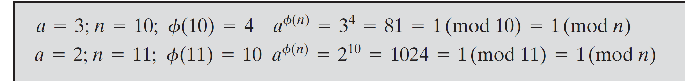
Euler’s Theorem
Euler’s theorem states that if n is a positive integer and a, n are co-prime, then

Slide 18
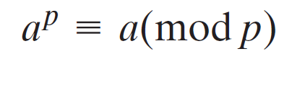
Fermat's Little Theorem
It is a fundamental theorem in elementary number theory, which helps compute powers of integers modulo prime numbers.
If p is prime and a is a positive integer not divisible by p, then
a^{p - 1}≡ 1 (mod p)
If p is prime and a is a positive integer, then
p = 5, a = 3 a^p = 3^5 = 243 = 3(mod 5) = a(mod p)

Slide 19
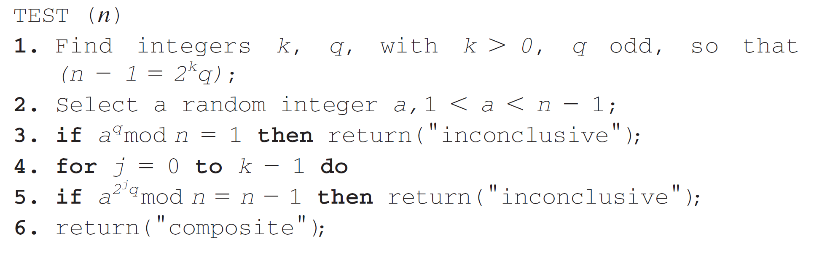
Miller-Rabin Primality Test
// a is called base
// Probably Prime
// Probably Prime
// Not Prime

Slide 20
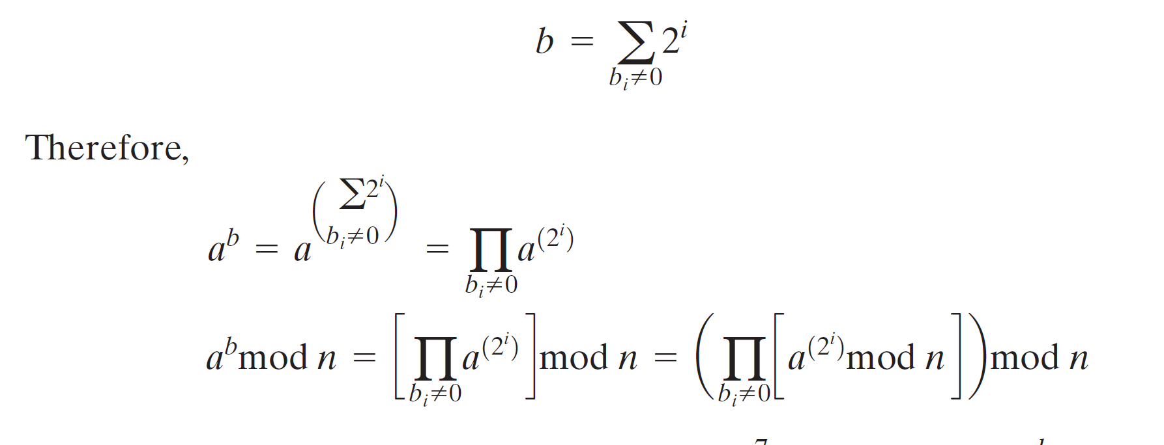
EXPONENTIATION
Both encryption and decryption in RSA involve raising an integer to an integer power, mod n.
To find the value a^{b} with a and b positive integers. If we express b as a binary number b_{k} b_{k-1}... b_{0,} then we have

Slide 21
RSA Key Generation – Implementation Viewpoint
Step 1: Determining two prime numbers, p and q.Repeat the following technique twice, one for p and another for q.
i. Pick an odd integer n at random (e.g., using a pseudorandom number generator).
ii. Pick an integer a < n at random.
iii. Perform the probabilistic primality test, such as Miller-Rabin, with a as a parameter.
If n fails the test, reject the value n and go to step i.
iv. If n has passed a sufficient number of tests, accept n;
otherwise, go to step ii.

Slide 22
RSA Key Generation – Implementation Viewpoint (Contd.)
NOTE:
The prime number theorem states that the primes near N are spaced on the average one every (ln N) integers.
Thus, on average, one would have to test on the order of ln(N) integers before a prime is found.

Slide 23
RSA Key Generation – Implementation Viewpoint (Contd.)
Step 2- Selecting either e or d and calculating the other.
we need to select an e such that gcd(Φ(n), e) = 1 and then calculate d≡e⁻¹ (mod Φ(n)).
We can use extended Euclid’s algorithm.
It calculates the greatest common divisor of two integers and, if the gcd is 1, determine the inverse of one of the integers modulo the other.
NOTE:
The procedure is to generate a series of random numbers testing each against Φ(n) until a number relatively prime to Φ(n) is found.
The probability that two random numbers are relatively prime is about 0.6;

Slide 24
Next Topic
Knapsack Cryptosystem

Slide 25
Thank You

