Slide 1
Combining Symmetric and Asymmetric Key Cryptography
Key Wrapping
Digital Envelope

Slide 2
Motivation
Achieving best of both the worlds.
The encryption and decryption process must not take a long time.
The generated cipher text should be compact in size.
The solution should share to a large number of users easily, without introducing any additional complications.
The key distribution process must be solved by the solution.

Slide 3
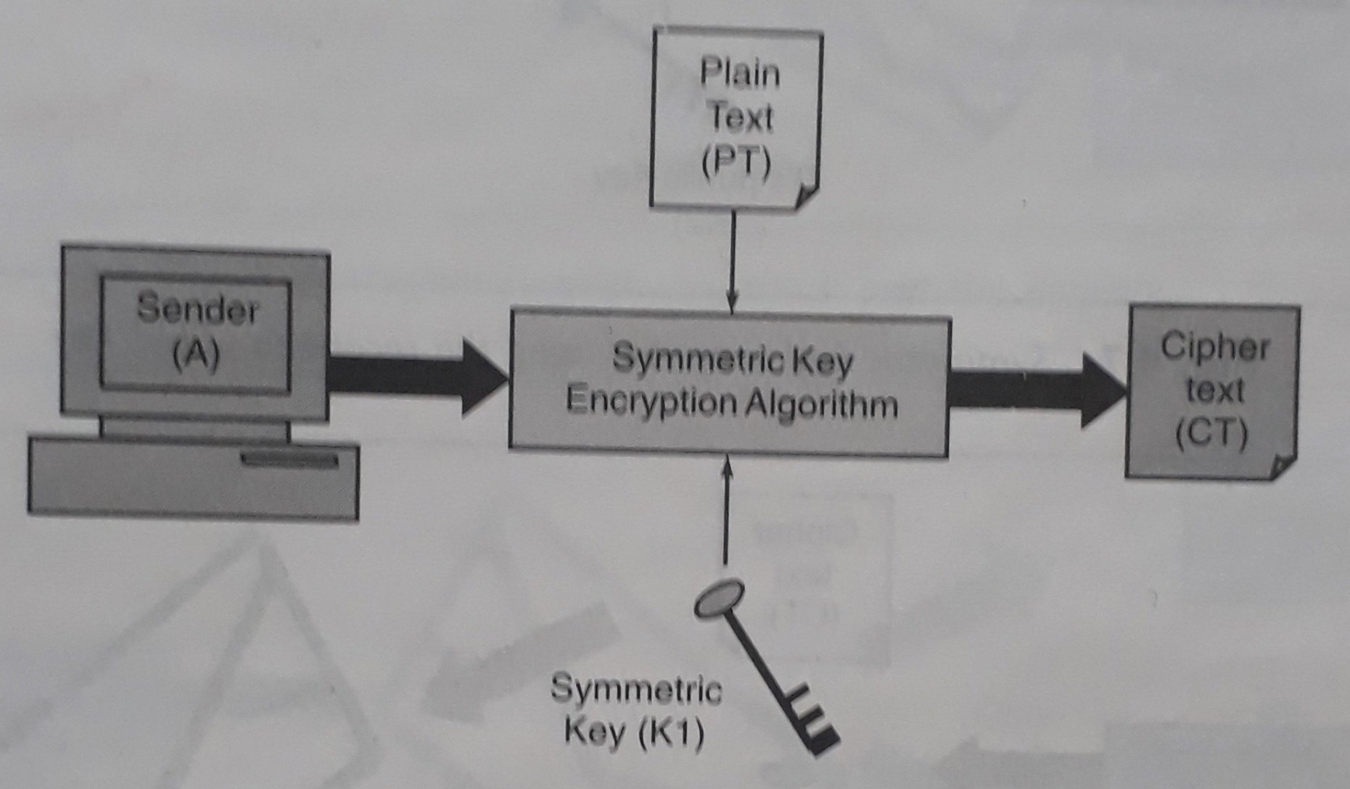
Step -1: Encrypting the plain text with a symmetric key algorithm

Slide 4
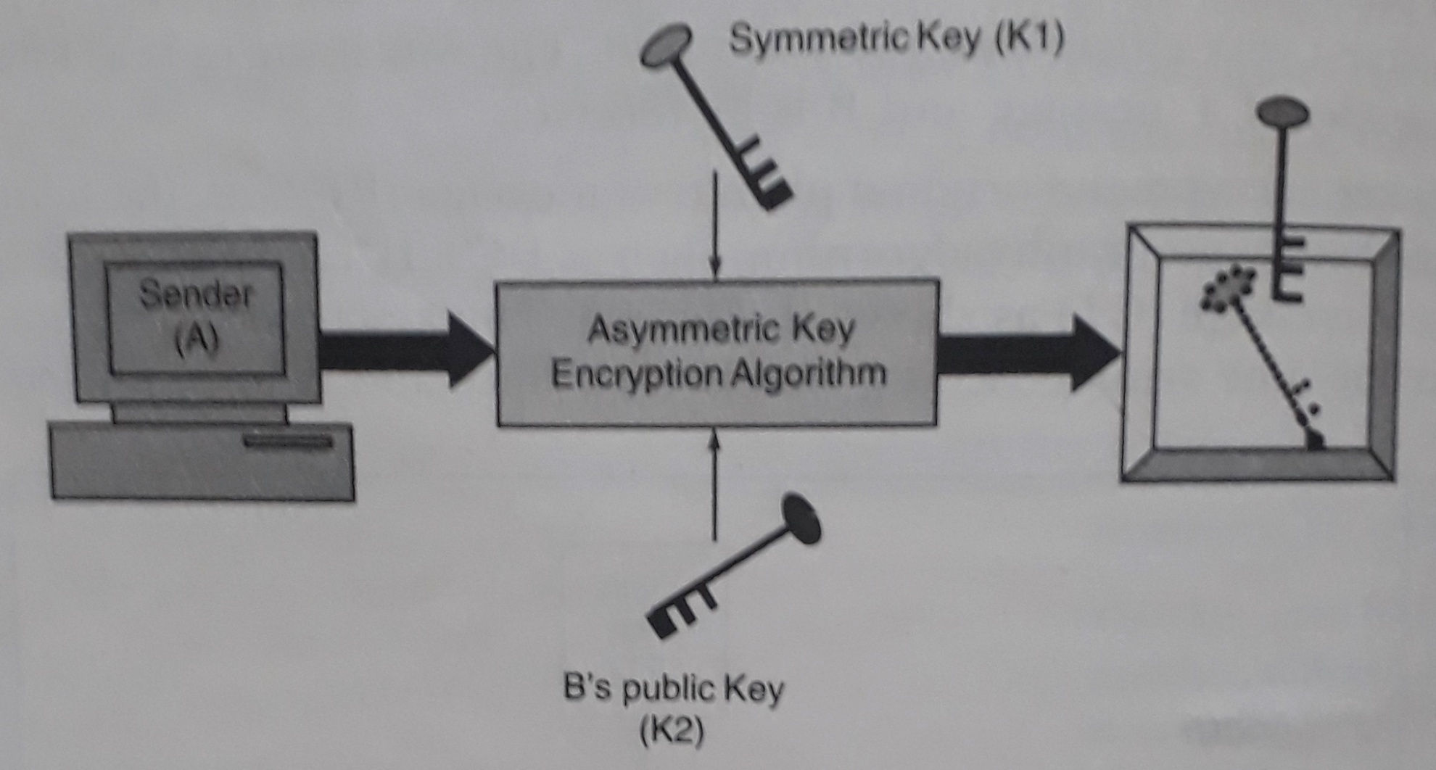
Step - 2 : Symmetric key wrapping using the receiver’s public key

Slide 5
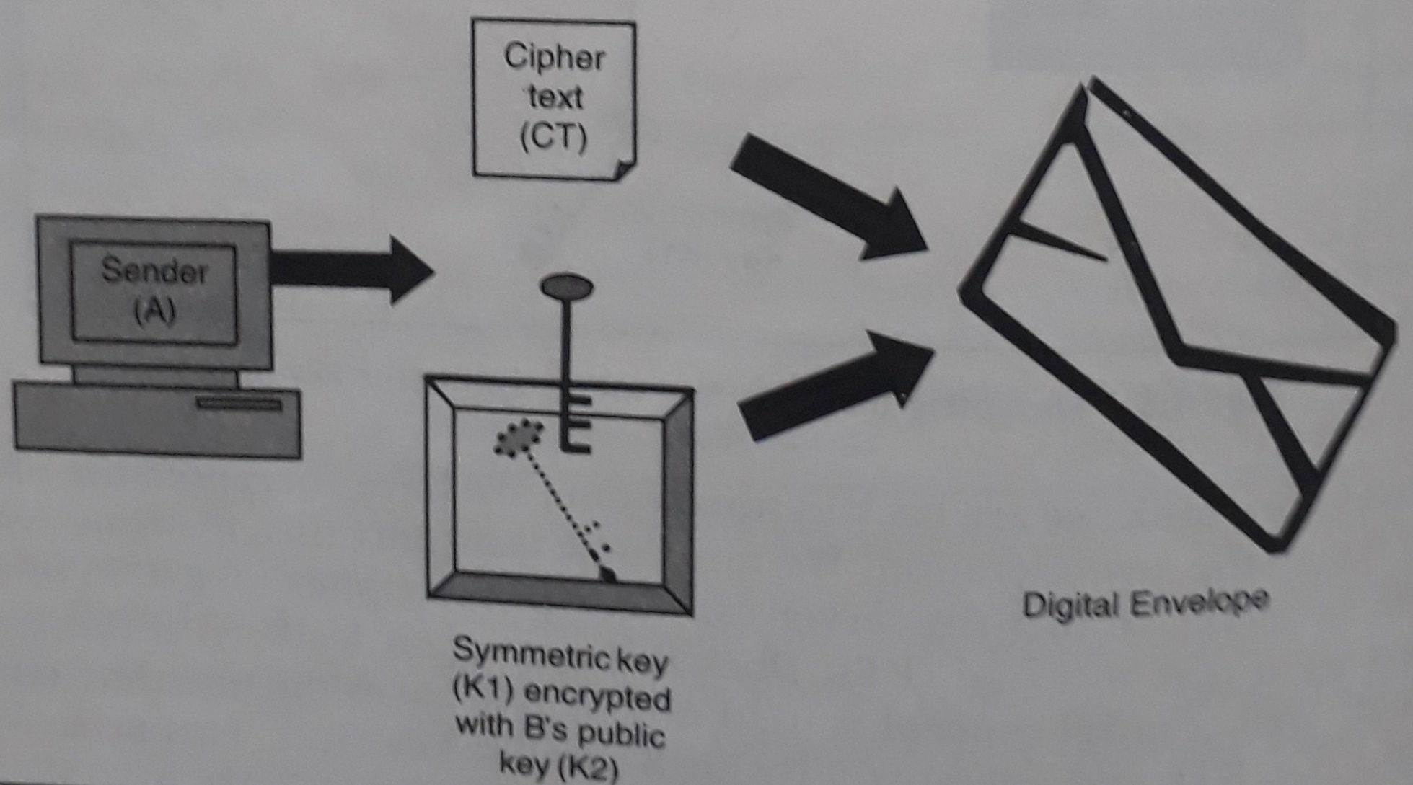
Step - 3 : Digital envelope creation

Slide 6
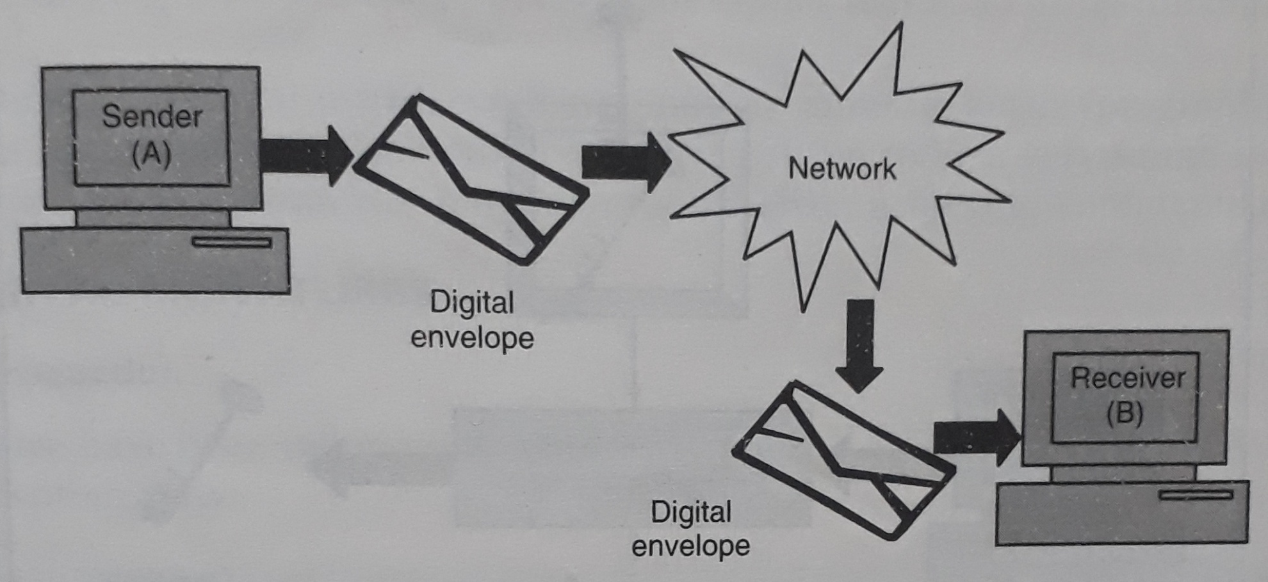
Step - 4 : Digital envelope reaches the receiver over network

Slide 7
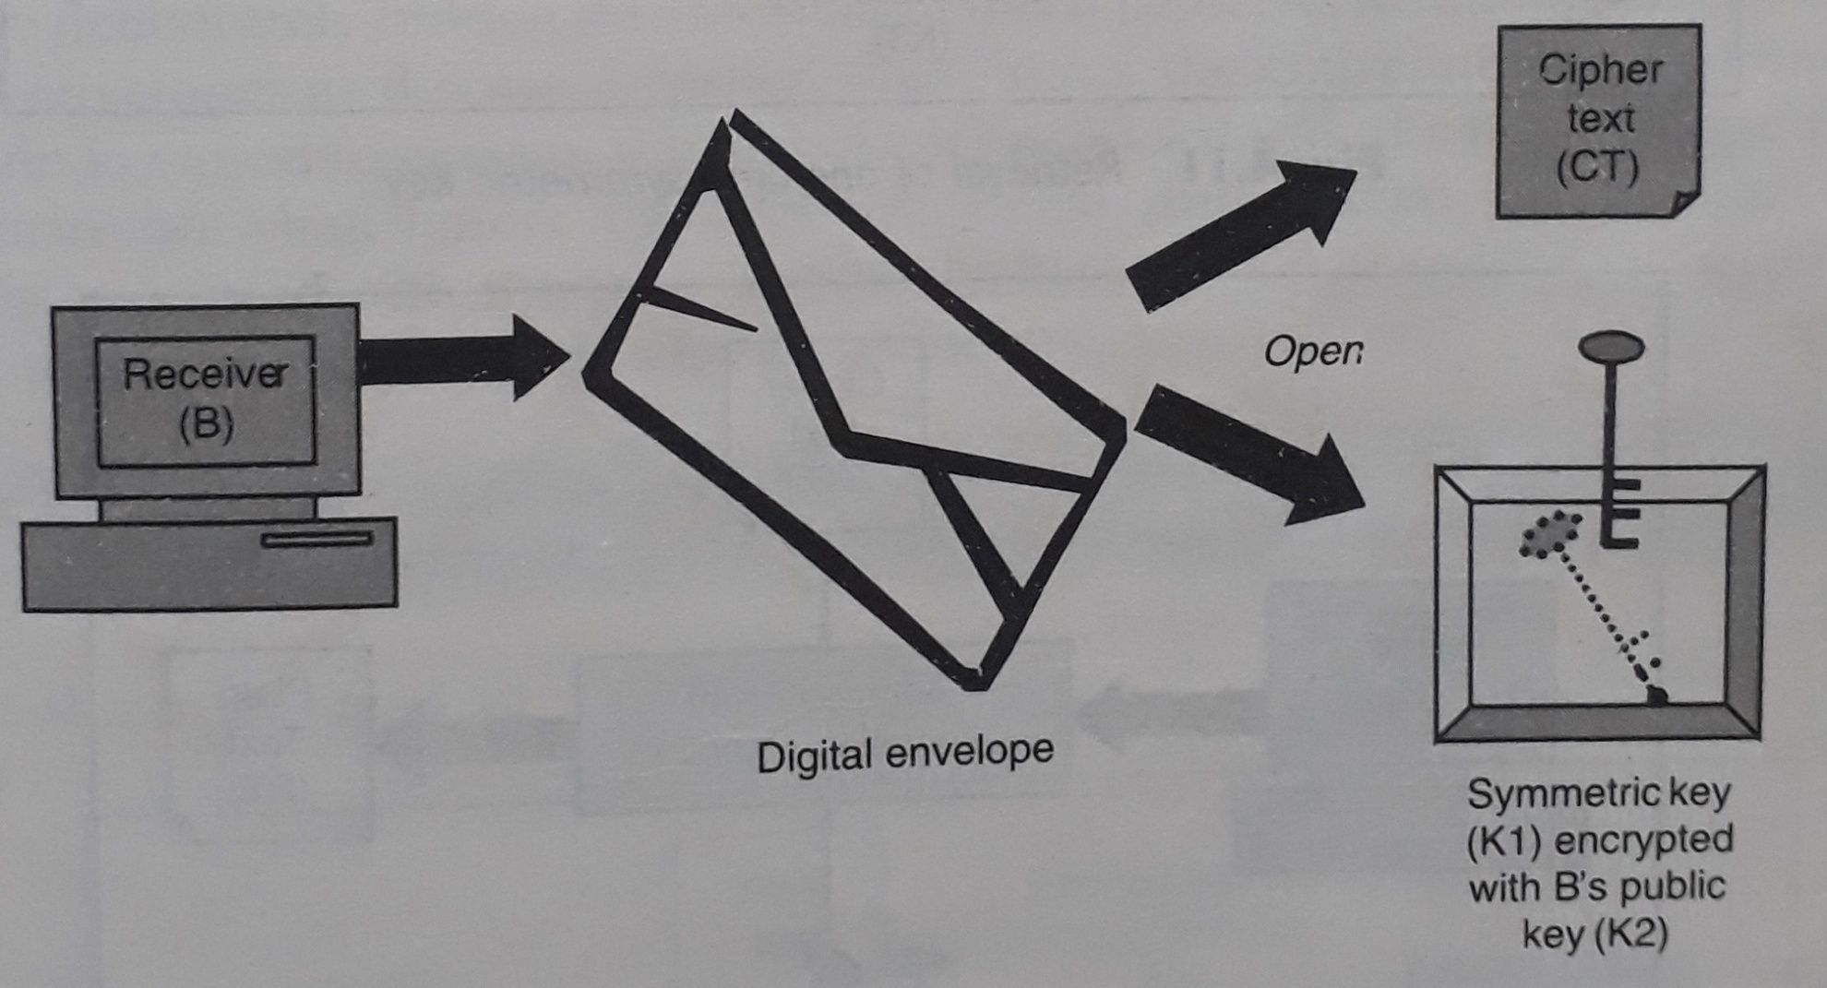
Step - 5 : Receiver opens the digital envelope

Slide 8
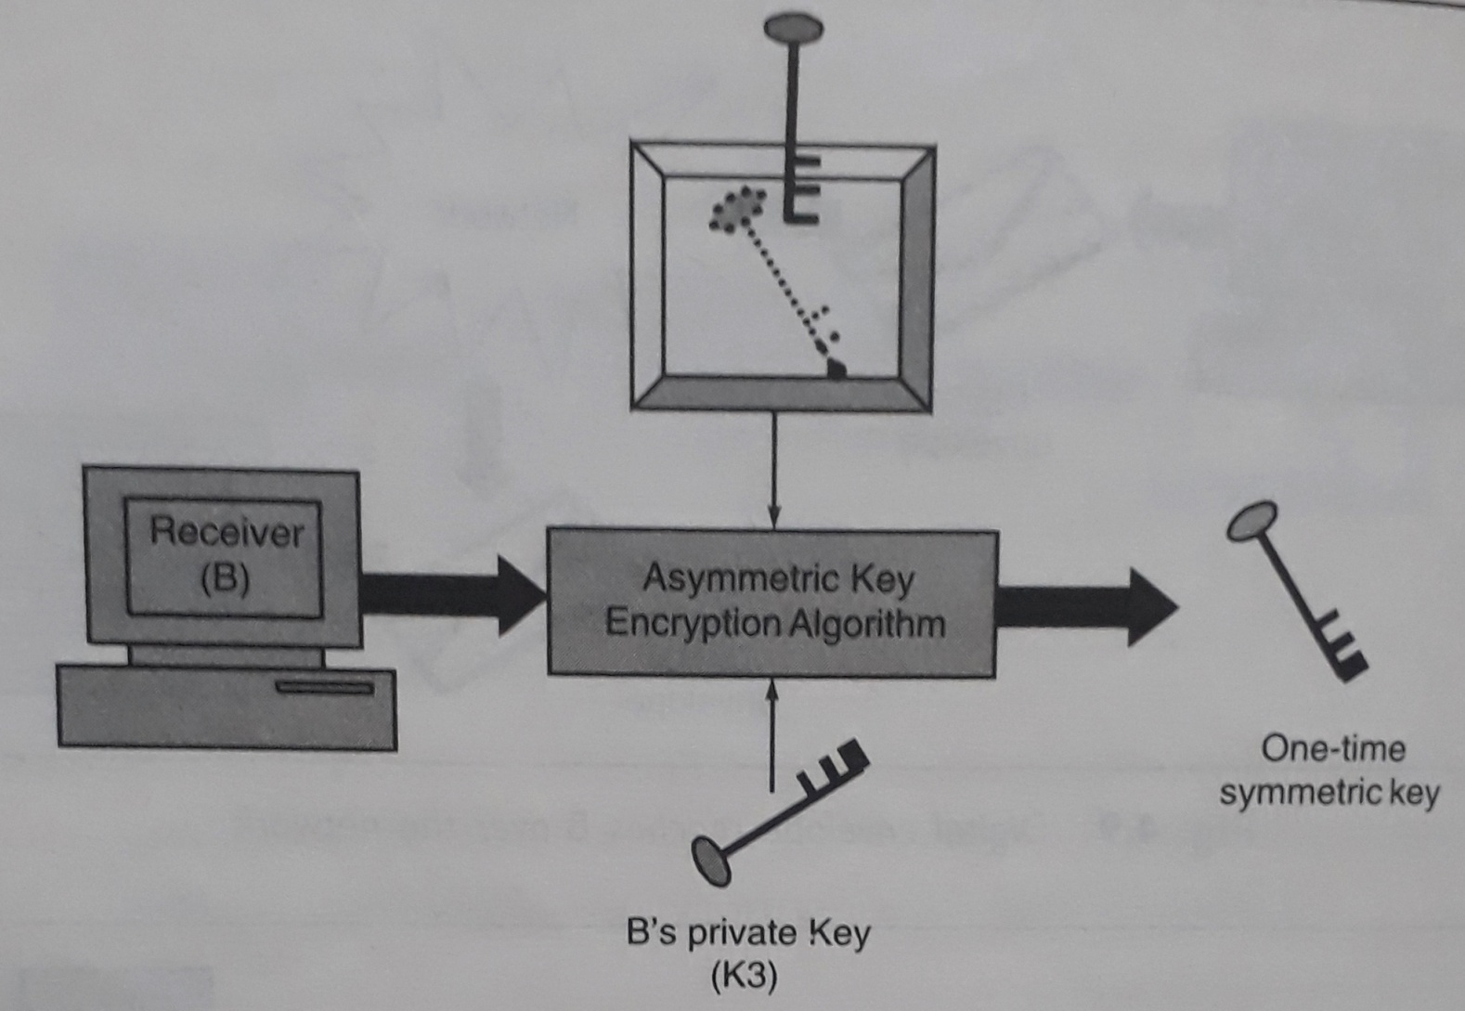
Step - 6 : Retrieval of one-time symmetric key

Slide 9
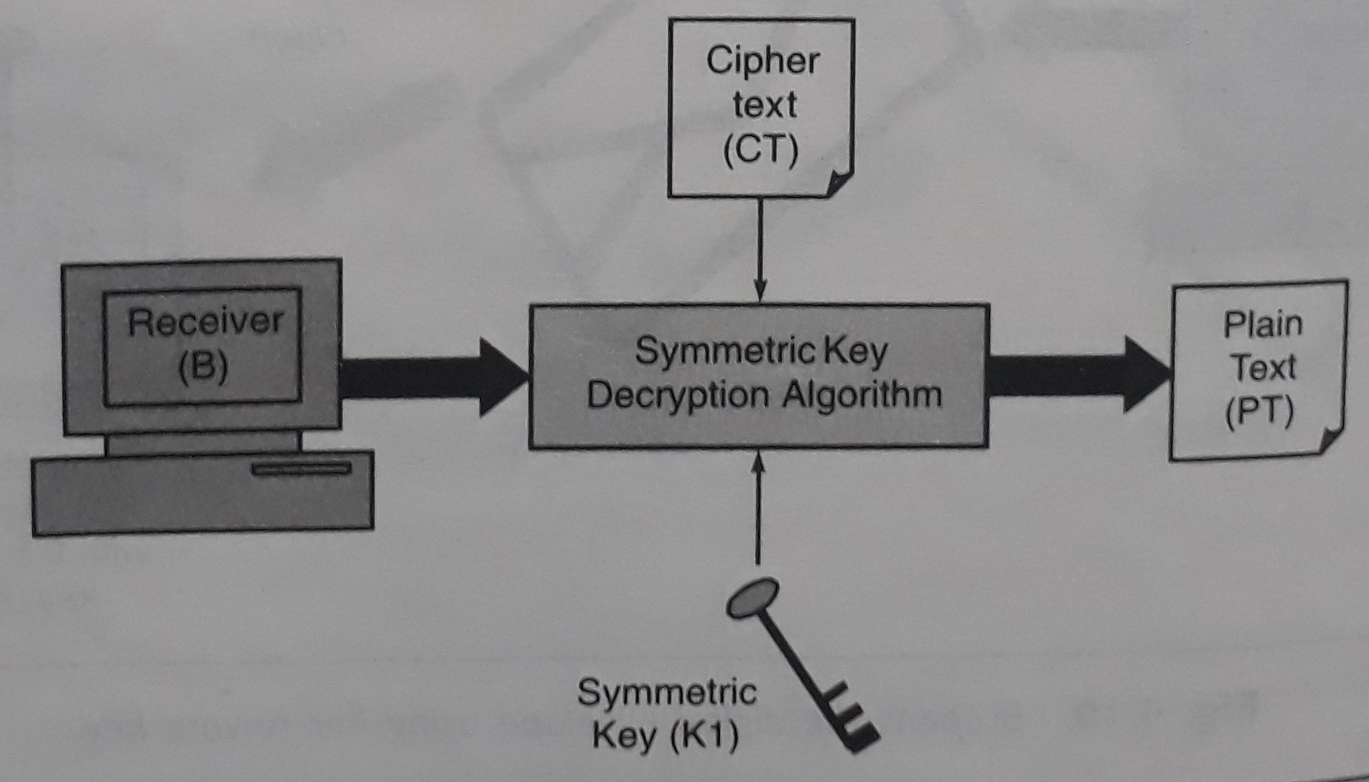
Step - 7 : Using symmetric key to retrieve the original plain text

Slide 10
Next Topics
Idea of Message Digests
Message digest algorithms – MD5, SHA

Slide 11
THANK YOU

