Slide 1
Message Digests
Idea of Message Digest
Requirements of Message Digest
MD5 Algorithm

Slide 2
Idea of Message Digest
A message digest, also called as hash, is a fingerprint or the summary of a message.
It is similar to the concepts of Longitudinal Redundancy Check (LRC) or Cyclic Redundancy Check(CRC).
It is used to verify the integrity of the data.

Slide 3
Example: Working Principle of LRC
Original Data
Original Data and LRC
11100100 11011101 00111001 00101001
11100100
11011101
00111001
00101001
Original data arranged as rows of a list
00101001
LRC
11100100 11011101 00111001 00101001
00101001

Slide 4
Simplistic Example of Message Digest
Original number is 7391743
Operation Result
Multiply 7 by 3 21
Discard first digit 1
Multiply 1 by 9 9
Multiply 9 by 1 9
Multiply 9 by 7 63
Discard first digit 3
Multiply 3 by 4 12
Discard first digit 2
Multiply 2 by 3 6
Message digest is 6

Slide 5
Requirements of Message Digest
For a given message, the message digest must always be the same.
Given a message digest, it should be very difficult to find the original message for which the digest was created.
Given any two messages, if we calculate their message digests, the two message digests must be different.
Note: If any two messages produce the same message digest, it is called as a collision.

Slide 6
Steps of MD5 Algorithm
Step 1: Append padding bits
Step 2: Append length
Step 3: Divide the input into 512-bit blocks
Step 4: Initialize chaining variables
Step 5: Process blocks

Slide 7
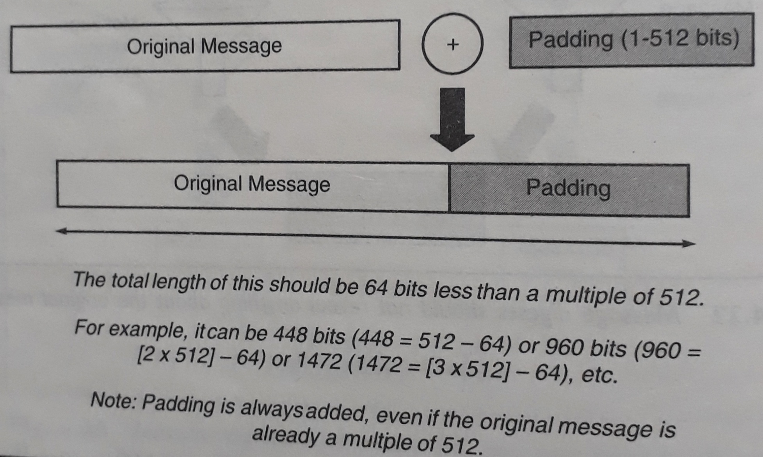
Step 1: Append padding bits

Slide 8
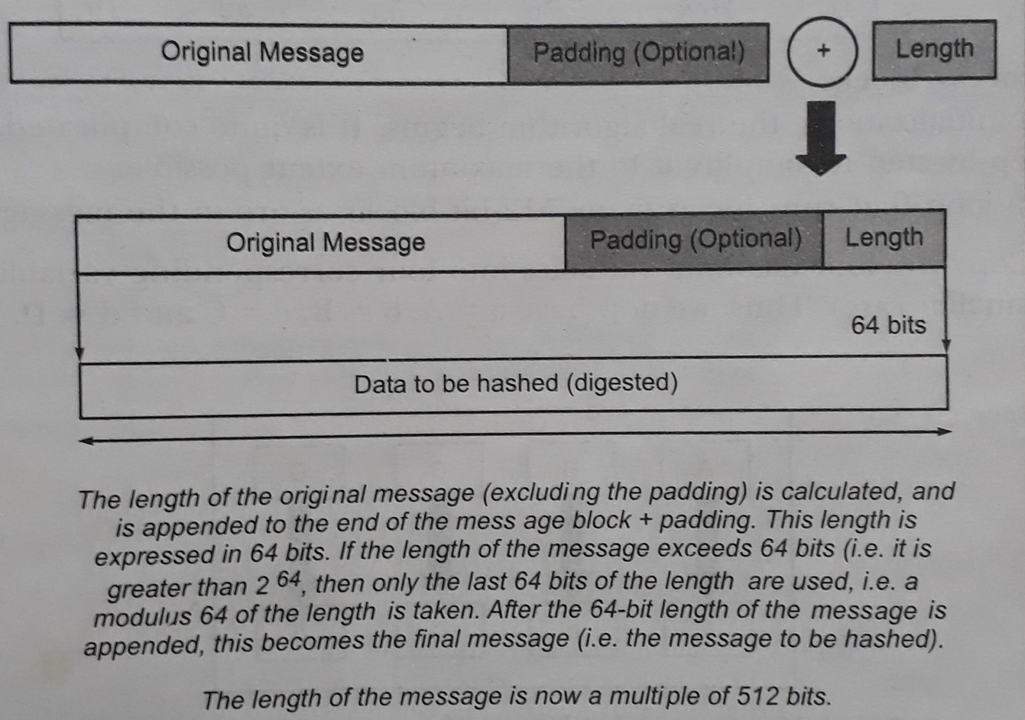
Step 2: Append length

Slide 9
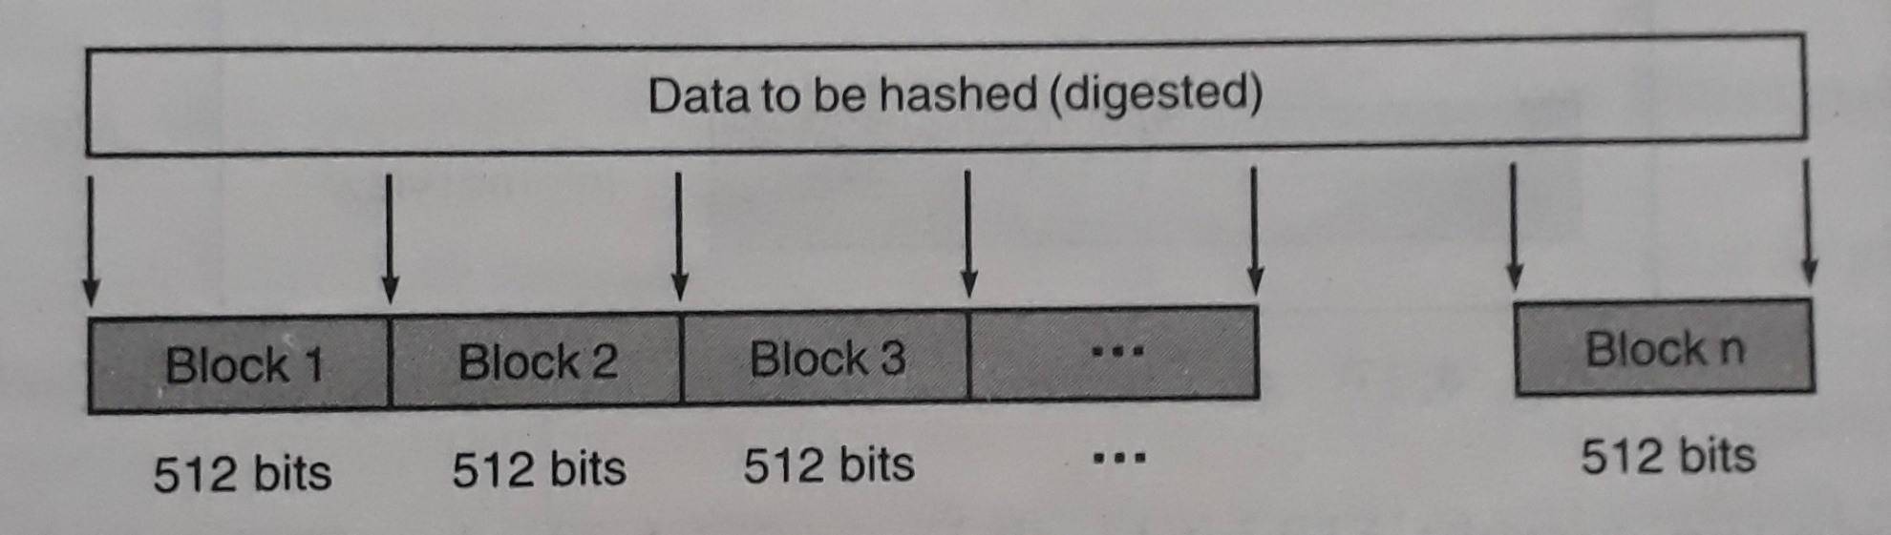
Step 3: Divide the input into 512-bit blocks

Slide 10
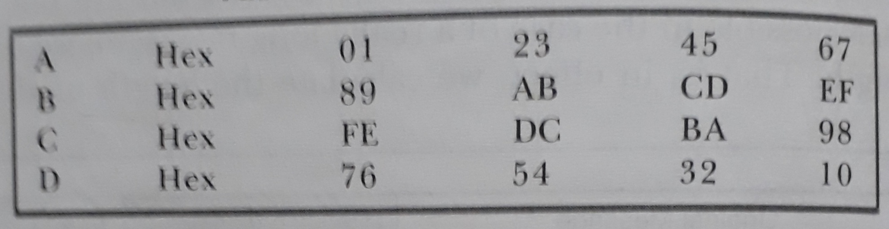
Step 4: Initialize chaining variables (32-bit each)

Slide 11
Step 5: Process blocks
The process is repeated for each 512-bit blocks. Step 5 consists of the following sub-steps:
Step 5.1: Copy chaining variables into temporary variables.
Step 5.2: Divide the 512-bit block into 16 sub-blocks.
Step 5.3: Perform four rounds consisting of 16 iterations in each round.

Slide 12
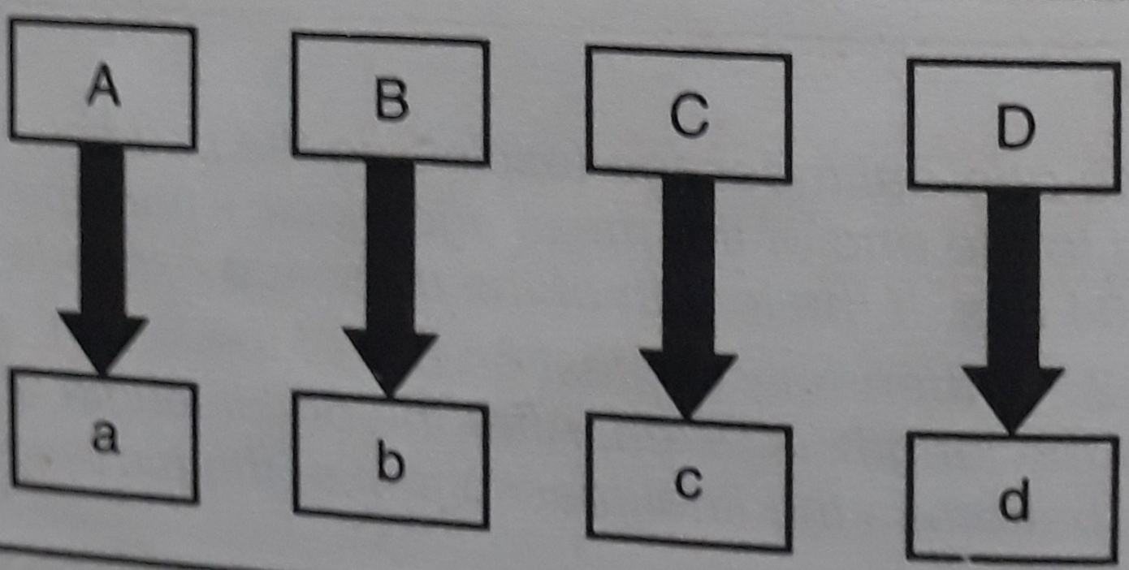
Step 5.1: Copy chaining variables into temporary variables

Slide 13
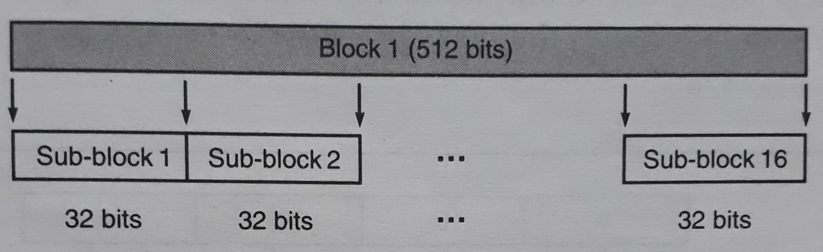
Step 5.2: Divide the 512-bit block into 16 sub-blocks (32-bit each)

Slide 14
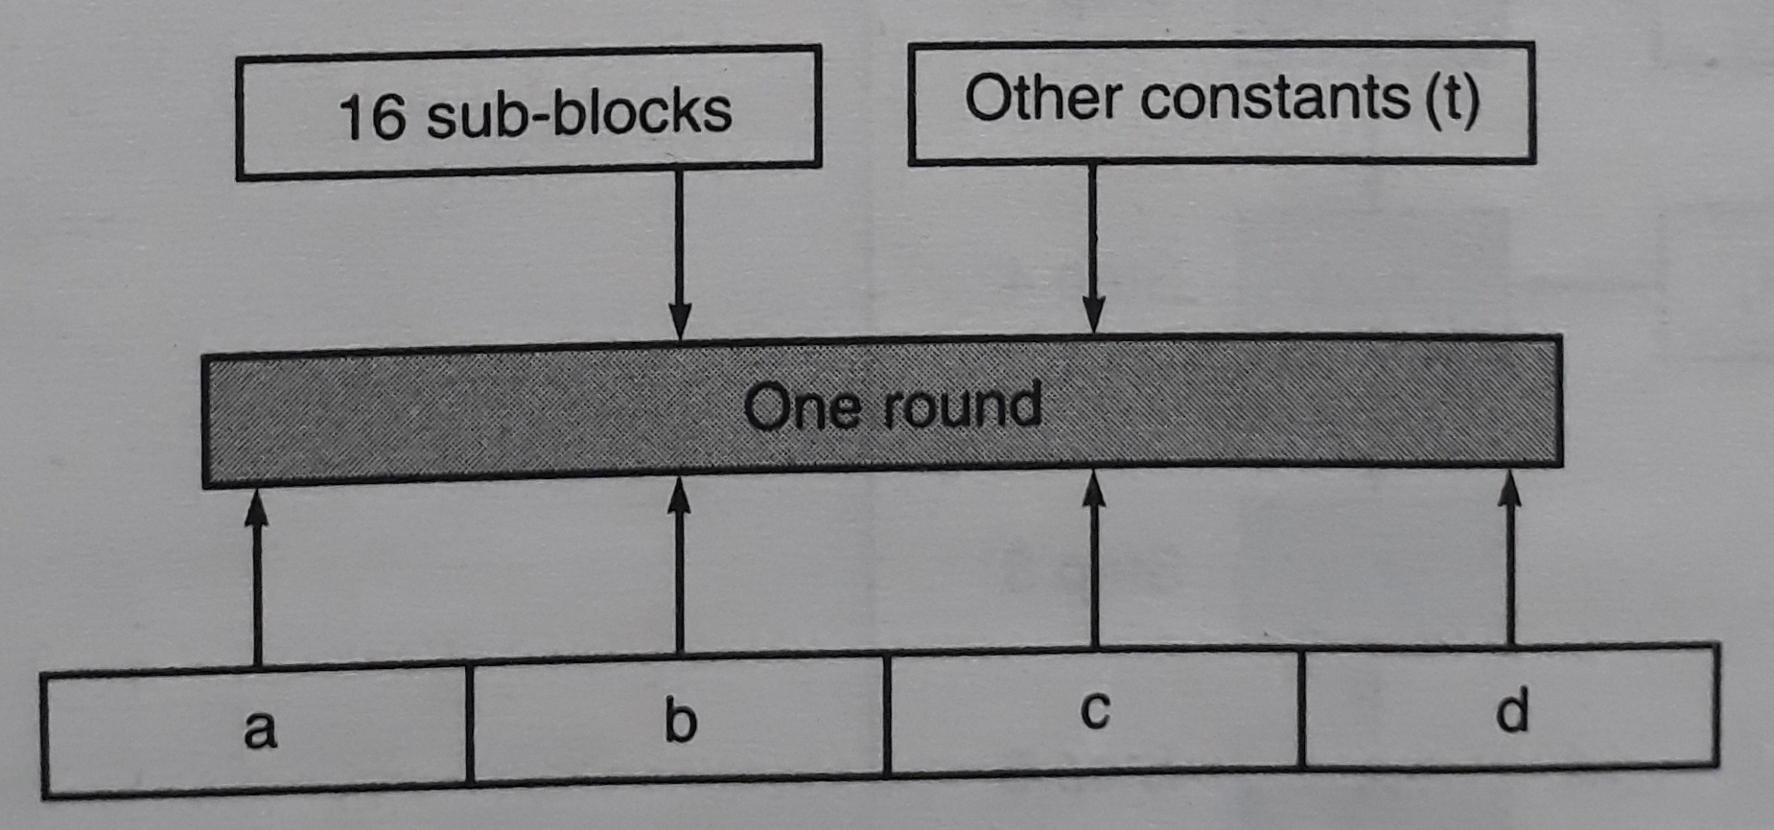
Step 5.3: Perform four rounds consisting of 16 iterations in each round

Slide 15
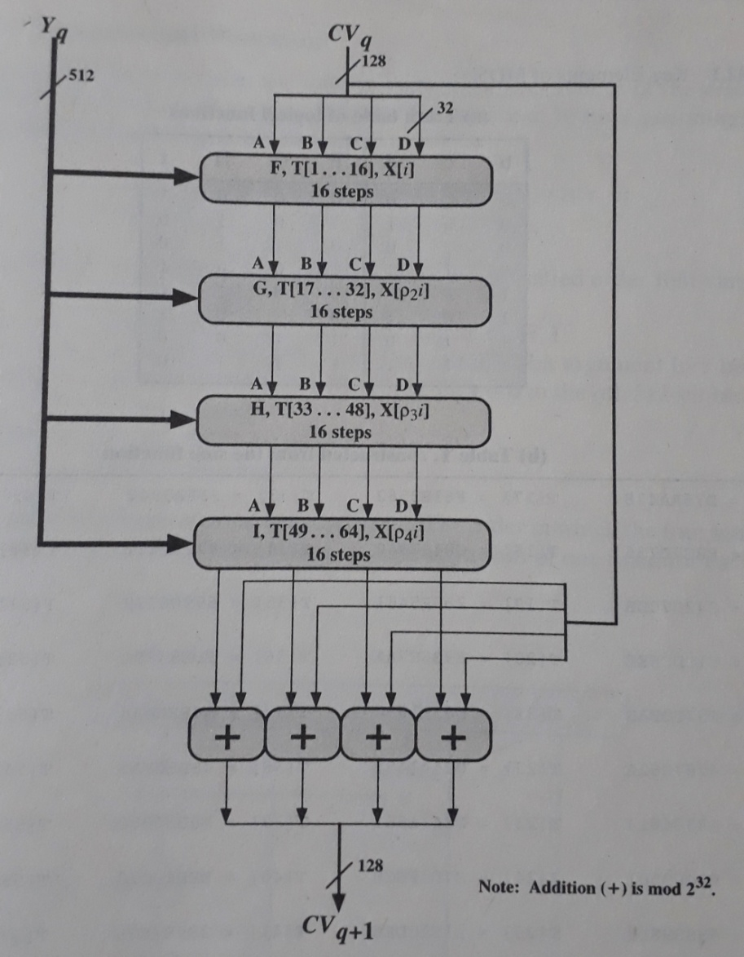
MD5 Processing of a Single 512-bit Block

Slide 16
Permutation of Message in Different Rounds
The array of 32-bit words X [0 ..... 15] holds the value of 512 bit input block.
In the first round, the words are used in their original order. The following permutations are defined for rounds 2 through 4.
ρ2(i) = (1+5i) mod 16
ρ3(i) = (5+3i) mod 16
ρ4(i) = 7i mod 16

Slide 17
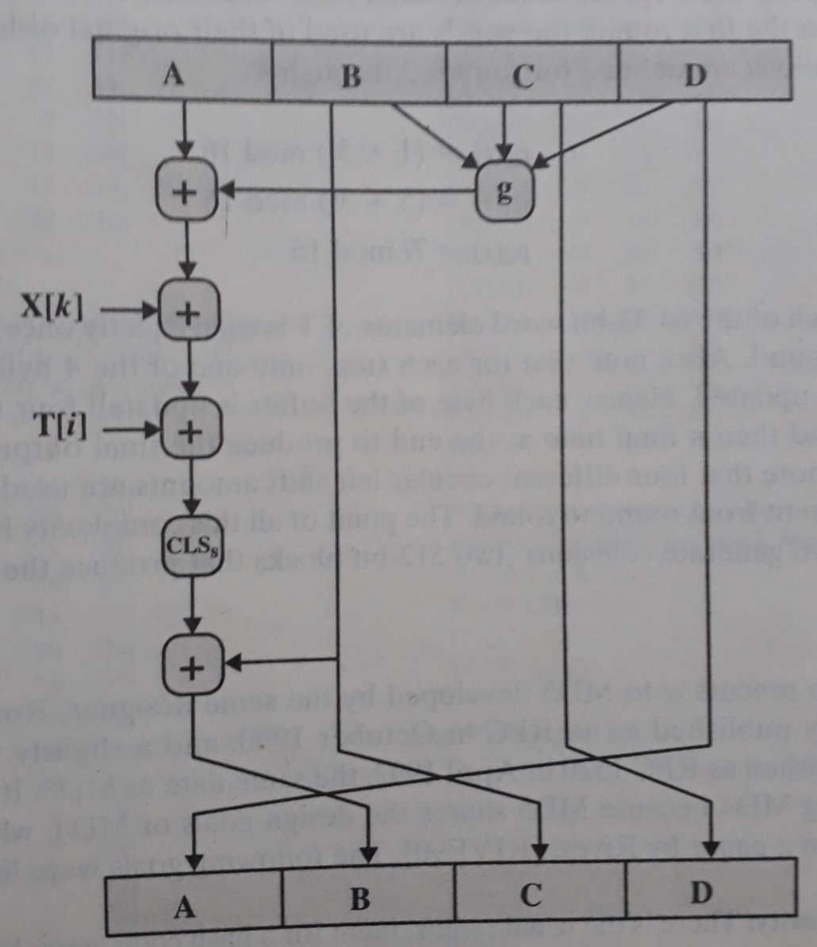
Elementary MD5 Operation (Single Iteration)

Slide 18
Process P in each round
Round | Process g
1 (F) | (b AND c) OR ((NOT b) AND (d))
2 (G) | (b AND d) OR (c AND (NOT d))
3 (H) | b XOR c XOR d
4 (I) | c XOR (b OR (NOT d))

Slide 19
The Strength of MD5
MD5 has a property that every bit of the message digest is some function of every bit in the input.
The possibility that two messages produce the same message digest using MD5 is in the order of 2⁶⁴ operations.
Given a message digest, working backwards to find the original message can lead up to 2¹²⁸ operations.

Slide 20
Advantages of MD5 Algorithm
MD5 is faster and simple to understand.
MD5 algorithm generates a strong password in 16 bytes format. All developers like web developers etc use the MD5 algorithm to secure the password of users.
To integrate the MD5 algorithm, relatively low memory is necessary.
It is very easy and faster to generate the digest of the original message.

Slide 21
Next Topic
Secure Hash Algorithm

Slide 22
THANK YOU

