Slide 1
Secure Hash Algorithm (SHA–1)

Slide 2
Steps of SHA-1 Algorithm
Step 1: Append padding bits [same as MD5]
Step 2: Append length [same as MD5]
Step 3: Divide the input into 512-bit blocks [same as MD5]
Step 4: Initialize chaining variables [One extra chaining variable E is required. So, message digest length will be (32 X 5) = 160 bits]
Step 5: Process blocks

Slide 3
Step 5: Process blocks
The process is repeated for each 512-bit blocks. Step 5 consists of the following sub-steps:
Step 5.1: Copy chaining variables into temporary variables.
Step 5.2: Divide the 512-bit block into 16 sub-blocks.
Step 5.3: Perform four rounds consisting of 20 iterations
in each round.

Slide 4
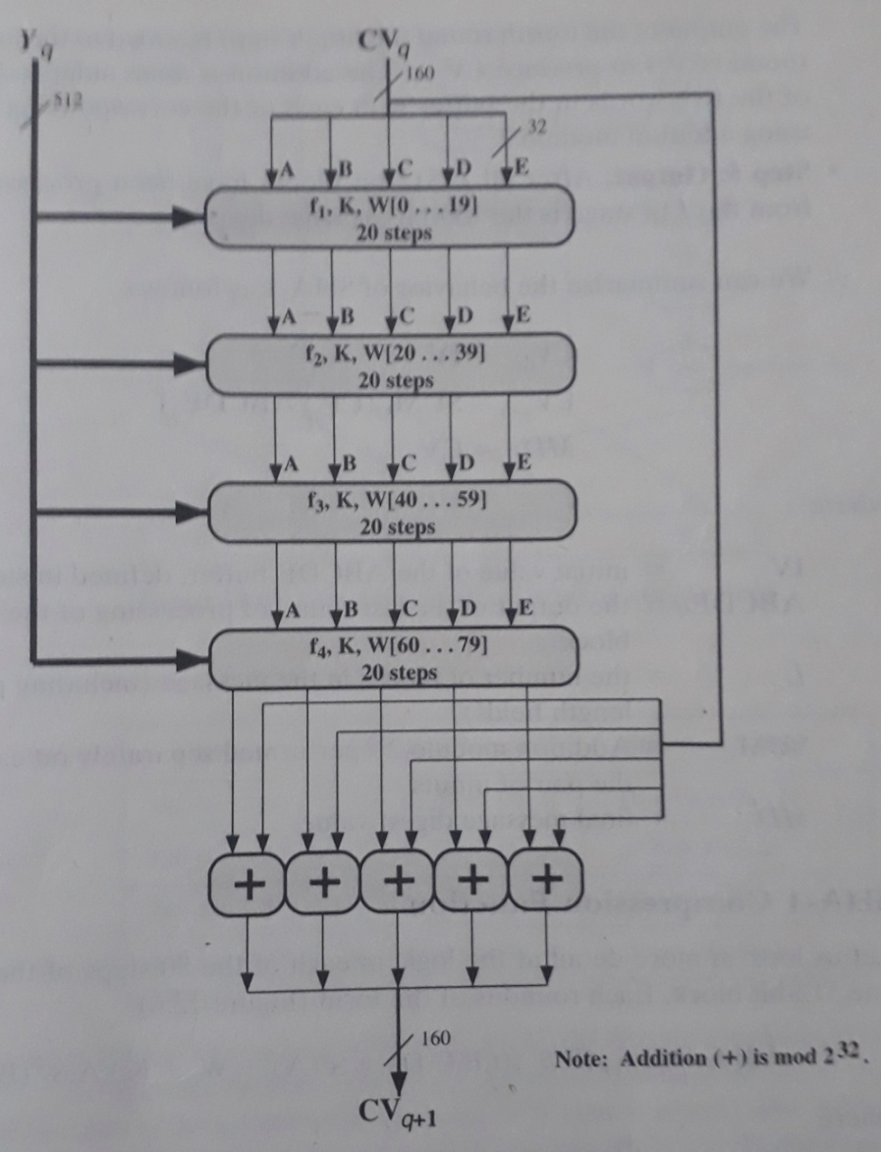
SHA-1 Processing of a Single 512-bit Block

Slide 5
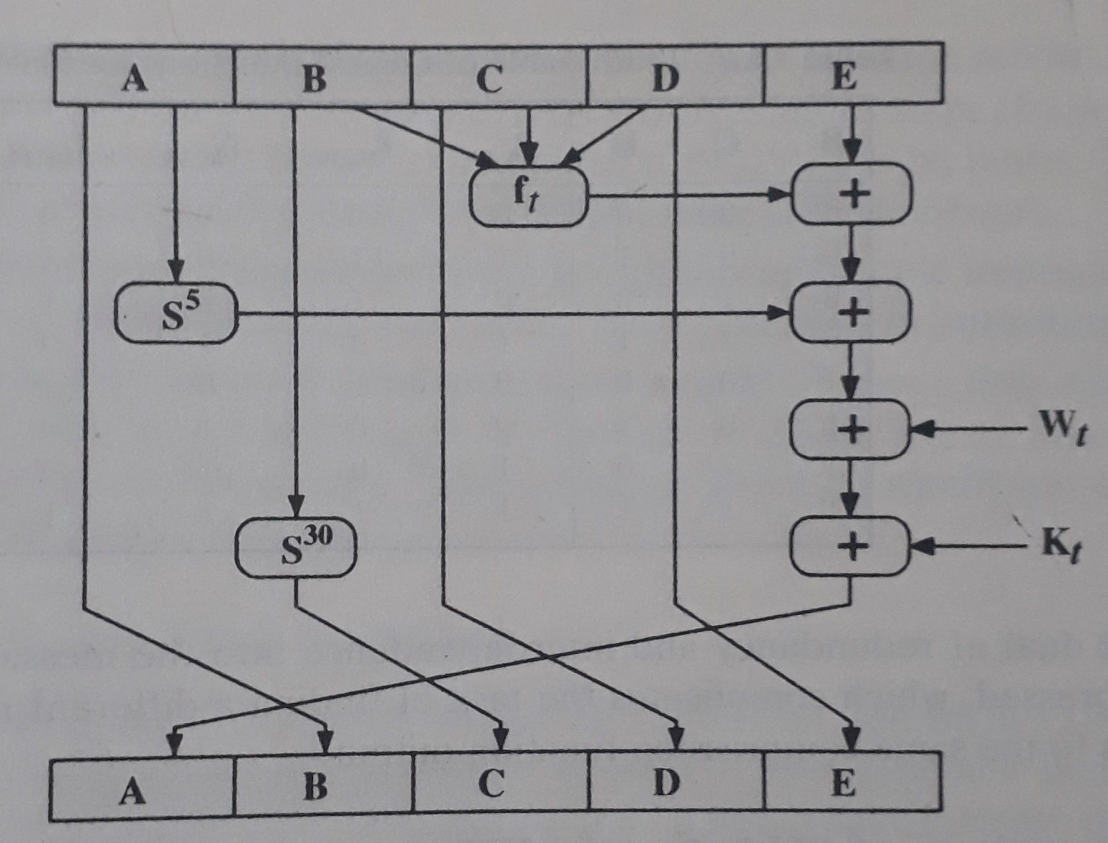
Elementary SHA-1 Operation (Single Iteration)

Slide 6
Process f in each round
Round | Process f
1 (f₁) | (b AND c) OR ((NOT b) AND (d))
2 (f₂) | b XOR c XOR d
3 (f₃) | (b AND c) OR (b AND d) OR (c AND d)
4 (f₄) | b XOR c XOR d

Slide 7
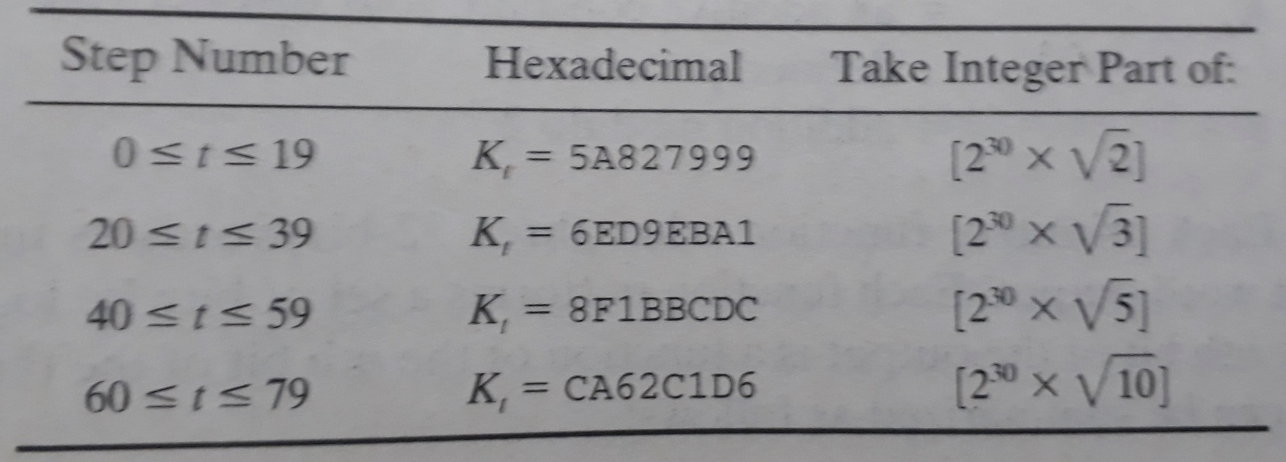
Constant K_{t} used in different rounds

Slide 8
Derivation of W_{t} from message sub-blocks
For the first 16 words of W (i.e. t = 0 to 15), the contents of the input message sub-blocks (32-bit each) become the contents of W_{t} straightaway.
The remaining 64 values of W (i.e. t = 16 to 79) are derived using the following equation:
W_{t} = S¹(W_{t-16} XOR W_{t-14} XOR W_{t-8} XOR W_{t-3})
where S¹ indicates a circular left shift by 1 position.

Slide 9
Question [3 Marks]
Compare and Contrast MD5 and SHA-1 Algorithms.

Slide 10
Next Topic
Message Authentication Code (MAC)

Slide 11
THANK YOU

