Slide 1
Message Authentication Code (MAC)

Slide 2
Introduction
The concept of Message Authentication Code (MAC) is quite similar to that of a message digest. However, there is one difference. There is no cryptographic process involved in the case of message digests.
In contrast, a MAC requires that the sender and the receiver should know a shared symmetric (secret) key, which is used in the preparation of the MAC. Thus, MAC involves cryptographic processing.

Slide 3
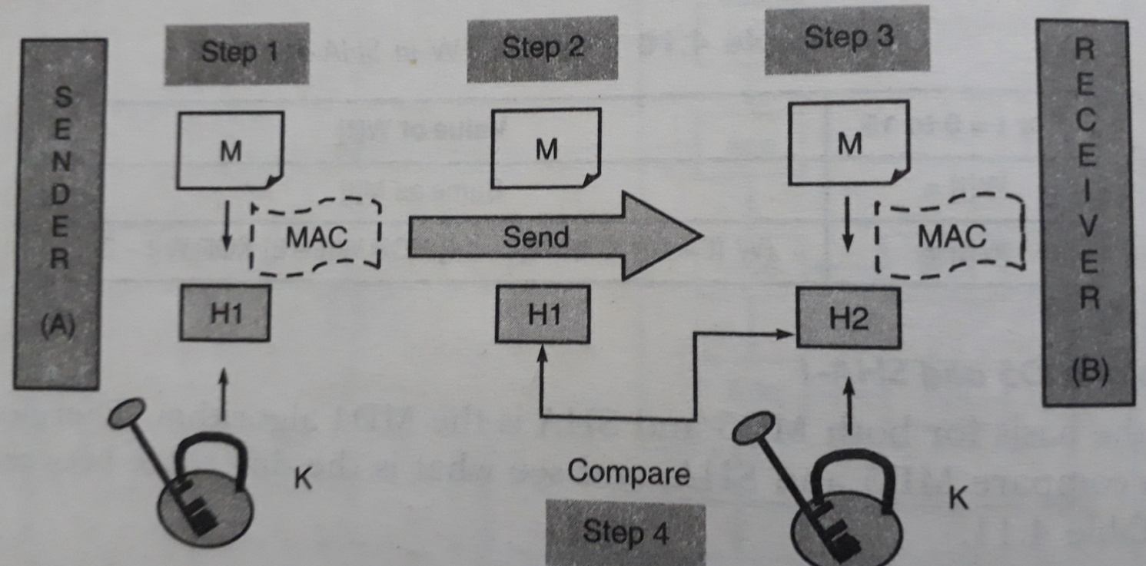
Message Authentication Code (MAC)

Slide 4
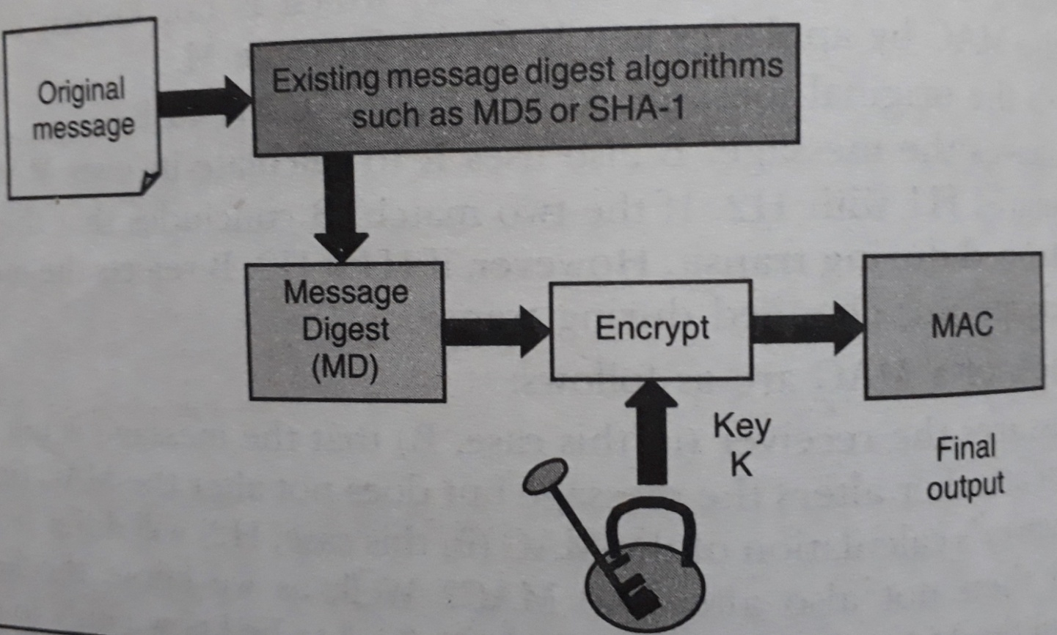
Hash-based Message Authentication Code (HMAC)

Slide 5
Working of HMAC
Variables that will be used in HMAC are as follows:
MD = The message digest / hash function used
M = The input message whose MAC is to be calculated
L = The number of blocks in the message M
b = The number of bits in each block
K = The shared symmetric key to be used in HMAC
ipad = A string 00110110 repeated b/8 times
opad = A string 01011010 repeated b/8 times

Slide 6
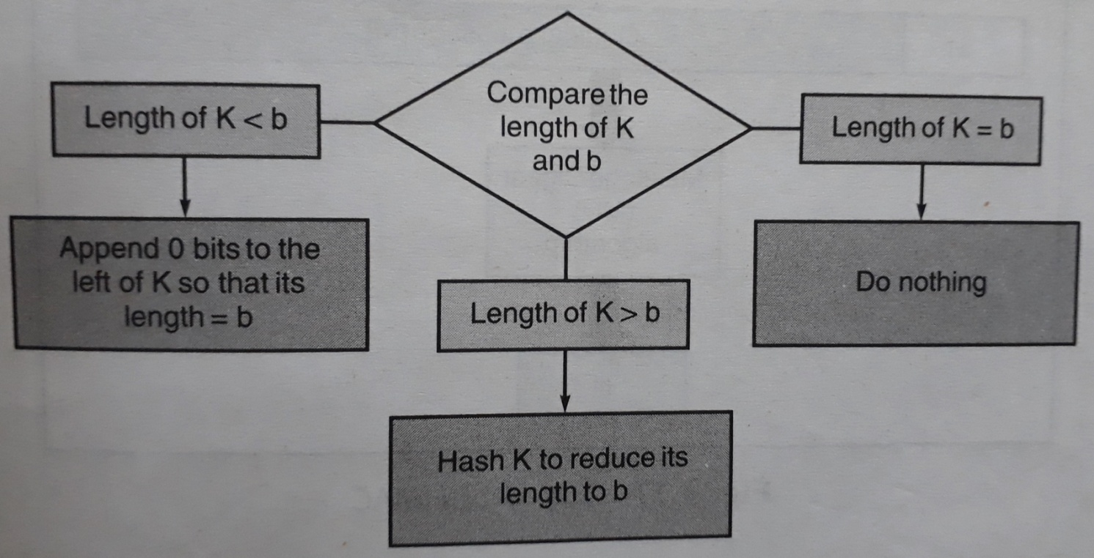
Step 1: Make the length of K equal to b

Slide 7
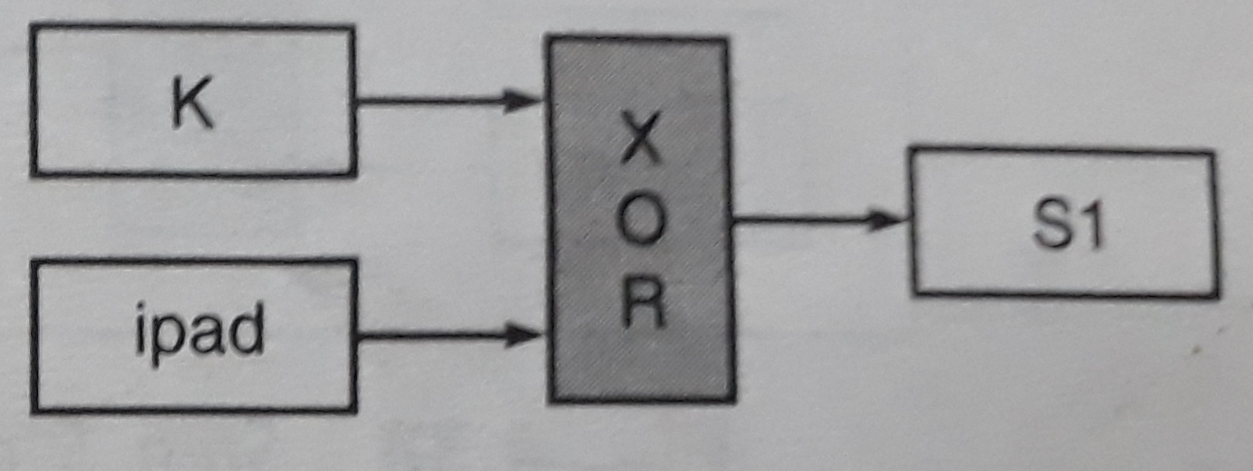
Step 2: XOR K with ipad to produce S1

Slide 8
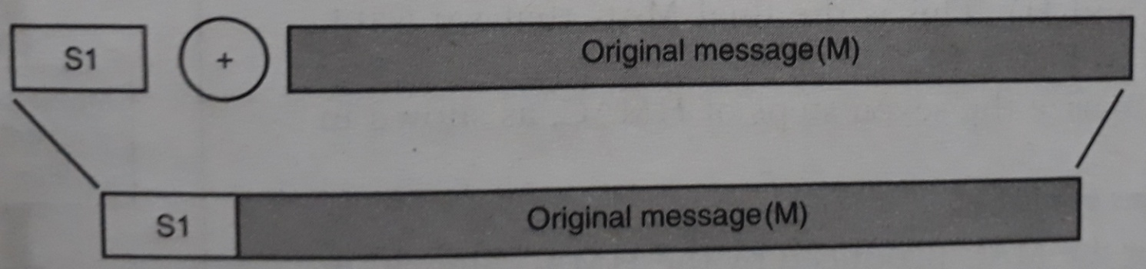
Step 3: Append M to S1

Slide 9
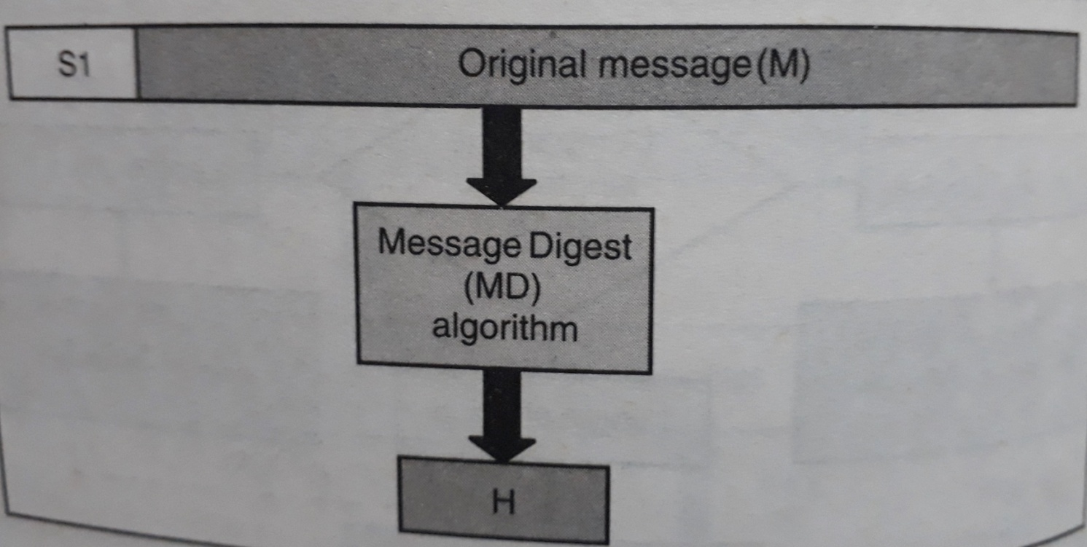
Step 4: Apply MD algorithm

Slide 10
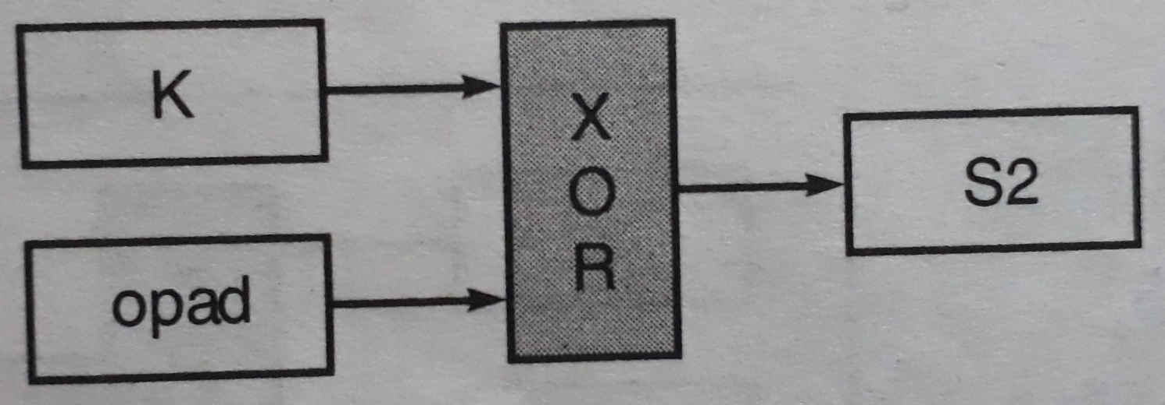
Step 5: XOR K with opad to produce S2

Slide 11
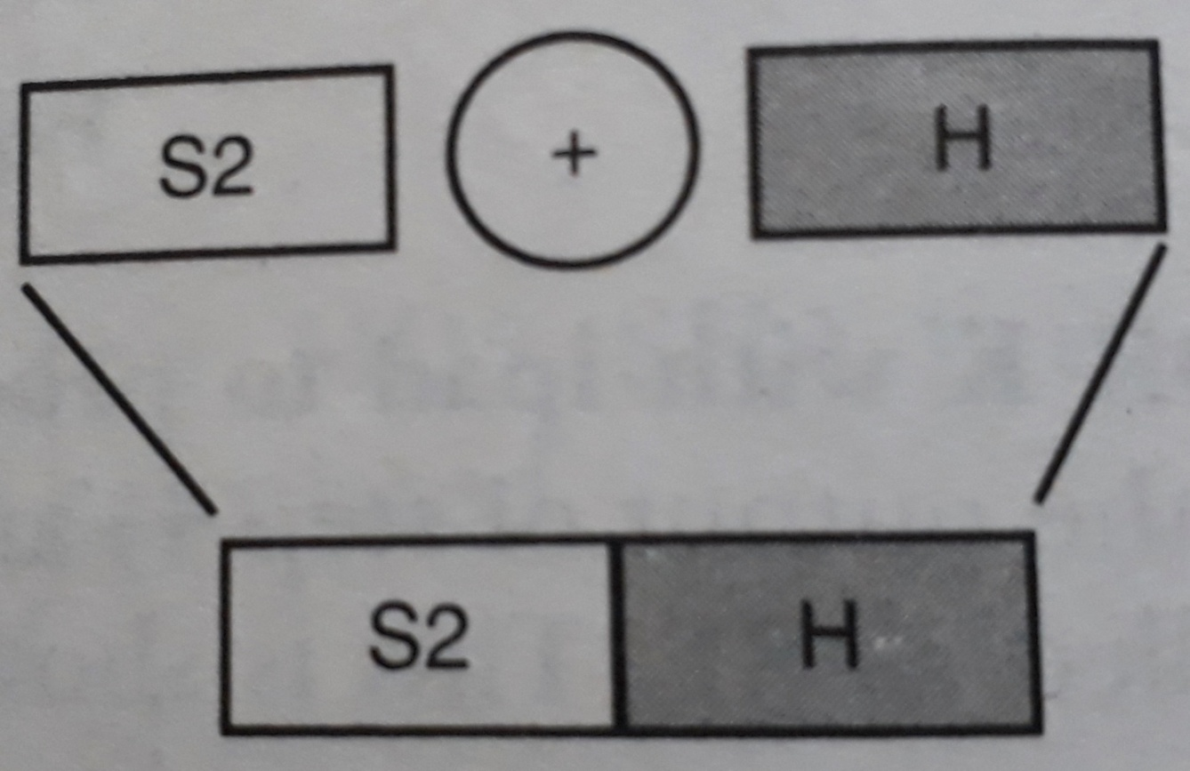
Step 6: Append H to S2

Slide 12
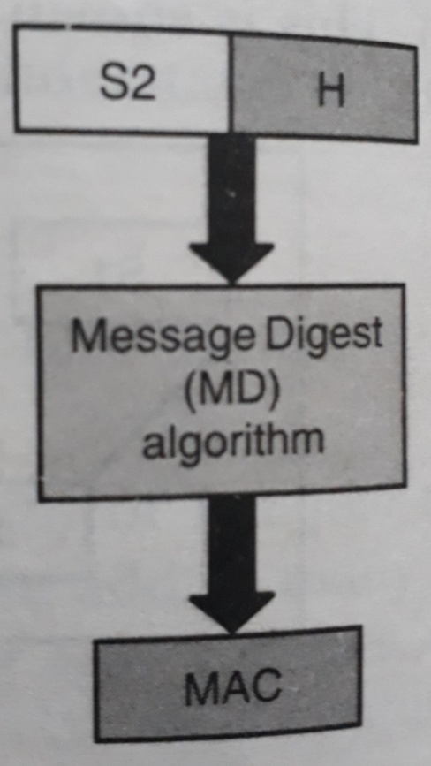
Step 7: Apply message digest algorithm

Slide 13
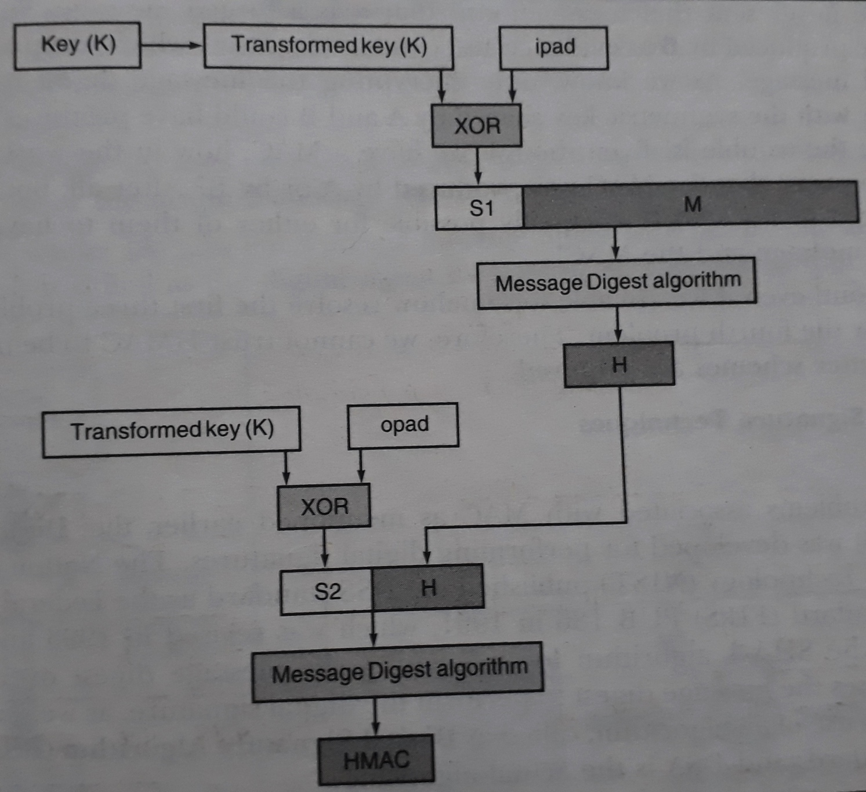
Complete HMAC operation

Slide 14
Disadvantages of HMAC
Problem of Key exchange
How to use a single symmetric key when multiple receivers are there?
Are both the sender and receiver trustworthy?

Slide 15
Thank You

