Slide 1
Digital Signature Techniques
RSA and Digital Signatures
DSA and Digital Signatures

Slide 2
RSA and Digital Signatures
RSA can be used for performing digital signatures.
Let us assume that the sender (A) wants to send a message M to the receiver (B) along with the digital signature (S) calculated over the message (M).

Slide 3
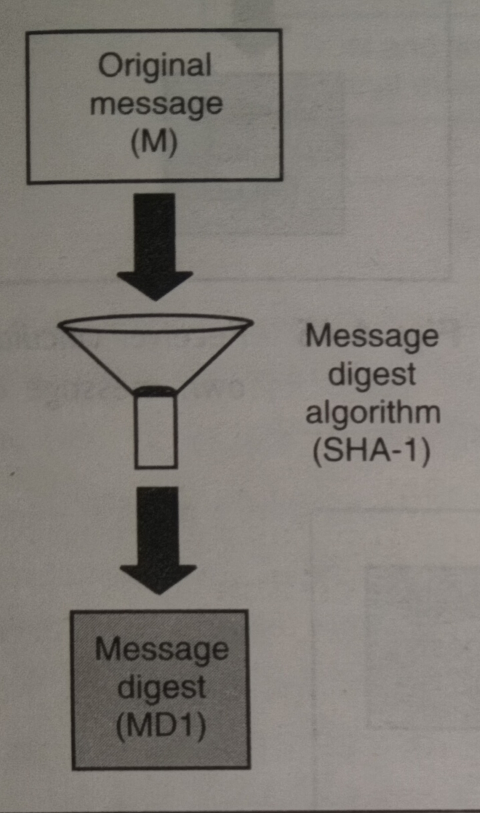
Step 1: Message-Digest Calculation
Sender (A) uses the SHA-1 message-digest algorithm to calculate the message digest (MD1) over the original message (M).

Slide 4
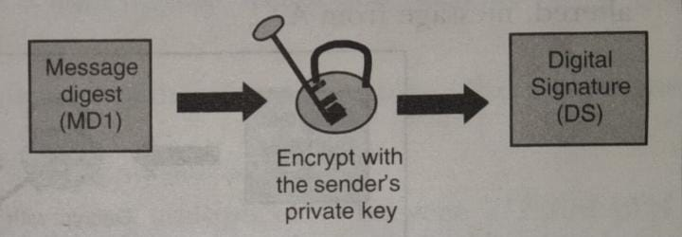
Step 2: Digital-Signature Creation
The sender (A) now encrypts the message digest with her private key. The output of this process is called the digital signature
(DS) of A.

Slide 5
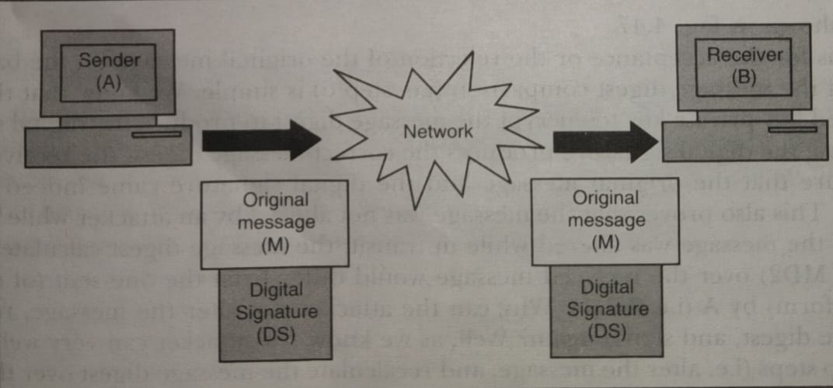
Step 3: Transmission of Original Message and Digital Signature Simultaneously
Now the sender (A) sends the original message (M) along with the digital signature (DS) to the receiver (B).

Slide 6
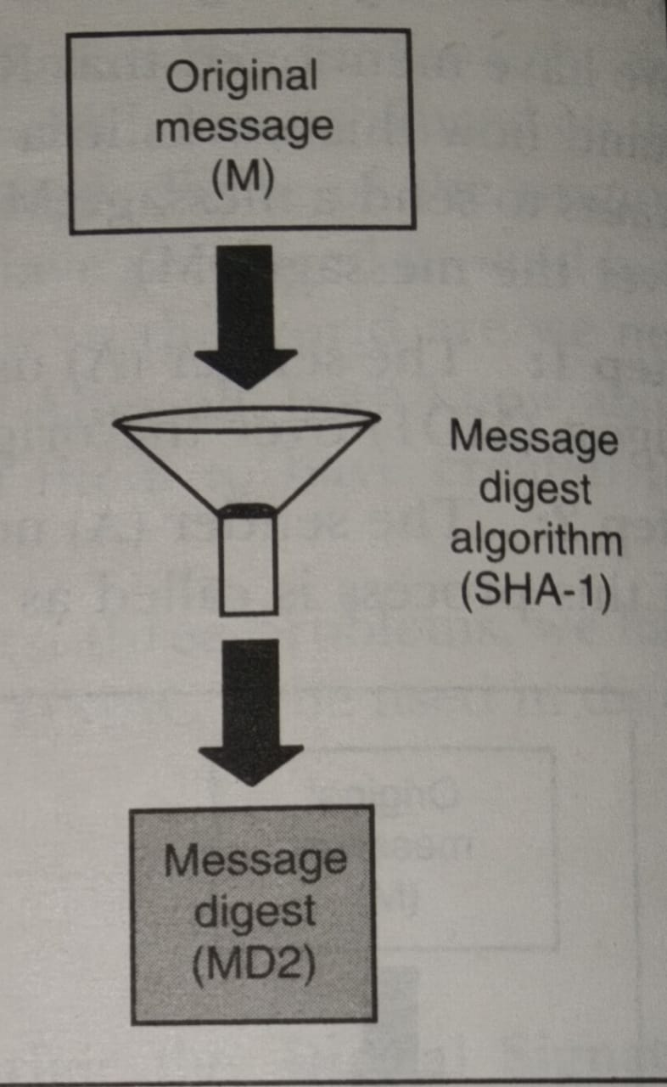
Step 4: Receiver Calculates Its Own Message Digest
After the receiver (B) receives the original message (M) and the sender’s (A’s) digital signature, B uses the same message-digest algorithm as was used by A, and calculates its own message digest (MD2).

Slide 7
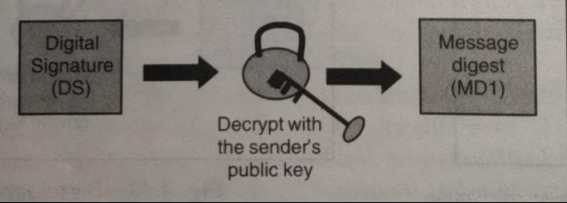
Step 5: Receiver Retrieves Sender’s Message Digest
The receiver (B) now uses the sender’s (A’s) public key to decrypt (sometimes also called de-sign) the digital signature. Note that A had used her private key to encrypt her message digest (MD1) to form the digital signature. Therefore, only A’s public key can be used to decrypt it. The output of this process is the original message digest as was calculated by A (MD1) in step 1.

Slide 8
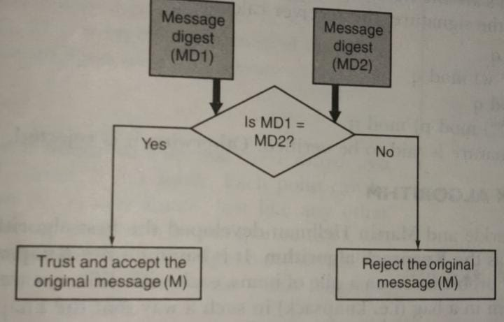
Step 6: Digital-Signature Verification
B now compares the following two message digests:
● MD2, which it had calculated in step 4
● MD1, which it retrieved from A’s digital signature in step 5
If MD1 = MD2, the following facts are established:
● B accepts the original message (M) as the correct, unaltered, message from A.
● B is also assured that the message came from A, and not from someone posing as A.

Slide 9
DSA and Digital Signatures
Due to the problems associated with MAC, the Digital Signature Standard (DSS) was developed for performing digital signatures. DSS makes use of the SHA-1 algorithm for calculating the message digest over an original message, and uses the message digest to perform the digital signature. For this, DSS makes use of an algorithm, called Digital Signature Algorithm (DSA).
Note that DSS is the standard, and DSA is the actual algorithm.

Slide 10
DSA and Digital Signatures
Like RSA, DSA is also based on asymmetric-key cryptography.
However, their objectives are totally different. RSA is primarily used for encrypting a message. Additionally, RSA can also be used for performing a digital signature over a message.
In contrast, DSA is used only for performing digital signature over a message. It cannot be used for encryption.

Slide 11
Variables used in Digital Signature(1/2)
The DSA algorithm makes use of the following variables:
p = A prime number of length L bits.
L = A multiple of 64 between 512 and 1024 (i.e. L = 512 or 576 or 640 or … 1024).
q = A 160-bit prime factor of (p – 1).
g = {h^((p – 1) / q)} mod p, where h is a number less than (p – 1) such that {h^((p – 1) / q)} mod p is greater than 1.

Slide 12
Variables used in Digital Signature(2/2)
x = A number less than q.
y =(g^x) mod p.
H = Message-digest algorithm (usually SHA-1).
The first three variables, p, q and g are public in nature, and can be sent across an insecure network freely. The private key is x, whereas the corresponding public key is y.

Slide 13
Signature Creation
Let us assume that the sender wants to sign a message m and send the signed message to the receiver.
Then, the following steps take place.
(a) The sender generates a random number k, which is less
than q.
(b) The sender now calculates:
● r =((g^k) mod p) mod q
● s = (k^(–1) (H(m) + xr)) mod q
where k^(–1) is the multiplicative inverse of k.
The values r and s are the signatures of the sender. The sender sends these values to the receiver.

Slide 14
Signature Verification
To verify the signature, the receiver calculates:
(c) w = (s^(–1)) mod q
u1 = (H(m) * w) mod q
u2 = (rw) mod q
v = (((g^u1)* (y^u2)) mod p) mod q
where s^(–1) is the multiplicative inverse of s.
If v = r, the signature is said to be verified. Otherwise, it is rejected.

Slide 15
Question [ 3 Marks ]
Compare and contrast RSA based Digital Signature Algorithm and Digital Signature Algorithm (DSA) introduced by Digital Signature Standard (DSS).

Slide 16
THANK YOU

