Slide 1
Malicious Software
Viruses and Related Threats
Virus Counter Measures

Slide 2
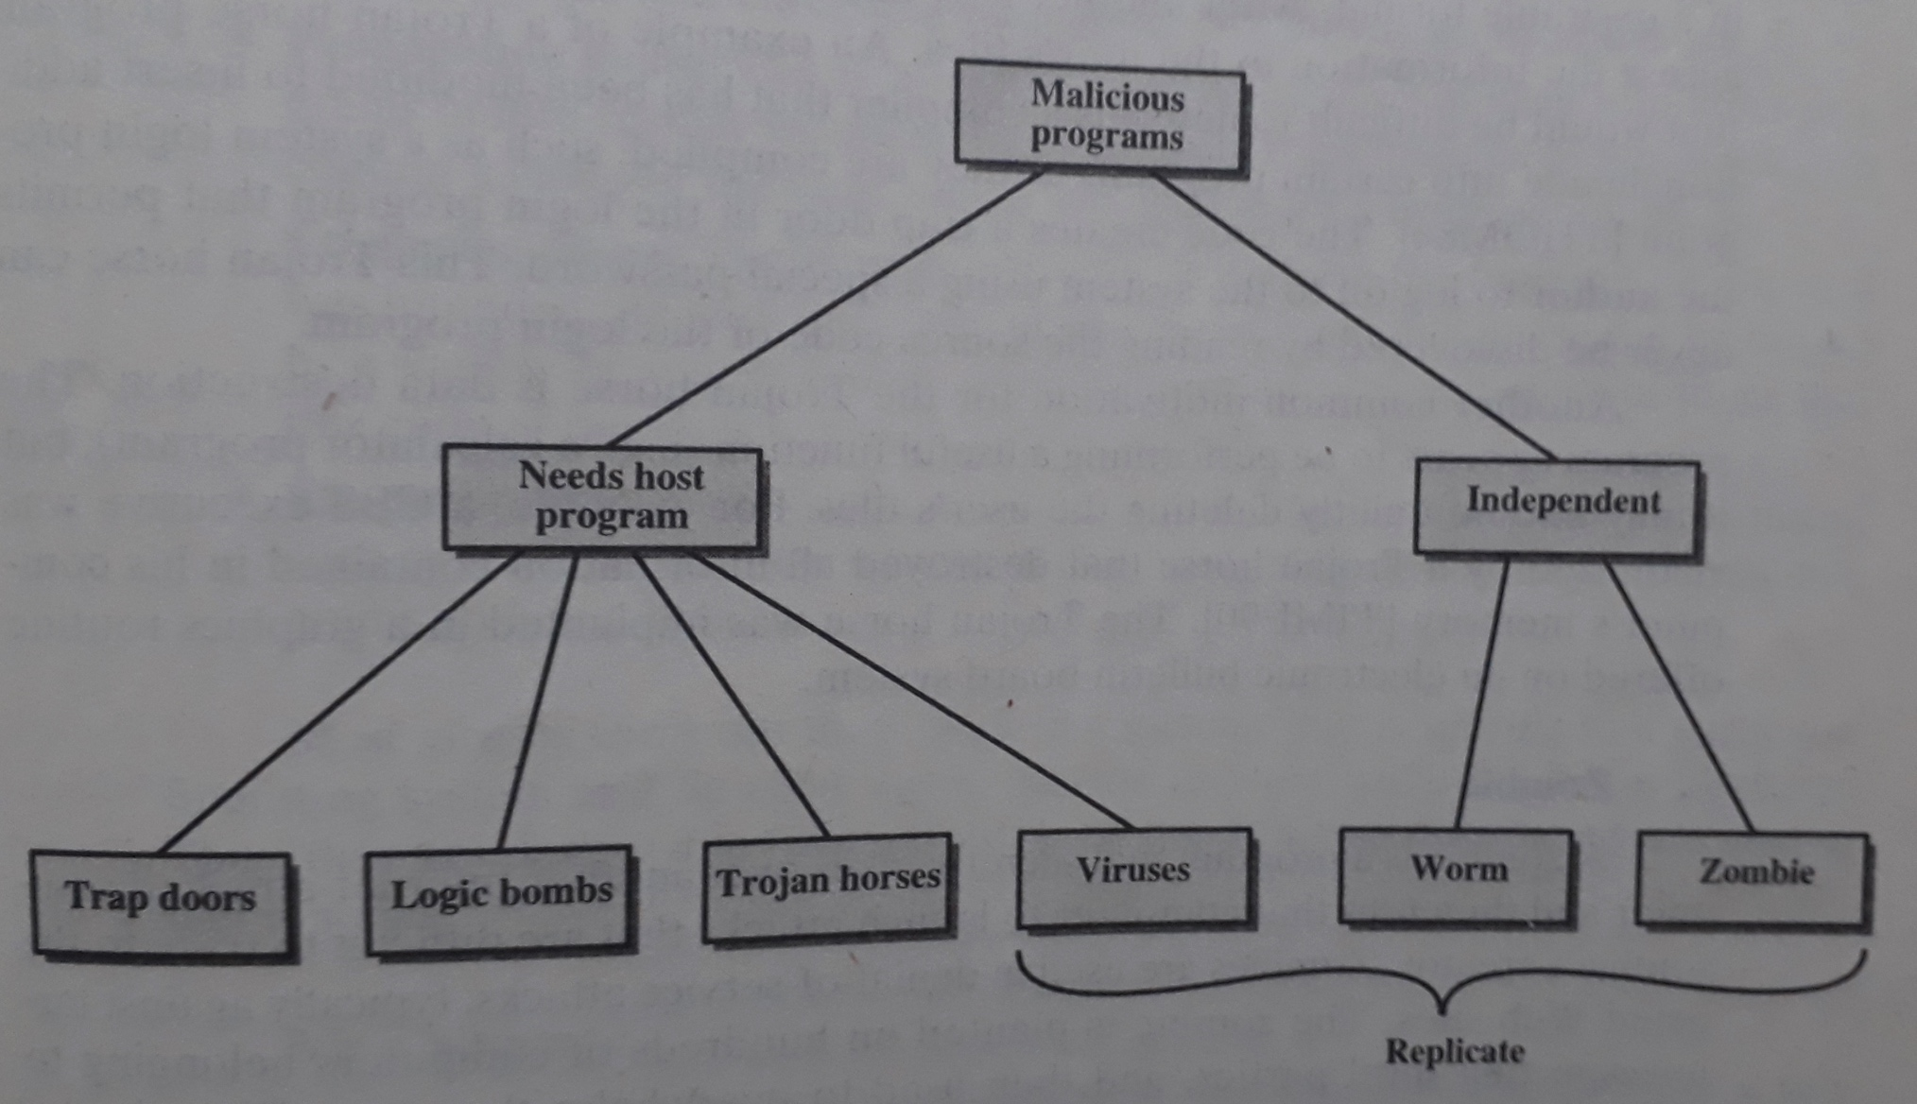
Taxonomy of Malicious Programs

Slide 3
Phases of Virus
During its lifetime, a typical virus goes through the following four phases:
Dormant Phase
Propagation Phase
Triggering Phase
Execution Phase

Slide 4
Types of Viruses
Parasitic Virus
Memory-resident Virus
Boot Sector Virus
Stealth Virus
Polymorphic Virus

Slide 5
Virus Countermeasures (1/2)
Antivirus Approaches
Detection
Identification
Removal

Slide 6
Virus Countermeasures (2/2)
Advanced Antivirus Techniques
Generic Decryption
Digital Immune System
Behavior–Blocking Software

Slide 7
Cyber Security Threats
Phishing Attacks
Ransomware Attacks

Slide 8
Thank You

